Slide 1
Azure Storage

Slide 2
Compatibility
Users or client applications can access to Azure Storage objects via:
Azure Storage REST API
Azure PowerShell
Azure CLI
From Azure Storage client library (.NET, Java, Node.js, Python, PHP, and Ruby).

Slide 3

Redundancy
Locally-Redundant Storage (LRS) | Geo-Redundant Storage (GRS) | Read-Access Geo-Redundant Storage (RA-GRS) | Zone Redundant Storage (ZRS)
3 copies of each file in one building but 3 different nodes or hard drives in the same region. | 3 copies of each file in one region and 3 copies in another region. | RA-GRS gives you read-only access to your data in the secondary location, in addition to the replication across two regions provided by GRS. | 3 copies across 2 or 3 facilities in a single
https://azure.microsoft.com/en-us/global-infrastructure/services/

Slide 4
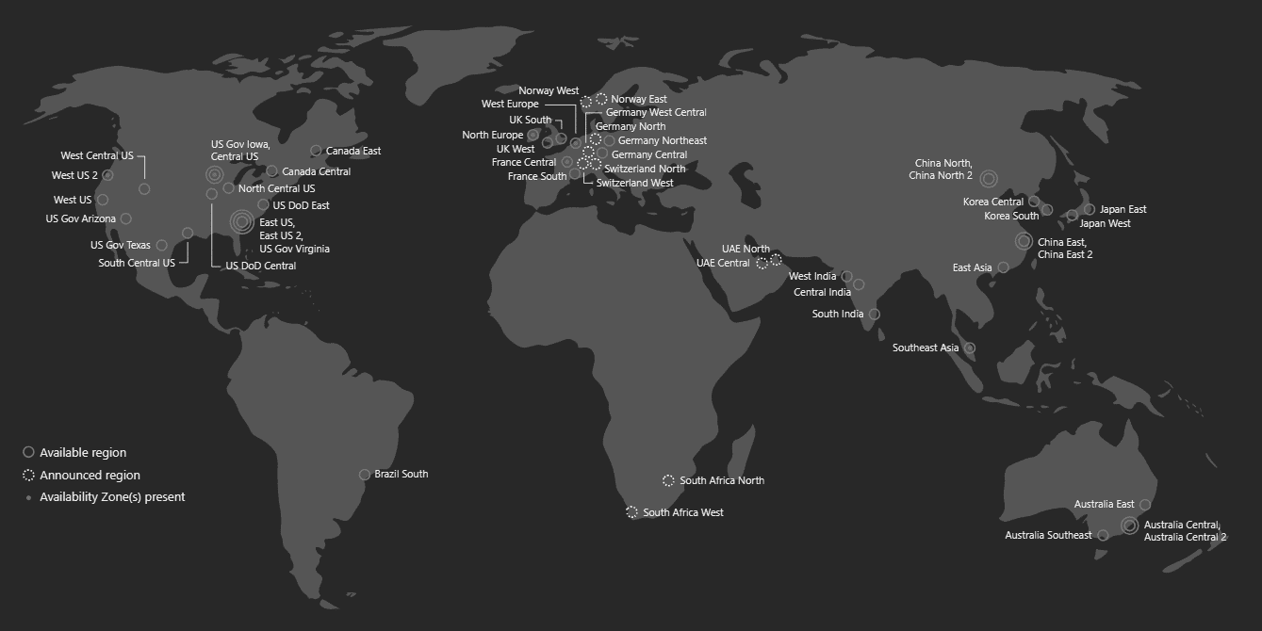

Slide 5

Access tier
Hot | Cold | Archive
Is optimized for storing data that is accessed frequently. | is optimized for storing data that is infrequently accessed and stored for at least 30 days. | is optimized for storing data that is rarely accessed and stored for at least 180 days with flexible latency requirements (up to 15 hours)
https://docs.microsoft.com/en-us/azure/storage/blobs/storage-blob-storage-tiers

Slide 6

Disk
Azure VM
Managed and scalable HDD or SSD disks (up to 64Tb per unit) that can be deployed on Azure VM and can be accessed only from one VM (it works as local drive).
https://azure.microsoft.com/es-es/services/storage/disks/

Slide 7

Files
Azure VM
It allows the storage of files through the SMB network protocol. It can be shared between different virtual machines. Shared resources can be mounted as drives on Windows, Linux or macOS systems.
https://azure.microsoft.com/es-es/services/storage/files/

Slide 8

Archive
Compliance, archival data that needs to be stored for a long time or backups. It’s stored for at least 180 days with flexible latency. To access it is necessary to overcome a process known as "rehydration“ and it could be delayed up to 15 hours.
https://azure.microsoft.com/es-es/services/storage/archive/

Slide 9

Blob
Storage of unstructured objects such as text or binaries with different levels of access (sporadic or frequent) and with a capacity of up to 500Tb per account.
Block blob | Page blob | Append blob
A blob is chopped and each block is likely to be distributed through the Azure infrastructure. Up to 4.77 TB per blob | Optimized for random read and write operations. Used on Azure VM. | Oriented to store incremental files where new bytes will be added to the end of the original blob.
Limitations of Azure Storage Account: http://bit.ly/2z4vpd6
https://azure.microsoft.com/es-es/services/storage/blobs/

Slide 10

Queues
Simplified messaging bus. Guarantees delivery but does not ensure the order. Messages expire after 7 days. It allows 80Gb for each queue and 64Kb for each message. It support Get, Peek, Update and Delete operations.
https://azure.microsoft.com/es-es/services/storage/queues/

Slide 11
Others
Tables, Data Lake, Azure Avere vFXT.

Slide 12

Pricing
Example
Service | Detail
Files | 50,60€/m each 1000Gb + 0,0126 each 10.000 operations.
Disk | 34,54€/m each HDD disk oo 64,77€/m SSD disk + 0,0003 each 100.000 operations.
Blob | 18,55€/m each 1000Gb + 0,042€ each 100.000 write operations and 0,003 each 100.000 write operations.
Archive | 1,69€/m each 1000Gb + 0,093 each 100.000 write operations and 4,638 each 100.000 read operations.
Queue | 37,95€/m each 1000Gb + 0,0034 each 10.000 operations.
https://azure.microsoft.com/es-es/pricing/calculator/

Slide 13

Talk is cheap, show me the code.
https://github.com/sergiobarriel/azure-storage-15-nov

Slide 14

Scenary
The corporation Cyberdyne Systems, known for developing Skynet, a software for the control of the military arsenal. It has opened new business routes, such as the development of robots.
For their new T-800 robot they need:
Store the frames that the robot captures for later review.
Establish a queue of military objectives.

Slide 15
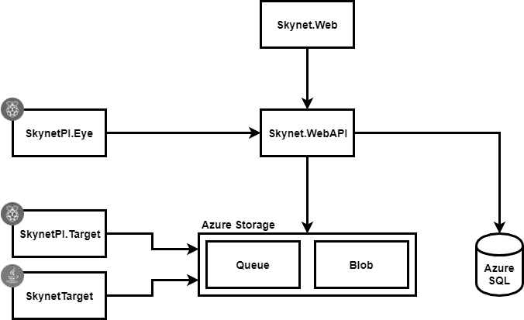
Infrastructure

