Slide 1
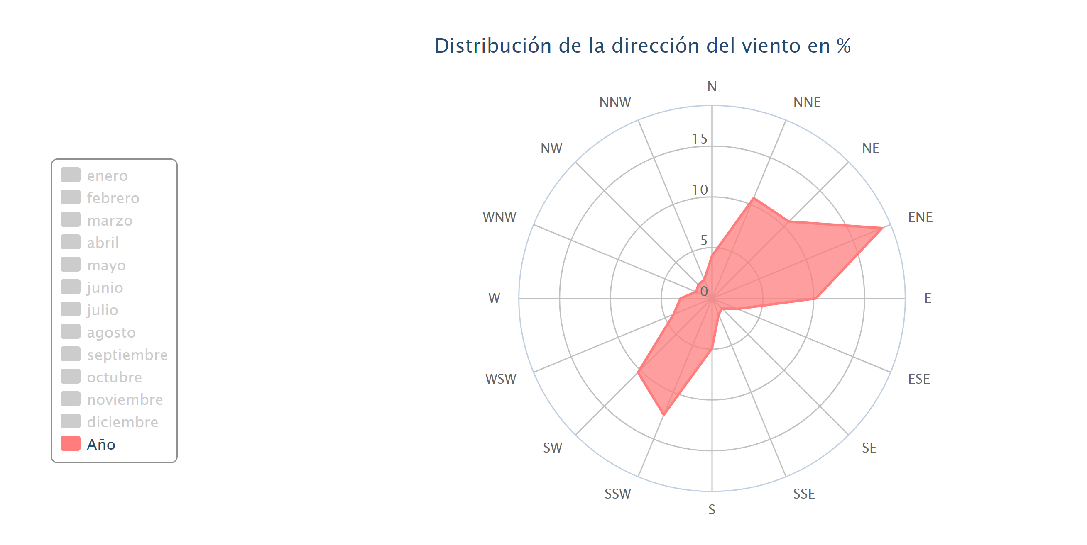
https://es.windfinder.com/windstatistics/gijon_musel

Slide 2
https://www.researchgate.net/publication/269377468_Time_series_analysis_and_forecasting_for_air_pollution_in_small_urban_area_An_SARIMA_and_factor_analysis_approach
Time series analysis and forecasting for air pollution in small urban area: An SARIMA and factor analysis approach

