Slide 1
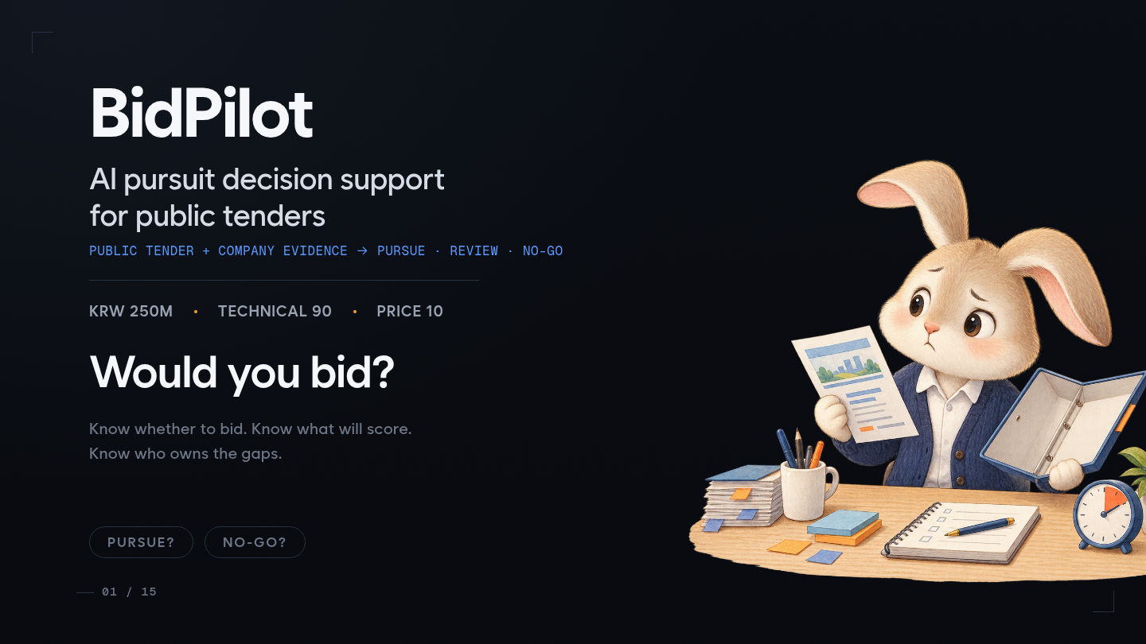
BidPilot · AI Pursuit Decision Support for Public Tenders
Public tender plus company evidence | PURSUE, REVIEW or NO-GO | KRW 250M | Technical 90 | Price 10 | Would you bid?

Slide 2
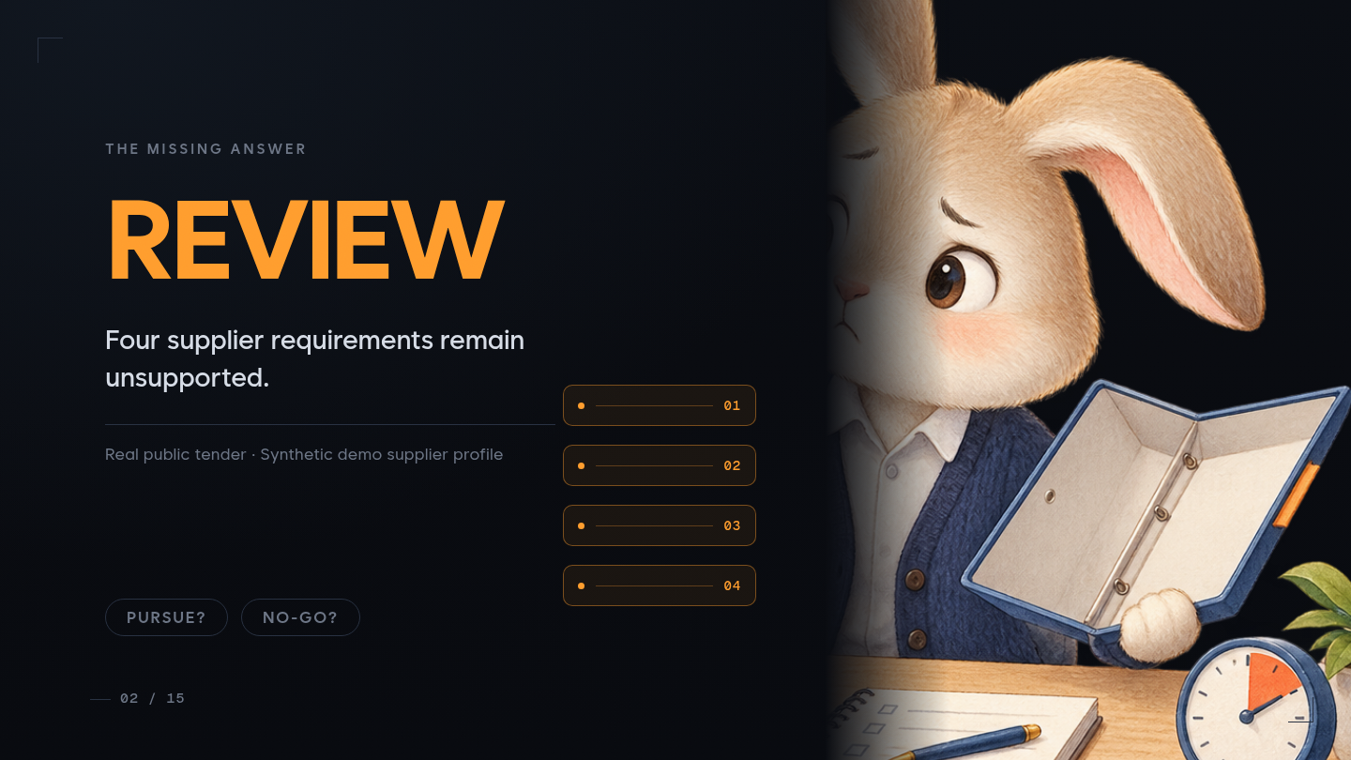
The Missing Answer · REVIEW
Four unsupported supplier requirements | Real public tender | Synthetic demo supplier profile

Slide 3
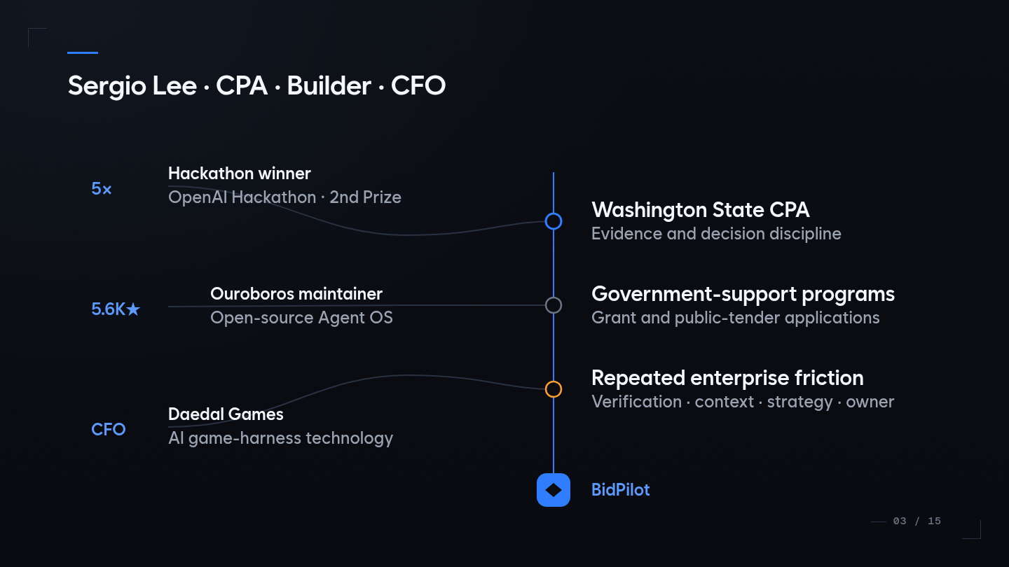
Sergio Lee · CPA · Builder · CFO
Washington State CPA | Government-support program specialist | Five-time hackathon winner including OpenAI Hackathon second prize | Maintainer of the 5.6K-star Ouroboros open-source Agent OS | CFO of Daedal Games, an AI game-harness technology company | BidPilot

Slide 4
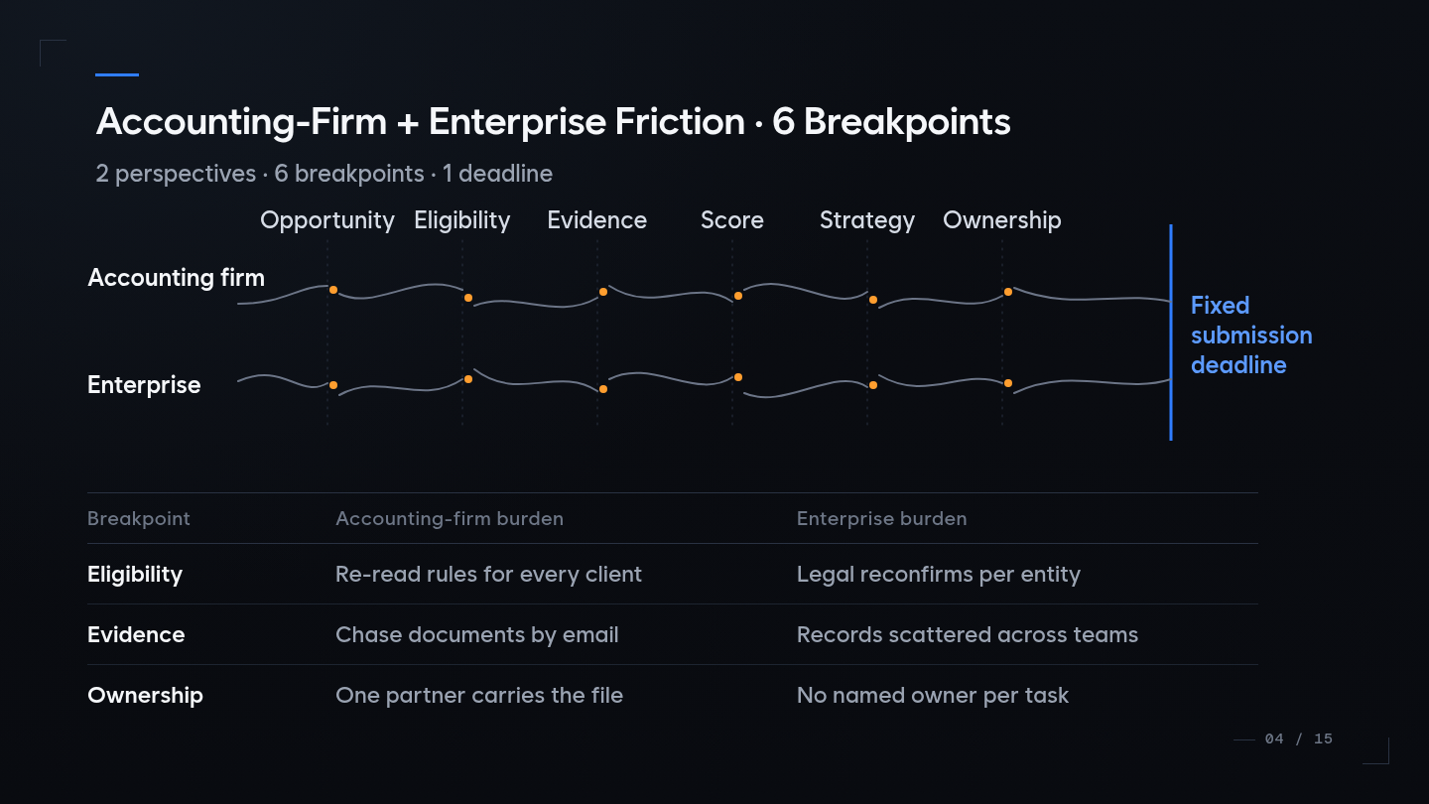
Accounting-Firm + Enterprise Friction · 6 Breakpoints
Opportunity | Eligibility | Evidence | Score | Strategy | Ownership | Fixed submission deadline

Slide 5
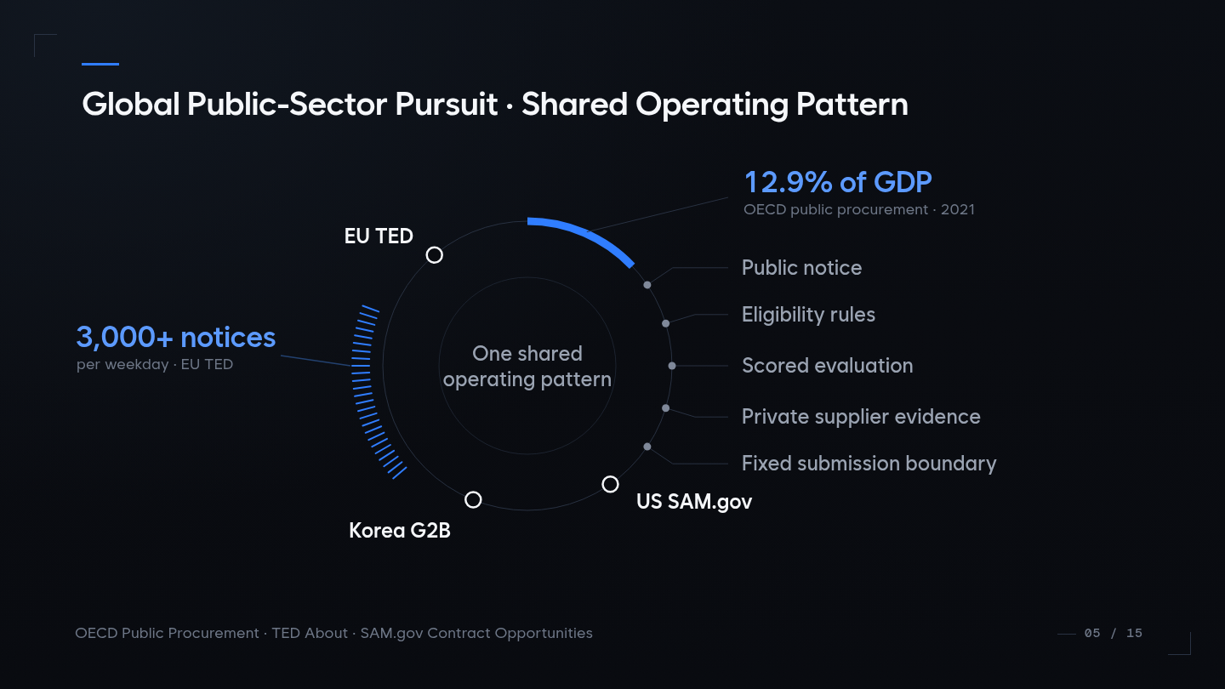
Global Public-Sector Pursuit · Shared Operating Pattern
Korea G2B | US SAM.gov | EU TED | OECD public procurement | One shared operating pattern

Slide 6
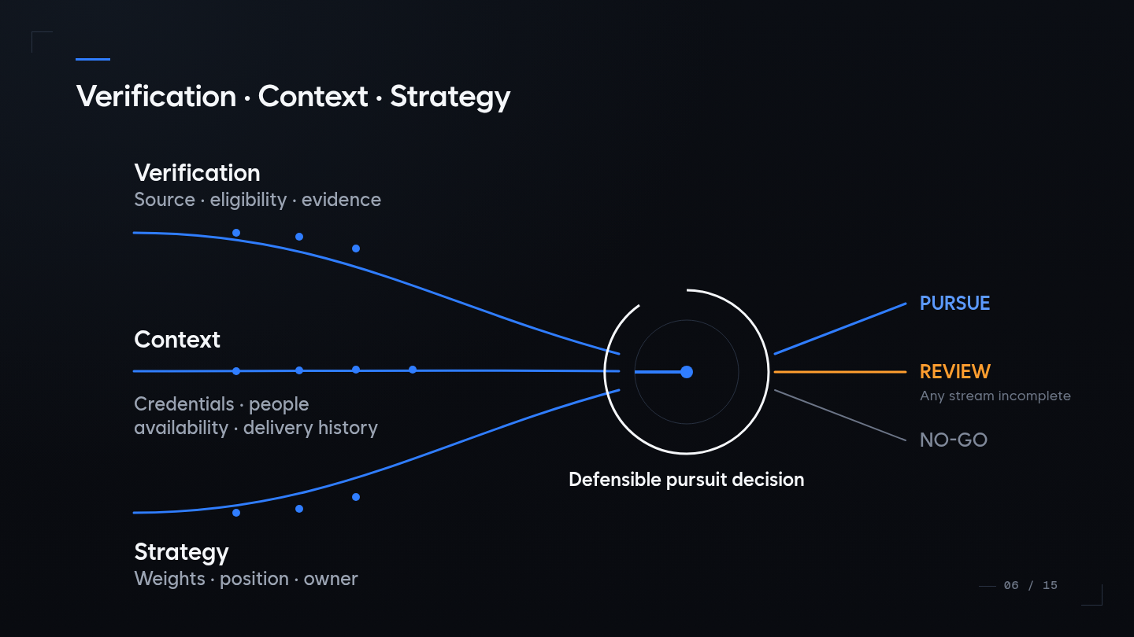
Verification · Context · Strategy
Source, eligibility and evidence | Credentials, people, availability and delivery history | Weights, position and owner | PURSUE, REVIEW or NO-GO

Slide 7
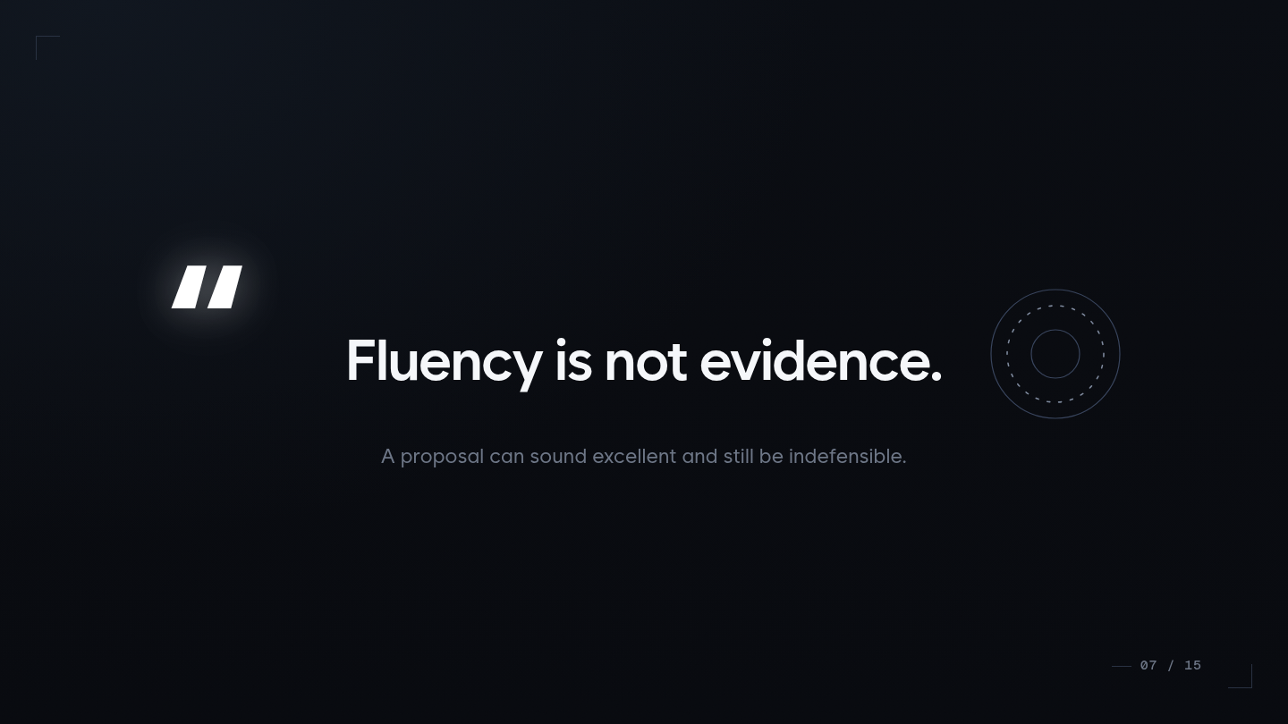
Fluency Is Not Evidence
A proposal can sound excellent and still be indefensible

Slide 8
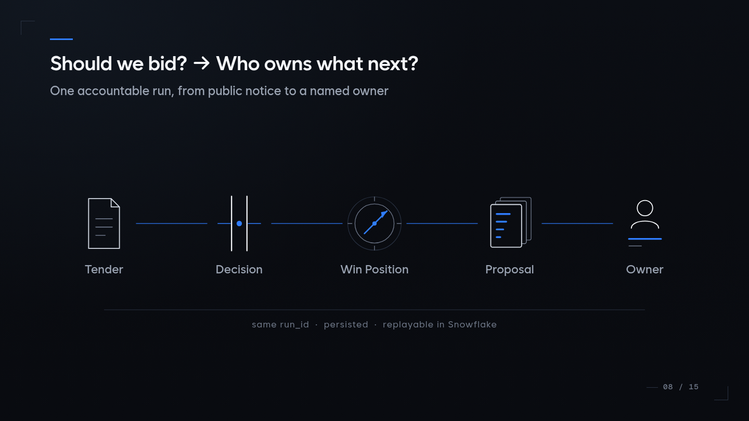
Should We Bid? · Who Owns What Next?
Tender | Decision | Win Position | Proposal | Owner | Same run ID persisted and replayable in Snowflake

Slide 9
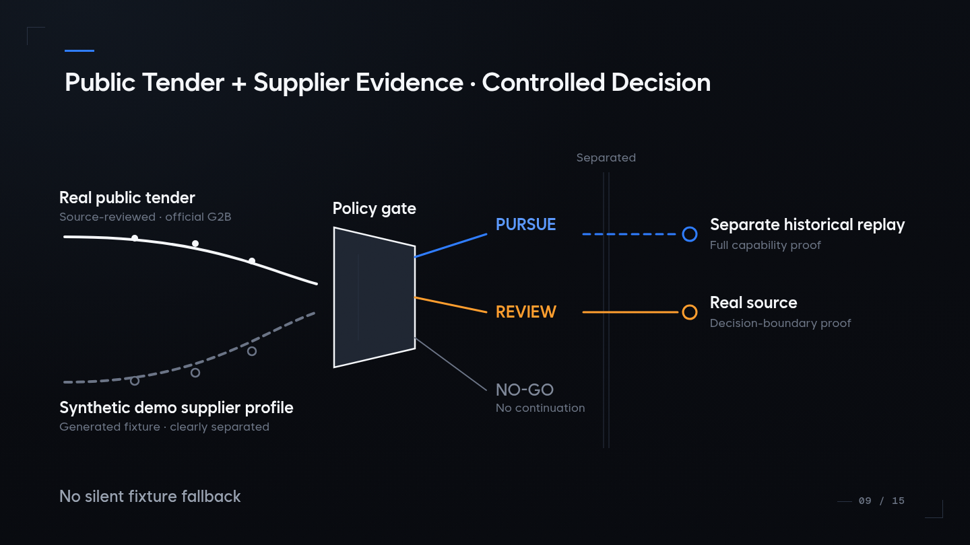
Public Tender + Supplier Evidence · Controlled Decision
Real public tender | Synthetic demo supplier profile | Policy gate | Separate historical replay | No silent fixture fallback

Slide 10
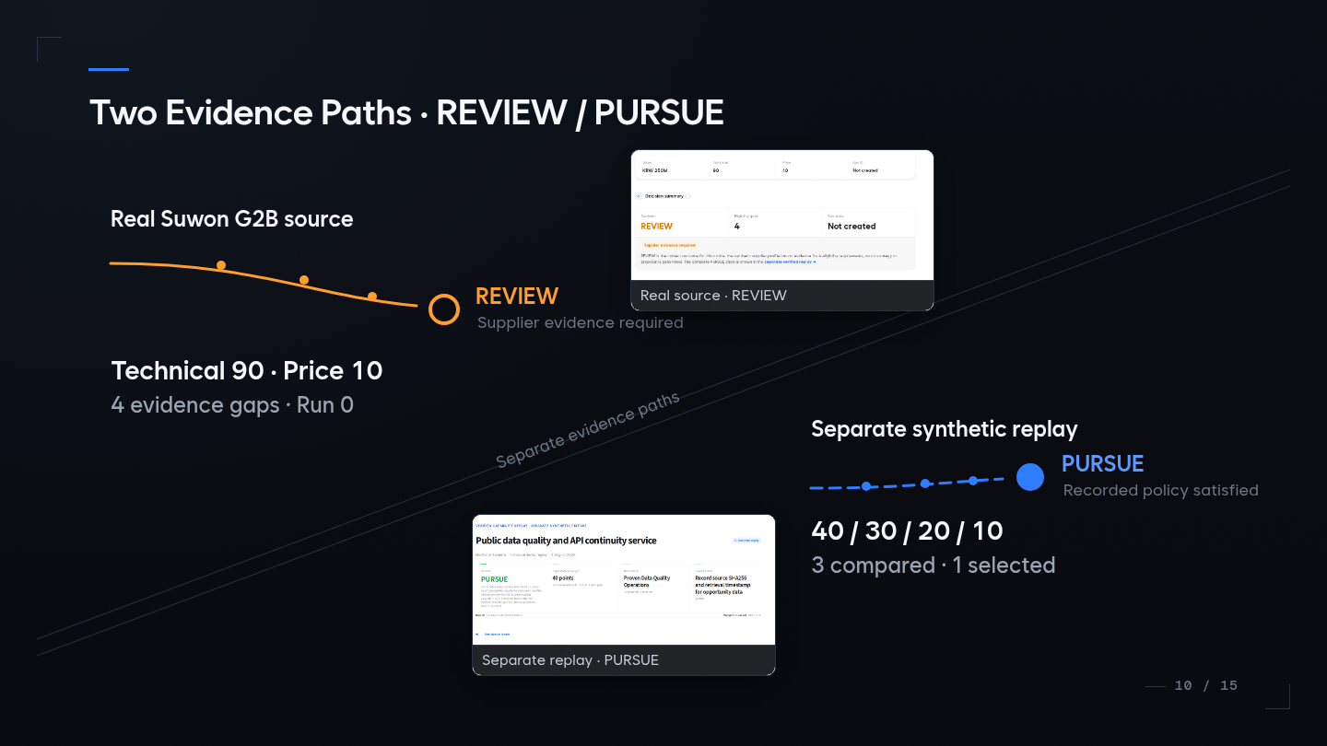

Two Evidence Paths · REVIEW / PURSUE
Real Suwon G2B source: REVIEW, four evidence gaps, no run | Separate synthetic replay: PURSUE, 40/30/20/10, three compared and one selected

Slide 11
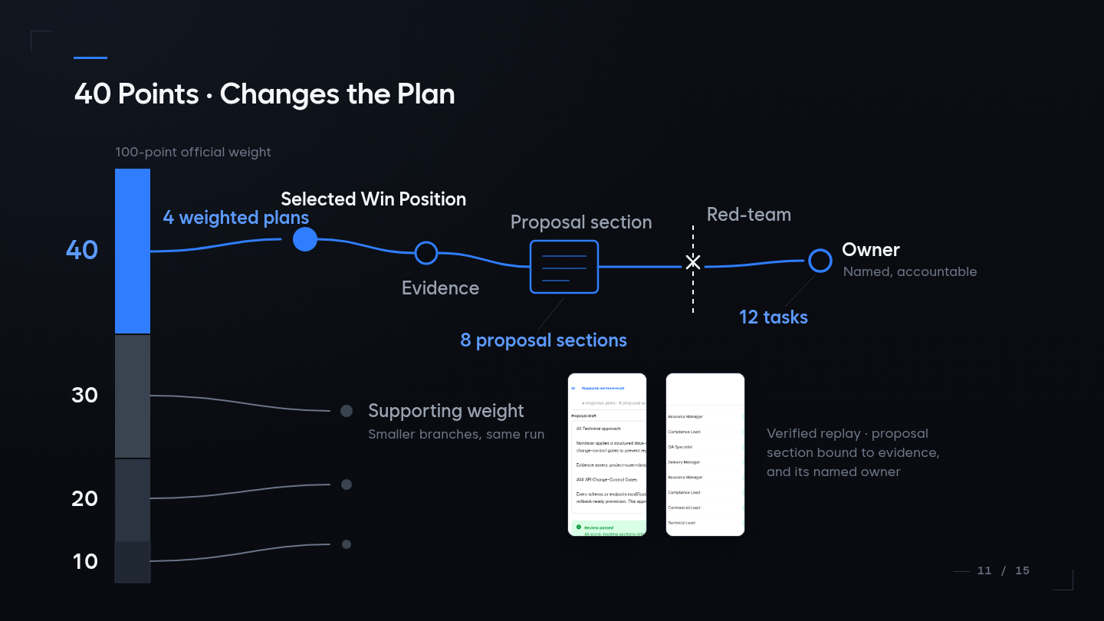
40 Points · Changes the Plan
Four weighted plans | Selected Win Position | Evidence | Eight proposal sections | Red-team | Twelve named tasks

Slide 12
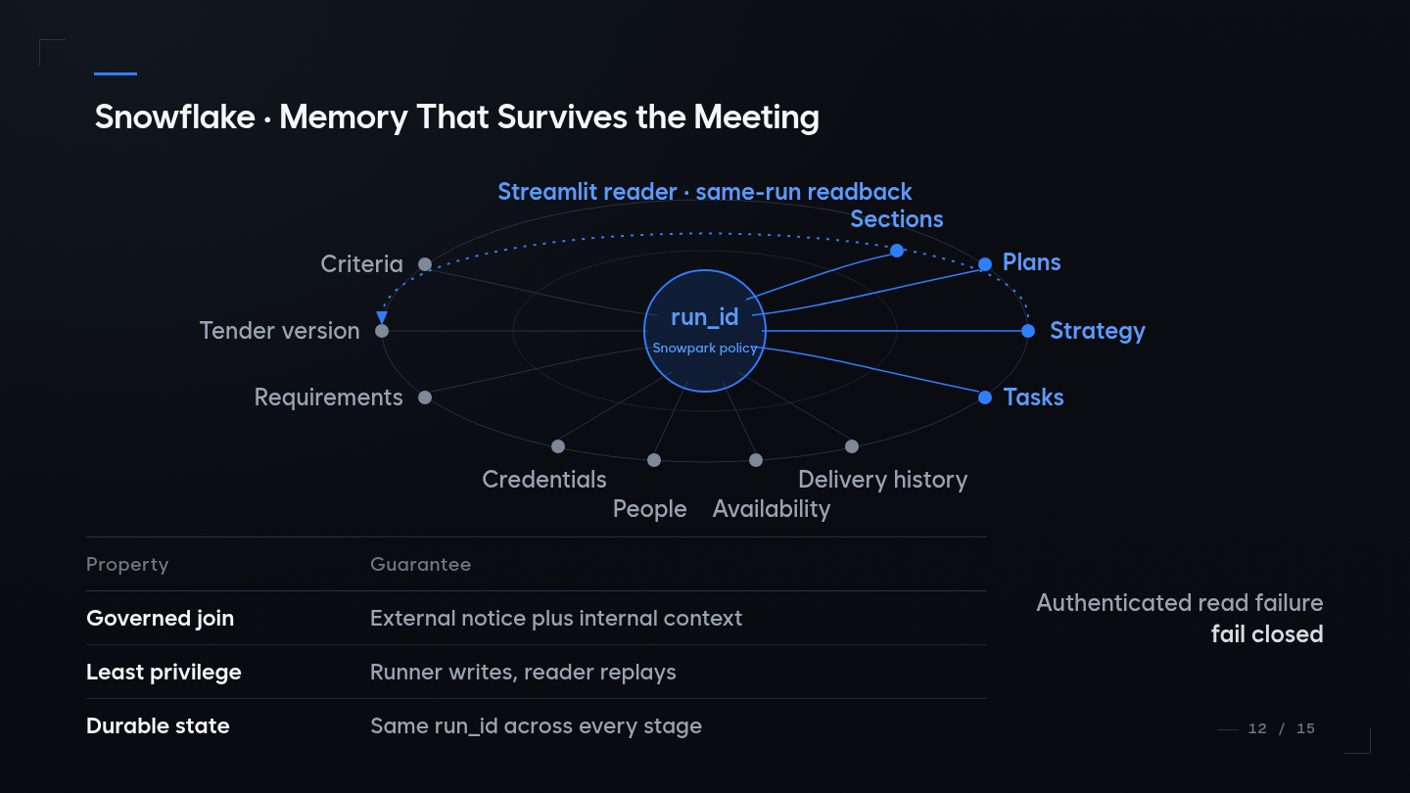
Snowflake · Memory That Survives the Meeting
Governed join | Least privilege | Durable state | Opportunity Graph | Snowpark policy | Streamlit reader | Same-run readback | Fail closed

Slide 13
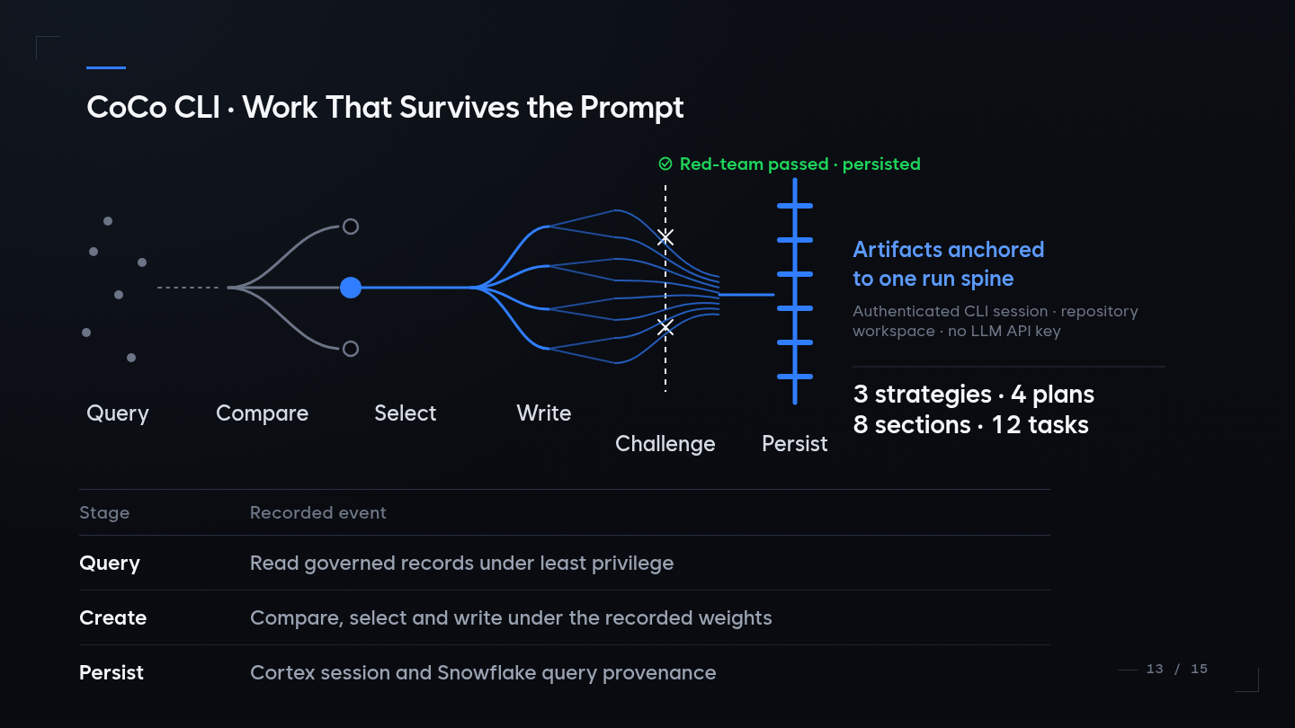
CoCo CLI · Work That Survives the Prompt
Query | Compare | Select | Write | Challenge | Persist | Cortex session and Snowflake query provenance

Slide 14
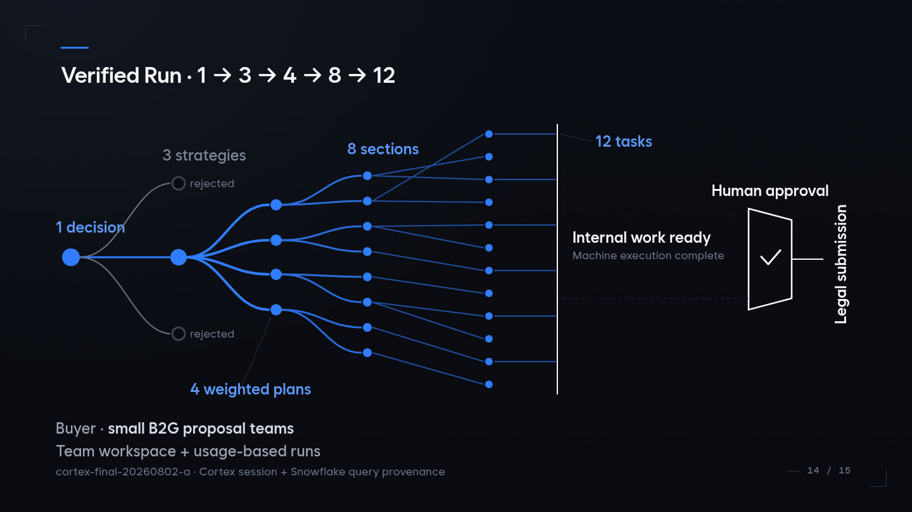
Verified Run · 1 → 3 → 4 → 8 → 12
One decision | Three strategies | Four weighted plans | Eight sections | Twelve tasks | Internal work ready | Human approval | Legal submission

Slide 15
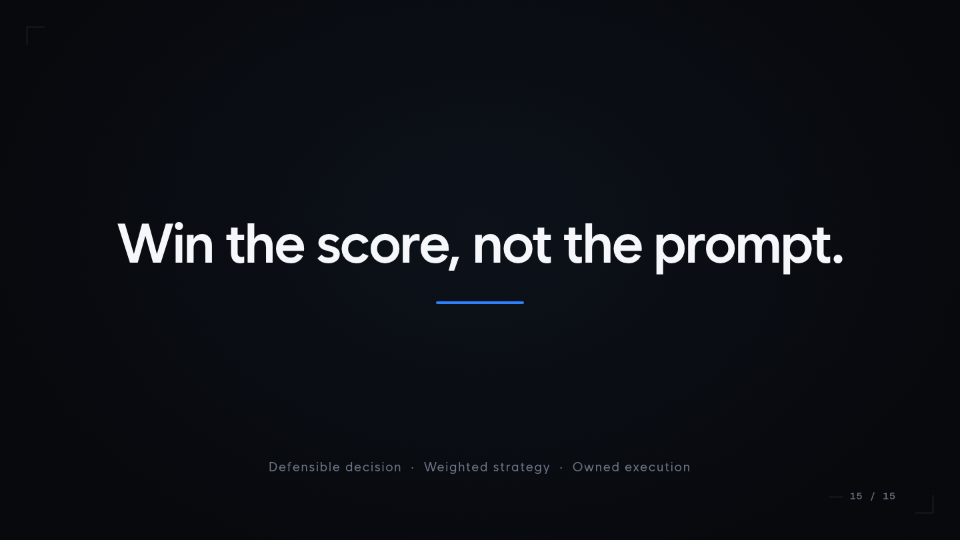
Win the score, not the prompt.
Defensible decision | Weighted strategy | Owned execution | Persisted and replayable in Snowflake

