Slide 1
Daemon Snapper's Workshop
Your app everywhere, just in a Snap!
How to make Snaps from System Daemons and Utilities
Till Kamppeter, Sergio Cazzolato

Slide 2
Introduction
What you need to know:
Basic installing from source, little code tweaks, …
Basic snapping, for example you should have attended one of:
  Snapping like Hell(sworth)
  ROS Deployment Workshop
Daemon (system service)
Runs permanently, from boot/install to shutdown/uninstall
No direct user interface (sometimes web admin interface)
No terminal interaction
Listens for events: Network, D-Bus, Domain socket, UDEV, …
Acts in response to events

Slide 3
Introduction
Daemons are not interactive, but this workshop is!
We have a little daemon for you to try out everything: exampled
It is a simple C program listening for raw data at a given port and storing it in a file
You will make a Snap of this little daemon
You will learn all aspects of making it working under the confinements of a Snap
We will show different methods to fulfill the needed requirements
We will apply advanced methods for using UDEV or for letting our daemon only accept connections from Snaps which plug a given interface
We will answer your questions and discuss your needs

Slide 4
Contents
Defining and controlling a daemon in snapcraft.yaml
Handling directories and files the daemon uses
Controlling the snapped daemon
System users and groups
Managing upstream code patches
Daemon dependencies – 2 daemons in 1 Snap
Daemon dependencies – External daemon
UDEV Rules – What?! snapd does not support them. But …
Timers – Run a daemon only at certain times
Snap Mediation – Allow connection only for client Snaps plugging interface XYZ

Slide 5
Hands-on exercises
This is a workshop, interactive, so you will try everything out on your laptop
Have a suitable Linux distribution running on your laptop, ideally Ubuntu
Have snapd and snapcraft installed
Get the example from the following GitHub repository:
https://github.com/sergiocazzolato/daemon-snapper.git
During the workshop you will added the files (mainly snapcraft.yaml) and build the Snap several times.

Slide 6
Defining and controlling a daemon in snapcraft.yaml
Daemon Snapper's Workshop

Slide 7
Treat an app as a daemon
Make sure your app is actually a daemon (running permanently)
Define it as a daemon in snapcraft.yaml, under apps::
Apps:
exampled:
command: bin/exampled-run.sh
daemon: simple
The daemon: entry has following modes available:
simple: Daemon runs in foreground
forking: Daemon forks background process and exits
oneshot: System utility to run once on every boot, no daemon
notify: Daemon notifies systemd

Slide 8
Treat an app as a daemon
For most modern daemons we use daemon: simple, daemons which are forking by default we make non-forking via command line: cupsd -f
We usually start the actual daemon through a wrapper script (here exampled-run.sh) to use env variables and command line options
There are further parameters for controlling the daemon, also to be used in its apps: entry:
  reload-command:, stop-command:, post-stop-command:: Additional scripts to handle restart, shutdown and clean-up
  start-timeout:, stop-timeout:, watchdog-timeout:: Timeouts for reporting failure or killing a stuck daemon
  before:, after:, timer:, … many more, see documentation:
  https://snapcraft.io/docs/services-and-daemons

Slide 9
Handling directories and files the daemon uses
Daemon Snapper's Workshop

Slide 10
Directories and files
Daemons use several directories and files:
  Configuration files
  Log files
  Data files
  Spool directories
  Domain sockets
  …
These are in /etc/…, /var/…, or /run/… by default, places not accessible from a Snap
Need to be all under /var/snap/NAME/…/…

Slide 11
Directories and files
Methods to change the locations (not necessarily available in all daemons)
  Command line options
    Via wrapper script
    Example: exampled -l $SNAP_COMMON/log.txt
  Environment variables
    Via snapcraft.yaml, in apps:
apps:
exampled:
environment:
LOGFILE: $SNAP_COMMON/log.txt
Via wrapper script

Slide 12
Directories and files
Methods to change the locations (not necessarily available in all daemons)
  Configuration file
    Provide modified/patched config file
    Let wrapper script modify config file to assure, even if user edits
    Config file must be under /var/snap/NAME/…, not under /snap/NAME/… or /etc/… (use the other methods described here for the config file location)
  Modifying upstream code
    Only open source, last mean
    As patch for your Snap only
    Actually upstream
      You are upstream maintainer
      Pull/Merge request
      Must work in Snap and in classic installation
        if ((loc = getenv("SNAP_COMMON")) == NULL) loc = "/var";

Slide 13
Controlling the snapped daemon
Daemon Snapper's Workshop

Slide 14
Controlling the snapped daemon
Snaps manage their own services without the need for manual intervention. However, snapd offers a set of commands to allow a snap’s services to be inspected and their statuses changed
These are the commands provided:
Use snap services to lists all the services added to the system by the currently installed and enabled snaps
> $ snap services
Adding a snap name as an argument will list only those services added by that snap
> $ snap services daemon-example

Slide 15
Controlling the snapped daemon
Services are restarted using the snap restart <snap name> command. This may be necessary if you’ve made custom changes to the snap application
> $ sudo snap restart daemon-example
The start and stop commands control whether a service should be currently running
> $ sudo snap stop daemon-example.exampled
> $ sudo snap start daemon-example.exampled
If you need to see the log output for a snap’s services, use the logs command
> $ sudo snap logs daemon-example
> $ sudo snap logs daemon-example.exampled

Slide 16
System users and groups
Daemon Snapper's Workshop

Slide 17
System users and groups
Daemons will always be started as root (standard apps as the calling user)
  Snapped daemon started by system boot or Snap install
Daemon (or wrapper script) could drop privileges to a system user
snapd does not allow use of the host system's users, like adm or lp, and does not support adding system users and groups.
Snapd has a user and a group, both named snap_daemon for this purpose
To activate them, add to snapcraft.yaml (top level, no section):
system-usernames:
snap_daemon: shared
You will need to configure your daemon to use snap_daemon and not its own user/group: Config file, build options, patch, …
Documentation: https://snapcraft.io/docs/system-usernames

Slide 18
Managing upstream code patches
Daemon Snapper's Workshop

Slide 19
Managing upstream code patches
Why do we need to modify (patch) the upstream code?
  Daemons and system software can often get tricky to snap
  Upstream's design did not take Snap into account
  Upstream does not always accept the changes, or it takes time until the next release
  Even classic Debian/RPM packaging often needs patches
Examples for patching needs
  Directory and file locations used are hard-coded, no options, config, …
  Daemon has to determine what the client plugs, to accept/deny inquiry
  Daemon does operations which are not allowed under confinement (like chown/chmod) but are also not needed under confinement

Slide 20
Managing upstream code patches
In snapcraft.yaml (only relevant lines, patch is in snap/local/ of your project repository):
parts:
exampled:
override-build: |
patch -p1 < $SNAPCRAFT_PROJECT_DIR/snap/local/log.patch
snapcraftctl build

Slide 21
Daemon dependencies –
2 daemons in 1 Snap
Daemon Snapper's Workshop

Slide 22
Daemon dependencies – 2 daemons in 1 Snap
Method 1: Sequencing directives in apps: entries
before: Supplies an ordered list of apps which are only started when our daemon is up and running
after: Supplies an ordered list of apps which must have been started before we start
In snapcraft.yaml it looks like:
apps:
exampleauxd:
daemon: simple
after: [exampled]

Slide 23
Daemon dependencies – 2 daemons in 1 Snap
Method 2: In wrapper script check whether the other daemon is ready (wait if not):
When systemd reports other daemon ready but it is not the case (Usually fault of that daemon)
When we are not a daemon, but need a daemon of our Snap running (we cannot use sequencing directives then)
Wrapper script checks in a loop until timeout:
Runs status utility of other daemon
Tries to access other daemon
Checks presence of daemon's process …

Slide 24
Daemon dependencies – External daemon
Daemon Snapper's Workshop

Slide 25
Daemon dependencies – External daemons
Sequencing directives before: and after: only work on apps in the same Snap
So for a dependency on an external daemon (other Snap or classically installed), method (2) of the previous section has to be used.
The installation of a Snap can trigger the installation of another Snap (containing the needed daemon)
  Placeholder content interface with needed Snap as default-provider::
  plugs:
  foo-install-example:
  interface: content
  content: foo
  default-provider: example
  target: $SNAP_DATA/foo

Slide 26
Daemon dependencies – External daemons
Placeholder content interface is a dirty workaround
  Snap has no explicit support for package dependencies
  (Snap A needs Snap B)
  Using this in seeded Snaps breaks the installation of the OS (bug)
  Needs native solution in snapd
The installation of a Snap cannot trigger the installation of a DEB or RPM package.

Slide 27
UDEV Rules – What?! snapd does not support them. But …
Daemon Snapper's Workshop

Slide 28
UDEV Rules
UDEV rules are needed for daemons or utilities triggered by appearing or disappearing of certain hardware
Snap does not support supplying UDEV rules
But a Snap plugging hardware-observe has enough access to observe hardware appearing/disappearing with the udevadm utility -> workaround
Wrapper script runs udevadm monitor to observe hardware
It parses the output lines and filters them for the relevant hardware
It starts/stops the actual daemon (for converting protocols, …) or triggers utilities (for mounting files systems, loading firmware, creating print queue, …)
Independent of whether actual app is daemon, the script with udevadm monitor permanently running is a daemon -> daemon: simple
Good News: On actual UDEV rule support by snapd is worked on

Slide 29
UDEV Rules
Example: ipp-usb: https://github.com/OpenPrinting/ipp-usb/
Daemon for IPP-over-USB: Printer connected via USB to be accessed as network printer (IPP, Internet Printing Protocol) on localhost
Printer is USB device with USB protocol 7/1/4
ipp-usb comes with UDEV rule for classic installation
Plugging the printer triggers start of ipp-usb daemon, daemon stops by itself on unplug, does not need to get triggered again by UDEV

Slide 30
UDEV Rules
Check for already plugged printer:
udevadm trigger --verbose --dry-run --subsystem-match=usb
--property-match=ID_USB_INTERFACES='*:070104:*'
Observe USB devices appearing/disappearing:
udevadm monitor --kernel --subsystem-match=usb
Filter 7/1/4 printer:
udevadm info --query property --path $DEV |
grep -q ID_USB_INTERFACES=.*:070104:.*
Script is snap/local/run-ipp-usb-server in the ipp-usb repository

Slide 31
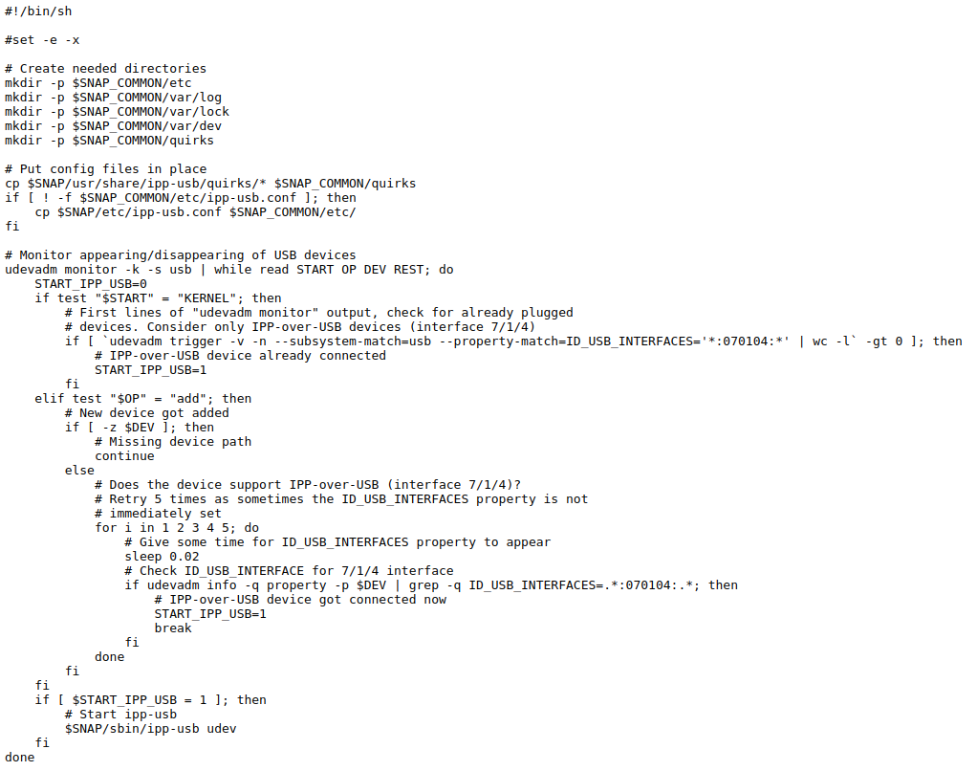
UDEV Rules

Slide 32
Timers – Run a daemon only at certain times
Daemon Snapper's Workshop

Slide 33
Timers – Run a daemon only at certain times
When creating snapcraft.yaml to build a new snap, a snap’s app could contain a timer: property. Timer strings are used in both refresh.timer setting and timer services as the timer.
A timer string is composed of one or more event sets, which are combined by using commas (,,) as separators.
Each event set defines the weekdays and the time windows in which events may occur.
If no weekdays are provided, the default is every day. If no time windows are provided, the default is an arbitrary time in the day.

Slide 34
Timers – Run a daemon only at certain times
Some examples:
00:00-24:00/24 -> Every hour on the hour
00:00-24:00/48 -> Every 30 minutes
12:00-13:00/12 -> Every 5 minutes from 12:00 to 13:00
23:00 -> Every day at 23:00
Mon,10:00,,Fri,15:10 -> Mondays at 10:00, Fridays at 15:10
Mon,9:00~11:00,,Wed,22:00~23:00 -> Mondays, some time between 9:00 and 11:00, Wednesday, some time between 22:00 and 23:00
Mon,Wed -> Monday and on Wednesday, at 0:00

Slide 35
Timers – Run a daemon only at certain times
Having this timer: Mon,Fri,10:00,15:00
Assuming today is Sunday, the next 5 events are, in order:
Monday 10:00
Monday 15:00
Friday 10:00
Friday 15:00
Monday 10:00
The next event will be scheduled inside the soonest opportunity that matches both one of the provided weekdays and one of the provided time windows.

Slide 36
Snap Mediation – Allow connection only for client Snaps plugging interface XYZ
Daemon Snapper's Workshop

Slide 37
Snap Mediation – Allow connection only for client Snaps plugging interface XYZ
Really advanced topic: Requires changes in upstream code!
Interfaces give Snaps controlled connection to the outside world, like via
  Additional, more permissive AppArmor rules
  Mounting certain file systems
  …
A program, usually a daemon, can determine whether a client is a Snap and which interfaces it is plugging, so an interface can also
  Give permission to a certain service which requires it
This method of allowing access only to a Snap which plugs a certain interface is called Snap Mediation.
AFAIK Snap Mediation is used by CUPS and PulseAudio

Slide 38
Snap Mediation – Allow connection only for client Snaps plugging interface XYZ
Example: The cups-control interface
A Snap plugging cups-control has full access to CUPS, not only printing but also administrative tasks, like creating queues, or deleting anyone's jobs
Therefore cups-control is a "dangerous" interface, needs explicit permission for auto-connection
So we have also a "safe" interface named cups only for printing, which auto-connects
But how to stop admin tasks when only cups is plugged?
What understands IPP (Internet Printing Protocol) and knows what are administrative tasks is solely CUPS, resembling this in snapd would be a nightmare …

Slide 39
Snap Mediation – Allow connection only for client Snaps plugging interface XYZ
So I have modified the CUPS daemon to check
  Inquiry is administrative? No -> Allow, Yes -> Continue
  Is client a confined Snap? No -> Allow, Yes -> Continue
  Does client plug cups-control? No-> Deny, Yes -> Allow
If client is confined Snap, AppArmor context is "snap.NAME. …", to be determined with libapparmor
Interfaces which the client is plugging can be determined with libsnapd-glib
See source code of CUPS, scheduler/auth.c.

Slide 40
Snap Mediation – Allow connection only for client Snaps plugging interface XYZ
Note that the Snap Mediation is only in CUPS 2.4.x or later
The CUPS Snap is only available with Snap Mediation (sufficiently new CUPS)
To assure that a Snap plugging cups does not hit an old, unprotected CUPS daemon and could manage it mess it up, we do as follows:
  The cups interface only connects to the domain socket of the CUPS Snap (which has Snap Mediation)
  In the future (Ubuntu 23.04 or all-Snap distro) the CUPS Snap will be the actually used printing system
  If the actually used printing system is a classically installed CUPS, the CUPS Snap's CUPS works as proxy/firewall, blocks admin requests and passes on print jobs
⇒ ⇒ ⇒ So be careful when introducing Snap Mediation, there can be old
versions of your target daemon still around!!

Slide 41
Questions, Discussion, Links, and more …
First of all, for further info and more detail – The Documentation:
  https://snapcraft.io/docs
  https://snapcraft.io/docs/services-and-daemons
  https://snapcraft.io/docs/system-usernames
More questions and discussion – The Forum:
  https://forum.snapcraft.io/
More hands-on experience with our snappers – The tutorial series going on:
  Deploying Flutter apps on Linux Desktop (including snapping them)
  Right after lunch, 14:00 -15:30, Palmkova 1 (This room)
  Snapping Desktop Applications (GNOME/GTK and KDE/Qt)
  Right after lunch, 14:00 -15:30, Palmkova 2 (Room next to us)

