Slide 1

Apache Druid® Ingestion and Data Modeling
Ingestion Spec Outline

Slide 2
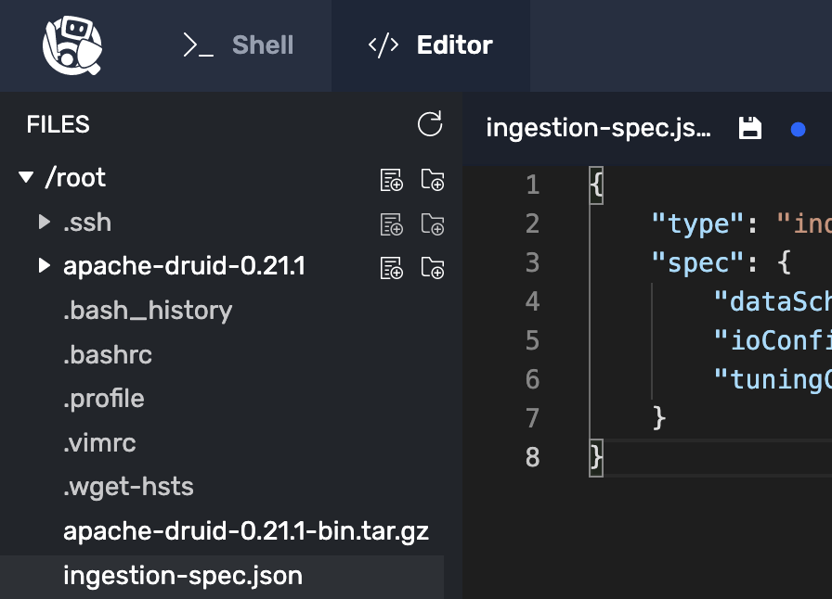
Click here to save the file
The blue dot means file is not yet saved

Slide 3
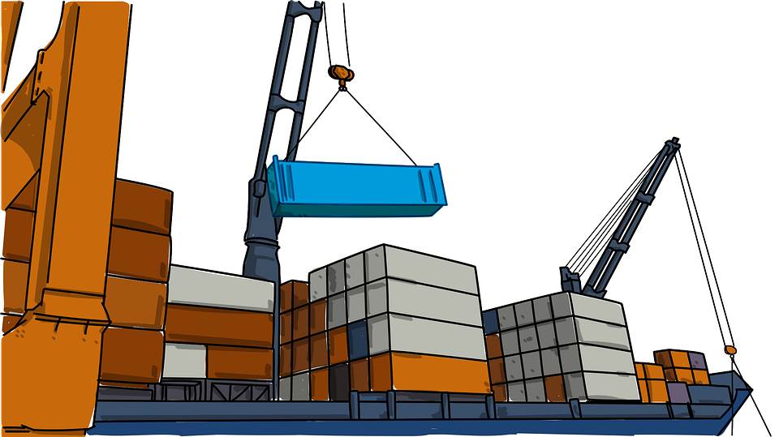
Your Data

Slide 4
Ingestion Spec is:
JSON file
Controls Ingestion tasks
Used to create Druid Tables
Ingestion Specification
Ingestion Specification
Ingestion Specification
{
?
?
}
{
“type”: …
?
}
{
“type”: …
“spec”: …
}

Slide 5
Ingestion Specification
Describes source of data
{
“type”: …
“spec”: {
“dataSchema”: {},
“ioConfig”: {},
“tuningConfig”: {}
}
}
Contains segment creation parameters
Describes resulting table

Slide 6
Two Ingestion Types:
Batch Ingestion (from a file)
Streaming Ingestion (from a streaming source)
Reasons for Doing Batch Ingestion:
One-time bulk load from a file
Add historical data
Replace part of a timeline with more accurate data
Add recent data from a lake or database

Slide 7
Ingestion Specification
{
“type”: ?
“spec”: …
}
Ingestion Specification
{
“type”: “index_parallel”
“spec”: …
}
Only Single-threaded

Slide 8
Ingestion Specification
{
“type”: ?
“spec”: …
}
Ingestion Specification
{
“type”: “kinesis”
“spec”: …
}
Only Single-threaded

Slide 9
“index_parallel” or “index”
Means
Batch Ingestion
Druid uses a
“Supervisor”
to control Streaming Ingestion
“kafka” or “kinesis”
Means
Streaming Ingestion

Slide 10





Slide 11

Ingestion
Data
Kafka

Slide 12

Hello
Ingestion
Spec!
Ingestion
Spec

Slide 13

Ingestion Spec

