Slide 1

Apache Druid® Ingestion and Data Modeling
dimensionsSpec Processing
Press Start to begin

Slide 2
Press Start to begin

Slide 3
Ingestion Spec
{
…
“dataSchema”: {
”dimensionsSpec": {
”dimensions": [
…
]
},
…
}
}
List the names of the columns you want in your table here

Slide 4
Ingestion Spec
{
…
“dataSchema”: {
”dimensionsSpec": {
”dimensionExclusions": [
…
]
},
…
}
}
List the names of the columns you don’t want in your table here

Slide 5
Apache Druid® Data Modeling Principles
1 - Create each table datasource for a specific set of query shapes
2 - Transform data, as much as possible, before storage
3 - Eliminate unused columns
4 - Filter out unnecessary rows
5 - Combine rows using query time granularity, approximation and rollup
6 - Organize segments for fast queries

Slide 6
Apache Druid® Data Modeling Principles
1 - Create each table datasource for a specific set of query shapes
2 - Transform data, as much as possible, before storage
3 - Eliminate unused columns
4 - Filter out unnecessary rows
5 - Combine rows using query time granularity, approximation and rollup
6 - Organize segments for fast queries

Slide 7
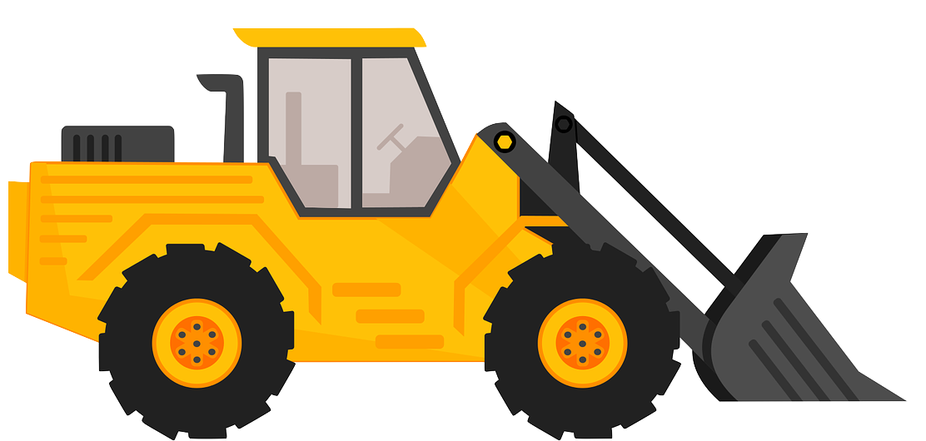

Slide 8

”dimensionsSpec": {
”dimensions": [
“processName”,
“pid”,
“cpu”
]
}
”dimensionsSpec": {
”dimensions": [
“processName”,
“pid”,
{
“name”: ”cpu”,
“type”: “float”
}
]
}

Slide 9
Since these are only column names…
This looks like a number…
Druid assumes these are String types
But we can treat is like a String!

Slide 10
Strings are a good default data type in Druid!
ID = 4266141748972145
ID =
4266141748972145
if (ID < 4266141748972146) …

Slide 11
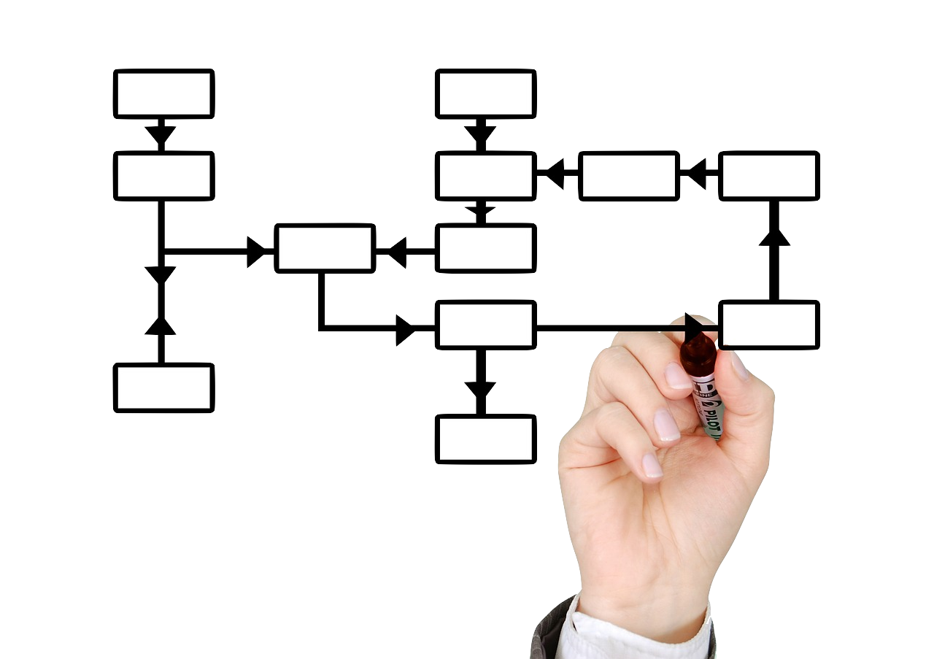

Slide 12
pid
cpu
processName
seconds
memory
”dimensionsSpec": {
”dimensions": [
“processName”,
“pid”,
“cpu”,
“memory”,
“seconds”
]
}
processName | pid | cpu | memory | seconds

Slide 13
"metricsSpec": [
{
"type": "floatSum",
"name": ”io_time",
"fieldName": ”io"
},
{
"type": "count",
"name": "agg-count"
}
]
Io_time | agg-count

Slide 14
"dimensionsSpec": {
"dimensions": [
"pid",
"upperProcessName"
]
},
"metricsSpec": [
{ "type" : "floatSum", "name" : "cpu", "fieldName" : "cpu" },
{ "type" : "floatSum", "name" : "memory", "fieldName" : "memory" },
{ "type" : "count", "name" : "agg-count" }
]

Slide 15
"dimensionsSpec": {
"dimensions": [
"pid",
"upperProcessName"
]
},

Slide 16
"dimensionsSpec": {
"dimensions": [
"pid",
"upperProcessName”,
{ “name”: ”cpu”, “type”: “float” },
{ "name": "memory", "type": "float” },
{ "name": "seconds", "type": "long” },
{ "name": "milliseconds", "type": "long” }
]
},

Slide 17
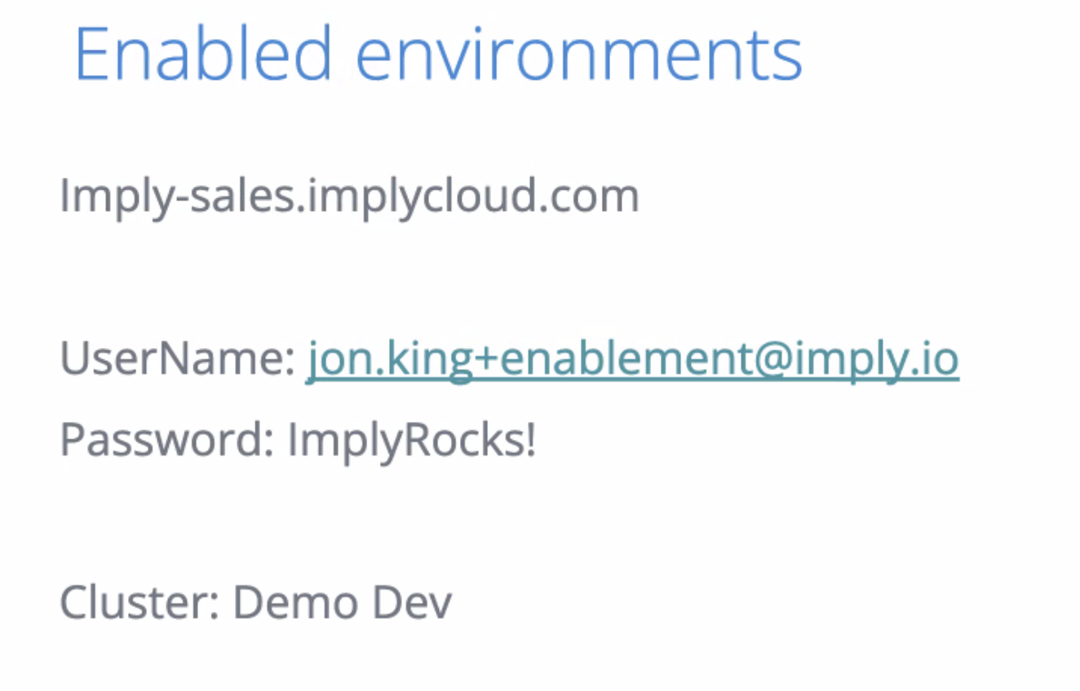

Slide 18
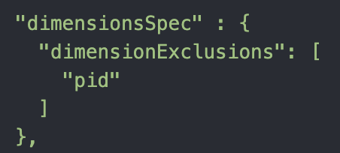


Slide 19


Chillax! Druid’s got this!
Dude! Where’s the schema????
String
String

Slide 20
Using schemaless?
There are no transforms in the table!
processName | pid | cpu | memory

Slide 21

No Data
Access

Slide 22
Reindex
(riːˈɪndɛks)
VERB (transitive)
computing
to create a new index for

Slide 23
Reindex
(riːˈɪndɛks)
VERB (transitive)
Druid
Ingesting data from existing segments
to create new segments

Slide 24


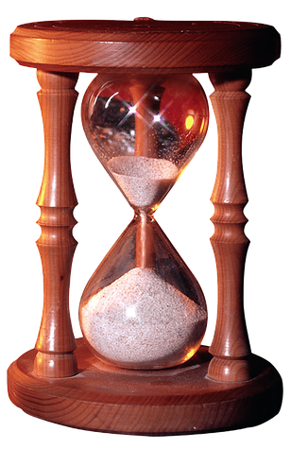
Compaction Task
Two ways to run them:
Manually
Scheduled
What do Manual Compaction
and Ingestion have in Common?
Both use a specification file
Both use an API to start them

Slide 25

Where are the spec and dataSchema objects?
We don’t use them for compaction!

Slide 26
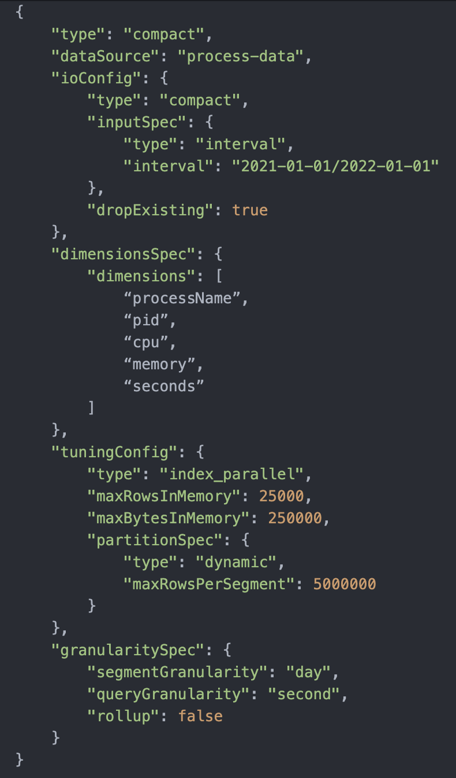

Slide 27
No dimensionsSpec retains all columns
Note: We cannot use a dimensionExclusions with compaction

Slide 29
Compaction
Process
Segment
Segment
Segment

