Slide 1

Apache Druid® Ingestion and Data Modeling
Rollup (metricsSpec) Processing
Press Start to begin

Slide 2
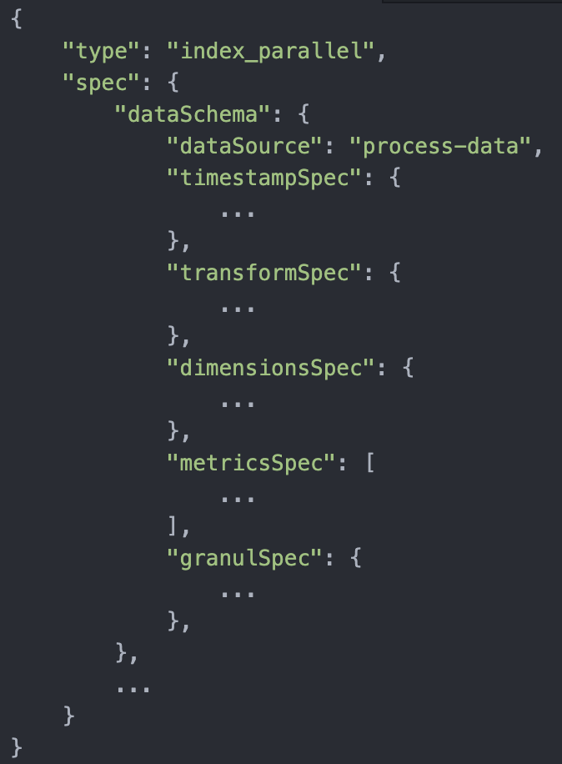
Ingestion Process Phases
Flattening
Timestamp
Transform
Dimensions
Metrics/Rollup

Slide 3
Expression Tree
concat()
upper()
substring()
substring()
strlen()

Slide 4
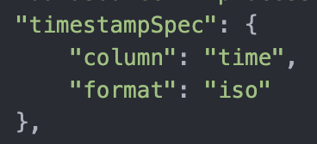
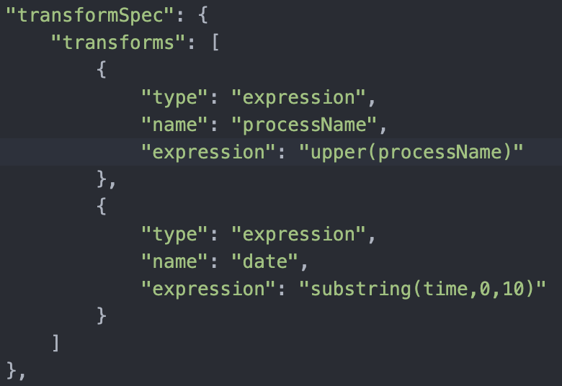
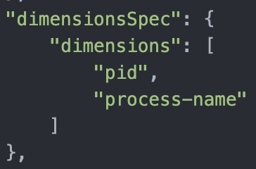
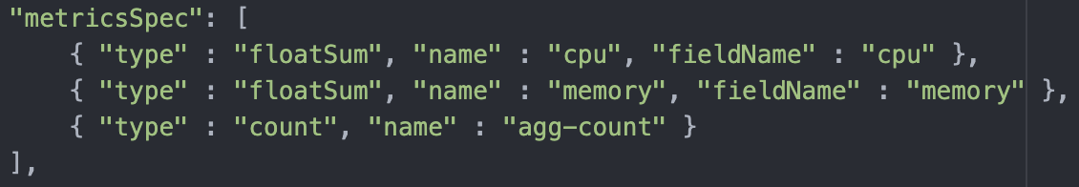
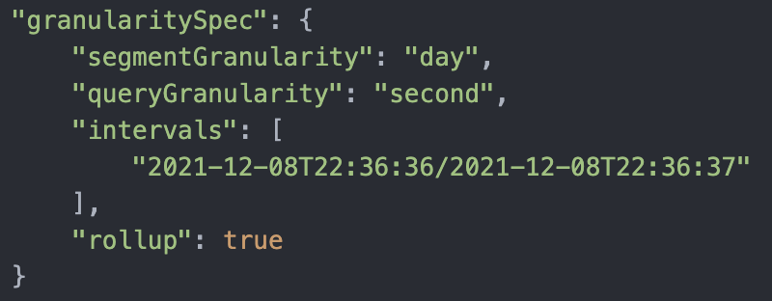

Slide 5
Apache Druid® Data Modeling Principles
1 - Create each table datasource for a specific set of query shapes
2 - Transform data, as much as possible, before storage
3 - Eliminate unused columns
4 - Filter out unnecessary rows
5 - Combine rows using query time granularity, approximation and rollup
6 - Organize segments for fast queries

Slide 6
Apache Druid® Data Modeling Principles
1 - Create each table datasource for a specific set of query shapes
2 - Transform data, as much as possible, before storage
3 - Eliminate unused columns
4 - Filter out unnecessary rows
5 - Combine rows using query time granularity, approximation and rollup
6 - Organize segments for fast queries

Slide 7
5 - Combine rows using query time granularity, approximation and rollup

Slide 8
Summarization == Rollup
__time | pid,etc. | count | min | max
time,pid,processName,cpu,memory
2022-02-18T18:28:59.887,114,middleManager,66.7,1.5
2022-02-18T18:28:59.964,112,router,53.3,1.8
2022-02-18T18:29:00.047,110,coordinator,26.7,2.2
2022-02-18T18:29:00.125,111,broker,26.7,2.7
2022-02-18T18:29:00.234,113,historical,26.7,2.2
2022-02-18T18:29:00.859,114,middleManager,70.0,1.5
2022-02-18T18:29:00.952,113,historical,40.0,2.2
2022-02-18T18:29:01.030,110,coordinator,30.0,2.2
2022-02-18T18:29:01.079,111,broker,30.0,2.7
2022-02-18T18:29:01.130,112,router,20.0,1.8
2022-02-18T18:29:01.359,112,router,50.0,1.8
2022-02-18T18:29:01.374,114,middleManager,50.0,1.5
2022-02-18T18:29:01.388,110,coordinator,30.0,2.2
2022-02-18T18:29:01.433,111,broker,30.0,2.7
2022-02-18T18:29:01.478,113,historical,30.0,2.2
2022-02-18T18:29:02.213,113,historical,50.0,2.2
2022-02-18T18:29:02.324,114,middleManager,50.0,1.5
2022-02-18T18:29:02.410,111,broker,40.0,2.7
2022-02-18T18:29:02.496,110,coordinator,30.0,2.2
2022-02-18T18:29:01.030,110,coordinator,30.0,2.2
2022-02-18T18:29:01.079,111,broker,30.0,2.7
2022-02-18T18:29:01.130,112,router,20.0,1.8
2022-02-18T18:29:01.359,112,router,50.0,1.8
2022-02-18T18:29:01.374,114,middleManager,50.0,1.5
2022-02-18T18:29:01.388,110,coordinator,30.0,2.2
2022-02-18T18:29:01.433,111,broker,30.0,2.7
2022-02-18T18:29:01.478,113,historical,30.0,2.2
Metrics

Slide 9
Summarization == Rollup
time,pid,processName,cpu,memory
2022-02-18T18:28:59.887,114,middleManager,66.7,1.5
2022-02-18T18:28:59.964,112,router,53.3,1.8
2022-02-18T18:29:00.047,110,coordinator,26.7,2.2
2022-02-18T18:29:00.125,111,broker,26.7,2.7
2022-02-18T18:29:00.234,113,historical,26.7,2.2
2022-02-18T18:29:00.859,114,middleManager,70.0,1.5
2022-02-18T18:29:00.952,113,historical,40.0,2.2
2022-02-18T18:29:01.030,110,coordinator,30.0,2.2
2022-02-18T18:29:01.079,111,broker,30.0,2.7
2022-02-18T18:29:01.130,112,router,20.0,1.8
2022-02-18T18:29:01.359,112,router,50.0,1.8
2022-02-18T18:29:01.374,114,middleManager,50.0,1.5
2022-02-18T18:29:01.388,110,coordinator,30.0,2.2
2022-02-18T18:29:01.433,111,broker,30.0,2.7
2022-02-18T18:29:01.478,113,historical,30.0,2.2
2022-02-18T18:29:02.213,113,historical,50.0,2.2
2022-02-18T18:29:02.324,114,middleManager,50.0,1.5
2022-02-18T18:29:02.410,111,broker,40.0,2.7
2022-02-18T18:29:02.496,110,coordinator,30.0,2.2
time,pid,processName,cpu,memory
2022-02-18T18:28:59.887,114,middleManager,66.7,1.5
2022-02-18T18:28:59.964,112,router,53.3,1.8
2022-02-18T18:29:00.047,110,coordinator,26.7,2.2
2022-02-18T18:29:00.125,111,broker,26.7,2.7
2022-02-18T18:29:00.234,113,historical,26.7,2.2
2022-02-18T18:29:00.859,114,middleManager,70.0,1.5
2022-02-18T18:29:00.952,113,historical,40.0,2.2
2022-02-18T18:29:01.030,110,coordinator,30.0,2.2
2022-02-18T18:29:01.079,111,broker,30.0,2.7
2022-02-18T18:29:01.130,112,router,20.0,1.8
2022-02-18T18:29:01.359,112,router,50.0,1.8
2022-02-18T18:29:01.374,114,middleManager,50.0,1.5
2022-02-18T18:29:01.388,110,coordinator,30.0,2.2
2022-02-18T18:29:01.433,111,broker,30.0,2.7
2022-02-18T18:29:01.478,113,historical,30.0,2.2
2022-02-18T18:29:02.213,113,historical,50.0,2.2
2022-02-18T18:29:02.324,114,middleManager,50.0,1.5
2022-02-18T18:29:02.410,111,broker,40.0,2.7
2022-02-18T18:29:02.496,110,coordinator,30.0,2.2

Slide 10
What are the two general types of rollup?
Precise metrics
Approximate metrics
Precise metrics
Count
Sum
Min
Max
Count
Precise metrics
Count
Sum
Min
Max
Sum
Min
Max
SELECT COUNT(*) FROM table

Slide 11
1 2022-02-18T18:29:02.213,113,historical,50.0,2.2
2 2022-02-18T18:29:02.324,114,middleManager,50.0,1.5
3 2022-02-18T18:29:02.410,111,broker,40.0,2.7
4 2022-02-18T18:29:02.496,110,coordinator,30.0,2.2
__time | pid,etc. | count | min | max
__time | pid,etc. | count | min | max
 |  | 4
time, pid, processName, cpu, memory
2022-02-18T18:29:00.047, 114, middleManager, 66.7, 1.5
2022-02-18T18:29:00.357, 112, router, 53.3, 1.8
2022-02-18T18:29:00.542, 110, coordinator, 26.7, 2.2
-------- ----
SUM 146.7 5.5
__time | pid,etc. | count | cpu | mem
 |  | 3 | 146.7 | 5.5

Slide 12
1 2022-02-18T18:29:02.213,113,historical,50.0,2.2
2 2022-02-18T18:29:02.324,114,middleManager,50.0,1.5
3 2022-02-18T18:29:02.410,111,broker,40.0,2.7
4 2022-02-18T18:29:02.496,110,coordinator,30.0,2.2
__time | pid,etc. | count | min | max
__time | pid,etc. | count | min | max
 |  | 4
time, pid, processName, cpu, memory
2022-02-18T18:29:00.047, 114, middleManager, 66.7, 1.5
2022-02-18T18:29:00.357, 112, router, 53.3, 1.8
2022-02-18T18:29:00.542, 110, coordinator, 26.7, 2.2
-------- ----
MIN 26.7 1.5
MAX 66.7 2.2
__time | pid,etc. | count | cpu | mem
 |  | 3 | 146.7 | 5.5

Slide 13
2022-02-18T18:29:02.213,113,historical,50.0,2.2
2022-02-18T18:29:02.324,114,middleManager,50.0,1.5
2022-02-18T18:29:02.410,111,broker,40.0,2.7
2022-02-18T18:29:02.496,110,coordinator,30.0,2.2
2022-02-18T18:29:02.000,113,historical,50.0,2.2
2022-02-18T18:29:02.000,114,middleManager,50.0,1.5
2022-02-18T18:29:02.000,111,broker,40.0,2.7
2022-02-18T18:29:02.000,110,coordinator,30.0,2.2

Slide 14
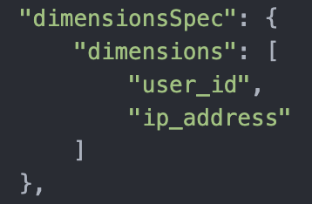
Raw Data
__time | user_id | ip_address | cpu | memory
2022-02-18T18:29:01.096 | druid_lover | 192.158.1.38 | 50.4 | 2.2
2022-02-18T18:29:01.122 | analyticsrus | 197.598.1.1 | 30.9 | 2.8
2022-02-18T18:29:01.288 | metricsmaniac | 193.111.1.1 | 42.2 | 7.1
2022-02-18T18:29:01.301 | druid_lover | 192.158.1.38 | 31.3 | 3.4
2022-02-18T18:29:01.444 | metricsmaniac | 193.111.1.1 | 44.7 | 2.3
2022-02-18T18:29:01.512 | analyticsrus | 197.598.1.1 | 63.2 | 4.1
2022-02-18T18:29:09.636 | metricsmaniac | 193.111.1.1 | 18.1 | 3.3
2022-02-18T18:29:09.719 | druid_lover | 192.158.1.38 | 24.4 | 3.2
2022-02-18T18:29:09.811 | analyticsrus | 197.598.1.1 | 39.8 | 2.9

Slide 15
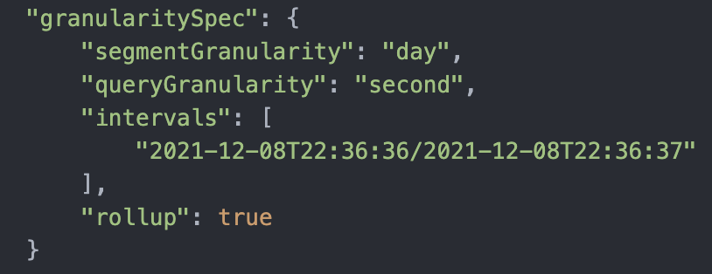
Raw Data
__time | user_id | ip_address | cpu | memory
2022-02-18T18:29:01.000 | druid_lover | 192.158.1.38 | 50.4 | 2.2
2022-02-18T18:29:01.000 | analyticsrus | 197.598.1.1 | 30.9 | 2.8
2022-02-18T18:29:01.000 | metricsmaniac | 193.111.1.1 | 42.2 | 7.1
2022-02-18T18:29:01.000 | druid_lover | 192.158.1.38 | 31.3 | 3.4
2022-02-18T18:29:01.000 | metricsmaniac | 193.111.1.1 | 44.7 | 2.3
2022-02-18T18:29:01.000 | analyticsrus | 197.598.1.1 | 63.2 | 4.1
2022-02-18T18:29:09.000 | metricsmaniac | 193.111.1.1 | 18.1 | 3.3
2022-02-18T18:29:09.000 | druid_lover | 192.158.1.38 | 24.4 | 3.2
2022-02-18T18:29:09.000 | analyticsrus | 197.598.1.1 | 39.8 | 2.9

Slide 16
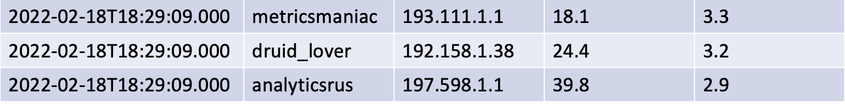

Raw Data
__time | user_id | ip_address | cpu | memory
2022-02-18T18:29:01.000 | druid_lover | 192.158.1.38 | 50.4 | 2.2
2022-02-18T18:29:01.000 | analyticsrus | 197.598.1.1 | 30.9 | 2.8
2022-02-18T18:29:01.000 | metricsmaniac | 193.111.1.1 | 42.2 | 7.1
2022-02-18T18:29:01.000 | druid_lover | 192.158.1.38 | 31.3 | 3.4
2022-02-18T18:29:01.000 | metricsmaniac | 193.111.1.1 | 44.7 | 2.3
2022-02-18T18:29:01.000 | analyticsrus | 197.598.1.1 | 63.2 | 4.1
2022-02-18T18:29:09.000 | metricsmaniac | 193.111.1.1 | 18.1 | 3.3
2022-02-18T18:29:09.000 | druid_lover | 192.158.1.38 | 24.4 | 3.2
2022-02-18T18:29:09.000 | analyticsrus | 197.598.1.1 | 39.8 | 2.9

Slide 17
Raw Data
__time | user_id | ip_address | cpu | memory
2022-02-18T18:29:01.000 | druid_lover | 192.158.1.38
2022-02-18T18:29:01.000 | analyticsrus | 197.598.1.1
2022-02-18T18:29:01.000 | metricsmaniac | 193.111.1.1
2022-02-18T18:29:09.000 | metricsmaniac | 193.111.1.1
2022-02-18T18:29:09.000 | druid_lover | 192.158.1.38
2022-02-18T18:29:09.000 | analyticsrus | 197.598.1.1

Slide 18
Raw Data
__time | user_id | ip_address | cpu | memory
2022-02-18T18:29:01.000 | druid_lover | 192.158.1.38 | 81.7 | 5.6
2022-02-18T18:29:01.000 | analyticsrus | 197.598.1.1 | 94.1 | 6.9
2022-02-18T18:29:01.000 | metricsmaniac | 193.111.1.1 | 86.9 | 9.4
2022-02-18T18:29:09.000 | metricsmaniac | 193.111.1.1 | 18.1 | 3.3
2022-02-18T18:29:09.000 | druid_lover | 192.158.1.38 | 24.4 | 3.2
2022-02-18T18:29:09.000 | analyticsrus | 197.598.1.1 | 39.8 | 2.9

Slide 19
Raw Data
__time | user_id | ip_address | cpu | memory | count
2022-02-18T18:29:01.000 | druid_lover | 192.158.1.38 | 81.7 | 5.6 | 2
2022-02-18T18:29:01.000 | analyticsrus | 197.598.1.1 | 94.1 | 6.9 | 2
2022-02-18T18:29:01.000 | metricsmaniac | 193.111.1.1 | 86.9 | 9.4 | 2
2022-02-18T18:29:09.000 | metricsmaniac | 193.111.1.1 | 18.1 | 3.3 | 1
2022-02-18T18:29:09.000 | druid_lover | 192.158.1.38 | 24.4 | 3.2 | 1
2022-02-18T18:29:09.000 | analyticsrus | 197.598.1.1 | 39.8 | 2.9 | 1

Slide 20
Raw Data
__time | user_id | ip_address | cpu | memory
2022-02-18T18:29:01.000 | druid_lover | 192.158.1.38 | 50.4 | 2.2
2022-02-18T18:29:01.000 | analyticsrus | 197.598.1.1 | 30.9 | 2.8
2022-02-18T18:29:01.000 | metricsmaniac | 193.111.1.1 | 42.2 | 7.1
2022-02-18T18:29:01.000 | druid_lover | 192.158.1.38 | 31.3 | 3.4
2022-02-18T18:29:01.000 | metricsmaniac | 193.111.1.1 | 44.7 | 2.3
2022-02-18T18:29:01.000 | analyticsrus | 197.598.1.1 | 63.2 | 4.1
2022-02-18T18:29:09.000 | metricsmaniac | 193.111.1.1 | 18.1 | 3.3
2022-02-18T18:29:09.000 | druid_lover | 192.158.1.38 | 24.4 | 3.2
2022-02-18T18:29:09.000 | analyticsrus | 197.598.1.1 | 39.8 | 2.9

Slide 21
Raw Data
__time | user_id | ip_address | cpu | memory | time
2022-02-18T18:29:01.000 | druid_lover | 192.158.1.38 | 50.4 | 2.2 | 30.6
2022-02-18T18:29:01.000 | analyticsrus | 197.598.1.1 | 30.9 | 2.8 | 65.3
2022-02-18T18:29:01.000 | metricsmaniac | 193.111.1.1 | 42.2 | 7.1 | 09.5
2022-02-18T18:29:01.000 | druid_lover | 192.158.1.38 | 31.3 | 3.4 | 13.3
2022-02-18T18:29:01.000 | metricsmaniac | 193.111.1.1 | 44.7 | 2.3 | 25.1
2022-02-18T18:29:01.000 | analyticsrus | 197.598.1.1 | 63.2 | 4.1 | 47.2
2022-02-18T18:29:09.000 | metricsmaniac | 193.111.1.1 | 18.1 | 3.3 | 17.6
2022-02-18T18:29:09.000 | druid_lover | 192.158.1.38 | 24.4 | 3.2 | 23.4
2022-02-18T18:29:09.000 | analyticsrus | 197.598.1.1 | 39.8 | 2.9 | 33.3

Slide 22
To rollup rows:
Set spec.dataSchema.granularitySpec.rollup to true
Row __time values must be equal (after truncation)
Row values (as specified in dimensionSpec) must be equal
How do I create a rollup average?
At query time use a SUM and count:
SELECT time_spent/”count” as mean_time_spent
FROM my_table

Slide 23


Benefits of using sketches
count
sum
min
max
Improves query speed
Reduces storage
Ingestion Side
Query Side
Run Ingestion
Execute Query
Use sketches in queries
Use sketches for ingestion

Slide 24

Rollup makes Druid fast!
Rollup also helps Druid scale!

Slide 25

Because, these simple aggregators just aren’t enough!

Slide 26
"metricsSpec": [
…
],
"metricsSpec": [
],
{
"type": "index_parallel",
"spec": {
"dataSchema": {
"dataSource": "process-data",
…
"metricsSpec": [
…
],
…
}
}
"metricsSpec": [
],

Slide 27
"metricsSpec": [
{
"type": "javascript",
"name": "cpu_memory",
"fieldNames": ["cpu", "memory"],
"fnAggregate" : "function(current, a, b) { return current + parseFloat(a) + parseFloat(b); }",
"fnCombine" : "function(partialA, partialB) { return partialA + partialB; }",
"fnReset" : "function() { return 0; }"
}
],

Slide 28
"metricsSpec": [
{
"type": "javascript",
"name": "cpu_memory",
"fieldNames": ["cpu", "memory"],
}
],

Slide 29
What are the three JavaScript aggregation functions?
FnAggreate
FnCombine
FnReset

Slide 30
ap·prox·i·ma·tion
/əˌpräksəˈmāSH(ə)n/
noun
a value or quantity that is nearly but not exactly correct.

Slide 31
HyperLogLog Sketch – for approximate count distinct
Theta Sketch – for mergable approximate count distinct
(HLL is faster if you don’t need to merge)
Quantile Sketch – for data distributions

Slide 32
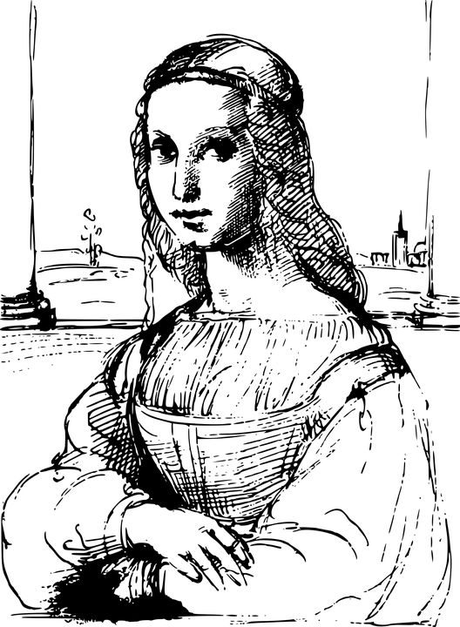

Slide 33
When we use a sketch here…
We must also use one here…

Slide 34

Marketing Funnel
How many people visited our web page?
How many people visited our web page
and then
bought our product?
How many people bought our product?

