Slide 1

Apache Druid® Ingestion and Data Modeling
timestampSpec Processing

Slide 2
Press Start to begin

Slide 3
Ingestion Process Phases
Flattening
Timestamp
Transform
Truncation happens down here
Dimensions
Metrics/Rollup

Slide 4
Column name has two underscores “__”
__time is the primary key
Flattening
{
“accountId”: “135XYZ”,
“name”: {
“first”: “Fred”,
“last”: “Flintstone”
},
“address”: {
“street”: “301 Cobblestone Way”,
“city”: “Bedrock”,
“zip”: “70777”
}
}
Druid uses __time to organize physical storage
Druid always requires this
__time | accountId | firstName | lastName | street | city | zip
2022-01-27T20:39:46Z | 135XYZ | Fred | Flintstone | 301 Cobblestone Way | Bedrock | 70777
… | … | … | … | … | … | …
… | … | … | … | … | … | …

Slide 5
Flattening
70777
{
“accountId”: “135XYZ”,
“name”: {
“first”: “Fred”,
“last”: “Flintstone”
},
“address”: {
“street”: “301 Cobblestone Way”,
“city”: “Bedrock”,
“zip”: “70777”
}
}
__time | accountId | firstName | lastName | street | city | zip

Slide 6
Raw input data
time, accout_id, first_name, last_name, street, city, zip
2022-01-27T20:39:46.123Z , 123XYZ, Fred, Flintstone, 301 Cobblestone Way, Bedrock, 70777
2022-01-27T20:39:46.456Z, 890ABC, Bugs, Bunny, 7007 Hollywood Blvd, Hollywood, 90028
2022-01-27T20:39:47.345Z, 573EFG, George, Jetson, 42 Skypad Apts, Orbit. City, 700084
Druid table datasource
__time | accountId | firstName | lastName | street | city | zip

Slide 7
Raw input data
time, accout_id, first_name, last_name, street, city, zip
2022-01-27T20:39:46.123Z , 123XYZ, Fred, Flintstone, 301 Cobblestone Way, Bedrock, 70777
2022-01-27T20:39:46.456Z, 890ABC, Bugs, Bunny, 7007 Hollywood Blvd, Hollywood, 90028
2022-01-27T20:39:47.345Z, 573EFG, George, Jetson, 42 Skypad Apts, Orbit. City, 700084
2022-01-27T20:39:46
2022-01-27T20:39:46
2022-01-27T20:39:47
Druid table datasource
__time | accountId | firstName | lastName | street | city | zip
2022-01-27T20:39:46
2022-01-27T20:39:46
2022-01-27T20:39:47

Slide 8
This mapping needs some data
This mapping needs some metadata
Druid also needs to know this format
Druid needs to know this name

Slide 9
{
…
“spec”: {
“dataSchema”: {
“timestampSpec”: {
“column”: “time”,
“format”: “iso”,
“missingValue”: “2022-01-27T20:39:46Z”
}
},
…
}
}

Slide 10
Ingestion Specification
{
…
“spec”: {
“dataSchema”: {
“timestampSpec”: {
}
},
…
}
}

Slide 11
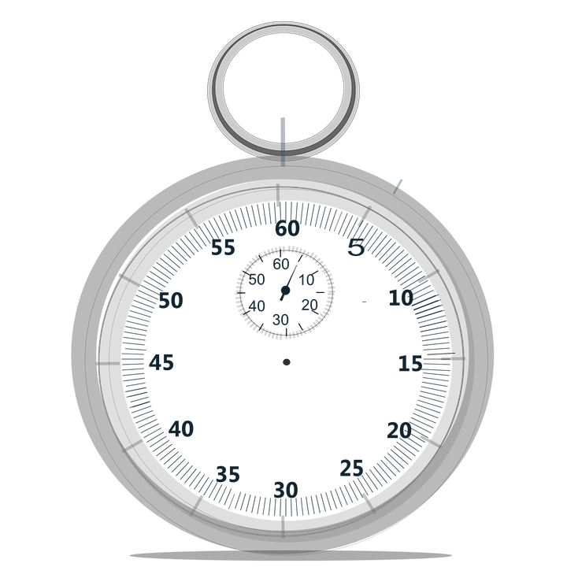
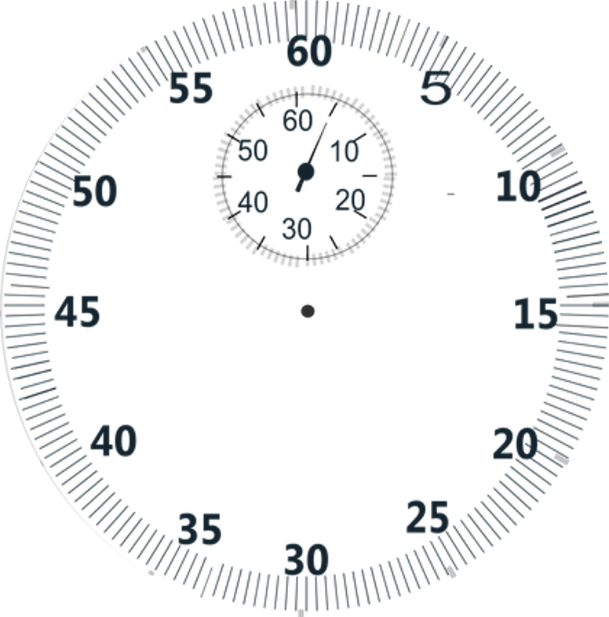


Slide 12
Truncation
2022-01-27T20:39:46.823Z
2022-01-27T20:39:46Z

Slide 13
{
…
“spec”: {
“dataSchema”: {
…
“granularitySpec”: {
…
“queryGranularity”: “second”,
…
}
},
…
}
}
{
…
“spec”: {
“dataSchema”: {
…
“granularitySpec”: {
…
}
},
…
}
}

Slide 14
{
…
“spec”: {
“dataSchema”: {
…
“granularitySpec”: {
…
“queryGranularity”: “second”,
“rollup”: true
}
},
…
}
}
{
…
“spec”: {
“dataSchema”: {
…
“granularitySpec”: {
…
}
},
…
}
}

Slide 15
queryGranularity can be any of:
{
…
“spec”: {
“dataSchema”: {
…
}
},
…
}
}
second
minute
fifteen_minute
thirty_minute
hour
day
week
month
quarter
year

Slide 16

PRINCIPLES

Slide 17
Two timestamp processing principles:
Apache Druid® Data Modeling Principles
1 - Create each table datasource for a specific set of query shapes
2 - Transform data, as much as possible, before storage
3 - Eliminate unused columns
4 - Filter out unnecessary rows
5 - Combine rows using query time granularity, approximation and rollup
6 - Organize segments for fast queries

Slide 18
__time | user_name | url | count
2022-01-27T20:39:46Z | fflintsone22 | /bedrock/retail | 1
2022-01-27T20:39:46Z | fflintsone22 | /bedrock/retail | 1
2022-01-27T20:39:46Z | fflintsone22 | /bedrock/retail | 1
__time | user_name | url | count
2022-01-27T20:39:46Z | fflintsone22 | /bedrock/retail | 3

Slide 19
Why am I doing this exercise?
To learn how to handle different time formats
To become more comfortable configuring ingestion
3 - Eliminate unused columns
4 - Filter out unnecessary rows
5 - Combine rows using query time granularity, approximation and rollup
6 - Organize segments for fast queries

Slide 20


Slide 21
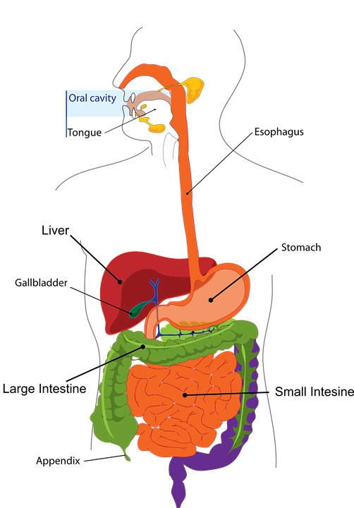
What are the two types of ingestion?
Batch
Streaming

Slide 22
{
"type": "kafka",
"spec": {
"ioConfig": {
"type": "kafka",
"consumerProperties": {
"bootstrap.servers": "localhost:9092"
},
"topic": "druid-processes",
"inputFormat": {
"type": "json"
},
"useEarliestOffset": true
},
"tuningConfig": {
"type": "kafka"
},
"dataSchema": {
"dataSource": "druid-processes",
"timestampSpec": {
"column": "time",
"format": "iso"
},
"granularitySpec": {
"queryGranularity": "none",
"rollup": false,
"segmentGranularity": "day"
}
}
}
}
{
"type": "kafka",
"spec": {
"ioConfig": {
"type": "kafka",
"consumerProperties": {
"bootstrap.servers": "localhost:9092"
},
"topic": "druid-processes",
"inputFormat": {
"type": "json"
},
"useEarliestOffset": true
},
"tuningConfig": {
"type": "kafka"
},
"dataSchema": {
…
}
}
}

