Slide 1
The Druid Servers
master-server
Coordinator-Overlord
ZooKeeper
data-server-1
data-server-2
Historical
MiddleManager
Historical
MiddleManager
query-server
Broker
Router

Slide 2

Apache Druid® Ingestion and Data Modeling
Press Start to begin

Slide 3
Apache Druid® Ingestion and Data Modeling
Ingestion
Data Modeling
Press Start to begin

Slide 4



Ingestion
Ingestion

Slide 5
Ingestion
Ingestion

Slide 6

Ingestion

Slide 7



Ingestion

Slide 8

Ingestion
Ingestion
Process
Query
Process

Slide 9


Slide 10

Ingestion
Important
Minimal
Ingestion
Processing
Pre-
Computed
Queries
Generally Applicable
SELECT this (and only this)
FROM that (and only that)
WHERE exactly as ingested…

Slide 11

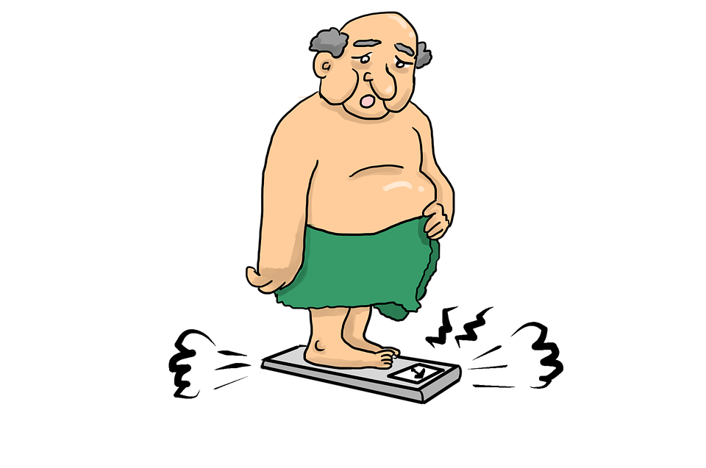
I seem to be very flexible
But really, I’m just slow

Slide 12




Slide 13
Apache Druid® Data Modeling Principles
1 - Create each table datasource for a specific set of query shapes
2 - Transform data, as much as possible, before storage
3 - Eliminate unused columns
4 - Filter out unnecessary rows
5 - Combine rows using query time granularity, approximation and rollup
6 - Organize segments for fast queries
Useful Common Settings!
WHERE clause
SELECT fields
FROM table
Generally Useful!

Slide 14


Slide 15


 |  |  |  | Count
 |  |  |  | 4
 |  |  |  | 3

Slide 16
URL | Status
http://imply.io/... | 200
http://druid.apache.org/... | 404
http://druid.apache.org/... | 100
http://imply.io/... | 300
http://imply.io/... | 200
http://druid.apache.org/... | 200
http://druid.apache.org/... | 404
http://imply.io/... | 100
http://druid.apache.org/... | 200
http://imply.io/... | 404
http://druid.apache.org/... | 200
URL | Status
http://imply.io/... | OK
http://druid.apache.org/... | Not Found
http://druid.apache.org/... | Continue
http://imply.io/... | Multiple Choice
http://imply.io/... | OK
http://druid.apache.org/... | OK
http://druid.apache.org/... | Not Found
http://imply.io/... | Continue
http://druid.apache.org/... | OK
http://imply.io/... | Not Found
http://druid.apache.org/... | OK

Slide 18
Druid Processes
Overlord
Coordinator
Ingestion
Spec
Middle Manager
Historical
Broker
Router

Slide 19




Scalability

