Slide 1

Apache Druid® Ingestion and Data Modeling
transformSpec Processing

Slide 2
Press Start to begin

Slide 3



Slide 4
404
Not Found
Druid
Null
Default Value
Data-in

Slide 5




Slide 6



Slide 7




Slide 8
Looks Like
Data-in
Data-out

Slide 9
What are the benefits of transforming data?
Simpler queries
Faster queries

Slide 10
Ingestion Specification
{
“type”: …
“spec”: {
“dataSchema”: {},
“ioConfig”: {},
“tuningConfig”: {}
}
}

Slide 11
“dataSchema”: {
"transformSpec": {
"transforms": [
{
"type": "expression",
"name": "upperProcessName",
"expression": "upper(processName)"
}
]
},
},

Slide 12
What are the two types of transformSpec actions?
Don’t use one of these…
as an input here
Modify data values
Remove unwanted rows
This is the name of a raw data field
This is the output field name

Slide 13
"transformSpec": {
"transforms": [
{
"type": "expression",
"name": "upperProcessName",
"expression": "upper(processName)"
}
]
},
"dimensionsSpec": {
"dimensions": [
"pid",
"upperProcessName"
]
},
Use transform output in dimensionsSpec

Slide 14
Use transform output in the metricsSpec too!

Slide 15
"transformSpec": {
"transforms": [
{
"type": "expression",
"name": "upperProcessName",
"expression": "concat(upper(substring(processName,0,1)),substring(processName,1,strlen(processName)-1))"
}
]
},

Slide 16
Apache Druid® Data Modeling Principles
1 - Create each table datasource for a specific set of query shapes
2 - Transform data, as much as possible, before storage
3 - Eliminate unused columns
4 - Filter out unnecessary rows
5 - Combine rows using query time granularity, approximation and rollup
6 - Organize segments for fast queries

Slide 17
Apache Druid® Data Modeling Principles
1 - Create each table datasource for a specific set of query shapes
2 - Transform data, as much as possible, before storage
3 - Eliminate unused columns
4 - Filter out unnecessary rows
5 - Combine rows using query time granularity, approximation and rollup
6 - Organize segments for fast queries

Slide 18
Apache Druid® Data Modeling Principles
1 - Create each table datasource for a specific set of query shapes
2 - Transform data, as much as possible, before storage
3 - Eliminate unused columns
4 - Filter out unnecessary rows
5 - Combine rows using query time granularity, approximation and rollup
6 - Organize segments for fast queries

Slide 19
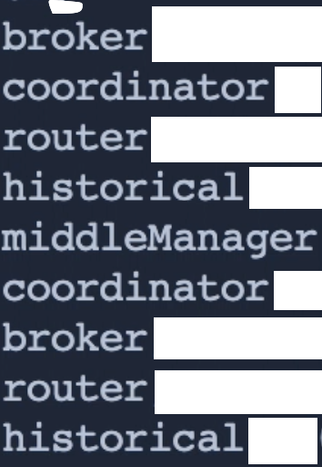

Slide 20





Slide 21
historical
Simple
Transform
HISTORICAL
Sophisticated
Transform
Historical
Transforms use Druid Native Query Language
Transforms do NOT use SQL

Slide 22
Returns a value of 12 for this string
strlen(“I love Druid”)
This is the string argument

Slide 23
“I love Druid”
Returns “Druid”
I | <sp> | L | O | V | E | <sp> | D | R | U | I | d
0 | 1 | 2 | 3 | 4 | 5 | 6 | 7 | 8 | 9 | 10 | 11
substring(“I love Druid”, 7, 5)
This is the target string
The starting offset
The length of the substring

Slide 24
Returns “Y”
substring(“you love Druid”, 0, 1)
upper(“you love Druid”)
“you love Druid”
upper(substring(“you love Druid”, 0, 1))
This is the string argument

Slide 25
First string argument
Second string argument
concat(“you love ”, “Druid”)
upper(“you love Druid”)
“you love Druid”
upper(substring(“you love Druid”, 0, 1))
Returns
“you love Druid”

Slide 26
h
istorical
historical
H
upperProcessName

Slide 27
processName
"transformSpec": {
"transforms": [
{
"type": "expression",
"name": ”upperProcessName",
"expression": "concat(upper(substring(processName,0,1)),substring(processName,1,strlen(processName)-1))"
}
]
},

Slide 28
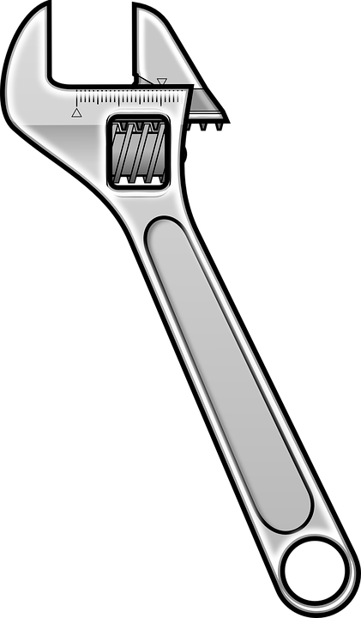
Here’s the output field name we’ll change
Ingestion
Spec

Slide 29
1644689576877
time
date
Transform
2022-02-11
2022-02-11T23:41:33.666
substring()
Transform

Slide 30
"transformSpec": {
"transforms": [
{
"type": "expression",
"name": "processName",
"expression": "concat(…)"
},
{
"type": "expression",
"name": "date",
"expression": "substring(time,0,10)"
}
]
},
"dimensionsSpec": {
"dimensions": [
"pid",
"processName",
"date"
]
},

Slide 31
1644689576877
__time
time
date
Transform
milliseconds
2022-02-11
2022-02-11T23:41:33.666
1644689576877
timestampSpec
Processing
877

Slide 32
The number of milliseconds since January 1, 1970
Truncation doesn’t happen here…
Ingestion Process Phases
Flattening
Timestamp
Transform
When does truncation happen?
Dimensions
Metrics/Rollup

Slide 33


__time = 1644689576877
__time = 1644689000000

Slide 34
What are two things we can do with the transformSpec?
Transform data values
Filter out unwanted rows
Filter [fil-ter]
verb (used with object)
to remove by the action of a filter.
Computers. to subject (data) to an algorithmic filter:
The search engine will filter your query results based on your location and user profile.

Slide 35




FALSE
Predicate
Raw Data Row

Slide 36
SELECT * FROM my_table
WHERE a = b
AND c = d
AND e = f
Ingestion
Query
SELECT * FROM …
WHERE …

Slide 37
Ingestion Process Phases
Flattening
Timestamp
Filtering
happens
here
Transformed columns are available
Transform
Dimensions
Metrics/Rollup

Slide 38
"filter": {
"type": "regex",
"dimension": "processName",
"pattern": ".+er”
}

Slide 39


