Slide 1


GO-TO-MARKET · AUG–SEP 2026
Permissionless Campaigns
2-week launch campaign · 4 activation pillars · every piece already written
“No sales call. No agency. No permission.”
Launch campaign plan · full copy & scripts: Master Doc

Slide 2



WHY WE RUN THIS CAMPAIGN
MASTER DOC ▸
Three objectives, one launch
CLOSE COMMUNITIES & PROJECTS
ACQUISITION NARRATIVE
UNIFY THE CONCEPTS
Convert the launch into signed demand.
Own one story: marketing without gatekeepers.
One frame that connects everything Rally has built.
First Verified cohort filled ($1,500 × N — the revenue line)
Flagship communities operating inside Rally (co-created campaign)
Project pipeline worked 1:1 with one-pager + case study
The Demo Video as acquisition engine — promoted at full throttle
KOLs launching real RLP-funded campaigns: the promotion IS the product
Every piece repeats the same hook, twice a week, for two weeks
RLPs = working capital · Communities = distribution · Campaigns = the market
Network (open floor) vs Verified (main stage) — one clean mental model
Ends at the vision: “Rally, the Hub of Communities”
KPI: Verified calls booked · cohort filled · communities claimed
KPI: video reach · new sign-ups · campaigns created
KPI: RLPs deployed into pools · consistent narrative across ~25 pieces
The campaign is designed so each pillar serves at least one objective — nothing publishes without a job.

Slide 3



THE STRATEGY
MASTER DOC ▸
Four activation pillars — everything else supports these
1 · THE PERMISSIONLESS VIDEO
Master Doc §5, 11.5 ▸
2 · SALES NARRATIVE & CO-MARKETING
Master Doc §6–7, 11 ▸
The hero. Everything derives from it.
Attract communities and projects.
Demo Video promoted at full throttle from Day 1
KOLs launch real permissionless campaigns funded in RLPs
Teaser · countdown · cutdowns · receipts thread keep it alive
Verified & Network pitches + use-case articles
Call for Projects (first cohort) + flagship co-created campaign
Case study with real ROI → pipeline + “Hub of Communities” vision
3 · CREATORS CREATING CAMPAIGNS
Master Doc §9, 11 ▸
4 · CONCEPT EDUCATION
Master Doc §8, 10, 13 ▸
Social proof from other voices.
Lower the barrier to the first campaign.
Creators launch campaigns with their RLPs — and tell it on video
Weekly Spotlight of the best community campaigns
Campaign Idea Battle: winning community idea gets funded
“How It Works” · “Why RLPs Matter” · brief-writing guide
Live demo: a campaign launched in 10 minutes, on stream
X Space debrief + AMAs — objections answered in public

Slide 4
CONTENTS & TIMING
MASTER DOC ▸
PILLAR 1
Teaser 15s — “Something permissionless is coming”
AUG 24
The Permissionless Video
Countdown post — launch date reveal
AUG 25
Serves: acquisition narrative + concept unification
DEMO VIDEO (100s, script locked) + launch thread pinned + mailing
AUG 26
One heavy production, ~25 pieces living off it — maximum leverage per euro
KOLs don't do ad reads: they launch real campaigns funded in RLPs. Their audience watches the product work
The hook carries the whole story: “Every campaign you've seen here was ours. That ends today.”
KOL activation: real RLP-funded campaigns + coordinated QT push
AUG 26→
Cutdowns 15s / 30s — fresh angles keep it circulating
W1–W2
“Anatomy of a Campaign” receipts thread — the video, proven with screenshots
SEP 8
Master Doc §4–5, 11.5 ▸

Slide 5
CONTENTS & TIMING
MASTER DOC ▸
PILLAR 2
Verified thread + “Why Verified — 5 Use Cases” + one-pager → pipeline
AUG 27
Sales Narrative & Co-marketing
Network thread + Verified vs Network visual + CALL FOR PROJECTS (first cohort)
AUG 28
Serves: close communities & projects (the revenue line)
Flagship co-created campaign goes live (partner community)
SEP 1
Two clean offers: Network (open floor, free) vs Verified (main stage, $1,500)
Co-marketing built in: projects launch WITH us — Call for Projects, flagship co-created campaign
Everything doubles as sales material: one-pager, comparison visual, use cases, case study
1:1 outreach to Sept–Oct launches — the video is the pitch
W1–W2
Case study “the receipts” + sales article → pipeline
SEP 4
Vision: “Rally, the Hub of Communities” — the story that closes communities
SEP 3
Master Doc §6–7, 11.3–11.4 ▸

Slide 6
CONTENTS & TIMING
MASTER DOC ▸
PILLAR 3
Creator video #1 — “I launched a campaign, here's what happened” (their words)
SEP 1
Creators Creating Campaigns
Spotlight thread: best community campaigns (recurring every Monday)
SEP 7
Serves: acquisition narrative + social proof
Partner video #2 — community-lead POV
SEP 2
The claim only lands when someone who isn't us says it
Creators spend their own RLPs on their own campaigns — the loop, demonstrated
Community content compounds: every spotlight makes the next creator want in
Poll feeds the Battle: “What would you launch a campaign for?”
W2
Campaign Idea Battle — the winning community idea gets funded for real
SEP 5
Master Doc §9, 11.1–11.2, 11.6 ▸

Slide 7
CONTENTS & TIMING
MASTER DOC ▸
PILLAR 4
Article: “Permissionless Campaigns — How It Works” (evergreen explainer)
AUG 26
Concept Education
Article: “Why RLPs Matter” — points become working capital
AUG 28
Serves: concept unification + lowering the barrier to campaign #1
Live demo: “Launch a campaign in 10 minutes” + guide “How to Write a Campaign Brief”
AUG 31
Ten minutes from idea to live — but only if people know how
Education content is evergreen: it keeps converting after the campaign ends
Objections answered in public build trust faster than any ad
X Space: Creators & Partners AMA — first campaigns debrief
AUG 29
Objections cheat sheet + tagline bank (Spaces, AMAs, replies)
ALWAYS
Master Doc §5.4, 7.5, 8, 10, 13 ▸

Slide 8
THE CALENDAR
MASTER DOC ▸
12 days · color-coded by pillar
Video
Sales
Creators
Education
PRE-LAUNCH: Mon Aug 24 teaser · Tue 25 countdown
LAUNCH · AUG 26 – SEP 1
WED 26
THU 27
FRI 28
SAT 29
MON 31
TUE 1
THE DROP
Verified
Network
Debrief
Live Demo
Creator Video #1
Demo Video + thread + mailing + KOL campaigns + How-It-Works
thread $1,500 + use cases + one-pager → pipeline
thread + comparison visual + Call for Projects + RLPs article
X Space: creators & partners AMA
“10 minutes” live build + brief guide
testimonial + flagship co-created campaign live
SOCIAL PROOF · SEP 2 – 8
WED 2
THU 3
FRI 4
SAT 5
MON 7
TUE 8
Partner Video #2
Vision
Case Study
Community Day
Spotlight
Anatomy
community-lead testimonial
“Rally, the Hub of Communities”
“the receipts” + sales article → pipeline + KOL push
AMA + Campaign Idea Battle (winner funded)
best community campaigns (every Monday)
receipts thread (screenshots) + cutdown

Slide 9
THE ASK
MASTER DOC ▸
What I need from design — all copy is final, design never waits for text
WAVE 1 · BEFORE THE DROP
WAVE 2 · LAUNCH WEEK
WAVE 3 · SOCIAL PROOF
due Aug 21–25
due Aug 26–31
due Sep 1–3
Demo Video edit (script locked) — the only heavy lift
Teaser 15s + countdown graphic
QT kit for communities, creators & KOLs
OG images (thread + article) + email header
Verified one-pager PDF (the sales asset)
Verified vs Network comparison visual
Call for Projects banner + form header
2 X Space covers · 2 cutdowns · video lower-thirds
Spotlight template (reusable every Monday)
Big-number stat template (case study + numbers posts)
AMA cover + Idea Battle bracket
15 assets · 3 waves · full spec table with per-asset deadlines in the Master Doc §12 ▸

Slide 10
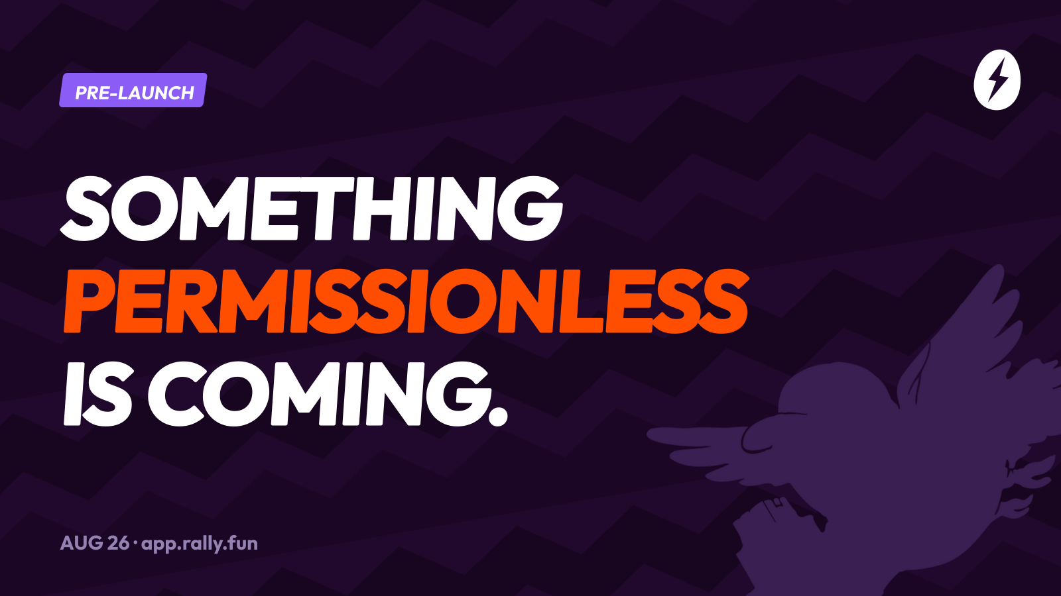
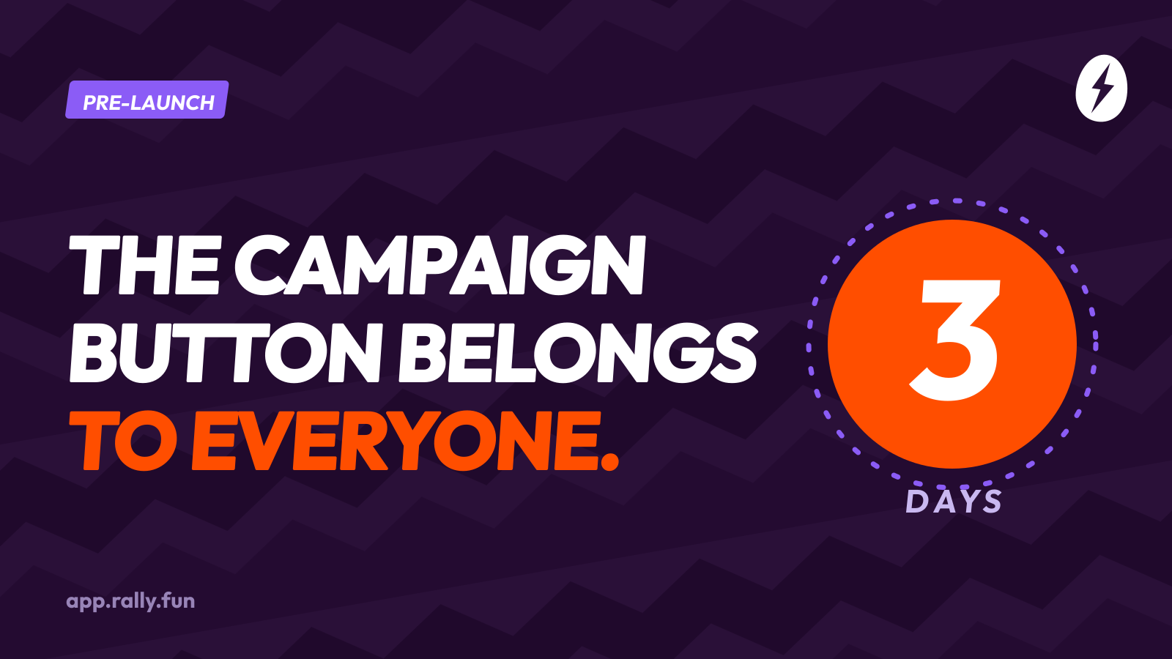
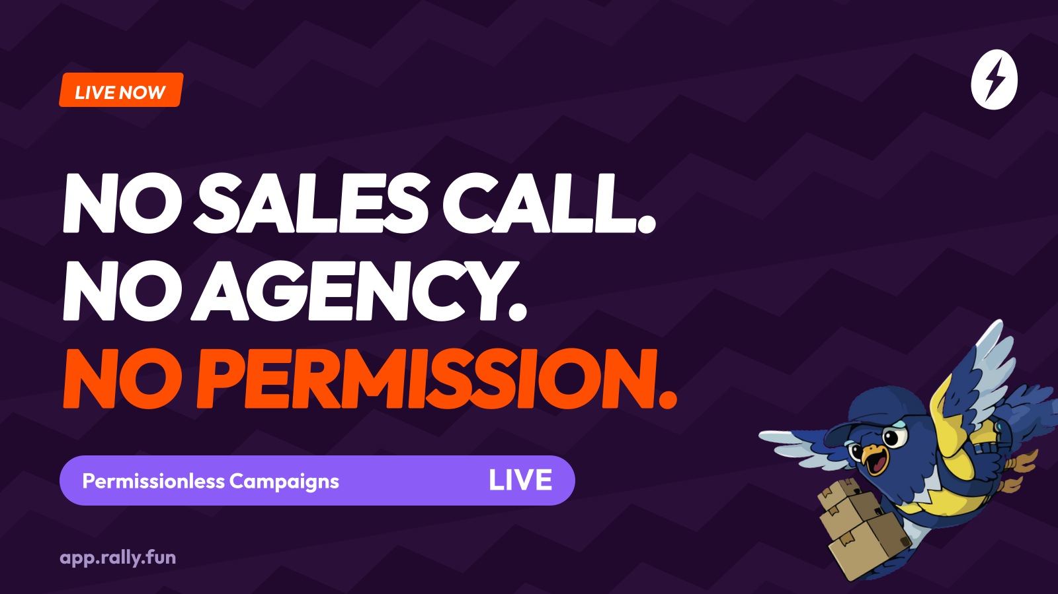
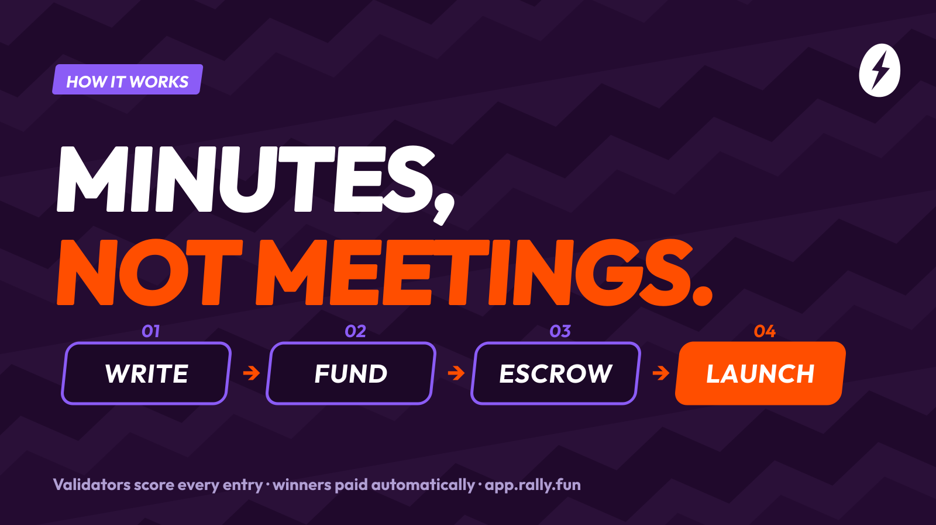
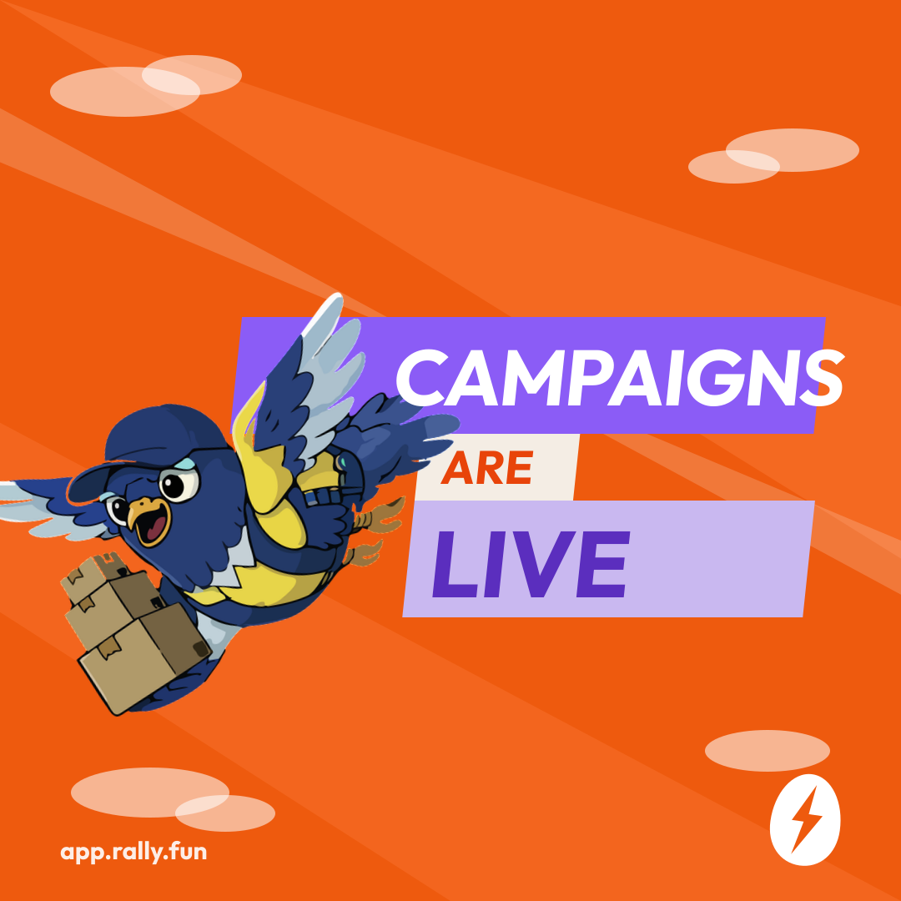
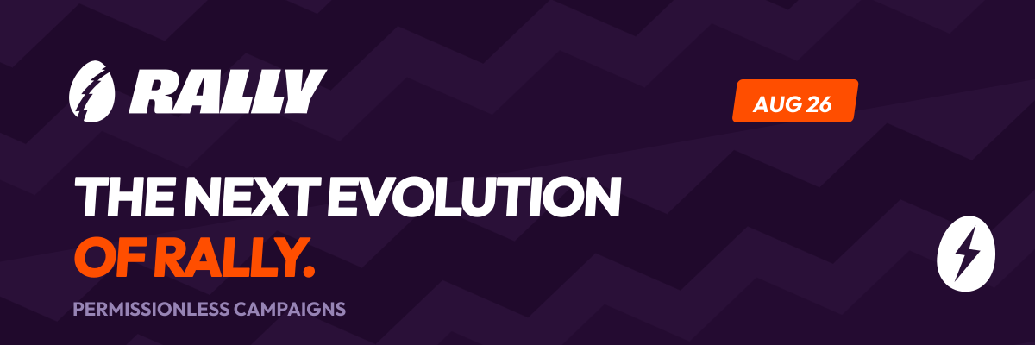
DESIGN KIT · ALREADY PRODUCED
MASTER DOC ▸
Pre-launch & launch day — ready to post
TEASER · MON AUG 24
COUNTDOWN 3·2·1 · AUG 24–25
LAUNCH THREAD OG · WED AUG 26
EMAIL HEADER · WED AUG 26
“HOW IT WORKS” ARTICLE OG · WED AUG 26
LIVE POST · WED AUG 26

Slide 11
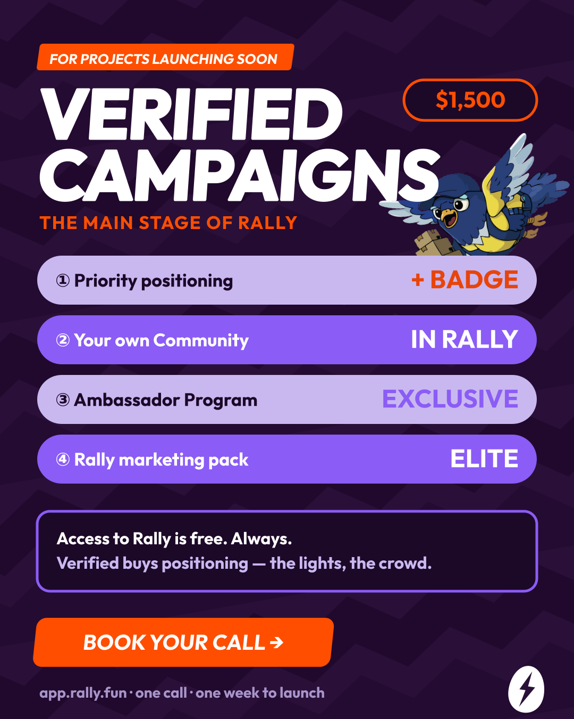
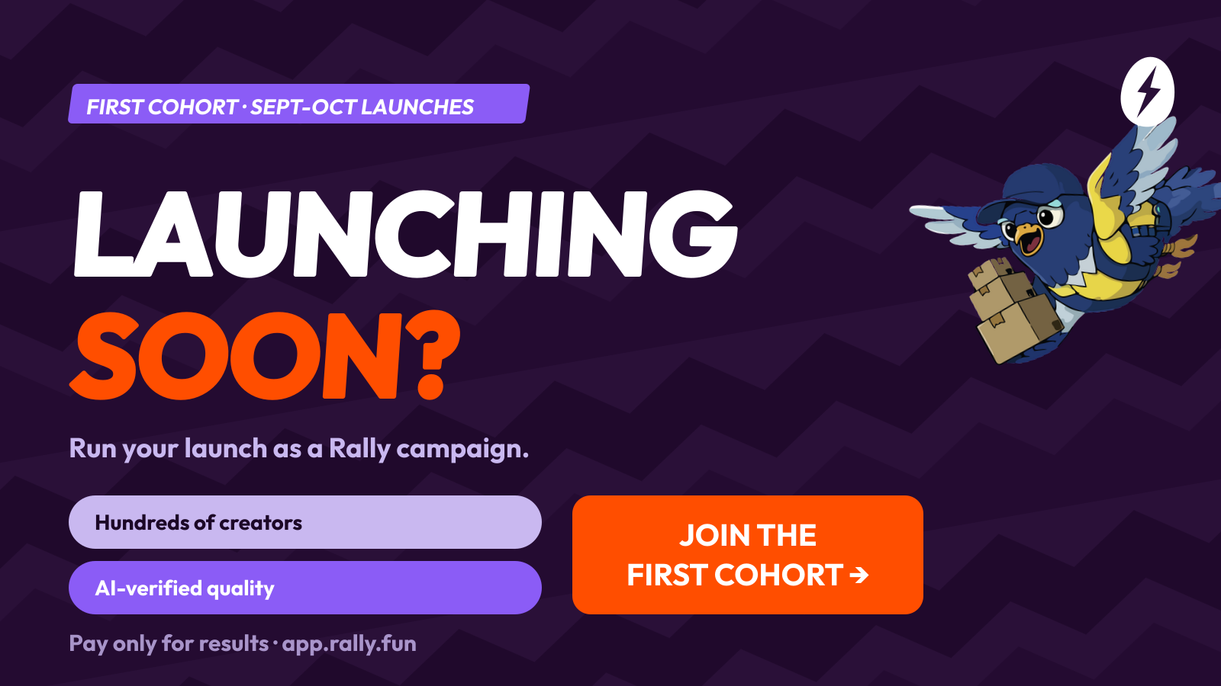
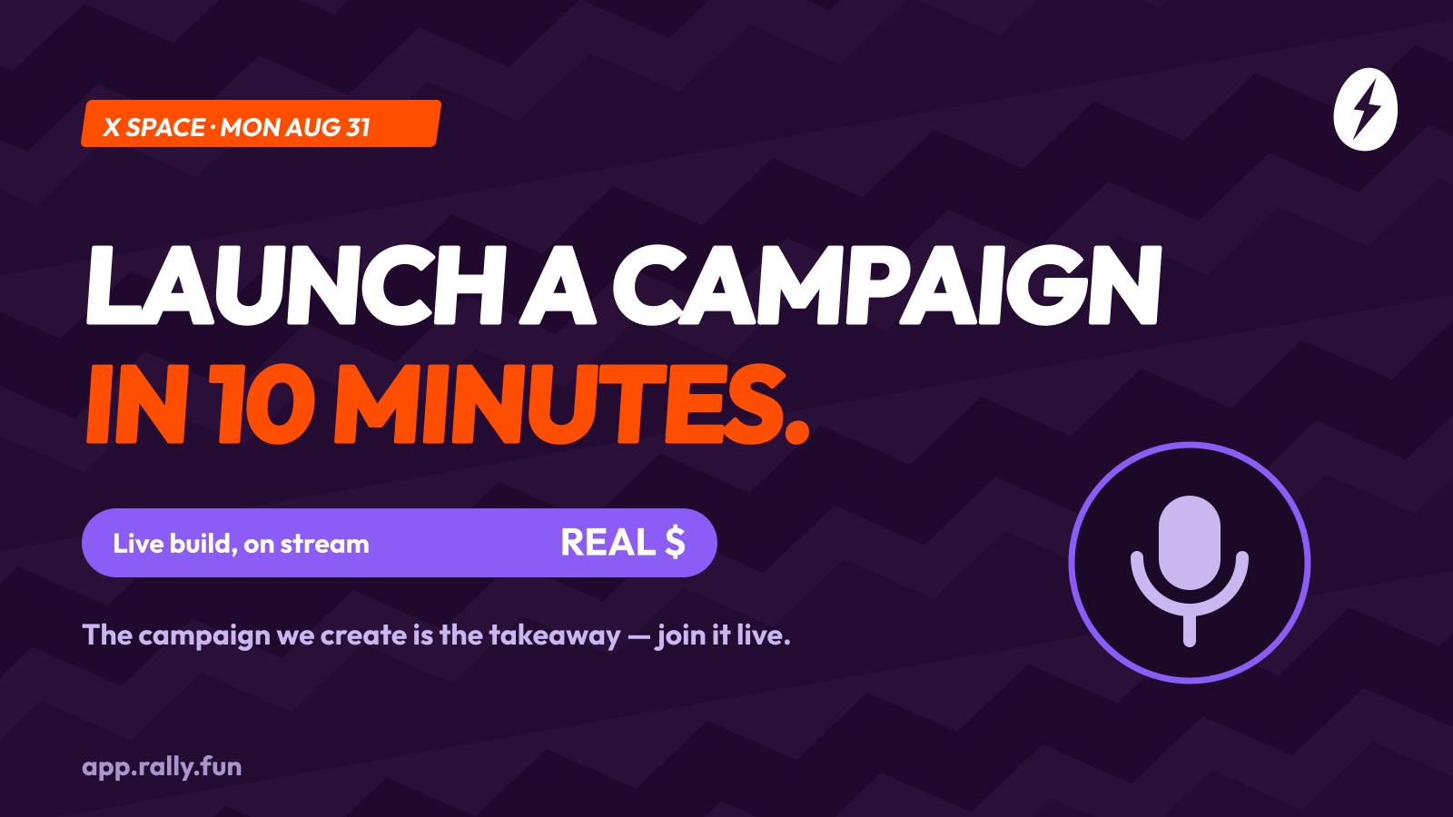
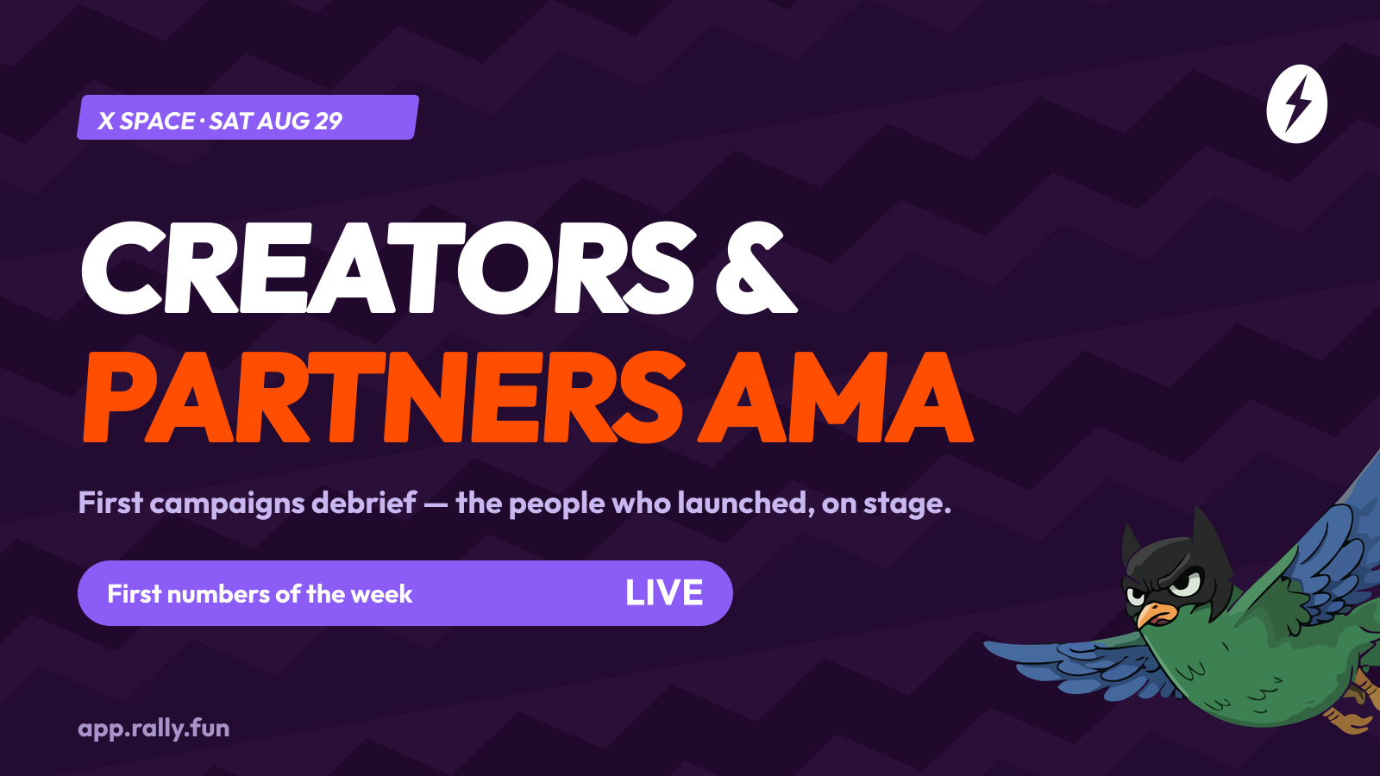
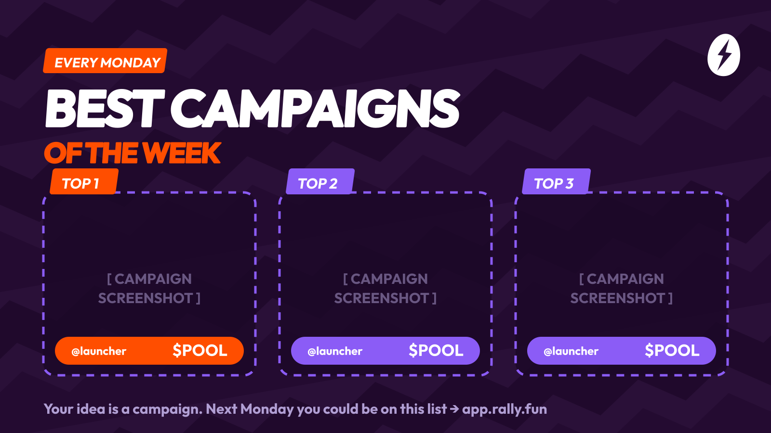
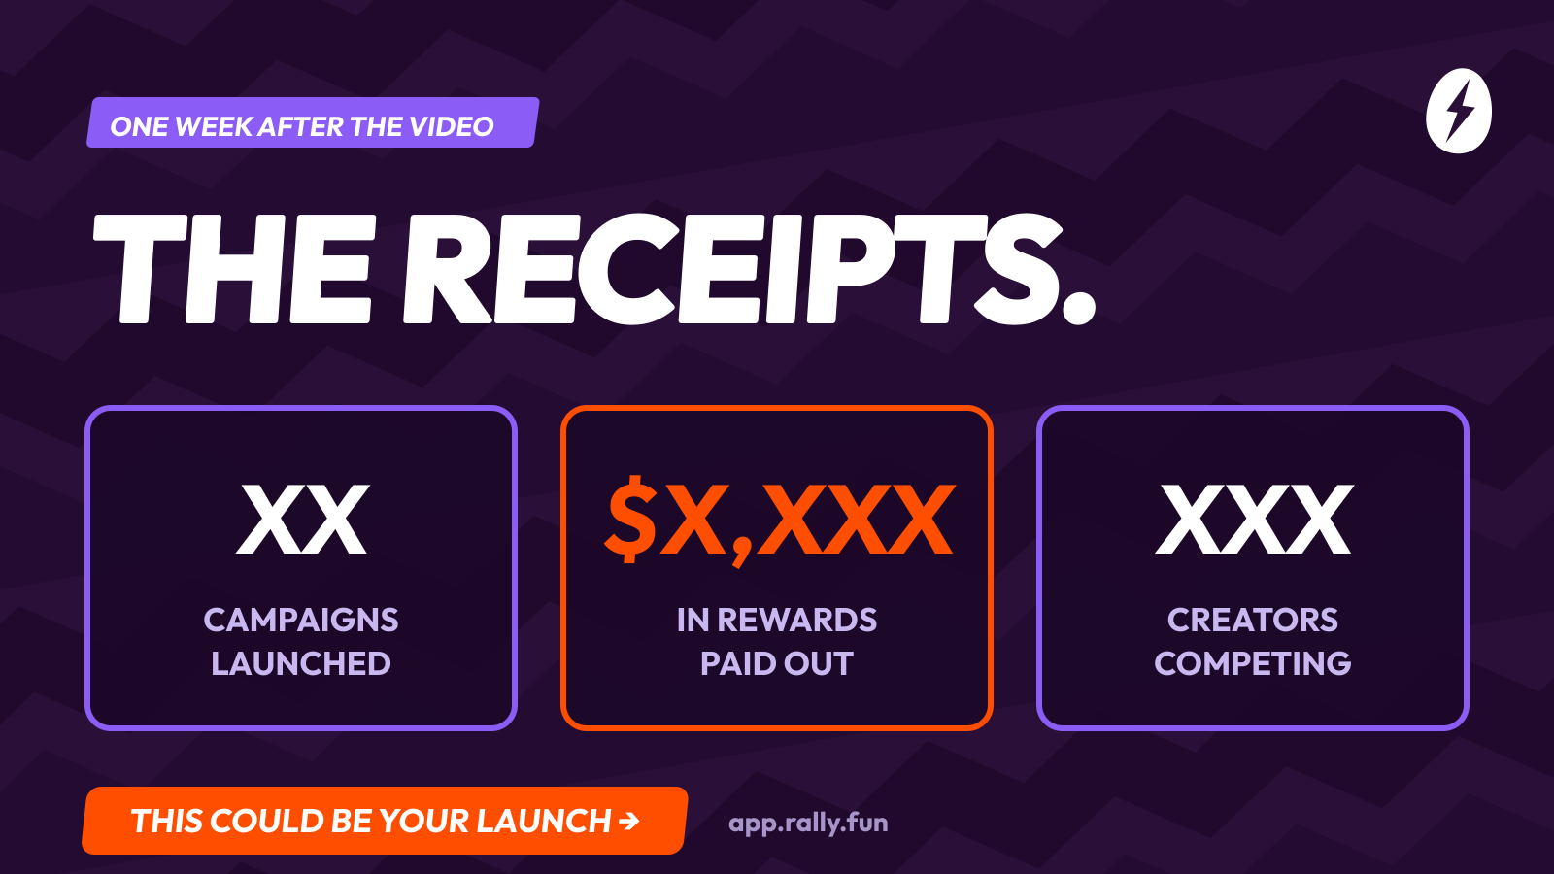
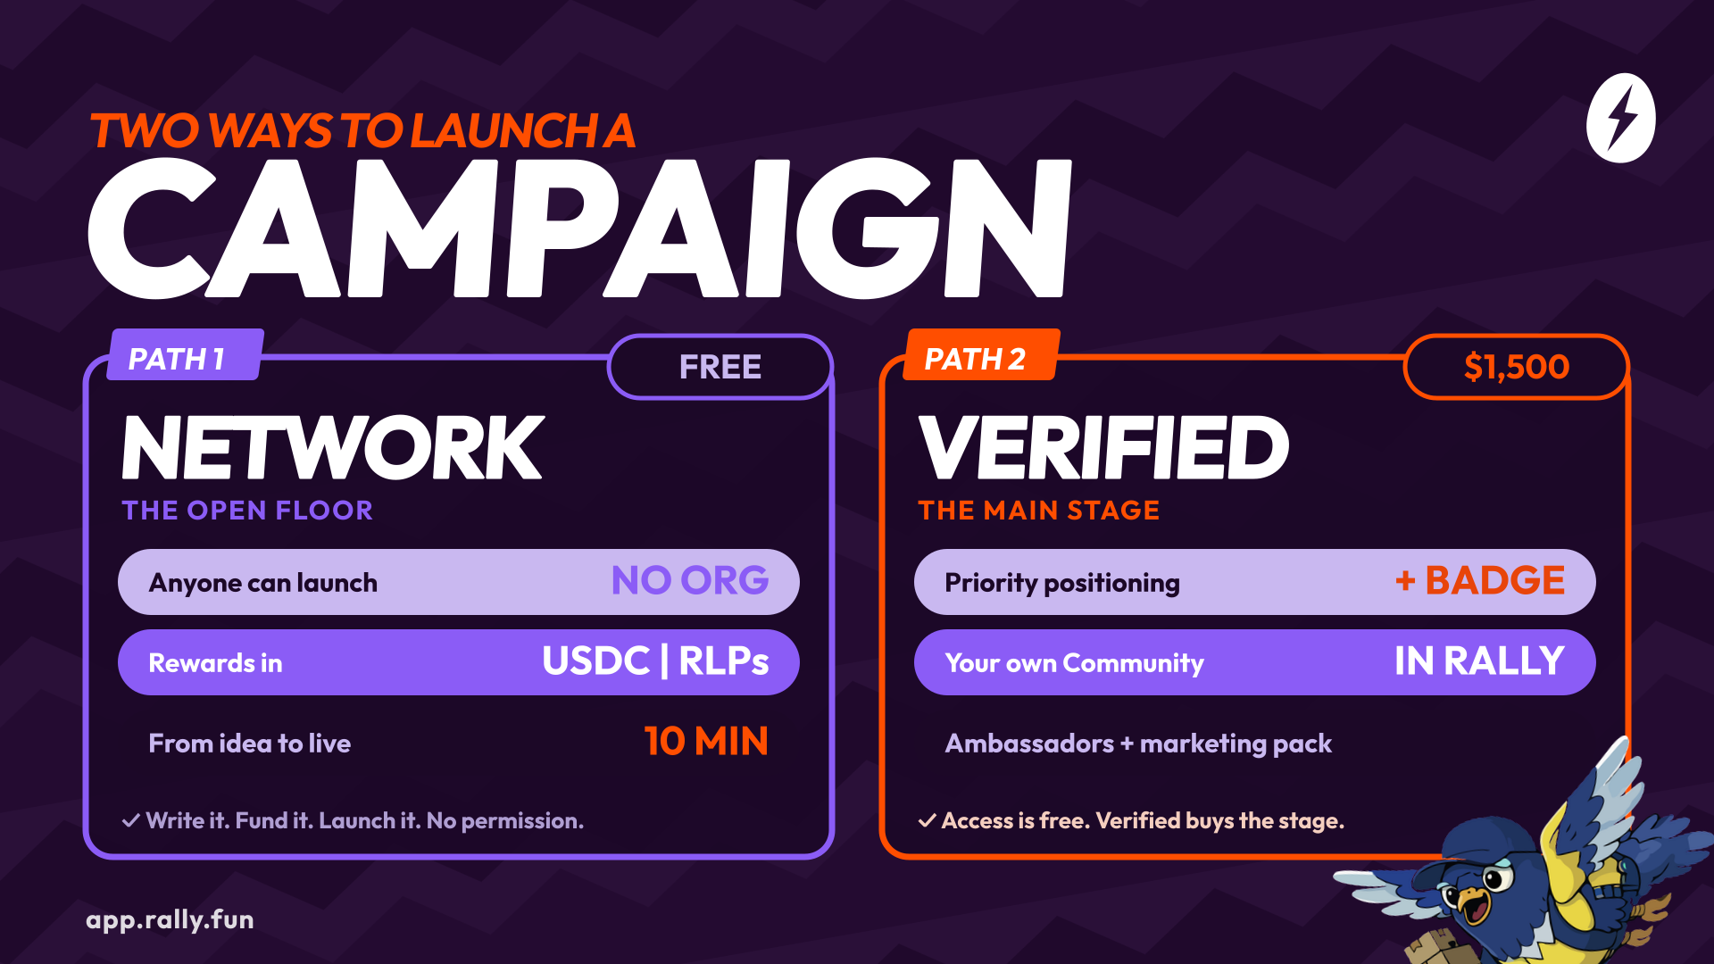
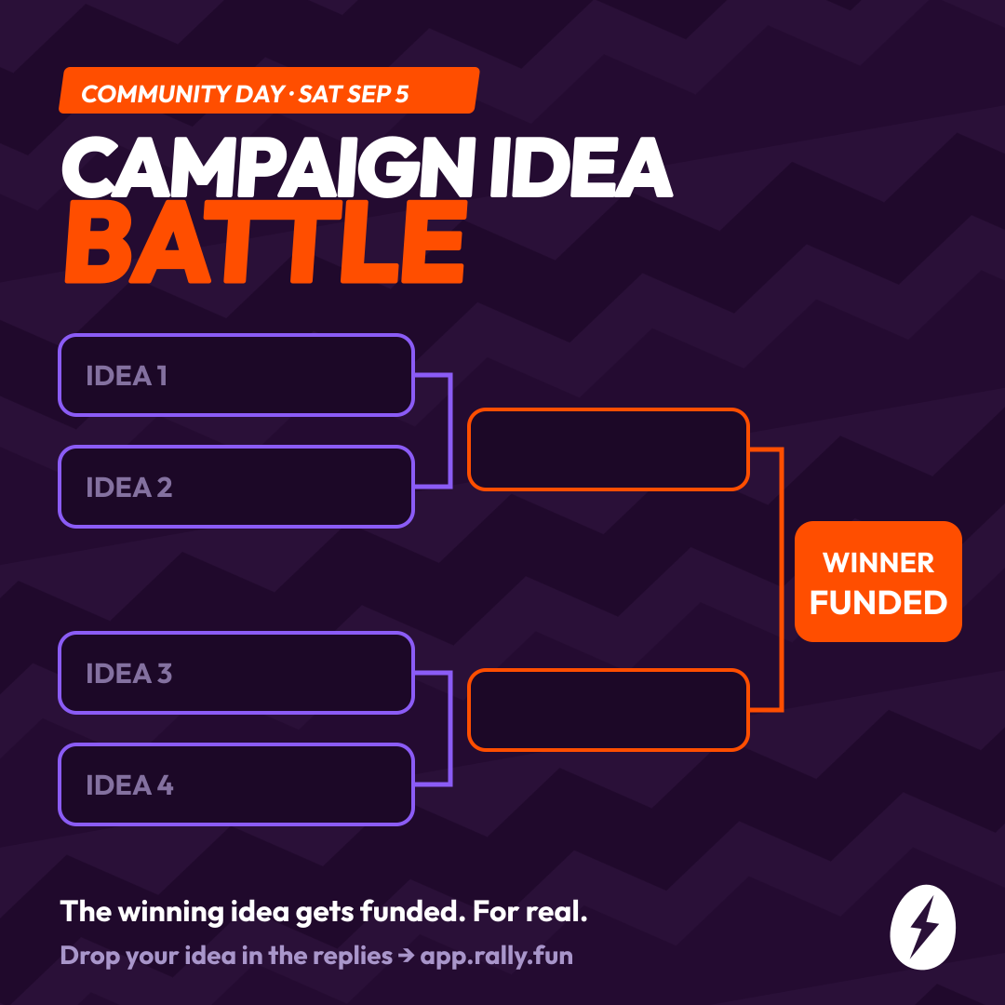
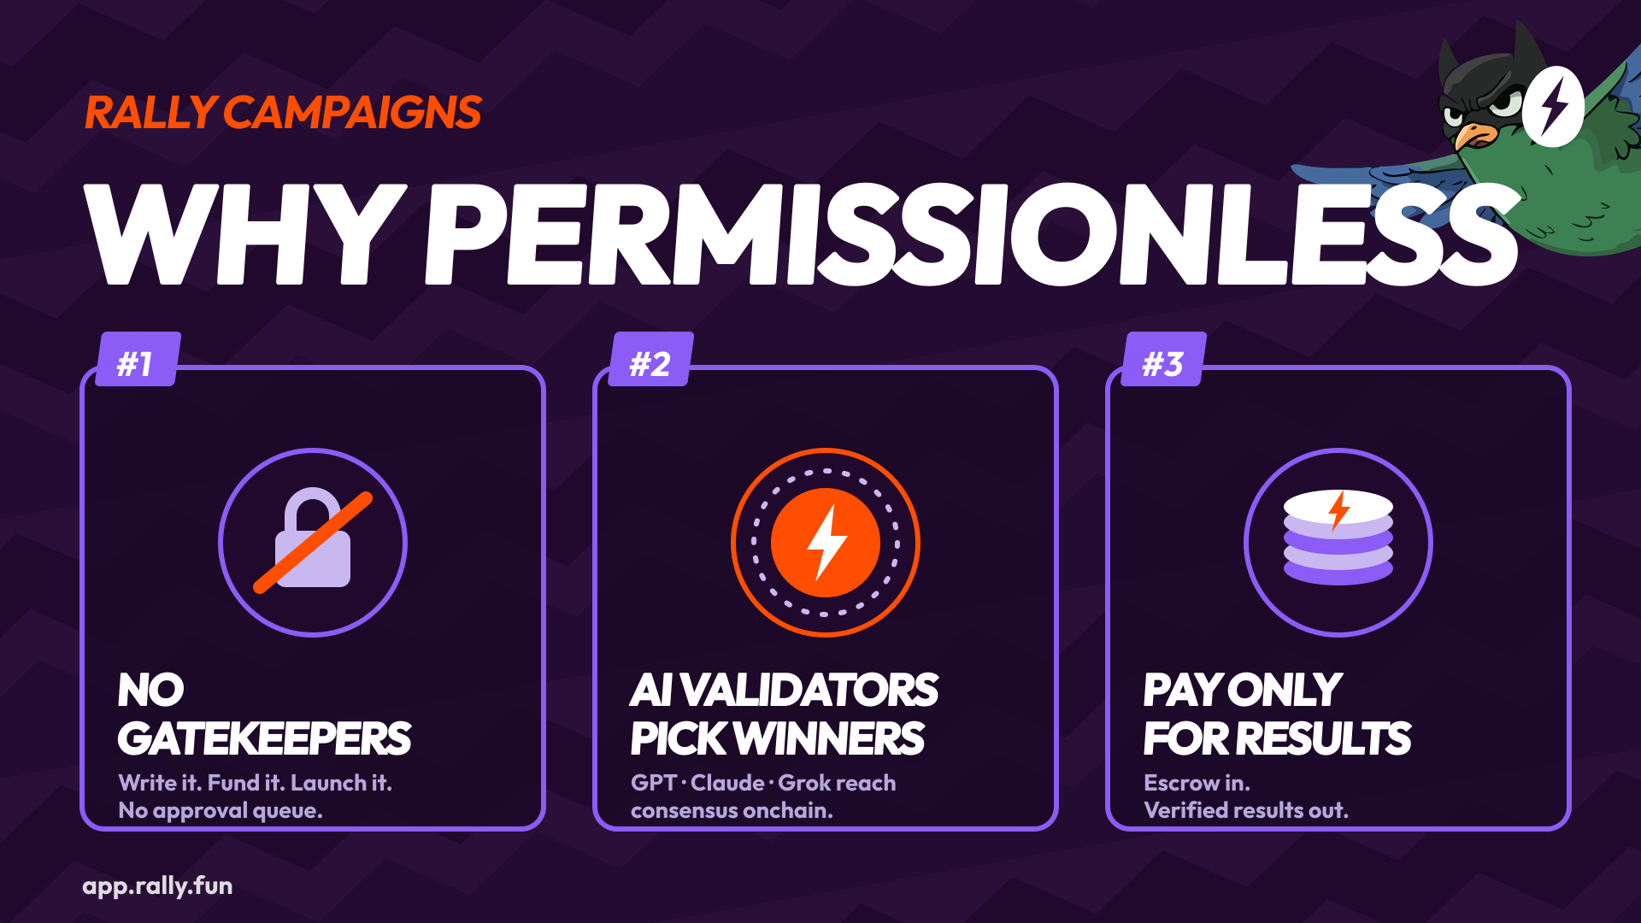
DESIGN KIT · ALREADY PRODUCED
MASTER DOC ▸
Sales, Spaces & weekly templates
CALL FOR PROJECTS · FRI AUG 28
SPACE LIVE DEMO · MON AUG 31
CREATORS & PARTNERS AMA · AUG 29
SPOTLIGHT TEMPLATE · EVERY MON
CASE STUDY “RECEIPTS” · FRI SEP 4
NETWORK VS VERIFIED · FRI AUG 28
STILL WITH DESIGN/EDITOR
Demo Video edit · cutdowns 15/30s · KOL clips · lower-thirds
VERIFIED ONE-PAGER · THU AUG 27
17 static assets produced in Rally's graphic line — regenerable in minutes (copy, dates, sizes).
IDEA BATTLE · SAT SEP 5
WHY PERMISSIONLESS · W1

Slide 12
“The campaign button belongs
to everyone now.”
4 pillars · 3 objectives · 12 days · everything written.
Greenlight this week = we ship Wednesday Aug 26.
Master Doc — plan, copy, scripts, design ▸

