Slide 1

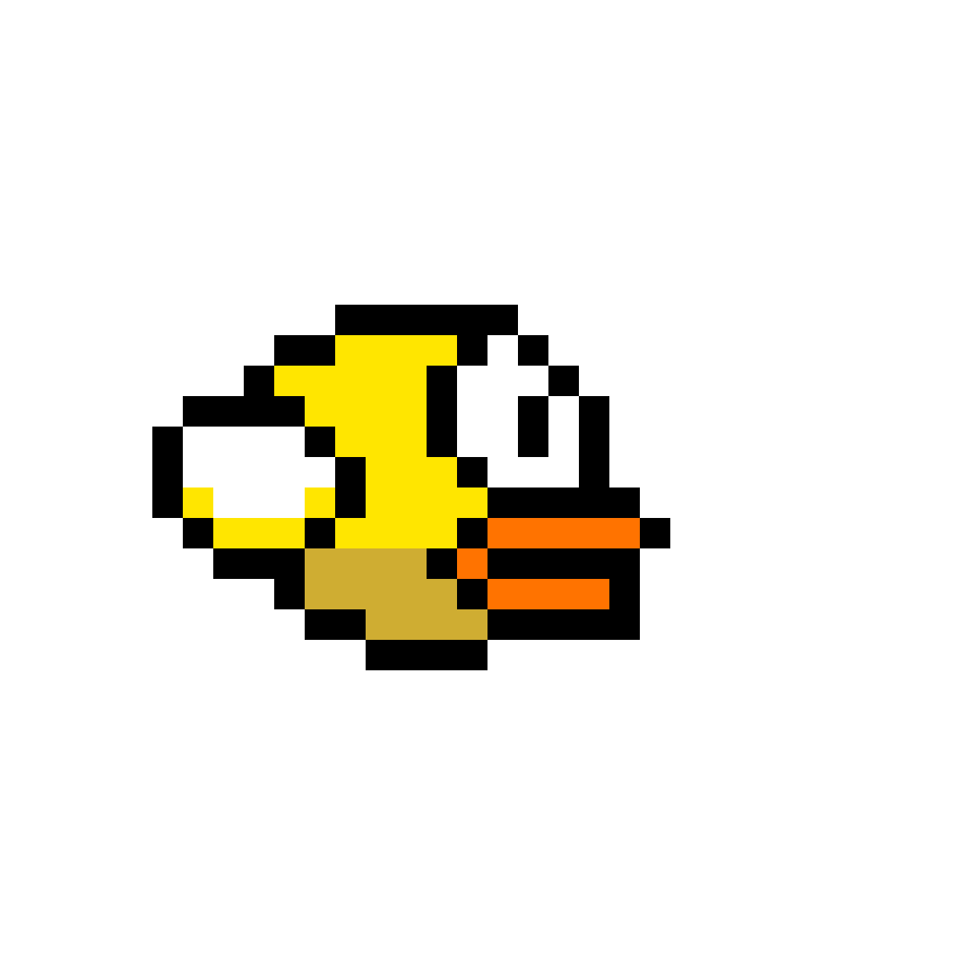

Team 4
Java Bootcamp project

Slide 2
Business analysis and analysis of given input
This project was created with educational purposes only.
As starting point of project was a classic FlappyBird tutorial. Our goals for that was:
Adding graphically localised playground.
Adding features, which was absent in original game,
like a Score counter, Sound, Hiscores, 3 lives and increasing.
Adding feature to change 3 different backgrounds
and 3 different birds.
Customisable game settings – sound volume adjustement
and silent mode.
Ability to launch on Android devices (APK file) and Desktop.
Project documentation.

Slide 3
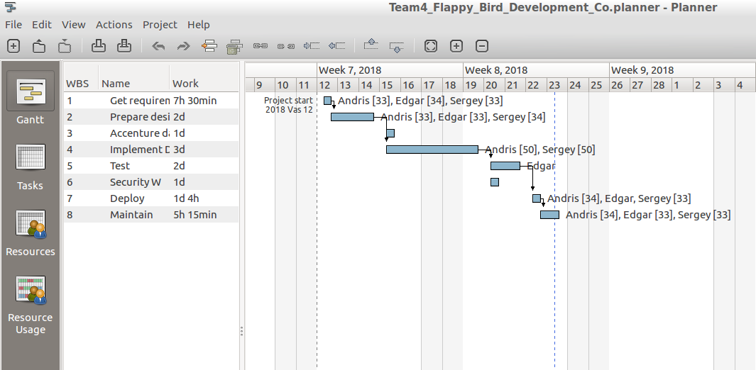
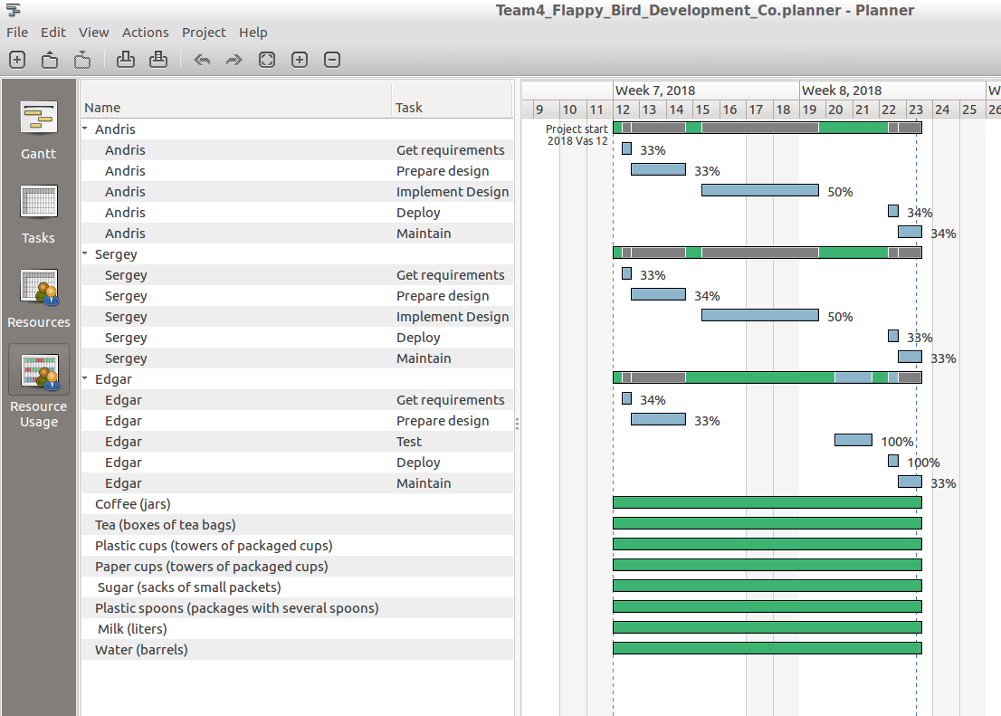




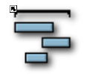

Project planning and used tools
Planner (Linux)
Android Studio
GitHub Issue
Tracker
Libre Office
GIMP Image
Editor
Paper notebooks

Slide 4
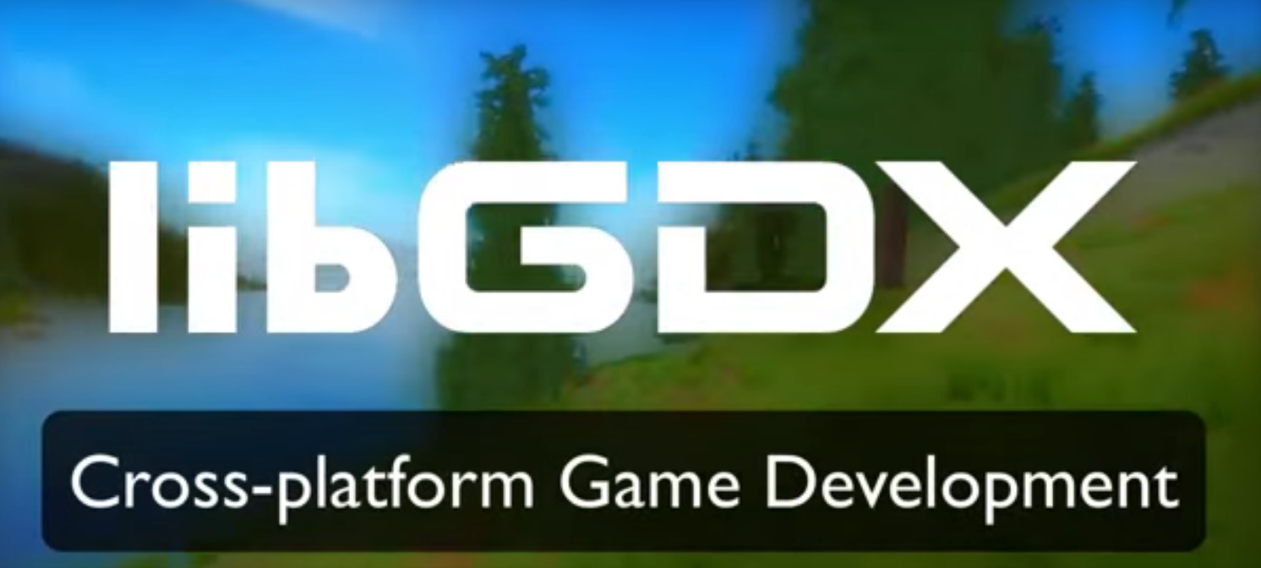
System overall design
Lib GDX Java game development framework

Slide 5
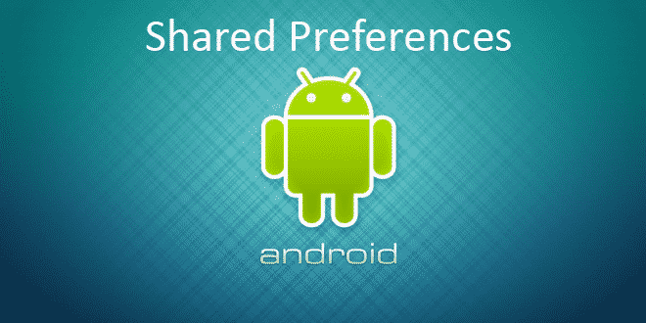
System data model
Project data (Game preferences and hiScores) stored using standard Android Shared Preferences.

Slide 6
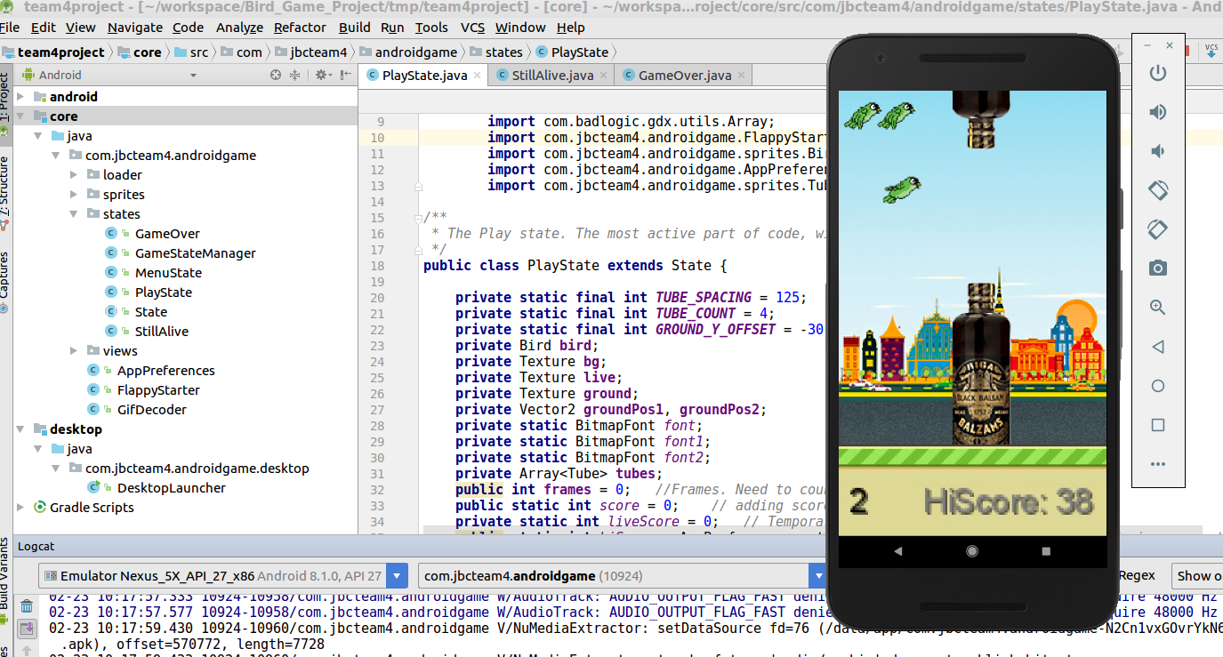
Testing
Due to game specific, project was manually tested on differend android devices, virtual Android Emulator and desktop PC.

Slide 7

System building and deployment
Project compiled and deployed using Android Studio + GitHub plugin.

Slide 8

URL to project resources
GitHub:
https://github.com/sergioko737/team4project
Lib GDX:
https://libgdx.badlogicgames.com/
Lib GDX GIF Animation:
https://stackoverflow.com/
APK file:
https://yadi.sk/d/JBLt4sv13SgRxd

Slide 9

Main features of the project
Graphically localised playground.
Features, which was absent in original
game, like a Score counter, Sound,
Hiscores, 3 lives and increasing.
Feature to change 3 different
backgrounds and 3 different birds.
Customisable game settings – sound
volume adjustement and silent mode.
Product placement ;)

Slide 10
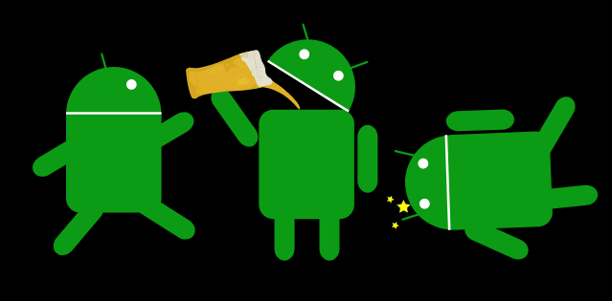
Team members and their main contribution to project
Sergej Kostjuchenko
Coding, testing, system analyze
Andris Magins
Coding, testing, code merging
Edgars Lukjanovichs
Graphical elements, coding, testing

Slide 11
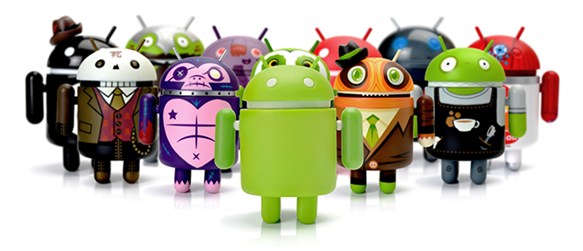
Biggest challenges in the project and lessons learned
On start of project was needed to understand how to use GDX Framework.
Teamwork – planning, workflow separation, code merging and distribution.

