Slide 1


Monitorización: Icinga & PandoraFMS TG1

Slide 2
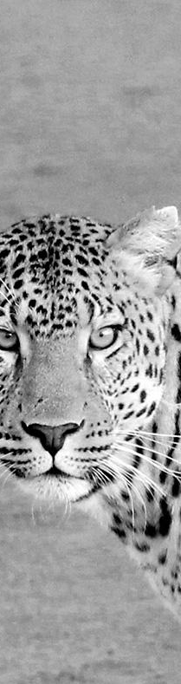
¡Hola!
Somos el grupo 6
Integrantes del grupo:
Sergio Martín Míguez (Coordinador)
Iván Alejandro Marugán
Daniel Corral García
Juan Felipe Martín Martín
Silvia del Valle Recio

Slide 3
1.
Descripción del tipo de tecnología
Aspectos a tener en cuenta sobre la monitorización.

Slide 4
La monitorización es la supervisión continua y generación de alertas de los estados de los servicios o hosts.

Slide 5


Sistema multiplataforma
Posee código abierto, vigila equipos y servicios.
Funciona mediante un sistema de alertas.

Slide 6
Sistema multiplataforma
Posee código abierto, monitoriza sistemas, aplicaciones o dispositivos de red.
Funciona mediante un sistema de alertas con o sin agentes.

Slide 7
3.
Fuentes de Información
Todo sobre Monitorización, Icinga y PandoraFMS

Slide 8


Fuentes de Monitorización
TFG: UAB – Víctor Arrebola
Trabajo donde se explica la viabilidad, los casos de uso, el diseño del sistema y la implementación de un sistema de monitorización.
Paper: IaasMon
POC donde muestra una tabla comparativa entre distintas tecnologías (Icinga, Zabbix…) y flujos de trabajo de los sistemas de monitorización.
Enlace: TFG: UAB – Victor Arrebola
Enlace: POC - IaasMon
SUB-Reddit: Monitoring
Sub-foro con sistema Q&A con mucha cantidad de información útil, reviews, opiniones… sobre el mundo de la monitorización.
Serverfault: Monitoring
Sub-foro con sistema Q&A con mucha cantidad de información útil, reviews, opiniones… sobre el mundo de la monitorización.
Enlace: https://www.reddit.com/r/Monitoring
Enlace: http://serverfault.com/questions/tagged/monitoring

Slide 9

https://icinga.com
Página web oficial del sistema de monitorización Icinga y sus dos versiones: Icinga1 e Icinga2. En ella se encuentra todo lo relacionado a la tecnología.
Github Icinga
Backup de la Wiki de Icinga1 donde aparecen ejemplos de código de servicios/hosts, guías de instalación, plugins, tests…
Open Hub: Icinga
Resumen completo del proyecto PandoraFMS de parte de Open Hub, muestra toda la información relativa al proyecto.
Enlace: https://www.icinga.com
Enlace: https://github.com/icinga
Enlace: https://www.openhub.net/p/icinga
https://pandorafms.com
Página web oficial del sistema de monitorización PandoraFMS. En ella se encuentra todo lo relacionado a la tecnología: Plugins, soporte, documentación, precios, cursos de entrenamiento...
Open Hub: PandoraFMS
Resumen completo del proyecto PandoraFMS de parte de Open Hub, muestra toda la información relativa al proyecto.
Enlace: https://pandorafms.com
Enlace: https://www.openhub.net/p/PandoraFMS

Slide 10
6.
Ayudas para estudiar las tecnologías.

Slide 11
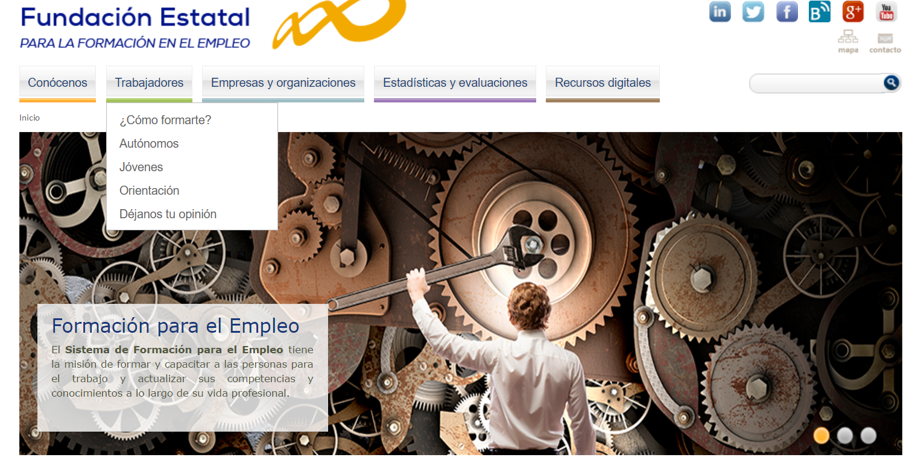
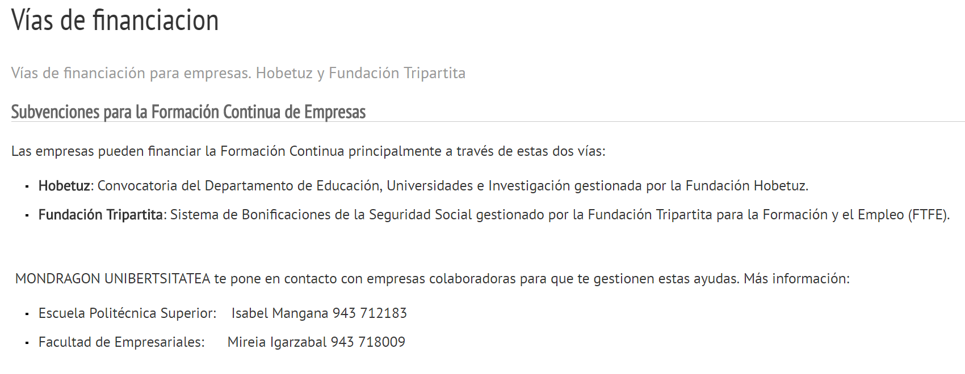
Ayudas

Slide 12
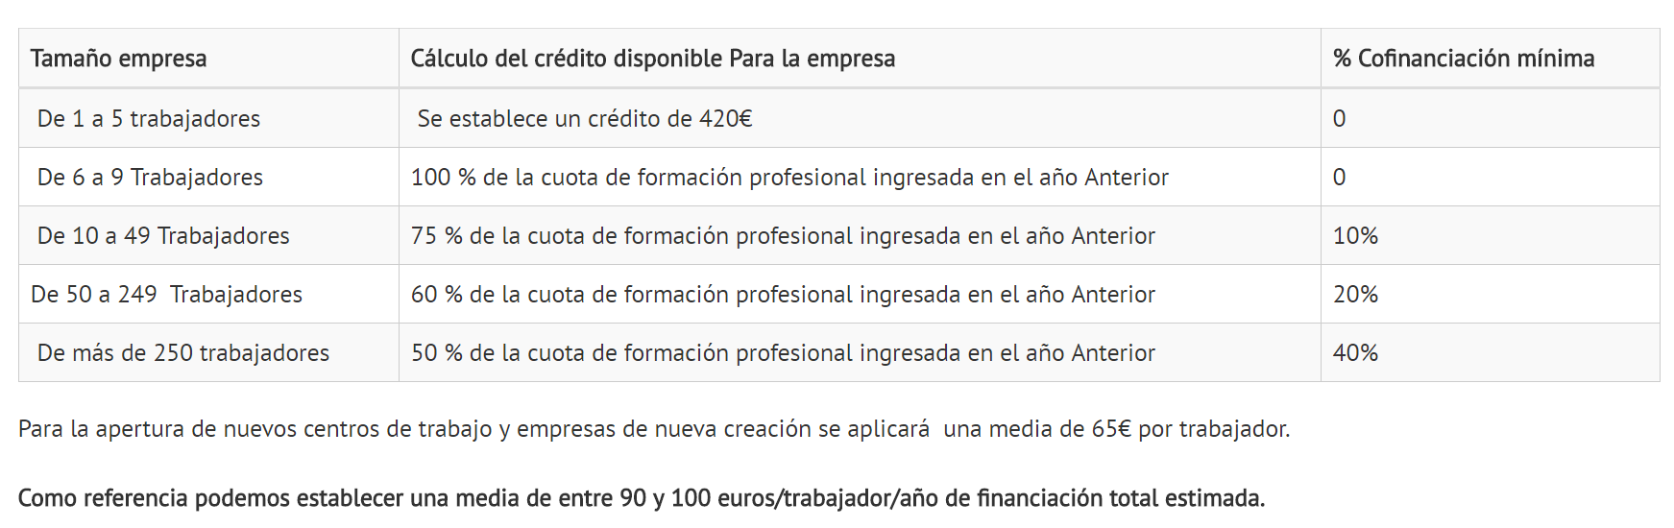
Créditos de financiación

Slide 13
7.
Recursos para implementar las tecnologías

Slide 14
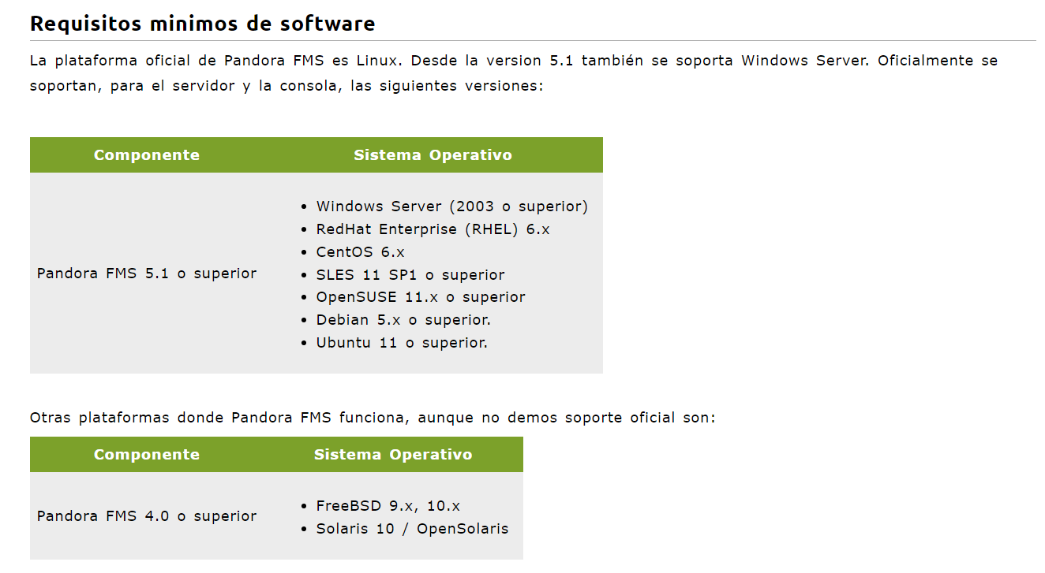
Recursos PandoraFMS

Slide 15
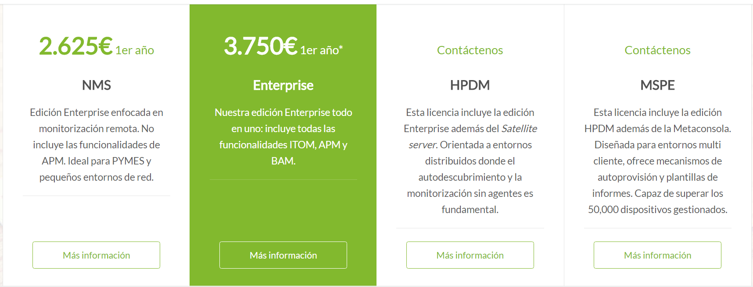
Planes de pago

Slide 16
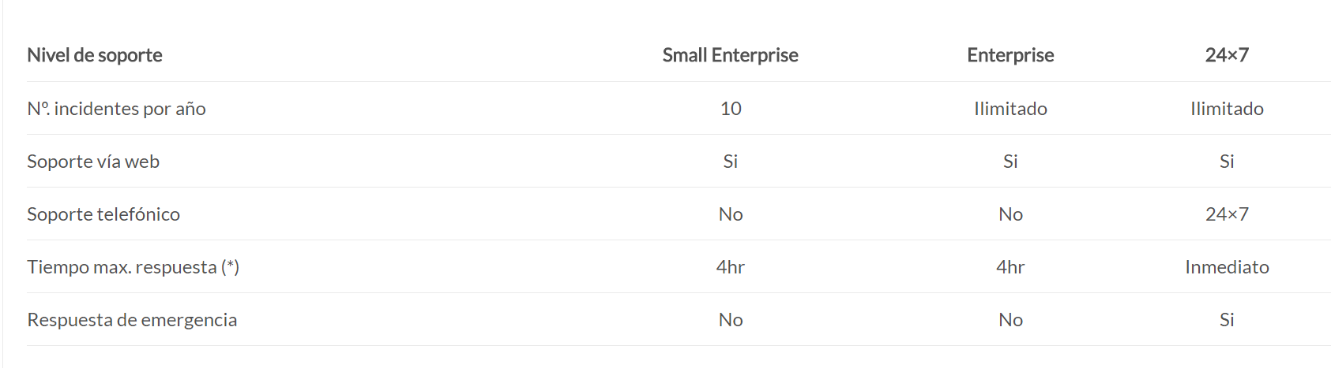
Servicio de soporte

Slide 17

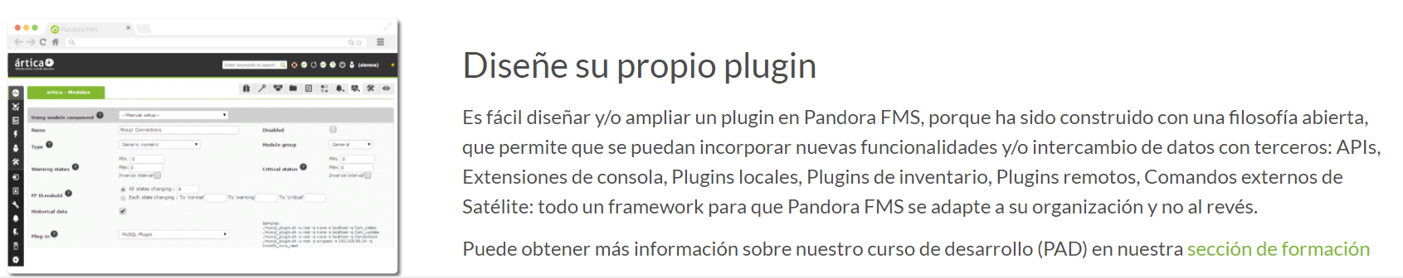
Plugins

Slide 18
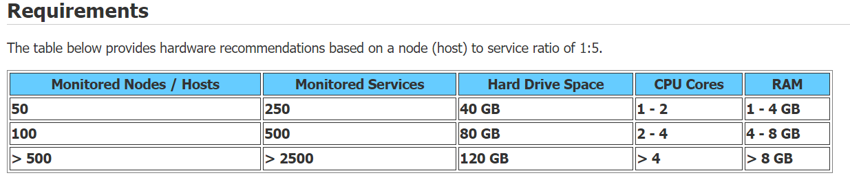
Recursos nagios

Slide 19
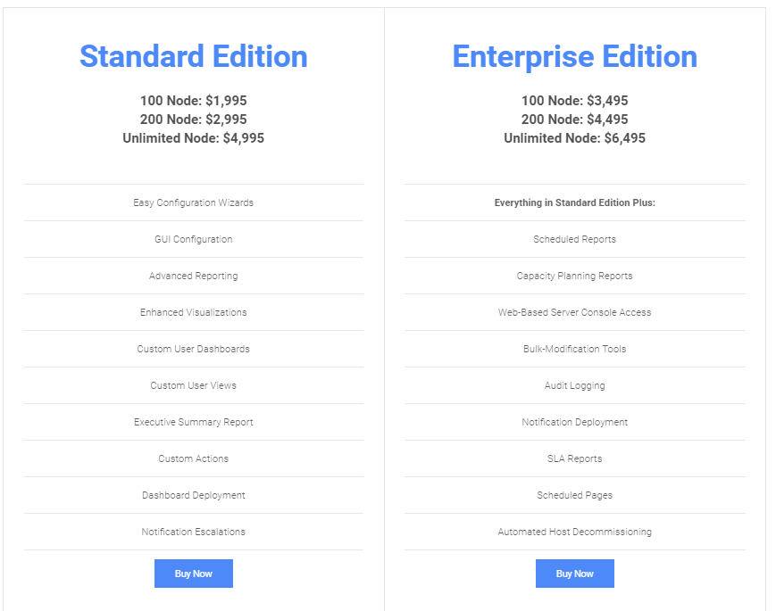
Versiones

Slide 20
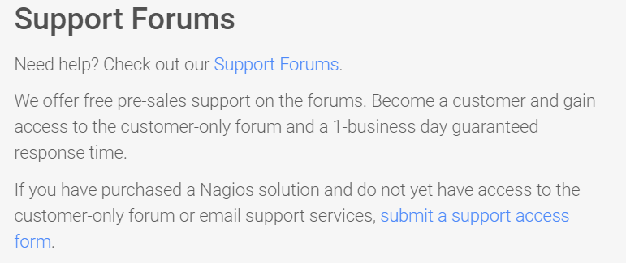
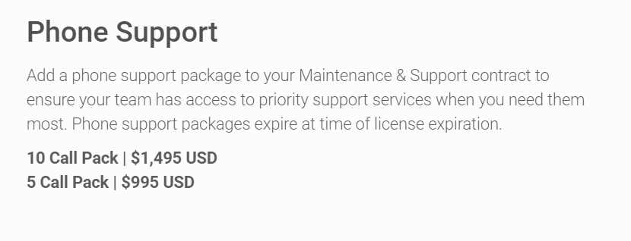
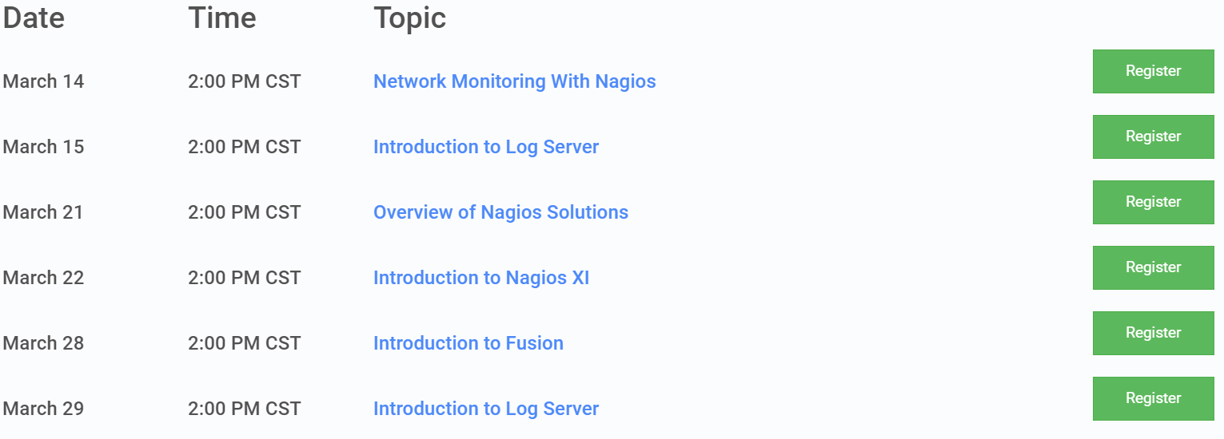
Pack de soporte telefónico y webinars…

Slide 21
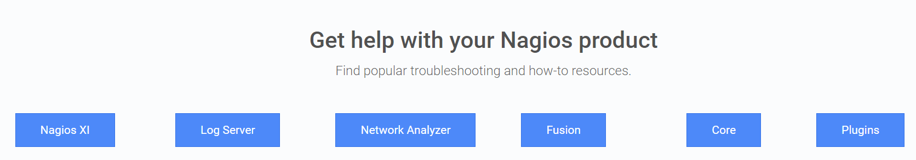
Librerías

Slide 22
This is a slide title
Here you have a list of items
And some text
But remember not to overload your slides with content
You audience will listen to you or read the content, but won’t do both.

Slide 23
Big concept
Bring the attention of your audience over a key concept using icons or illustrations

Slide 24
You can also split your content
White
Is the color of milk and fresh snow, the color produced by the combination of all the colors of the visible spectrum.
Black
Is the color of coal, ebony, and of outer space. It is the darkest color, the result of the absence of or complete absorption of light.

Slide 25
In two or three columns
Yellow
Is the color of gold, butter and ripe lemons. In the spectrum of visible light, yellow is found between green and orange.
Blue
Is the colour of the clear sky and the deep sea. It is located between violet and green on the optical spectrum.
Red
Is the color of blood, and because of this it has historically been associated with sacrifice, danger and courage.

Slide 26
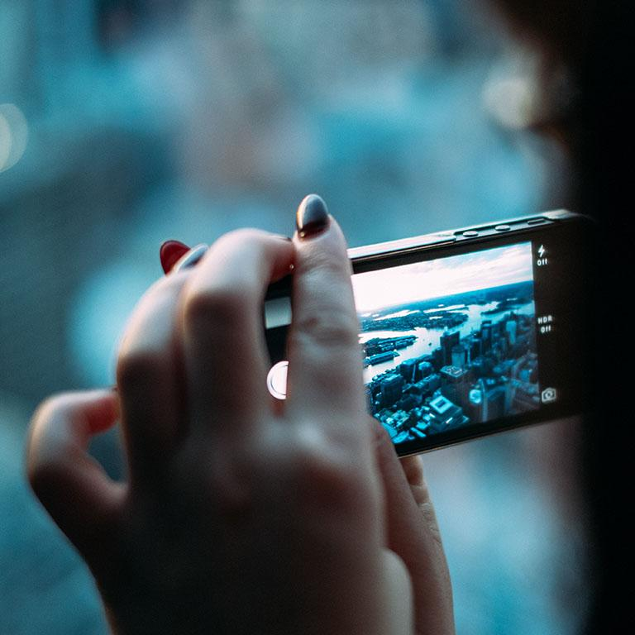
A picture is worth a thousand words
A complex idea can be conveyed with just a single still image, namely making it possible to absorb large amounts of data quickly.

Slide 27
Want big impact?
Use big image.

Slide 28
Use charts to explain your ideas
White
Gray
Black

Slide 29
And tables to compare data
 | A | B | C
Yellow | 10 | 20 | 7
Blue | 30 | 15 | 10
Orange | 5 | 24 | 16

Slide 30

Maps
our office

Slide 31
89,526,124
Whoa! That’s a big number, aren’t you proud?

Slide 32
89,526,124$
185,244 users
100%
That’s a lot of money
And a lot of users
Total success!

Slide 33
Our process is easy
First
Second
Last

Slide 34
Let’s review some concepts
Yellow
Is the color of gold, butter and ripe lemons. In the spectrum of visible light, yellow is found between green and orange.
Blue
Is the colour of the clear sky and the deep sea. It is located between violet and green on the optical spectrum.
Red
Is the color of blood, and because of this it has historically been associated with sacrifice, danger and courage.
Yellow
Is the color of gold, butter and ripe lemons. In the spectrum of visible light, yellow is found between green and orange.
Blue
Is the colour of the clear sky and the deep sea. It is located between violet and green on the optical spectrum.
Red
Is the color of blood, and because of this it has historically been associated with sacrifice, danger and courage.

Slide 35
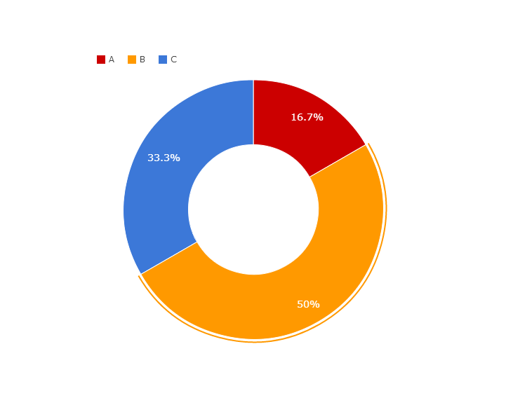
You can copy&paste graphs from Google Sheets

Slide 36
Android project
Show and explain your web, app or software projects using these gadget templates.
Place your screenshot here

Slide 37
iPhone project
Show and explain your web, app or software projects using these gadget templates.
Place your screenshot here

Slide 38
Tablet project
Show and explain your web, app or software projects using these gadget templates.
Place your screenshot here

Slide 39
Place your screenshot here
Desktop project
Show and explain your web, app or software projects using these gadget templates.

Slide 40
Thanks!
Any questions?
You can find me at:
@username
user@mail.me

Slide 41
Credits
Special thanks to all the people who made and released these awesome resources for free:
Presentation template by SlidesCarnival
Photographs by Unsplash

Slide 42

Presentation design
This presentations uses the following typographies and colors:
Titles: Raleway
Body copy: Lato
You can download the fonts on this page:
https://www.google.com/fonts#UsePlace:use/Collection:Lato:400,700,400italic,700italic|Raleway:400,700
Click on the “arrow button” that appears on the top right
Dark blue #2185c5
Light blue #7ecefd
Yellow #ff9715
Magenta #f20253
Dark gray #677480
Light gray #97abbc
You don’t need to keep this slide in your presentation. It’s only here to serve you as a design guide if you need to create new slides or download the fonts to edit the presentation in PowerPoint®

Slide 43
SlidesCarnival icons are editable shapes.
This means that you can:
Resize them without losing quality.
Change fill color and opacity.
Change line color, width and style.
Isn’t that nice? :)
Examples:

Slide 44
😉
Now you can use any emoji as an icon!
And of course it resizes without losing quality and you can change the color.
How? Follow Google instructions https://twitter.com/googledocs/status/730087240156643328
✋👆👉👍👤👦👧👨👩👪💃🏃💑❤😂😉😋😒😭👶😸🐟🍒🍔💣📌📖🔨🎃🎈🎨🏈🏰🌏🔌🔑 and many more...

