Slide 1
Homework Challenge 1 solution

Slide 2
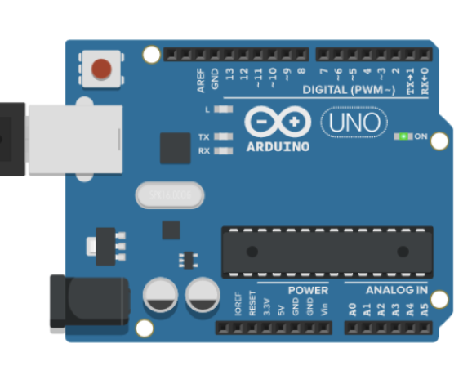

Shall we move a turtle?
2
A turtle holding a pen…

Slide 3
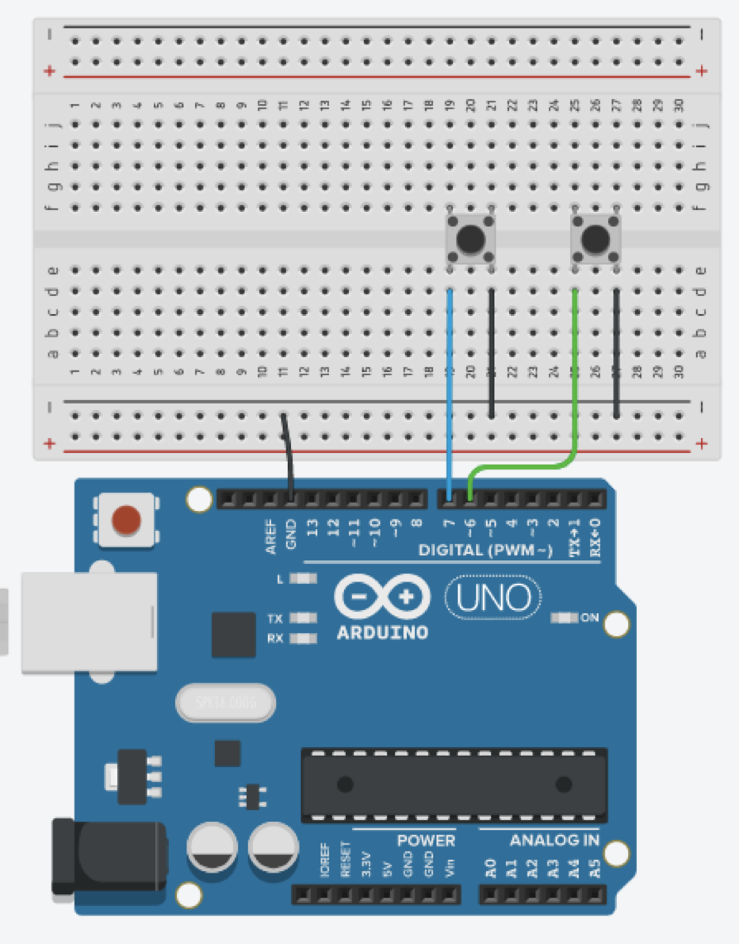
Arduino side:
3
Assemble this two button circuit of (in this case, connected to pins #6 and #7 using the arduino internal pullup resistor).
Use the Arduino program provided in the skeleton, that reads the state of the two buttons.
Notes:
o timeout = 0.1 retorna -1 no caso de não estar a ler nada

Slide 4
Arduino side:
4
When the button on the left is pressed, the character 'L' should be printed on the serial port, and the character 'R' should be printed when it happens with the button on the right.
The state of the buttons is updated every 50ms (why?) - that is, the reading of the digital pin for each button should be performed and reported (via serial port) at intervals of 50ms.
Notes:
o timeout = 0.1 retorna -1 no caso de não estar a ler nada

Slide 5
A possible solution (Arduino Side)
5
#define ButtonA 6
#define ButtonB 7
long ellapsed;
void setup() {
pinMode (ButtonA,INPUT_PULLUP);
pinMode (ButtonB,INPUT_PULLUP);
Serial.begin (9600);
ellapsed=millis();
}
void loop() {
if (millis()-ellapsed>50){
bool R = !digitalRead(ButtonA);
bool L = !digitalRead(ButtonB);
ellapsed=millis();
if (R && L) Serial.println('X');
else {
if (R) Serial.println('R');
if (L) Serial.println('L');
}
}
}
Notes:
o timeout = 0.1 retorna -1 no caso de não estar a ler nada

Slide 6
What now?
Now we need for you to write a program that receives the ’L’ or ´R’ characters and moves a dot, or ball.
A suggestion: use a PVector to store the object (dot, ball) coordinates and a another PVector to add to the object PVector on each draw().
You have the rotate method to help you…

Slide 7
PVector heading;
PVector turtle;
long count=0;
void setup() {
size(800,800);
heading= new PVector(1,0);
turtle= new PVector(400,400);
}
void draw(){
ellipse(turtle.x,turtle.y,10,10);
turtle.add(heading);
if (count==0) heading.rotate(random(-10,10));
count=(count+1)%100;
println(count);
}
An example
for PVector

Slide 8
PVector heading, turtle;
void setup() {
size(800,800);
String portName = Serial.list()[1]; //change to match your port
myPort = new Serial(this, portName, 9600);
myPort.bufferUntil('\n');
myPort.clear();
heading= new PVector(1,0);
turtle= new PVector(400,400);
}
void draw(){
ellipse(turtle.x,turtle.y,10,10);
turtle.add(heading);
}
void serialEvent(Serial myPort) {
try{
val = myPort.readStringUntil('\n');
String SP=trim(val);
if (SP!=null) {
if (SP.equals("R")) heading.rotate(radians(10));
if (SP.equals("L")) heading.rotate(radians(-10));
if (SP.equals("X")) exit();
}
} catch (Exception e) {
e.printStackTrace();
}
}
Processing
solution

Slide 9
A more elegant solution for the first class challenge
9

Slide 10
import processing.serial.*;
ball b;
Serial myPort;
void setup(){
size(1024,1024);
String portName = Serial.list()[1]; //choose the right serial port
myPort = new Serial(this, portName, 9600);
b=new ball(width/2,height/2,20);
}
void draw(){
background(255);
b.move();
b.show();
b.collide();
}
void serialEvent(Serial myPort) {
try {
char cmd = (char) myPort.read();
b.steer(cmd);
}
catch (Exception e) {
e.printStackTrace();
}
}
void keyPressed() {
b.steer(key);
}
10
A possible solution, Pt1 (Processing)
Notes:
o timeout = 0.1 retorna -1 no caso de não estar a ler nada

Slide 11
A possible solution, Pt2 (Processing, class to handle ball)
class ball{
PVector pos, dir;
int rad;
ball(int _x, int _y, int _rad) {
pos=new PVector(0,0);
dir=new PVector(0,0);
pos.x=_x;
pos.y=_y;
rad=_rad;
dir.x=0;
dir.y=-1;
}
void steer(char cmd){
if (cmd=='L') dir.rotate(radians(-0.2));
else if (cmd=='R') dir.rotate(radians(0.2));;
}
void move(){
pos.add(dir);
}
void collide(){
PVector plim=new PVector();
plim=PVector.add(pos,dir);
if ((plim.x>width-rad) || (plim.x<rad)) dir.rotate(2*(HALF_PI-dir.heading()));
if ((plim.y>width-rad) || (plim.y<rad)) dir.rotate(-2*(dir.heading()));
}
void show(){
ellipse(pos.x,pos.y,rad*2,rad*2);
}
}
11
Handles collisions with left or right window limits.
Handles collisions with top or bottom window limits.
Notes:
o timeout = 0.1 retorna -1 no caso de não estar a ler nada

