Slide 1

Sergio Muñoz Villullas

Slide 2


What i'm going to talk about?
-Software
-Hardware
-Peripherals

Slide 3
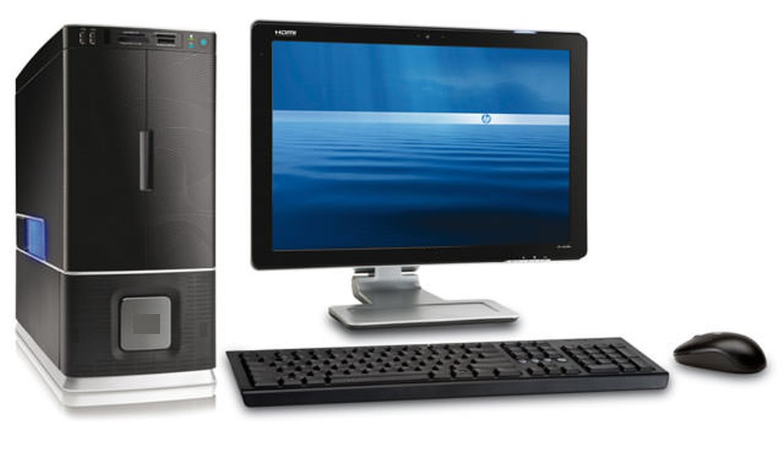
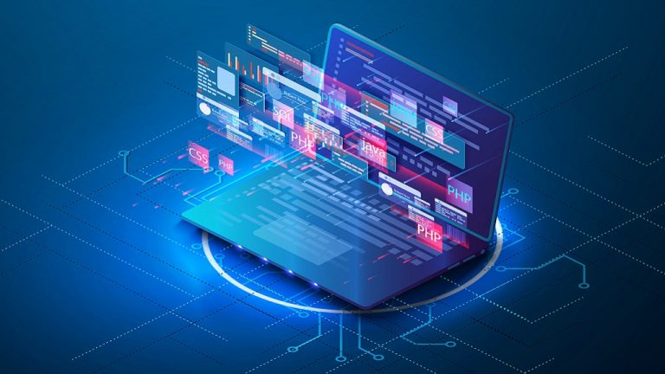
Introduction
Currently, it is very common for people to use computer based in technology without any problem, but many of those people are unaware of the conceptual part and the logical function of the components within a process

Slide 4
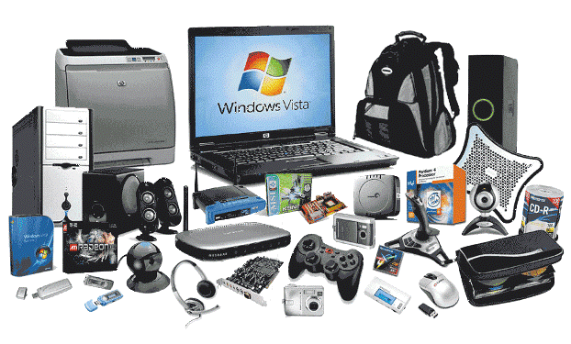
Hardware
Physical components

Slide 5

Peripherals
To carry out all the tasks that a user needs
Three types
Input Peripherals
Output Peripherals
Input and Output Peripherals

Slide 6
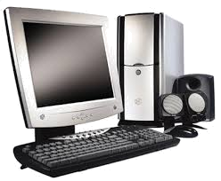
Input peripherals
Enter data

Slide 7
Output peripherals
Obtain data

Slide 8
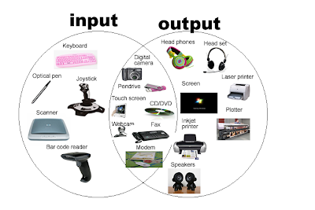
Input and Output peripherals
mixture

Slide 9
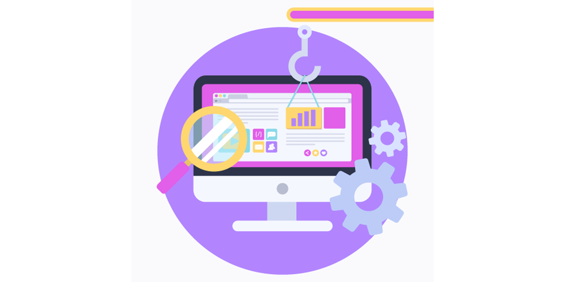
Software
computer programs or applications, instructions and rules

Slide 10
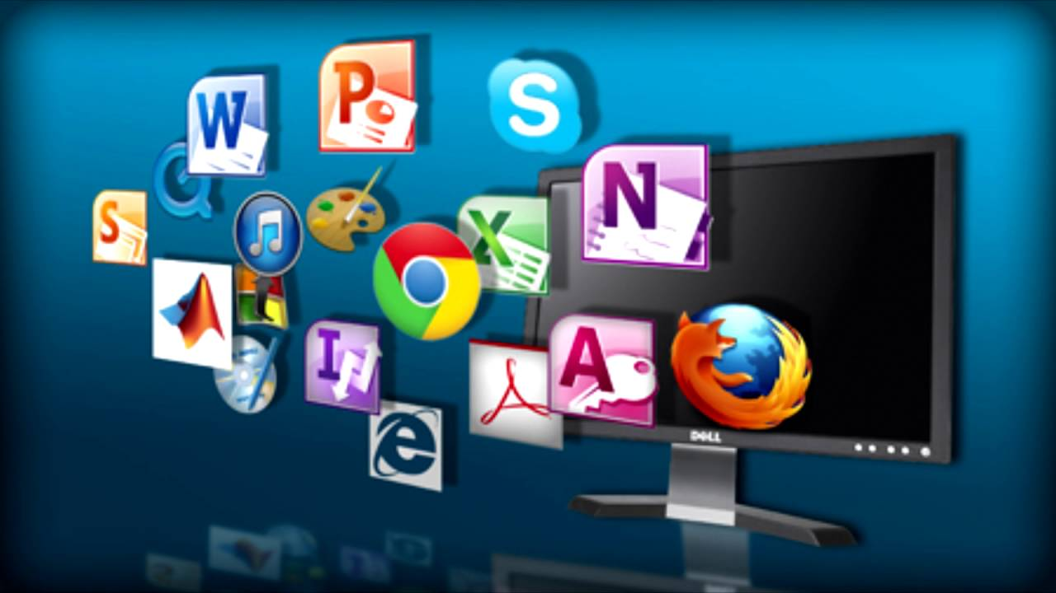
Software examples
Examples

Slide 11
Vocabulary
computer , technology, components, process, hardware, CPU, mouse, keyboard, monitor, hard disk, scanner, speakers, printer, devices, tasks, peripherals, input, output, data, software, browsers

Slide 12

Quiz

Slide 13

The end

