Slide 1

Sergio Muñoz Villullas
Notes:
<número>

Slide 2


What i'm going to talk about?
-Software
-Hardware
-Peripherals
Notes:
<número>

Slide 3
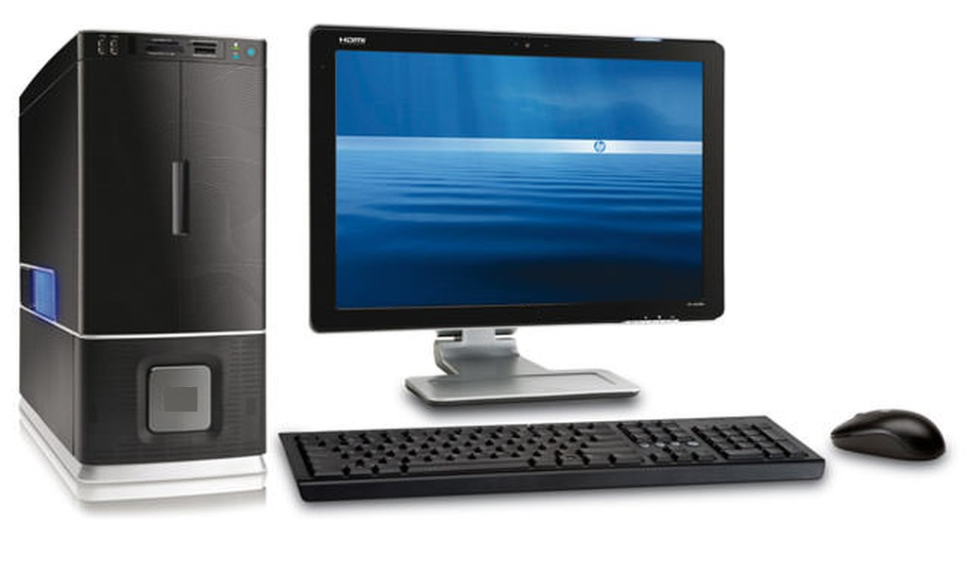
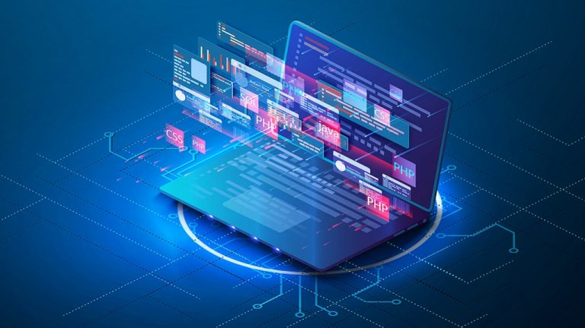
Introduction
Currently, it is very common for people to use computer based in technology without any problem, but many of those people are unaware of the conceptual part and the logical function of the components within a process
8/11/21
<número>
Notes:
<número>

Slide 4
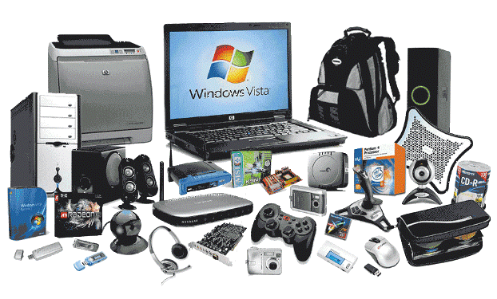
Hardware
Physical components
8/11/21
<número>
Notes:
<número>

Slide 5
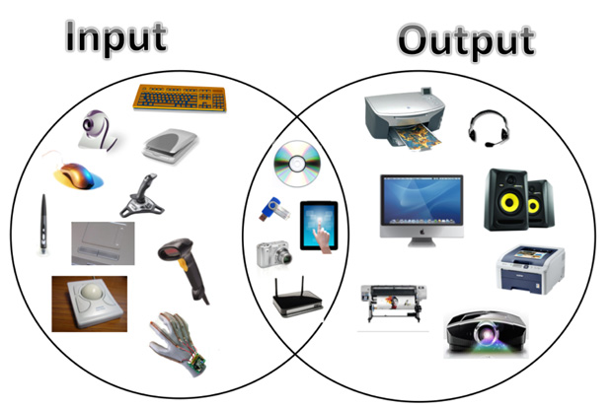
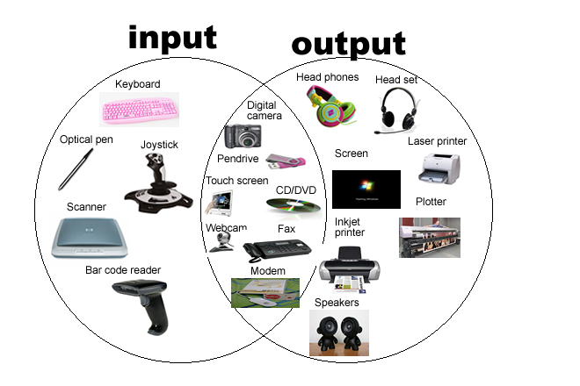

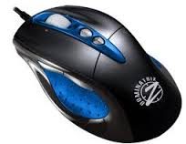
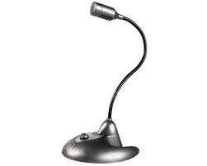
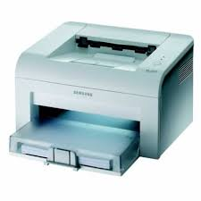
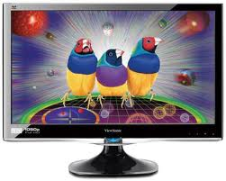
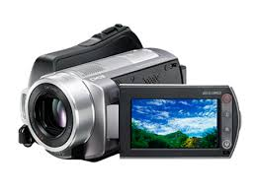
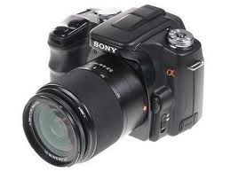
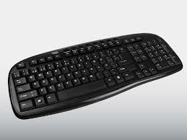
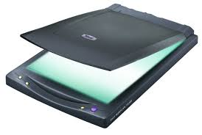
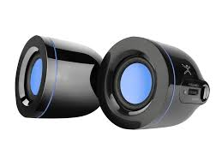
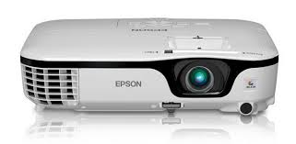
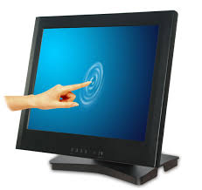
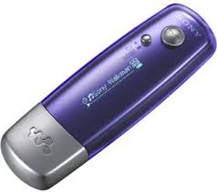
Peripherals
To carry out all the tasks that a user needs
Three types
Input Peripherals
Output Peripherals
Input and Output Peripherals
8/11/21
<número>
Notes:
<número>

Slide 6
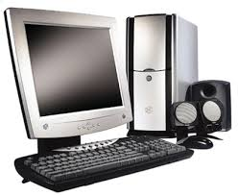
Input peripherals
They allow a user to enter data into a computer, such as text, images, audio or video

Slide 7
Output peripherals
They allow a user to obtein data into a computer, such as text, images, audio or video

Slide 8
Input and Output peripherals
They allow a user to enter and obtain data into a computer, such as text, images, audio or video

Slide 9
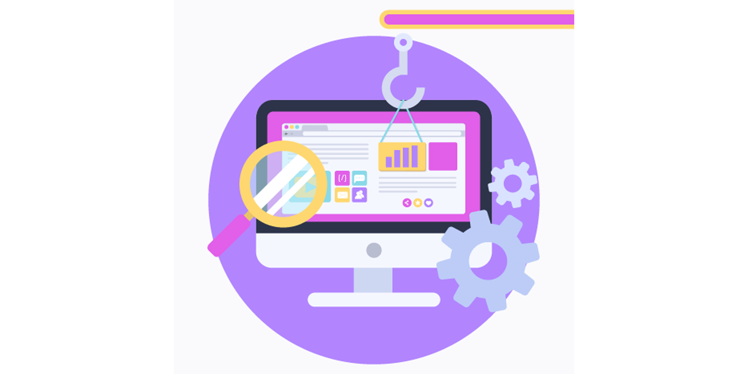
Software
Computer programs or applications, instructions and rules that are necessary to carry out specific tasks
8/11/21
<número>
Notes:
<número>

Slide 10
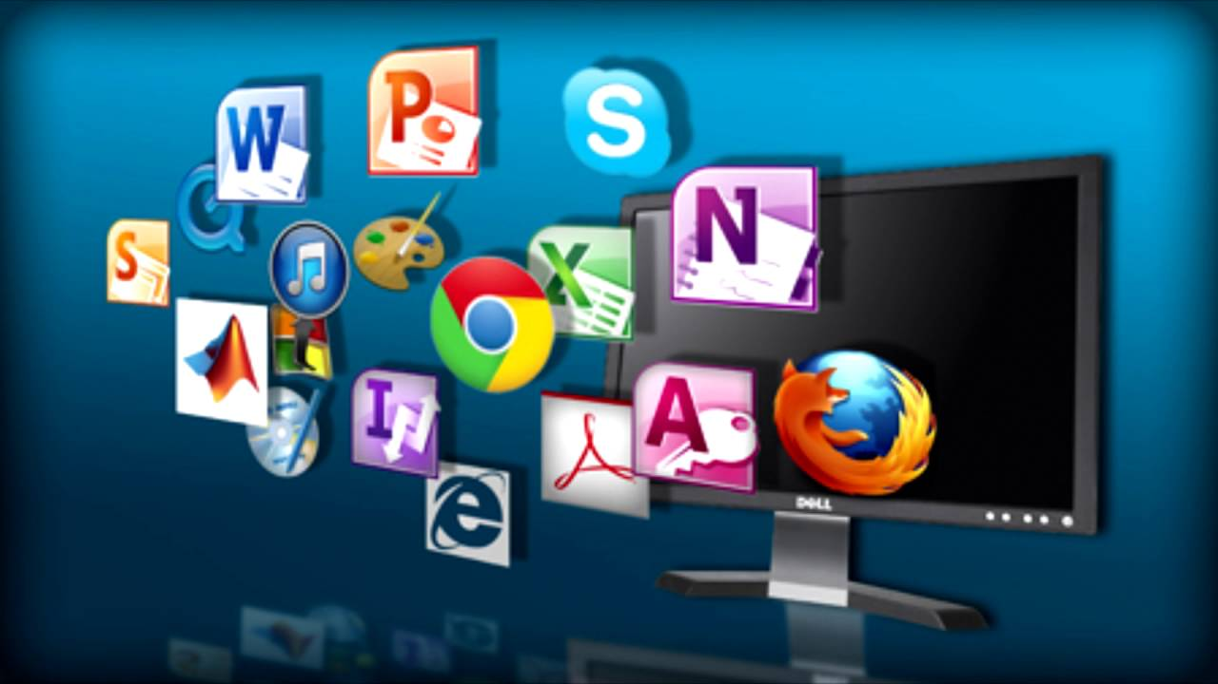
Software examples
Examples
8/11/21
<número>
Notes:
<número>

Slide 11
Vocabulary
computer , technology, components, process, hardware, CPU, mouse, keyboard, monitor, hard disk, scanner, speakers, printer, devices, tasks, peripherals, input, output, data, software, browsers
8/11/21
<número>
Notes:
<número>

Slide 12

Quiz
8/11/21
<número>
Notes:
<número>

Slide 13

The end
8/11/21
<número>
Notes:
<número>

