Slide 1

Sergio Muñoz Villullas

Slide 2


What i'm going to talk about?
-Software
-Hardware
-Peripherals

Slide 3
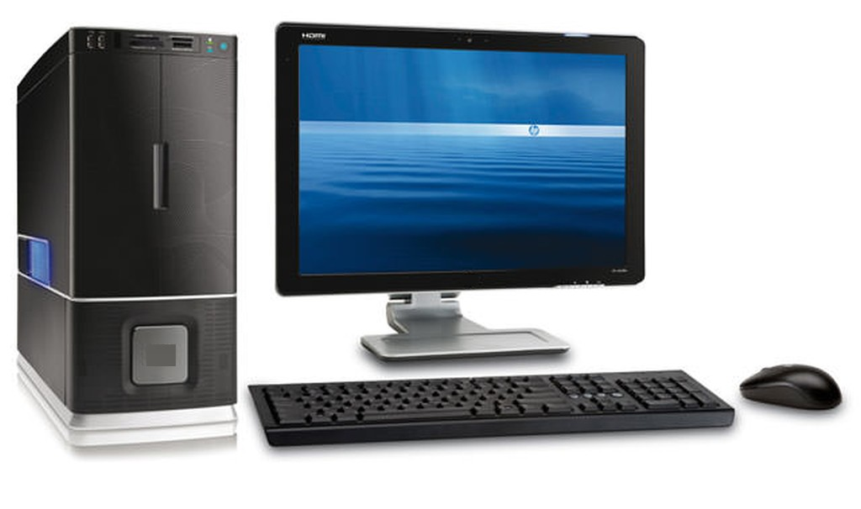
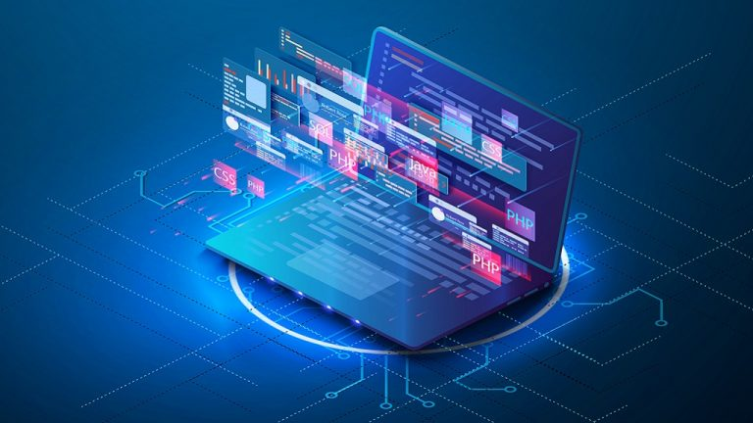
Introduction
Currently, it is very common for people to use computer based in technology without any problem, but many of those people are unaware of the conceptual part and the logical function of the components within a process

Slide 4
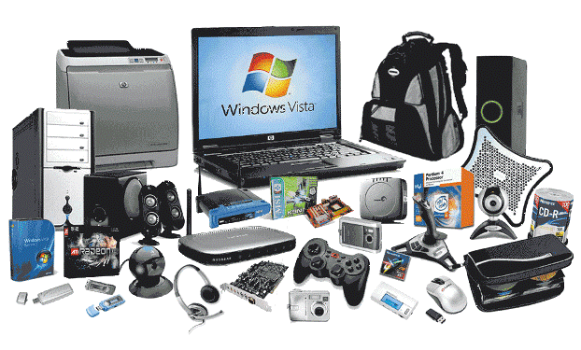
Hardware
Physical components

Slide 5
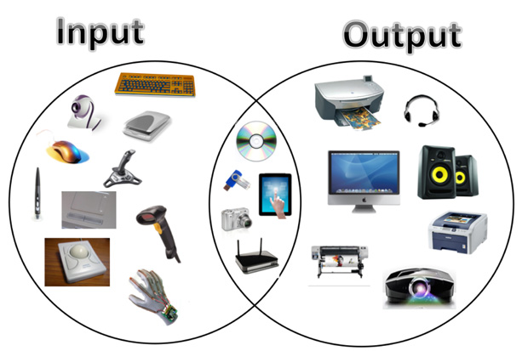
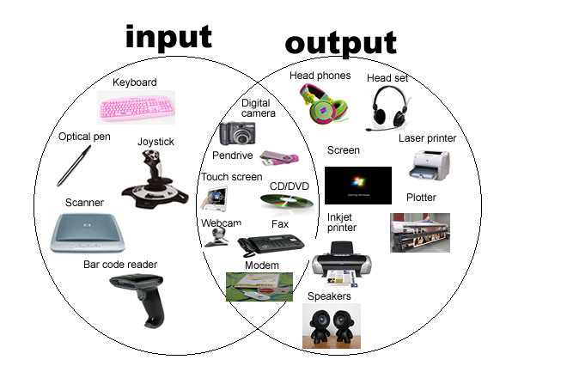
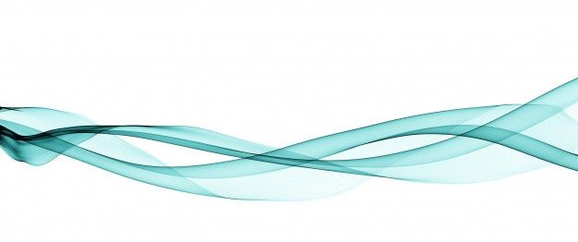
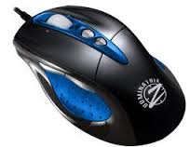
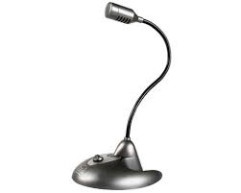
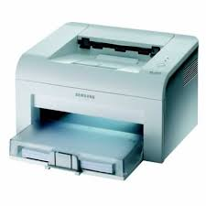
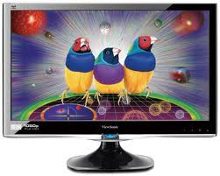
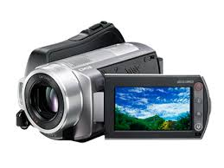
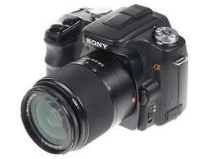
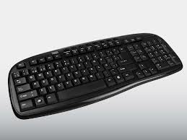
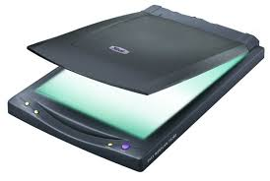
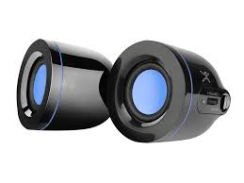
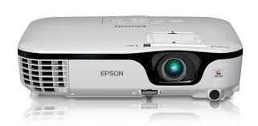
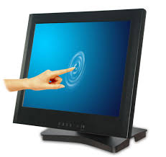
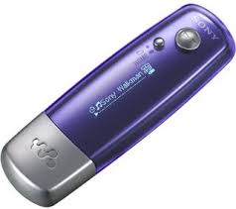
Peripherals
To carry out all the tasks that a user needs
Three types
Input Peripherals
Output Peripherals
Input and Output Peripherals

Slide 6
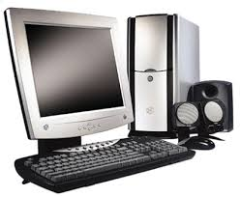
Input peripherals
They allow a user to enter data into a computer, such as text, images, audio or video

Slide 7
Output peripherals
They allow a user to obtein data into a computer, such as text, images, audio or video

Slide 8
Input and Output peripherals
They allow a user to enter and obtain data into a computer, such as text, images, audio or video

Slide 12
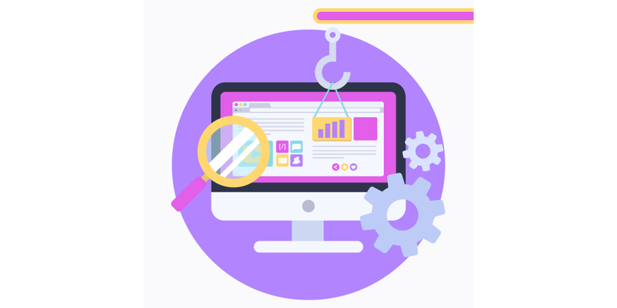
Software
Computer programs or applications, instructions and rules that are necessary to carry out specific tasks

Slide 13
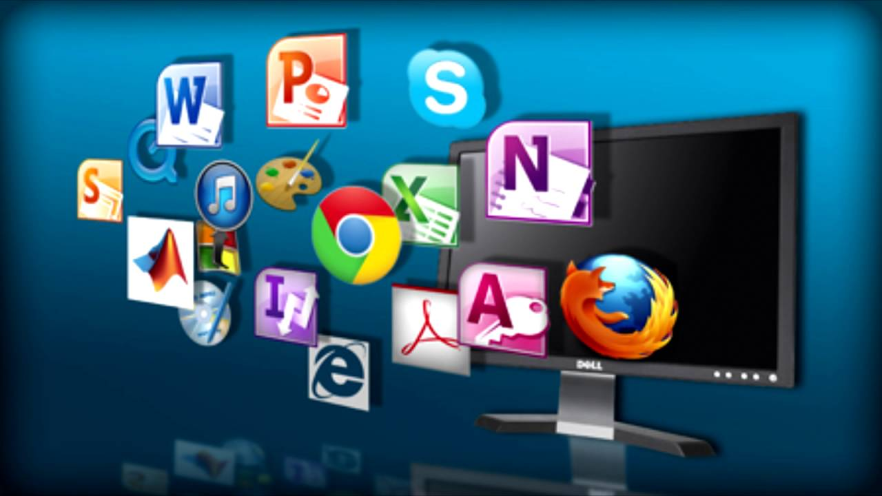
Software examples
Examples

Slide 14
Vocabulary
computer , technology, components, process, hardware, CPU, mouse, keyboard, monitor, hard disk, scanner, speakers, printer, devices, tasks, peripherals, input, output, data, software, browsers

Slide 15

Quiz

Slide 16

The end

