Slide 1

Computer applications
Sergio Muñoz Villullas

Slide 2
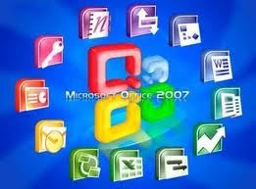

What I am going to talk about?
What are applications?
What applications are?
What are they used for?
Some examples with a short explanation
Vocabulary
Quiz

Slide 3
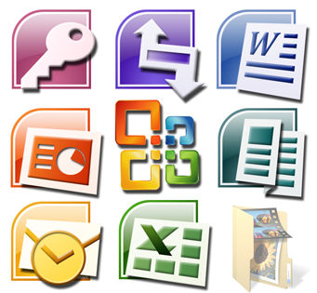
What are applications?
An application is a computer program designed as a tool to perform specific operations or functions.

Slide 4
What are they used for?
Generally, they are designed to facilitate certain complex tasks and make people's computing experience easier.

Slide 5
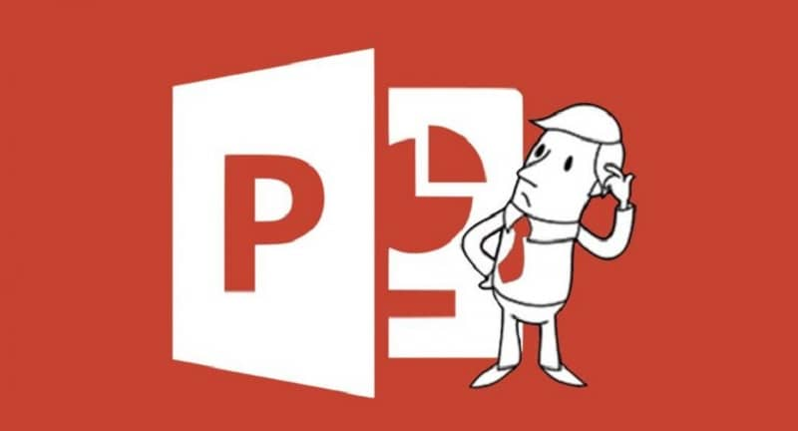
Power Point
Is a presentation program developed by the Microsoft company for Windows operating systems, macOS and lately for Android and iOS.

Slide 6

Microsoft Excel
Microsoft Excel is a spreadsheet developed by Microsoft for Windows, macOS, Android, and iOS. It has calculus, graphs, calculated tables and a macro programming language called Visual Basic for Applications.

Slide 7

Microsoft Word
Microsoft Word is word processing software. Created by Microsoft and integrated by default into the Microsoft Office suite, it was originally developed by Charles Simonyi for the IBM computer, with the DOS operating system, in 1981.

Slide 8
Vocabulary
tool, tasks, developed,
operating systems, spreadsheet,
software calculus, graphs, programming

Slide 9

Quiz

Slide 10

The end

