Slide 1
Arduino Programming in Python
Sergio Paniego Blanco

Slide 2




Who am I?
Artificial Intelligence MSc - UPM
Informatic Engineering and Software Enginnering - URJC
Student Developer GSoC - JdeRobot
sergiopaniego
sergiopaniego
sergiopaniego

Slide 3
Summary
Google Summer of Code
Problematic
State of the art
PyOnArduino
Demo

Slide 4

Google Summer of Code
Timeline
February - Organizations announced
March - Student applications
April – Student Projects announced
April & May – Community Boarding
May to August – Coding
June, July & August - Evaluations
Global program
Bring students into open source development
Remote work + meetings
JdeRobot – 6 students

Slide 5


Problematic
Arduino programming language complexity
Need of easy to use tools for newbies
Code Arduino boards using Python

Slide 6
State of the art
Current solution for the problematic
Continuous communication between the robot and the PC.
Possible approaches
Pyxie
Cython
LLVM

Slide 7
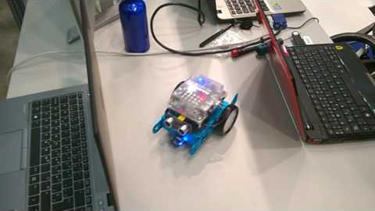

Slide 8
PyOnArduino
JdeRobot Robot Programming tool
People:
José María Cañas
Gorka Guardiola
Luis Roberto Morales
Sergio Paniego Blanco
Translate Python-like code to Arduino code
Translate, compile and upload the code directly

Slide 9
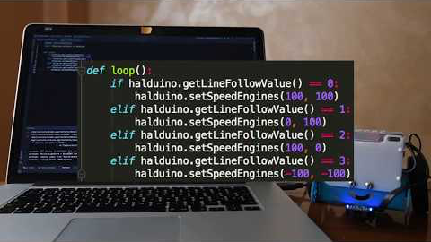

Slide 10
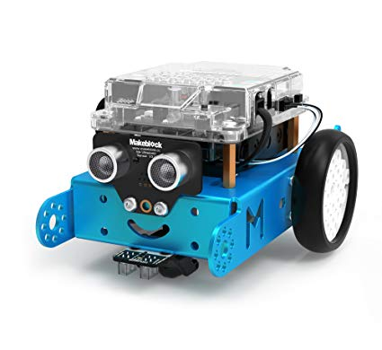
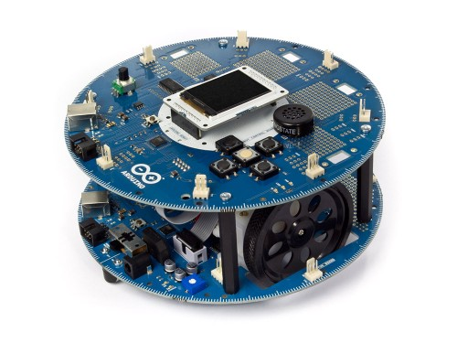
Supported robots
MBOT
COMPLUBOT

Slide 11
PyOnArduino’s structure

Slide 13
Translator
Abstract Syntax Tree
Each node – Statement in the code
Information for analyzing the code
Inessential puntuation and delimiters
Python library
NodeTransformer and NodeVisitor

Slide 14
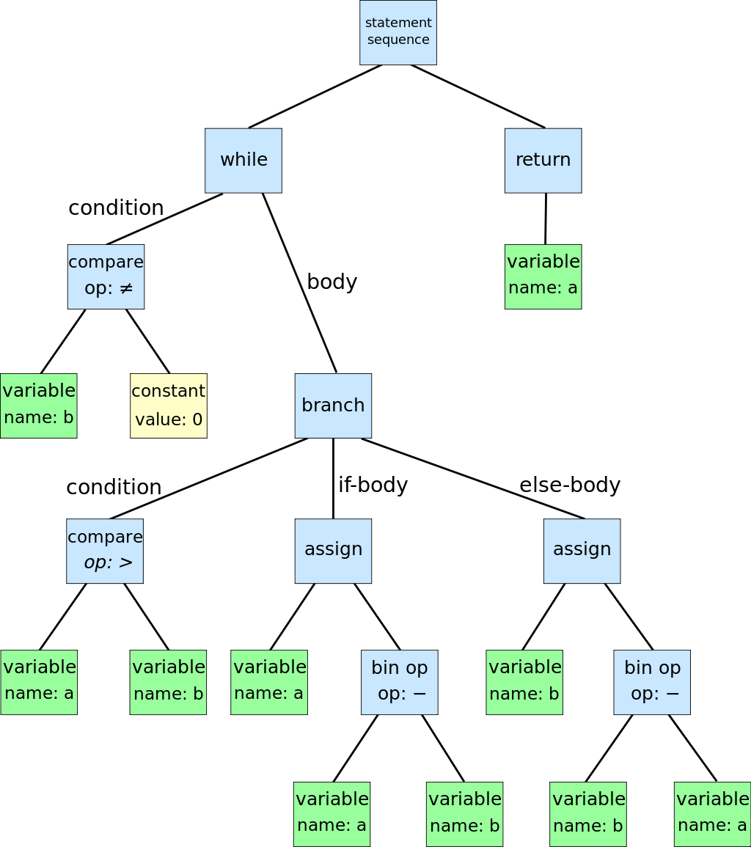
Abstract Syntax Tree
Greatest Common Divisor
while b ≠ 0
if a > b
a := a − b
else
b := b − a
return a

Slide 15
Translator
Abstract Syntax Tree
Each node – Statement in the code
Information for analyzing the code
Python library
NodeTransformer and NodeVisitor

Slide 16
NodeVisitor & NodeTransformer
import ast
class MyVisitor(ast.NodeVisitor): def visit_Str(self, node): print('String Node: "' + node.s + '"') class MyTransformer(ast.NodeTransformer): def visit_Str(self, node): return ast.Str('str: ' + node.s)
parsed = ast.parse("print('Hello World’)”)
MyTransformer().visit(parsed) MyVisitor().visit(parsed)

Slide 17
HALduino
Hadware Abstraction Layer
halduino.py
Specific halduino for each robot
Get rid of Arduino’s complexity

Slide 18
HALduino example
Python
setSpeedEngines(leftSpeed: int, rightSpeed: int)
Arduino
MeDCMotor leftMotor(9); MeDCMotor rightMotor(10); void setSpeedEngines(int speedLeft, int speedRight) { leftMotor.run(speedLeft); rightMotor.run(speedRight); }

Slide 19
Sensors and actuators supported
Complubot
Sensor/Actuator | Supported functions
DC Engines | setSpeedEngines (left,right)
Ultrasonic sensors | getUS()
Infrared sensors | getIR[1,2,3,4,5]()
Beep emitter | playBeep(type)
Sound emitter | playMelody(melody)
Screen write | setScreenText(text), cleanScreen()

Slide 20
Sensors and actuators supported
mBot
Sensor/Actuator | Supported functions
DC Engines | setSpeedEngines (speed)
Ultrasonic sensors | getUS()
LEDs | setLeds(ledNumber, red, green, blue)
Infrared sensors | getMessage(), sendMessage(message)
Light sensor | getLightSensor()
Button | isButtonPressed(), isButtonReleased()
Buzzer | playBuzzer(tone, length)
External screen | drawString(name), showClock(hour, min)

Slide 21
Python features supported
Feature | Limitations/Comments
Variable declaration | SUPPORTED
Function declaration | With/without return statement
Operators | + - / * ^ %
Comparators | < <= >= == !=
Logic operators | And or is not
pass | SUPPORTED
loops | While, for(limited)
Sleep() | SUPPORTED
if | If/elif/else
Boolean operations | and or
print | SUPPORTED

Slide 22
Stop and go code example Mbot
import HALduino.halduino as halduino def set_engine(direction: int): if direction == 0: halduino.setSpeedEngines(0, 0) print('STOP!') elif direction == 1: halduino.setSpeedEngines(100, 100) print('Forward') def loop(): if halduino.getUS() < 10: set_engine(0) else: set_engine(1)

Slide 23
Stop and go code example Complubot
import HALduino.halduino as halduino def set_engine(direction: int): if direction == 0: halduino.setSpeedEngines(0, 0) print('STOP!') elif direction == 1: halduino.setSpeedEngines(100, 100) print('Forward') def loop(): if halduino.getUS() < 30: set_engine(0) else: set_engine(1)

Slide 24
Managing robot’s architecture
Versatility
Configure robot’s ports
# Example of an mBot setup leftMotor = 9 rightMotor = 10 ultrasonicSensor = 3 rgbled = 7 lightSensor = 6 ledMtx = 3 lineFollower = 2

Slide 25
Executing PyOnArduino
Python 3.x
Arduino IDE
Arduino Makefile
python3 translator/Translator.py [input-file] [robot]
python3 translator/Translator.py [input-file] [robot] [architecture-file]

Slide 26
Make & Arduino Makefile
Build automation
Directives used by make
make upload
# mBot Makefile ARDUINO_LIBS= Makeblock-Libraries-master Wire SPI MONITOR_PORT= /dev/cu.wchusbserial1420 BOARD_TAG = uno ARDUINO_DIR = /Applications/Arduino.app/Contents/Java include /usr/local/opt/arduino-mk/Arduino.mk

Slide 27
Problems during development
Dynamic typing in Python vs Arduino
Architectural Stop
Variables’ type in function declaration
Lost parentheses

Slide 28
DEMO TIME!
Lets see how PyOnArduino tool works!

Slide 29
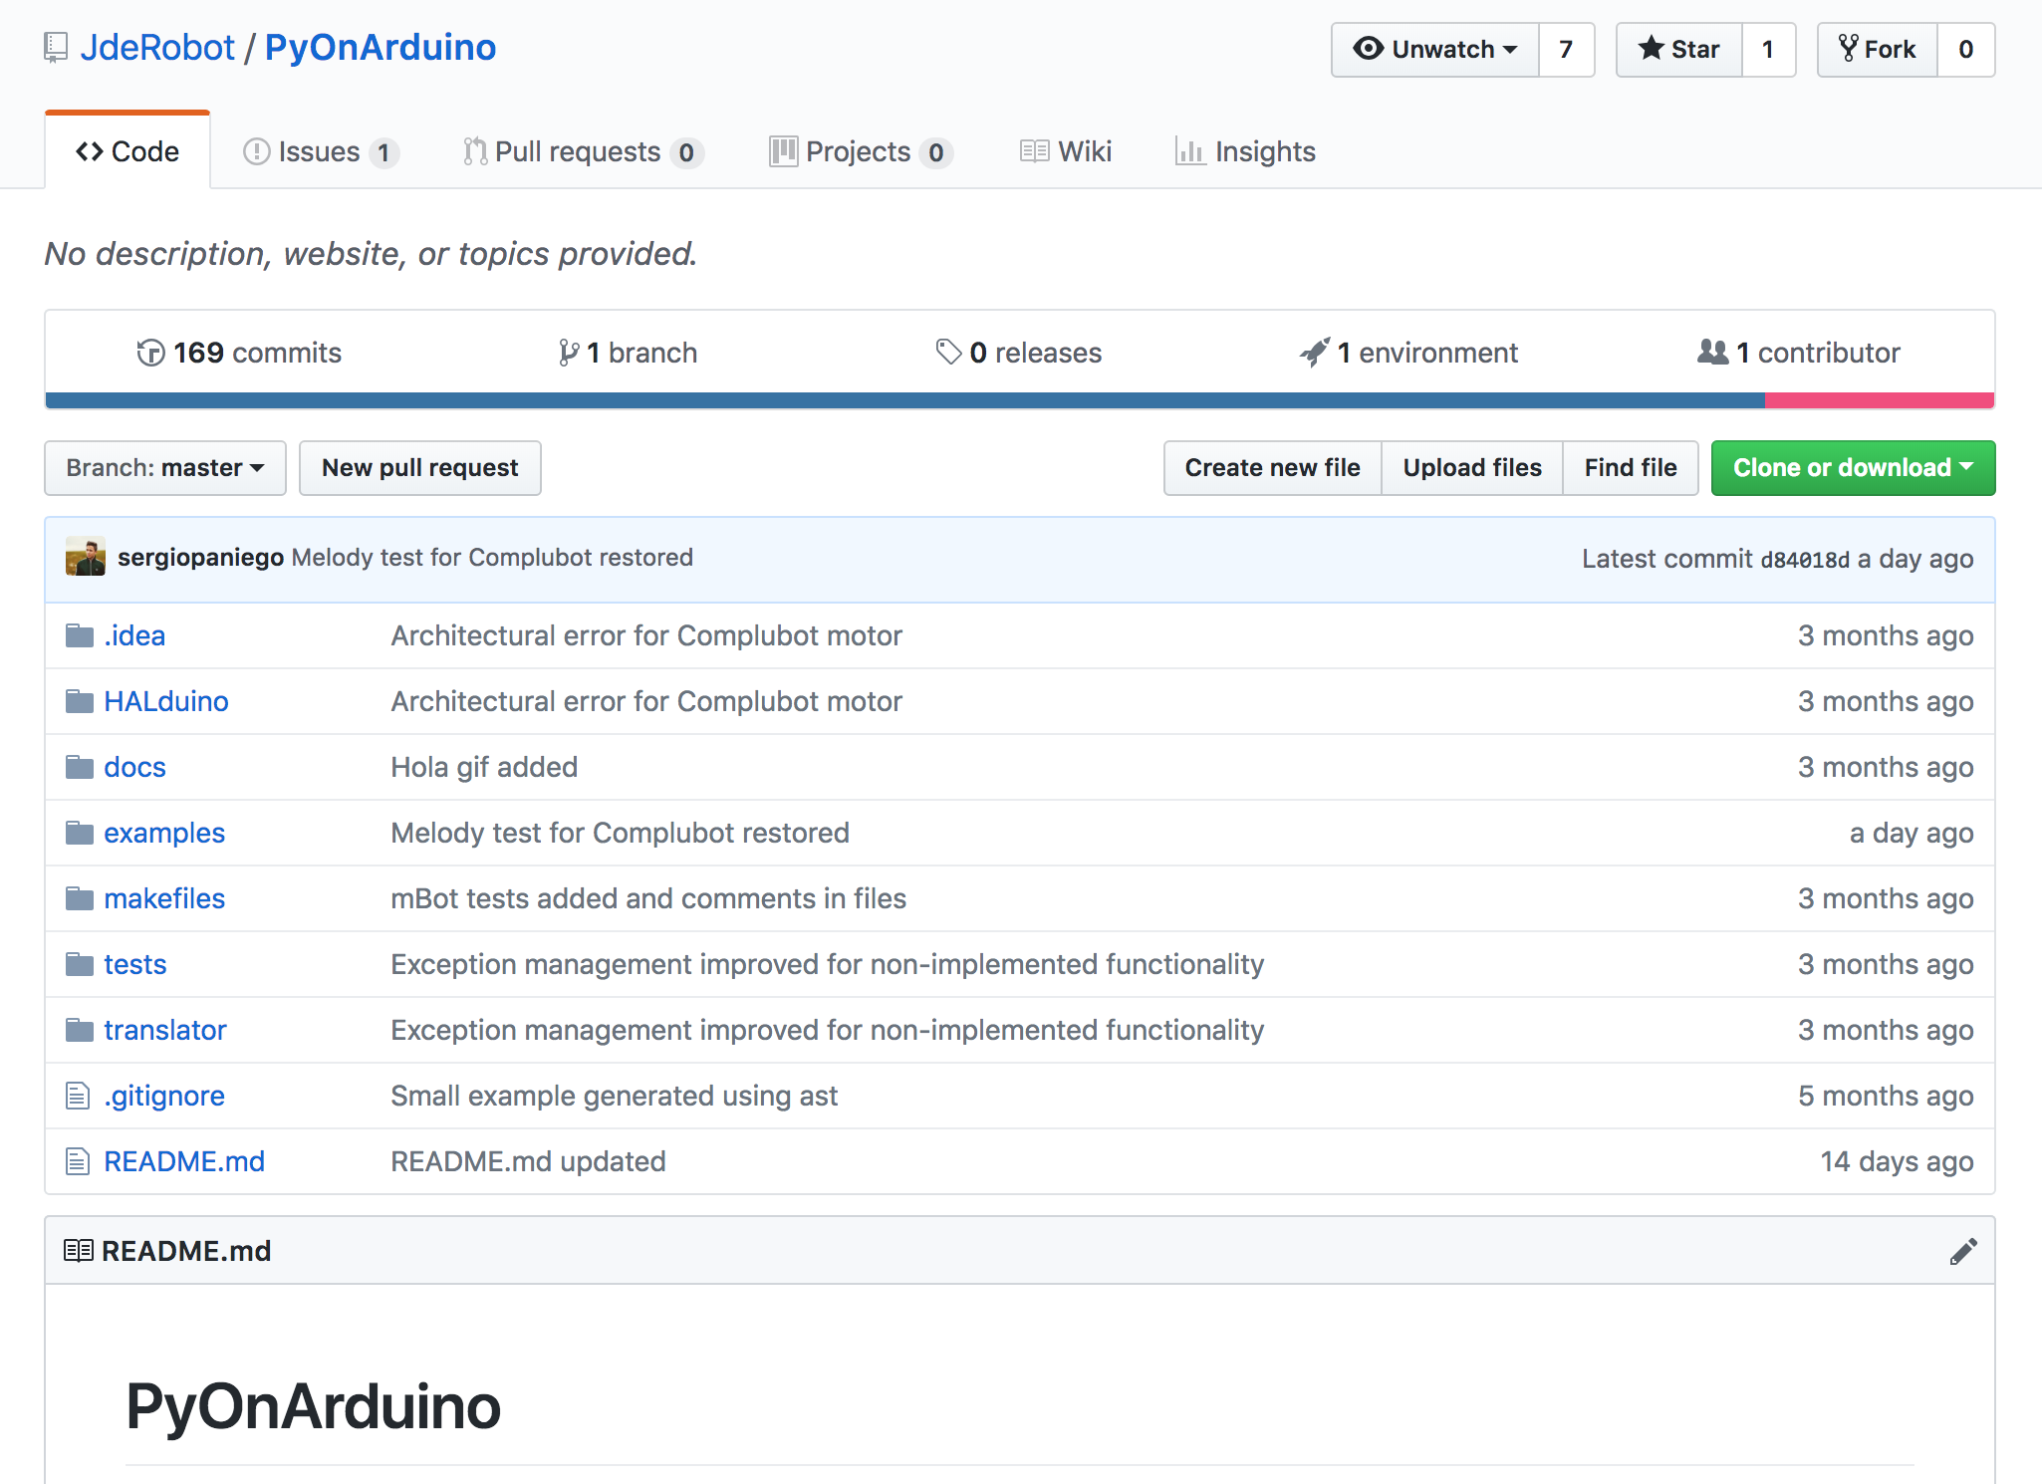

Slide 30
Thanks!
Any questions?
You can find me at @sergiopaniego

