Slide 1
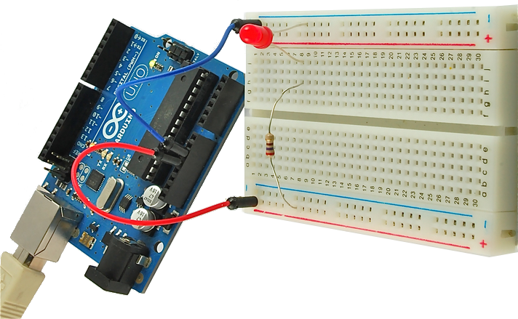
In The Blink Of An LED:
An introduction to physical computing

Slide 2

Overview of Class
Getting Started:
Context
Components
Software Installation
Electrical:
Ohm's Law
Circuits
Multimeters
Inputs and Outputs
Analog vs Digital
Microcontrollers:
Digital Outputs
Analog Outputs
Digital Inputs
Analog Inputs
Serial Communication

Slide 3


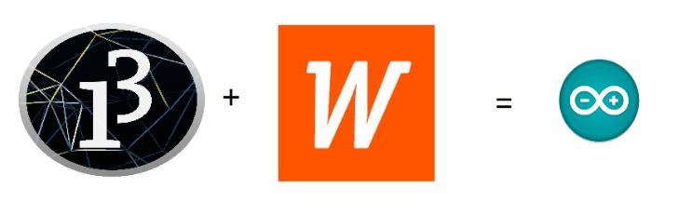
Wiring Library, Processing
(and Arduino)
Open Source Hardware/Software
Processor
Coding is accessible & transferrable
(C++, Processing, java)

Slide 4

Quick Definitions
Arduino – can refer to the Amtel ATMEGA328p microcontroller, the development board or the programming environment
microcontroller – shitty computer, but generally one with GPIO and analog input pins
GPIO pins – general purpose input/output pins, send and receive signals from outside the chip
physical computing – using a computer to interact with the real world
development board – microcontroller with connectors to easily access the GPIO, analog input and power

Slide 5

USB
(to Computer)
PWR IN
(7-12V)
RESET
SCL\SDA
(I2C Bus)
POWER
5V / 3.3V / GND
GPIO Pins
PWM(3, 5, 6, 9, 10, 11)
Analog INPUTS

Slide 6

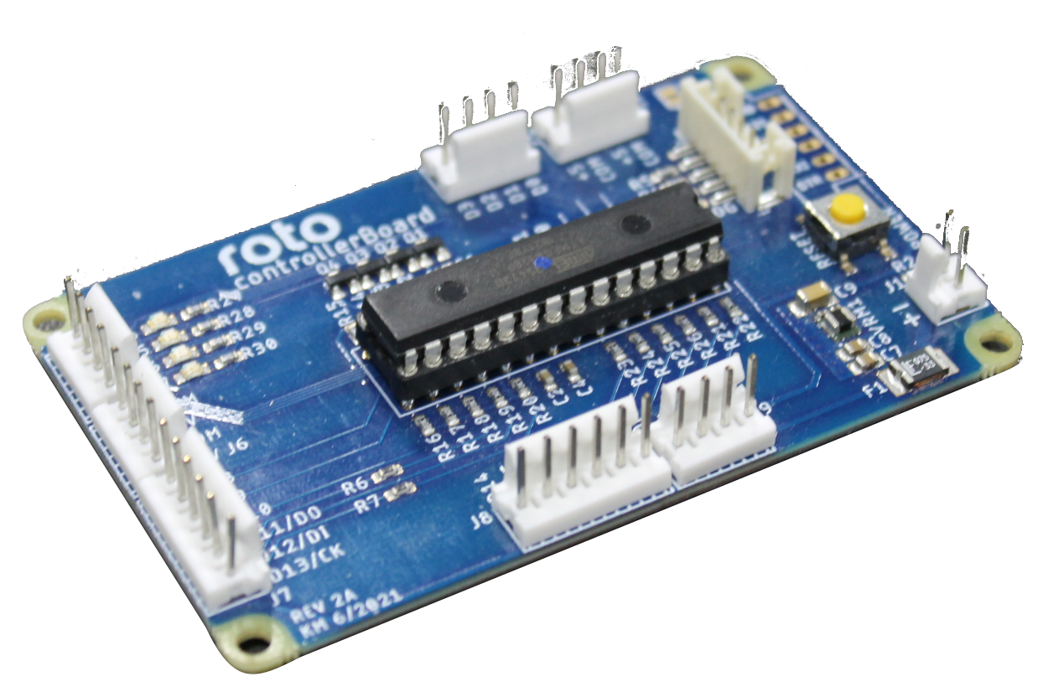
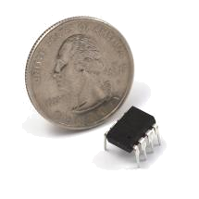
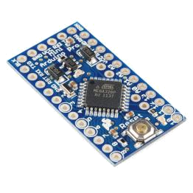
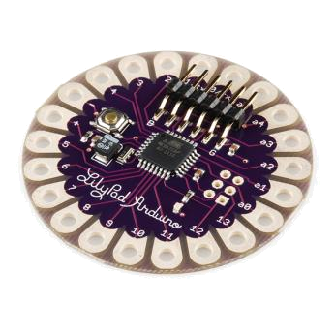
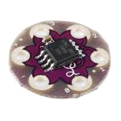
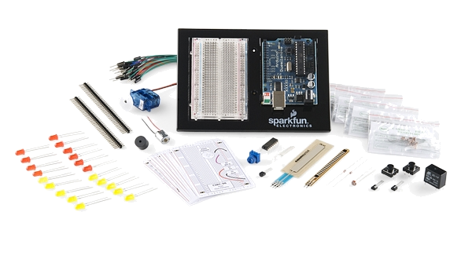
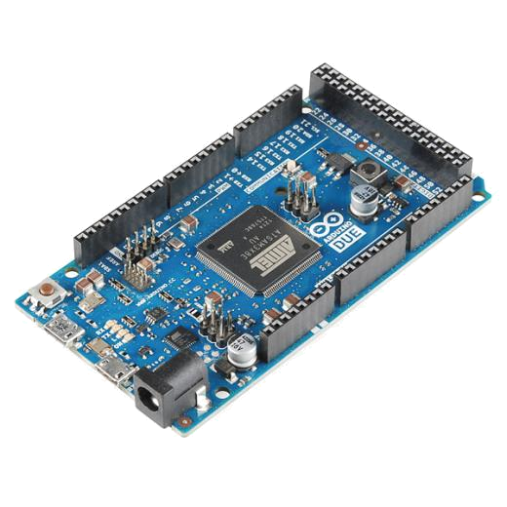
Arduino & Arduino Compatible Boards

Slide 7
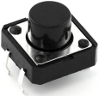
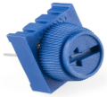
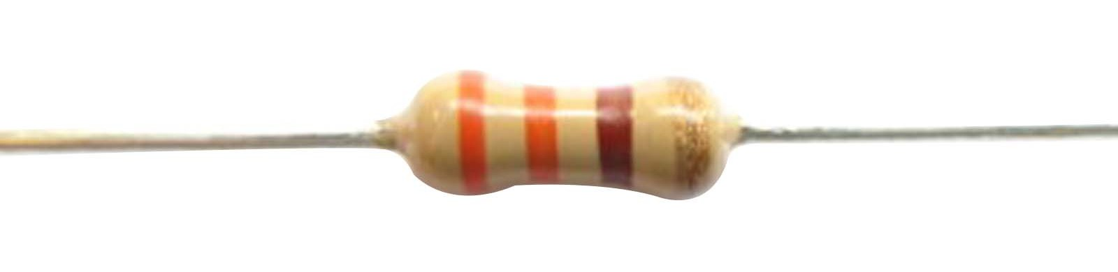




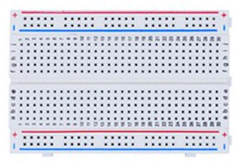
Included Components
Name | Image | Type | Function | Notes
Push Button |  | Digital Input | Switch - Closes or opens circuit
Trim potentiometer |  | Analog Input | Variable resistor | Also called a Trimpot.
Resistor |  | Passive Component | Drops Voltage | Color-Coded for Different Values
Photoresistor |  | Analog Input | Light Dependent Resistor (LDR) | Resistance varies with light.
LED |  | Digital & Analog Output | Emits a single wavelength light
RGB LED |  | Digital & Analog Output | 16,777,216 different colors | Ooh... So pretty.
Jumper Wires |  | Interconnect | Connects other components | Your extroverted friend
Breadboard |  | Interconnect | Where the connections happen | The neighborhood pub

Slide 8

Getting Started
https://microcontrollers.smartypantsconsulting.ltd
Sample Code
Schematic/Wiring Diagrams
Web Resources

Slide 9

Getting Started
Notes:
This is why there’s a diversity problem in Engineering

Slide 10
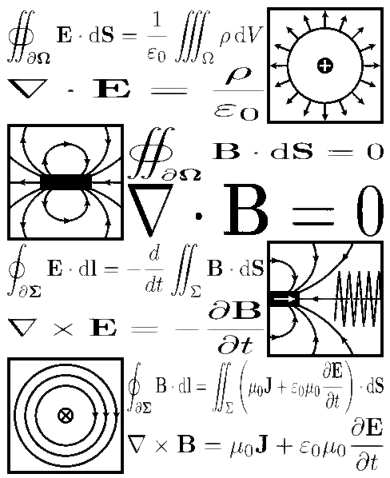
Electricity / Electronics Basic Concepts
Voltage
Current
Resistance
Ohm’s Law
Using a Multimeter

Slide 11
Electrical Properties
Voltage
V
Current
I
Resistance
R
  The amount of potential energy in a circuit (how “hard” it can push electrons)
  Units: Volts (V)
  Related to number of electrons that flow through a circuit every second
  Units: Amperes (A)
  How difficult it is for electrons to flow through a circuit
  Units: Ohms (Ω)

Slide 12

Ohm’s Law

Slide 13



Current Flow Analogy
High Current
Low Current

Slide 14

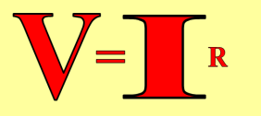

Voltage Analogy
Water
Tower
Water
Tower
V
V
More Energy == Higher Voltage
Less Energy == Lower Voltage

Slide 15
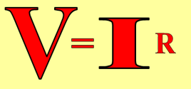
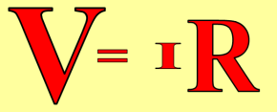
Resistance Analogy
Water
Tower
Water
Tower
V
Big Pipe == Lower Resistance
Small Pipe == Higher Resistance

Slide 16
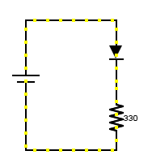
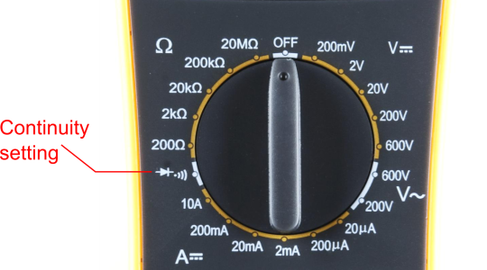
Continuity – Is it a Circuit?
The word “circuit” is derived from the circle. An Electrical Circuit must have a continuous LOOP from Power (V_{cc}) to Ground (GND).
Continuity- it is important to make sure all the portions of circuits are connected. Continuity is the simplest and possibly the most important setting on your multimeter. Sometimes we call this “ringing out” a circuit.

Slide 17
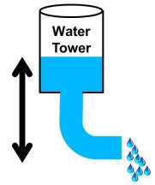

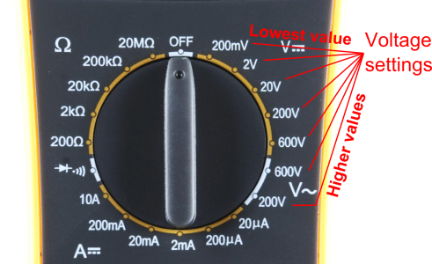

Measuring Electricity – Voltage
Voltage is a measure of potential electrical energy. A voltage is also called a potential difference – it is measured between two points in a circuit – across a device.

Slide 18
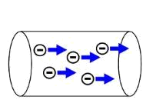
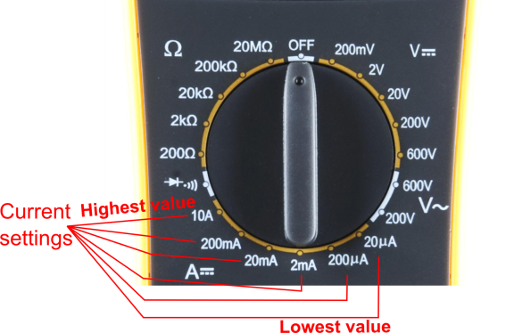
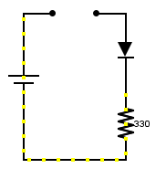
Measuring Electricity -- Current
Current is the measure of the rate of charge flow. For Electrical Engineers – we consider this to be the movement of electrons.
In order to measure this – you must break the circuit or insert the meter in-line (series).

Slide 19
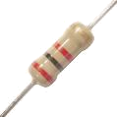
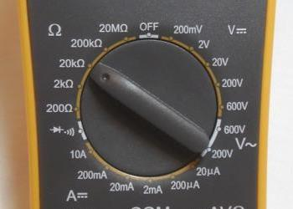

Measuring Electricity -- Resistance
Resistance is the measure of how much opposition to current flow is in a circuit.
Components should be removed entirely from the circuit to measure resistance. Note the settings on the multimeter. Make sure that you are set for the appropriate range.
Resistance
settings

Slide 20
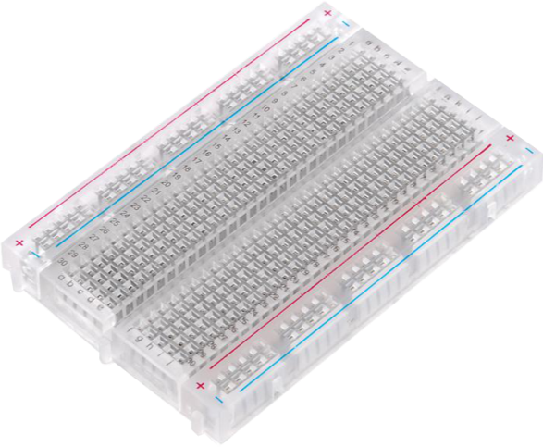
Prototyping Circuits
Solderless Breadboard
One of the most useful tools in an engineer or Maker’s toolkit. Good things to remember:
  A breadboard is easier than soldering
  A breadboard isn’t the same as soldering
    Sometimes breadboards break
    Sometimes breadboards don’t make good connections
    They’re not good for high-speed applications
  Know what dots are connected to each other

Slide 21
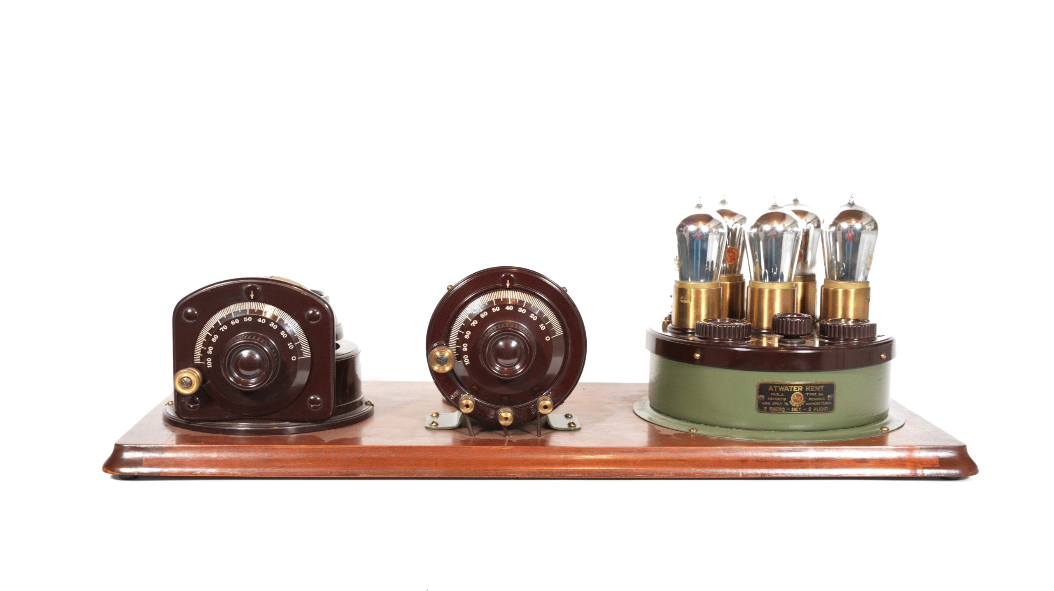
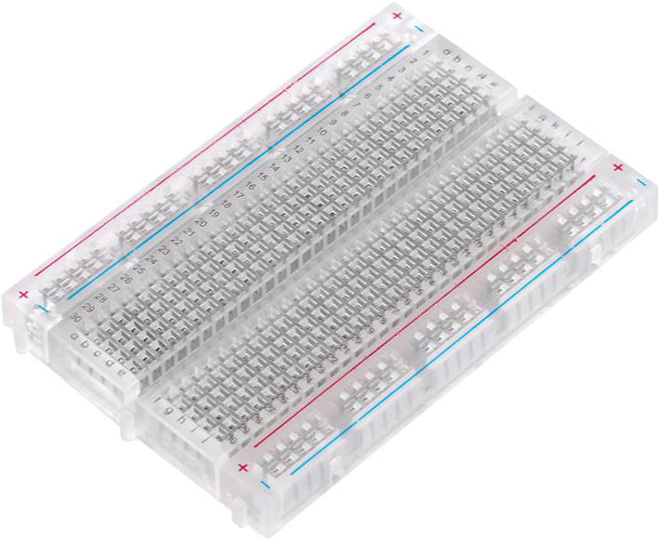
Why a Breadboard?
Atwater Kent Radios (ca 1923)

Slide 22
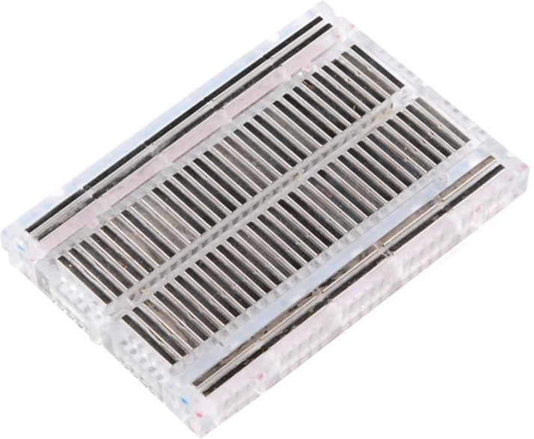
What’s a Breadboard?

Slide 23
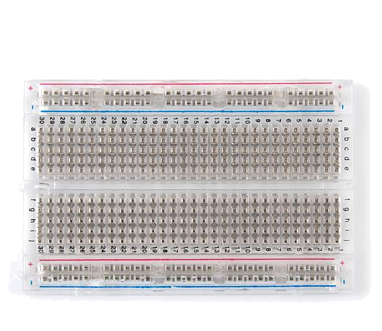

How It’s All Connected
Each row (horizontal) of 5 holes are connected
Vertical columns- called power buses- are connected vertically

Slide 24
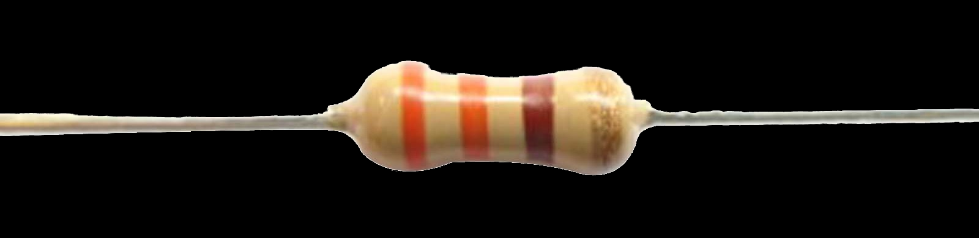
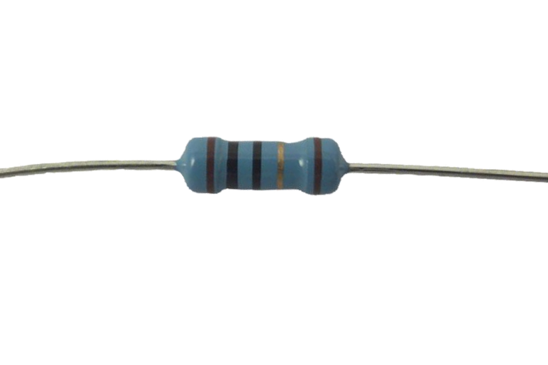
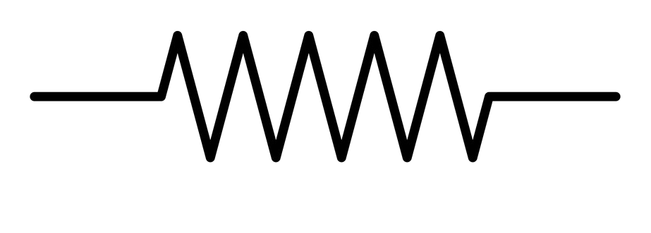
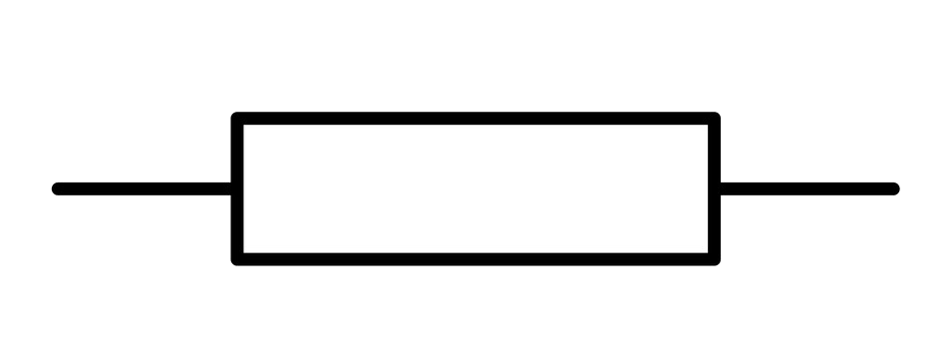
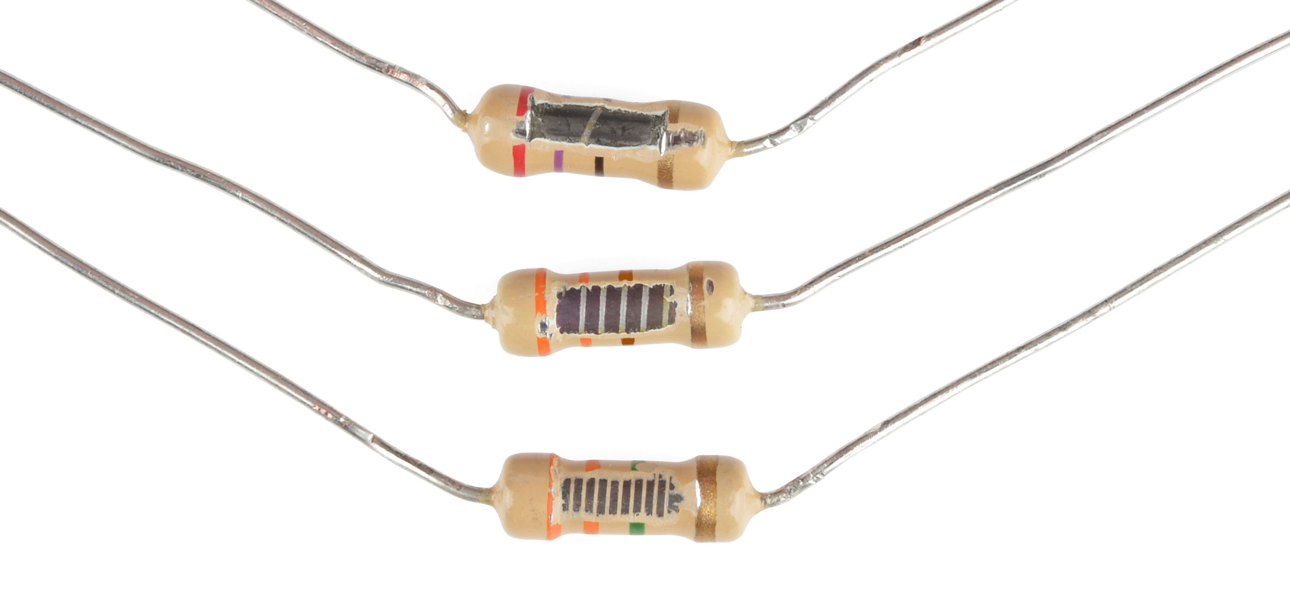
Component Spotlight: The Resistor
Ohms(Ω)
Notes:
3300 ohm
10 ohm

Slide 25

Decoding Resistor Values

Slide 26
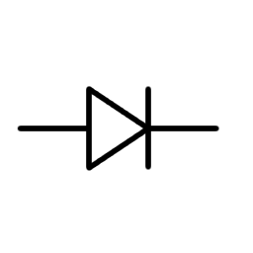
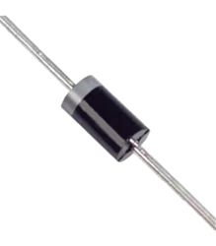

Component Spotlight: The LED
Diode
Notes:
Has enough energy to get over but not back

Slide 27
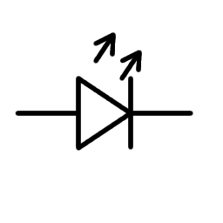
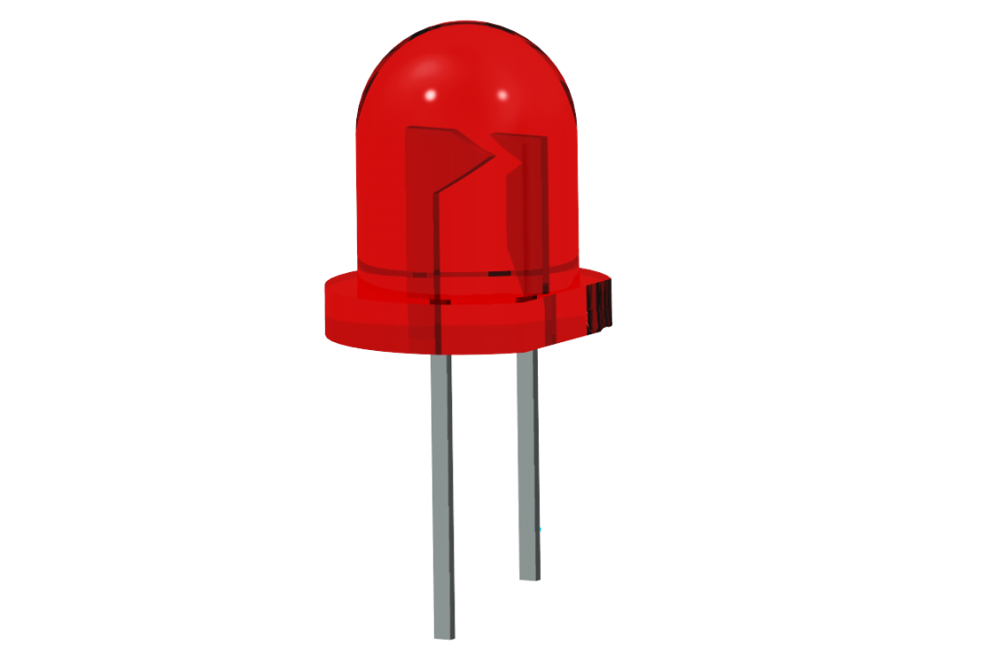
Component Spotlight: The LED
Light Emitting Diode

Slide 28

Component Spotlight: The LED

Slide 29


LED Mnemonic
Cathode, like Cathy, is short and negative

Slide 30
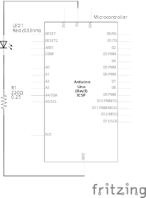
Using the Breadboard to built a simple circuit
Use the breadboard to wire up
a single LED
a 220 Ω Resistor
(Red-Red-Black-Black-Gold)
or
(Red-Red-Brown-Gold)

Slide 31
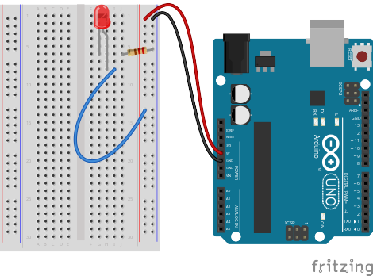
Using the Breadboard to built a simple circuit

Slide 32



Go ahead and plug your board in!

Slide 33

Adding Control

Slide 34

Concepts: INPUT vs. OUTPUT
Referenced from the perspective of the microcontroller
Input is a signal / information going into the board.
Output is any signal exiting the board.
Almost all systems that use physical computing will have an output
What are some examples of inputs and outputs?

Slide 35


Concepts: INPUT vs. OUTPUT
Referenced from the perspective of the microcontroller
Input is a signal / information going into the board.
Output is any signal exiting the board.
Examples: Buttons, Switches, Microphones, Light Sensors, Touch Sensors, Flex Sensors, Humidity Sensors, Temperature Sensors…
Examples: LEDs, RGB LEDs, monitors, relays, DC motors, servo motors, buzzers, speakers

Slide 36
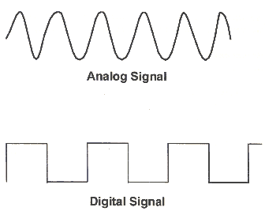
Concepts: Analog vs. Digital
Microcontrollers are digital devices – ON or OFF. Also called discrete.
Analog signals are anything that can be a full range of values. What are some examples?
5 V
5 V
0 V
0 V

Slide 37
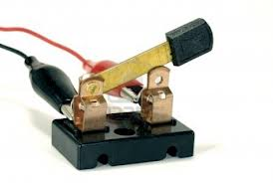
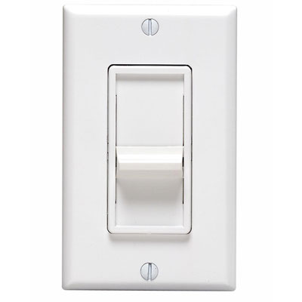


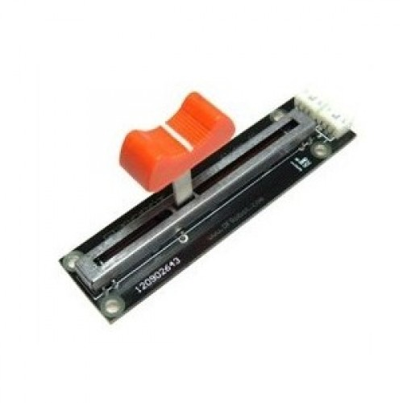
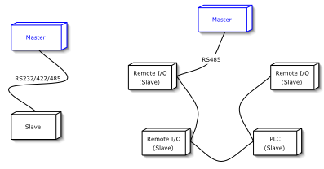
digitalWrite()
analogWrite()
if() statements / Boolean logic
BIG 6 CONCEPTS
digitalRead()
analogRead()
Serial communication

Slide 38
digitalWrite()
Project #1 – Blink
“Hello World” of Physical Computing
Psuedo-code – how should this work?
Turn LED ON
Turn LED OFF
Rinse & Repeat
Notes:
In 1969 Ken Thompson and Dennis Ritchie developed a programming language called B, since it was a stripped-down version of of another language- BCPL, “Basic Combined Programming Language”
In 1972 Brian Kernigham’s book A Tutorial Introduction to the Language B included printing “hi!” as one of the first examples
The next example, used to illustrate external variables, was the slightly more complicated “hello, world!”
This phrase got taken up at Bell Labs, where the language was developed
When B evolved into C, Kerningham included “hello world” in his hugely popular book The C Programming Language (1978)

Slide 39
digitalWrite()
Project #1 – Blink
“Hello World” of Physical Computing
Psuedo-code – how should this work?
Turn LED ON
Wait
Turn LED OFF
Wait
Rinse & Repeat
Notes:
In 1969 Ken Thompson and Dennis Ritchie developed a programming language called B, since it was a stripped-down version of of another language- BCPL, “Basic Combined Programming Language”
In 1972 Brian Kernigham’s book A Tutorial Introduction to the Language B included printing “hi!” as one of the first examples
The next example, used to illustrate external variables, was the slightly more complicated “hello, world!”
This phrase got taken up at Bell Labs, where the language was developed
When B evolved into C, Kerningham included “hello world” in his hugely popular book The C Programming Language (1978)

Slide 40
Project #1 - Blink
Inputs and Outputs
Turn LED ON
Wait
Turn LED OFF
Wait
Rinse & Repeat
Inputs | Outputs
None | LED/resistor

Slide 41
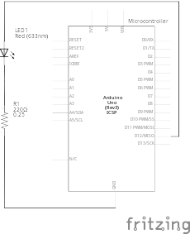
Project #1 - Blink
Schematic
Move the blue wire from the power bus to pin 12 (or any other Digital I/O pin) on the microcontroller board.

Slide 42
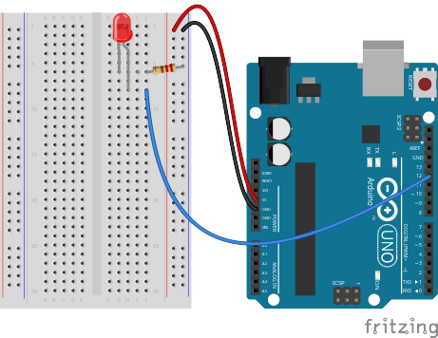
Project #1 – Blink
Wiring Diagram

Slide 43
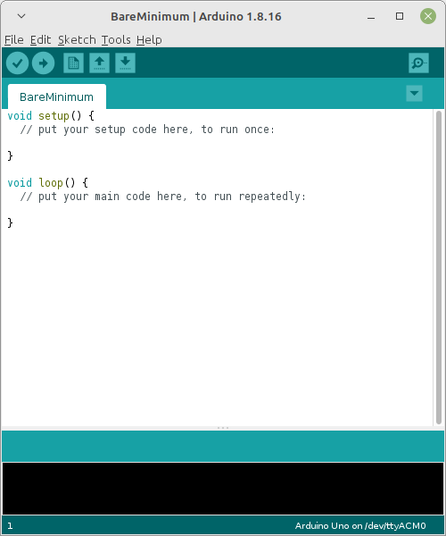

Open up Arduino IDE
IDE → Integrated Development Environment
Lets you write, compile (and upload) code all in the same place
Versions 1 and 2 are aesthetically different, functionally the same (for our purposes)

Slide 44

Exploring the Arduino IDE
CODING WINDOW
Port / Board Selection
Verify
Button
Upload
Button
SERIAL / OUTPUT WINDOW

Slide 45

Settings: Tools → Serial Port
Your computer communicates to the microcontroller via a serial port through a USB-Serial adapter.
Check to make sure that the drivers are properly installed.
Notes:
All connections to computers- mice, printers etc use a serial port. Gotta pick the right one.

Slide 46

Settings: Tools → Board
Next, double-check that the proper board is selected under the
Tools → Board menu.
Notes:
All connections to computers- mice, printers etc use a serial port. Gotta pick the right one.

Slide 47

Coding
This is like trying to learn ‘sports’ in a few hours, or ‘cooking’ or anything else that is a field of study unto itself
We’re going to go over some very broad concepts, in the form of commands and function, giving you just enough to be dangerous
You can copy/paste the examples, or type them in yourself, then we’ll review what each is doing line by line

Slide 48

Commands
Commands are what you want the microcontroller to do. They’re a code to translate between English and computer-speak
Only one command can go on a line
Because it’s a code, the syntax or how you type the commands, is very important
If you don’t get it just right, the output at the bottom of the IDE will try to tell you what’s wrong

Slide 49
Project #1 – Blink
Three Command to Start
pinMode(pin, INPUT/OUTPUT);
// NOTE: -> commands are CASE-sensitive
Notes:
Three commands to rule the world… or at least do 80% of cool Arduino projects.

Slide 50
Project #1 – Blink
Three Command to Start
pinMode(pin, INPUT/OUTPUT);
ex: pinMode(12, OUTPUT);
// NOTE: -> commands are CASE-sensitive
Notes:
Three commands to rule the world… or at least do 80% of cool Arduino projects.

Slide 51
Project #1 – Blink
Three Command to Start
pinMode(pin, INPUT/OUTPUT);
ex: pinMode(12, OUTPUT);
digitalWrite(pin, HIGH/LOW);
// NOTE: -> commands are CASE-sensitive
Notes:
Three commands to rule the world… or at least do 80% of cool Arduino projects.

Slide 52
Project #1 – Blink
Three Command to Start
pinMode(pin, INPUT/OUTPUT);
ex: pinMode(12, OUTPUT);
digitalWrite(pin, HIGH/LOW);
ex: digitalWrite(12, HIGH);
// NOTE: -> commands are CASE-sensitive
Notes:
Three commands to rule the world… or at least do 80% of cool Arduino projects.

Slide 53
Project #1 – Blink
Three Command to Start
pinMode(pin, INPUT/OUTPUT);
ex: pinMode(12, OUTPUT);
digitalWrite(pin, HIGH/LOW);
ex: digitalWrite(12, HIGH);
delay(time_ms);
// NOTE: -> commands are CASE-sensitive
Notes:
Three commands to rule the world… or at least do 80% of cool Arduino projects.

Slide 54
Project #1 – Blink
Three Command to Start
pinMode(pin, INPUT/OUTPUT);
ex: pinMode(12, OUTPUT);
digitalWrite(pin, HIGH/LOW);
ex: digitalWrite(12, HIGH);
delay(time_ms);
ex: delay(2500);
// NOTE: -> commands are CASE-sensitive
Notes:
Three commands to rule the world… or at least do 80% of cool Arduino projects.

Slide 55
Functions
Functions are groups of commands
They need a unique name
They can take numbers as inputs (arguments) and spit out a number as an output (return) but don’t have to
They begin and end with curly brackets → { }
We wont be dealing with them in too much more detail, save every Arduino program requires two functions, the setup() function and the loop() function

Slide 56

Notes:
Review the two main parts of the sketch – void setup() and void loop()
Provide rationale for good commenting.
Emphasize the need for good / clean coding practices like indenting.

Slide 57
Comments, Comments, Comments
Comments are ignored by the microcontroller. They’re just for you – the programmer and your friends…or anyone else human that might read your code.
// this is for single line comments
/* this is for multi-line comments
Like this…
And this….
*/

Slide 58

comments
Notes:
Review the two main parts of the sketch – void setup() and void loop()
Provide rationale for good commenting.
Emphasize the need for good / clean coding practices like indenting.

Slide 59

Project #1 - Blink
Code Review

Slide 60
Project #1 – Blink
Puzzles
Challenge 1a – blink with a 200 ms second interval.
Challenge 1b – find the fastest blink that the human eye can still detect…
1 ms delay? 2 ms delay? 3 ms delay???
Challenge 1c – blink to mimic a heartbeat
Challenge 1d – change the output pin

Slide 61
analogWrite()
Project #2 – Fade
Not so fast, Jack
Psuedo-code – how should this work?
LED Gets Brighter
Achieves Maximum Brightness
LED Dims
Goes completely off
Rinse & Repeat
Goes c

Slide 62
Project #2 – Fade
Inputs and Outputs
LED Gets Brighter
Achieves Maximum Brightness
LED Dims
Goes completely off
Rinse & Repeat
Goes c
Inputs | Outputs
None | LED/resistor

Slide 63

Project #2 – Fade
Schematic
Move the blue wire to pin 9 (or 3, 5, 6, 10 or 11) on the microcontroller board.

Slide 64

Project #2 – Fade
Wiring Diagram

Slide 65
Fading in and Fading Out
(Analog or Digital?)
A few pins on the Arduino allow for us to modify the output to “mimic” an analog signal.
This is done by a technique called:
Pulse Width Modulation (PWM)

Slide 66





Concepts: Analog vs. Digital
To create an analog signal, the microcontroller uses a technique called PWM. By varying the duty cycle, we can fool the eye into seeing an average brightness.
Pulse Width Modulation (PWM)

Slide 67


Programming Concepts: Variable

Slide 68


Programming Concepts: Variable Types
Variable Types:
8 bits
16 bits
32 bits
byte/char
2⁸ = 256 values
(0 - 255)
int/ unsigned int
2¹⁶ = 65,536 values
(-32728 – 32727)
(0 – 65535)
long/unsigned long
2³² = 4,294,967,296
(-2147483648 – 2147483647)
(0 – 4294967295)

Slide 69

How Big Is 2³²?
The function millis() returns the number of milliseconds since the program started
The type of data millis() returns is an unsigned long int
4,294,967,296 milliseconds is 49.71 days

Slide 70
Variables: Which Cup Should You Choose?
Variable Types:
8 bits
16 bits
32 bits
byte/char
2⁸ = 256 values
(0 - 255)
int/ unsigned int
2¹⁶ = 65,536 values
(-32728 – 32727)
(0 – 65535)
long/unsigned long
2³² = 4,294,967,296
(-2147483648 – 2147483647)
(0 – 4294967295)

Slide 71
Variables: Which Cup Should You Choose?
Variable Types:
8 bits
16 bits
32 bits
byte/char
2⁸ = 256 values
(0 - 255)
int/ unsigned int
2¹⁶ = 65,536 values
(-32728 – 32727)
(0 – 65535)
long/unsigned long
2³² = 4,294,967,296
(-2147483648 – 2147483647)
(0 – 4294967295)

Slide 72


Programming Concepts: Variable Scope
Global
---
Local

Slide 73

Project #2 – Fade
New Command!
analogWrite(pin, val);
pin – refers to the OUTPUT pin (limited to pins 3, 5, 6, 9, 10, 11.) – denoted by a ~ symbol
val – byte/char value (0 – 255).
0 => 0V | 255 => 5V

Slide 74

Fade - Code Review

Slide 75
Project #2 - Fade
Puzzles
Challenge 2a – Change the rate of the fading in and out. There are at least two different ways to do this – can you figure them out?
Challenge 2b – Use 2 (or more) LEDs – so that one fades in as the other one fades out.

Slide 76



Project #2.1- Color Mixing
RGB LED
R
G
B
Common Cathode LED
This means the negative side of the LED is all tied to Ground.

Slide 77


Project #2.1 – Color Mixing
Schematic
Note: The longest leg of the RGB LED is the Common Cathode. This goes to GND.
Use pins 5, 6, & 9

Slide 78

Project #2.1 – Color Mixing
Wiring Diagram
Notes:
Pause for code transfer

Slide 79

Project #2.1 - Color Mixing
Code Review

Slide 80


How many unique colors can you create?
Click the “Color Picker” link at microcontrollers.smartypantsconsulting.ltd
Pick out a few colors that you want to try re-creating for a lamp or lighting display...
Play around with this and the analogWrite() command.

Slide 81
Project #2.1 - Color Mixing
Code Review

Slide 82



Project: Mood Lamp / Light Sculpture
Notes:
Here are a few examples of project ideas that you can extend this to in the class.

Slide 83


Slide 84

Previously On...
Voltage, Current and Resistance
Inputs and Outputs
Digital Vs. Analog
Commands
  pinMode(pin, INPUT/OUTPUT);
  digitalWrite(pin, HIGH/LOW);
  delay(ms);
  analogWrite(pin, 0-255);
Functions
  void setup() {}
  void loop() {}
Comments
  // Keep things clear
Variables
  int led = 9;
  int brightness = brightness + 1;

Slide 85
Ohm’s Law

Slide 86
Previously On...
Voltage, Current and Resistance
Inputs and Outputs
Digital Vs. Analog
Commands
  pinMode(pin, INPUT/OUTPUT);
  digitalWrite(pin, HIGH/LOW);
  delay(ms);
  analogWrite(pin, 0-255);
Functions
  void setup() {}
  void loop() {}
Comments
  // Keep things clear
Variables
  int led = 9;
  int brightness = brightness + 1;

Slide 87
The Most Important Lesson
Notes:
This is why there’s a diversity problem in Engineering

Slide 88



Inputs!
Input is any signal entering an electrical system
Both digital and analog sensors are forms of input
Input can also take many other forms: a keyboard, a mouse, infrared sensors, biometric sensors, touch sensors or just plain voltage from a circuit
This is what makes interactive exhibits interactive

Slide 89





Digital Input
Like digital output, can only sense if a signal is high or low
For Arduino
  High is voltage above 3 V
  Low is voltage below 1.5 V
General category is “switches”
Includes push buttons (momentary switches), toggle switches, knife switches (maintained switches), capacitive/touch switches, and many other sensors

Slide 90










Component Spotlight: The Push Button /
Momentary Switch

Slide 91

Push Button and Breadboard Connections
Our buttons have to bridge the gap on our breadboards
The top pins are connected to each other and so are the bottom ones

Slide 92

Using the Breadboard to Built a Simple Input Circuit
Remember our original circuit?

Slide 93

Using the Breadboard to Built a Simple Input Circuit
Remember our original circuit?
We’re going to wire that up again, but this time with a switch

Slide 94


Using the Breadboard to Built a Simple Input Circuit

Slide 95

Using the Breadboard to Built a Simple Input Circuit

Slide 96
Go ahead and plug your board in!

Slide 97
Adding Control

Slide 98
Adding Control
Any circuit that has meaningful input has some degree of control

Slide 99
Adding Control
Any circuit that has meaningful input has some degree of control
Microcontrollers allow us to assign different relationships between inputs and outputs

Slide 100
if() statements / Boolean logic
Project #3 – Lie Detector
Just give me 3 clock cycles with the bastard
Psuedo-code – how should this work?
Green LED turns on
Statement true?
YES
NO
Red LED turns on

Slide 101
Project #3 – Lie Detector
Inputs and Outputs
Green LED turns on
Statement true?
YES
NO
Red LED turns on
Inputs | Outputs
None | Green LED
 | Red LED
Notes:
Our program is running hundreds of thousands of times every second

Slide 102

Project #3 – Lie Detector
Schematic
You can leave the button on the breadboard- we’ll be using it again soon

Slide 103

Project #3 – Lie Detector
Wiring Diagram

Slide 104

Project #3 – Lie Detector
Conditional Statements
the if() statement

Slide 105
Project #3 – Lie Detector
Conditional Statements
If this is true

Slide 106
Project #3 – Lie Detector
Conditional Statements
If this is true
Do this

Slide 107
Project #3 – Lie Detector
Conditional Statements
If this is true
Do this
Otherwise

Slide 108
Project #3 – Lie Detector
Conditional Statements
If this is true
Do this
Otherwise
Do this

Slide 109
Boolean Operators
<Boolean> | True if:
(a) | a is true, HIGH or does not equal zero
(!a) | a is false, LOW or equals zero
(a) == (b) | a is equal to b
(a) != (b) | a is not equal to b
(a) > (b) | a is greater than b
(a) >= (b) | a is greater than or equal to b
(a) < (b) | a is less than b
(a) <= (b) | a is less than or equal to b
(a) && (b) | both a is true AND b is true
(a) || (b) | either a is true OR b is true

Slide 110
Déjà Vu

Slide 111


Project #3 – Lie Detector
Code Review
1 | /*
2 | * Test our if() statements
3 | */
4
5 | // assign pin based off circuit
6 | int red_led = 13;
7 | int green_led = 12;
8
9 | // these are the variables we'll play around with
10 | int a = true;
11 | int b = false;
12
13 | // the setup function runs once when you press reset or power the board
14 | void setup() {
15 | pinMode(red_led, OUTPUT);
16 | pinMode(green_led, OUTPUT);
17
18 | // change the expression inside the if() and look at the results
19 | if (a) {
20 | digitalWrite(red_led, LOW);
21 | digitalWrite(green_led, HIGH);
22 | }
23 | else {
24 | digitalWrite(green_led, LOW);
25 | digitalWrite(red_led, HIGH);
26 | }
27 | }
28
29 | // the loop function runs over and over again forever
30 | void loop() {
31
32 | }

Slide 112
Project #3 – Lie Detector
Code Review
1 | /*
2 | * Test our if() statements
3 | */
4
5 | // assign pin based off circuit
6 | int red_led = 13;
7 | int green_led = 12;
8
9 | // these are the variables we'll play around with
10 | int a = true;
11 | int b = false;
12
13 | // the setup function runs once when you press reset or power the board
14 | void setup() {
15 | pinMode(red_led, OUTPUT);
16 | pinMode(green_led, OUTPUT);
17
18 | // change the expression inside the if() and look at the results
19 | if (b) {
20 | digitalWrite(red_led, LOW);
21 | digitalWrite(green_led, HIGH);
22 | }
23 | else {
24 | digitalWrite(green_led, LOW);
25 | digitalWrite(red_led, HIGH);
26 | }
27 | }
28
29 | // the loop function runs over and over again forever
30 | void loop() {
31
32 | }

Slide 113
Project #3 – Lie Detector
Code Review
1 | /*
2 | * Test our if() statements
3 | */
4
5 | // assign pin based off circuit
6 | int red_led = 13;
7 | int green_led = 12;
8
9 | // these are the variables we'll play around with
10 | int a = true;
11 | int b = false;
12
13 | // the setup function runs once when you press reset or power the board
14 | void setup() {
15 | pinMode(red_led, OUTPUT);
16 | pinMode(green_led, OUTPUT);
17
18 | // change the expression inside the if() and look at the results
19 | if (!b) {
20 | digitalWrite(red_led, LOW);
21 | digitalWrite(green_led, HIGH);
22 | }
23 | else {
24 | digitalWrite(green_led, LOW);
25 | digitalWrite(red_led, HIGH);
26 | }
27 | }
28
29 | // the loop function runs over and over again forever
30 | void loop() {
31
32 | }

Slide 114
Project #3 – Lie Detector
Code Review
1 | /*
2 | * Test our if() statements
3 | */
4
5 | // assign pin based off circuit
6 | int red_led = 13;
7 | int green_led = 12;
8
9 | // these are the variables we'll play around with
10 | int a = true;
11 | int b = false;
12
13 | // the setup function runs once when you press reset or power the board
14 | void setup() {
15 | pinMode(red_led, OUTPUT);
16 | pinMode(green_led, OUTPUT);
17
18 | // change the expression inside the if() and look at the results
19 | if (!a) {
20 | digitalWrite(red_led, LOW);
21 | digitalWrite(green_led, HIGH);
22 | }
23 | else {
24 | digitalWrite(green_led, LOW);
25 | digitalWrite(red_led, HIGH);
26 | }
27 | }
28
29 | // the loop function runs over and over again forever
30 | void loop() {
31
32 | }

Slide 115
Project #3 – Lie Detector
Code Review
1 | /*
2 | * Test our if() statements
3 | */
4
5 | // assign pin based off circuit
6 | int red_led = 13;
7 | int green_led = 12;
8
9 | // these are the variables we'll play around with
10 | int a = 9;
11 | int b = 5;
12
13 | // the setup function runs once when you press reset or power the board
14 | void setup() {
15 | pinMode(red_led, OUTPUT);
16 | pinMode(green_led, OUTPUT);
17
18 | // change the expression inside the if() and look at the results
19 | if (a > b) {
20 | digitalWrite(red_led, LOW);
21 | digitalWrite(green_led, HIGH);
22 | }
23 | else {
24 | digitalWrite(green_led, LOW);
25 | digitalWrite(red_led, HIGH);
26 | }
27 | }
28
29 | // the loop function runs over and over again forever
30 | void loop() {
31
32 | }

Slide 116
Project #3 – Lie Detector
Code Review
1 | /*
2 | * Test our if() statements
3 | */
4
5 | // assign pin based off circuit
6 | int red_led = 13;
7 | int green_led = 12;
8
9 | // these are the variables we'll play around with
10 | int a = 9;
11 | int b = 5;
12
13 | // the setup function runs once when you press reset or power the board
14 | void setup() {
15 | pinMode(red_led, OUTPUT);
16 | pinMode(green_led, OUTPUT);
17
18 | // change the expression inside the if() and look at the results
19 | if (a < b) {
20 | digitalWrite(red_led, LOW);
21 | digitalWrite(green_led, HIGH);
22 | }
23 | else {
24 | digitalWrite(green_led, LOW);
25 | digitalWrite(red_led, HIGH);
26 | }
27 | }
28
29 | // the loop function runs over and over again forever
30 | void loop() {
31
32 | }

Slide 117
Project #3 – Lie Detector
Code Review
1 | /*
2 | * Test our if() statements
3 | */
4
5 | // assign pin based off circuit
6 | int red_led = 13;
7 | int green_led = 12;
8
9 | // these are the variables we'll play around with
10 | int a = true;
11 | int b = 5;
12
13 | // the setup function runs once when you press reset or power the board
14 | void setup() {
15 | pinMode(red_led, OUTPUT);
16 | pinMode(green_led, OUTPUT);
17
18 | // change the expression inside the if() and look at the results
19 | if (b > 5 || a) {
20 | digitalWrite(red_led, LOW);
21 | digitalWrite(green_led, HIGH);
22 | }
23 | else {
24 | digitalWrite(green_led, LOW);
25 | digitalWrite(red_led, HIGH);
26 | }
27 | }
28
29 | // the loop function runs over and over again forever
30 | void loop() {
31
32 | }

Slide 118
Project #3 – Lie Detector
Code Review
1 | /*
2 | * Test our if() statements
3 | */
4
5 | // assign pin based off circuit
6 | int red_led = 13;
7 | int green_led = 12;
8
9 | // these are the variables we'll play around with
10 | int a = true;
11 | int b = 5;
12
13 | // the setup function runs once when you press reset or power the board
14 | void setup() {
15 | pinMode(red_led, OUTPUT);
16 | pinMode(green_led, OUTPUT);
17
18 | // change the expression inside the if() and look at the results
19 | if (b > 5 && a) {
20 | digitalWrite(red_led, LOW);
21 | digitalWrite(green_led, HIGH);
22 | }
23 | else {
24 | digitalWrite(green_led, LOW);
25 | digitalWrite(red_led, HIGH);
26 | }
27 | }
28
29 | // the loop function runs over and over again forever
30 | void loop() {
31
32 | }

Slide 119
Project #3 – Lie Detector
Code Review
1 | /*
2 | * Test our if() statements
3 | */
4
5 | // assign pin based off circuit
6 | int red_led = 13;
7 | int green_led = 12;
8
9 | // these are the variables we'll play around with
10 | int a = true;
11 | int b = 5;
12
13 | // the setup function runs once when you press reset or power the board
14 | void setup() {
15 | pinMode(red_led, OUTPUT);
16 | pinMode(green_led, OUTPUT);
17
18 | // change the expression inside the if() and look at the results
19 | if (b >= 5 && a) {
20 | digitalWrite(red_led, LOW);
21 | digitalWrite(green_led, HIGH);
22 | }
23 | else {
24 | digitalWrite(green_led, LOW);
25 | digitalWrite(red_led, HIGH);
26 | }
27 | }
28
29 | // the loop function runs over and over again forever
30 | void loop() {
31
32 | }

Slide 120
Boolean Operators
<Boolean> | True if:
(a) | a is true, HIGH or does not equal zero
(!a) | a is false, LOW or equals zero
(a) == (b) | a is equal to b
(a) != (b) | a is not equal to b
(a) > (b) | a is greater than b
(a) >= (b) | a is greater than or equal to b
(a) < (b) | a is less than b
(a) <= (b) | a is less than or equal to b
(a) && (b) | both a is true AND b is true
(a) || (b) | either a is true OR b is true

Slide 121
digitalRead()
Project #4 – Button/Maintained Switch Switch
Who you callin’ momentary?
Psuedo-code – how should this work?
LED turns off
Button Pressed?
LED
status?
ON
Rinse & Repeat
YES
OFF
LED turns on

Slide 122
digitalRead()
Project #4 – Button/Maintained Switch Switch
Who you callin’ momentary?
Psuedo-code – how should this work?
LED turns off
Button Pressed?
Pressed Before?
LED
status?
ON
Rinse & Repeat
YES
NO
OFF
LED turns on

Slide 123
Project #4 – Button/Maintained Switch Switch
Inputs and Outputs
LED turns off
Button Pressed?
Pressed Before?
LED
status?
ON
Rinse & Repeat
YES
NO
OFF
LED turns on
Inputs | Outputs
Push Button | LED
Notes:
Our program is running hundreds of thousands of times every second

Slide 124

Transitioning to Micro-control
Output & Input

Slide 125


Transitioning to Micro-control
Output & Input

Slide 126
Project #4 – Button/Maintained Switch Switch
Wiring Diagram

Slide 127
Project #4 – Button/Maintained Switch Switch
Wiring Diagram
WRONG!!!

Slide 128


This Part Is Good

Slide 129


So This Must Be Bad…

Slide 130
So This Must Be Bad…
But Why?!

Slide 131


Another Water Analogy

Slide 132
Analogy Continued...

Slide 133
Analogy Continued...
?

Slide 134

All Stopped Up

Slide 135

All Stopped Up
(kinda)

Slide 136
Switch Off

Slide 137

Switch On

Slide 138

Switch Off?!

Slide 139

Analogy Extended
(Thin but holding)

Slide 140
So This Approach...

Slide 141
Doesn’t Work!

Slide 142
What About...

Slide 143

Changing Bathroom Fixtures?

Slide 145


Getting Rid of the Unnecessary Crap

Slide 146

Changing the Viewpoint

Slide 147
Changing the Viewpoint

Slide 148
Changing the Viewpoint

Slide 149
Changing the Viewpoint

Slide 150
Switch Off

Slide 151

Switch On

Slide 152

Switch Right After Off

Slide 153
Switch Off

Slide 154
Stop Playin’ With the Commode!!

Slide 155

Possible Solution

Slide 156
How Do We Get Here?
?

Slide 157
Resistance Analogy
Water
Tower
Water
Tower
V
Big Pipe == Lower Resistance
Small Pipe == Higher Resistance

Slide 158
How Do We Get Here?
?

Slide 159

The Pull-Up Resistor!

Slide 160
But There’s A Trade-Off Between This...

Slide 161
…And This

Slide 162
It’s All About Compromise
10kΩ is a good value
(brown-black-black-red-gold)
or
(brown-black-orange-gold)

Slide 163
Decoding Resistor Values

Slide 164

Project #4 – Button/Maintained Switch Switch
Input Schematic
Schematic of Pull-Up Resistor and Switch

Slide 165

Project #4 – Button/Maintained Switch Switch
Full Schematic
And the output is still the same as Project 1!

Slide 166

Project #4 – Button/Maintained Switch Switch
Wiring Diagram

Slide 167
Project #4 – Button/Maintained Switch Switch
Our First Input Commands!
pinMode(pin, INPUT/OUTPUT);
Notes:
Three commands to rule the world… or at least do 80% of cool Arduino projects.

Slide 168
Project #4 – Button/Maintained Switch Switch
Our First Input Commands!
pinMode(pin, INPUT/OUTPUT);
ex: pinMode(2, INPUT);
Notes:
Three commands to rule the world… or at least do 80% of cool Arduino projects.

Slide 169
Project #4 – Button/Maintained Switch Switch
Our First Input Commands!
pinMode(pin, INPUT/OUTPUT);
ex: pinMode(2, INPUT);
digitalRead(pin);
Notes:
Three commands to rule the world… or at least do 80% of cool Arduino projects.

Slide 170
Project #4 – Button/Maintained Switch Switch
Our First Input Commands!
pinMode(pin, INPUT/OUTPUT);
ex: pinMode(2, INPUT);
digitalRead(pin);
ex: digitalRead(2);
Notes:
Three commands to rule the world… or at least do 80% of cool Arduino projects.

Slide 171
Project #4 – Button/Maintained Switch Switch
Our First Input Commands!
pinMode(pin, INPUT/OUTPUT);
ex: pinMode(2, INPUT);
digitalRead(pin);
ex: digitalRead(2);
ex: int button_state = digitalRead(2);
Notes:
Three commands to rule the world… or at least do 80% of cool Arduino projects.

Slide 172
Project #4 – Button/Maintained Switch Switch
Our First Input Commands!
pinMode(pin, INPUT/OUTPUT);
ex: pinMode(2, INPUT);
digitalRead(pin);
ex: digitalRead(2);
ex: int button_state = digitalRead(2);
button_state will either be HIGH or LOW
HIGH if switch is off, LOW if switch is on
Notes:
Three commands to rule the world… or at least do 80% of cool Arduino projects.

Slide 173

Project #4 – Button/Maintained Switch Switch
Code Review

Slide 174

Code Review Continued

Slide 175


Code Review Continued

Slide 176
Project #4 – Button/Maintained Switch Switch
Puzzles
Challenge 4a – Wire another LED. Make the button turn one off and the other on
Challenge 4b – Make an LED blink when you press the button (hint: look at File>Examples>Digital>Blink Without Delay)
Challenge 4c – Make an LED alternate between off, on and blink by pressing the button

Slide 177
analogRead()
Project #4 – Night Light
How Dark Is Too Dark?
Psuedo-code – how should this work?
LED turns on
TOO DARK!
Check How Dark It Is
How Dark Is It?
Rinse & Repeat
IT’S FINE
LED turns off

Slide 178
Project #4 - Night Light
Inputs and Outputs
LED turns on
TOO DARK!
Check How Dark It Is
How Dark Is It?
Rinse & Repeat
IT’S FINE
LED turns off
Inputs | Outputs
Photoresistor | LED

Slide 179


The Voltage Divider

Slide 180

The Voltage Divider

Slide 181

The Voltage Divider
“From each according to their ability, to each according to their need.”

Slide 182

The Voltage Divider
How many carrots does the fairy have left at this point?

Slide 183

The Voltage Divider
How many carrots does the fairy have left at this point?

Slide 184

The Voltage Divider
How many carrots does the fairy have left at this point?

Slide 185

The Voltage Divider
How many carrots does the fairy have left at this point?

Slide 186

The Voltage Divider
How many carrots does the fairy have left at this point?

Slide 187

The Switch-Over

Slide 188

Project #4 – Night Light
Schematic

Slide 189

Project #4 – Night Light
Wiring Diagram

Slide 190

Project #4 – Night Light
int sensor_val = analogRead(pin);
pin – refers to the analog input pin (limited to pins A0, A1, A2, A3, A4 and A5)
Arduino uses a 10-bit analog-to-digital converter (ADC):
This means that sensor_val is always a number between 0 and 1023
  Minimum Carrots → 0
  Maximum Carrots → 1023

Slide 191
Determining Analog Values
But the top bunny is always going to get some carrots, so we can’t really get to 1023
And we can’t really make our bottom bunny so small that it gets 0 carrots
So how do we determine the minimum and maximum numbers for our circuit?
Do math

Slide 192
Determining Analog Values
But the top bunny is always going to get some carrots, so we can’t really get to 1023
And we can’t really make our bottom bunny so small that it gets 0 carrots
So how do we determine the minimum and maximum numbers for our circuit?
Do math
Ask the microcontroller

Slide 193



Using Serial Communication
Method used to transfer data between two devices.
Data passes between the computer and Arduino through the Universal Serial Bus (USB!) cable. Data is transmitted as zeros (‘0’) and ones (‘1’) sequentially.
Arduino dedicates Digital I/O pin # 0 to receiving and Digital I/O pin #1 to transmit.
Notes:
Serial is the same for novels, soldiers, murders, killers, communication
For this reason, we typically do not use Digital I/O 0 or 1 for anything in our designs.

Slide 194

Displaying the Serial Monitor

Slide 195

A Tour of the Serial Monitor

Slide 196

A Tour of the Serial Monitor

Slide 197

A Tour of the Serial Monitor

Slide 198

A Tour of the Serial Monitor

Slide 199

A Tour of the Serial Monitor

Slide 200

A Tour of the Serial Monitor

Slide 201


Baud Rate
How do we know how many 0’s and 1’s there are?
We tell how the computer and microcontroller how long a signal has to be high or low to count as a 1 or a 0 by setting the baud rate
For our purposes it doesn’t really matter what the baud rate is, it’s just important that the microcontroller and computer agree!

Slide 202
Serial Commands
Serial.begin(baud_rate);
ex: Serial.begin(9600);
Serial.print(“Text”);
Serial.print(variable);
Serial.println(“Text”);
Serial.println(variable);

Slide 203

Ask Arduino - Code Review

Slide 204

Serial Communication:
Serial Debugging
void loop()
{
int xVar = 10;
Serial.print ( “Variable xVar is “ ) ;
Serial.println ( xVar ) ;
}

Slide 205

Serial Communication:
Serial Troubleshooting
void loop ( )
{
Serial.print (“Digital pin 9: “);
Serial.println (digitalRead(9));
}

Slide 206

Night Light - Code Review

Slide 207
Analog Sensors
Examples:
Sensors | Variables
Photoresistor | light_level
Microphone | sound_volume
Temp Sensor | temp
Flex Sensor | bend
Accelerometer | tilt, acceleration

Slide 208

Trimpot (Potentiometer)
Variable Resistor
fixed
end
wiper
fixed
end

Slide 209
Trimpot (Potentiometer)
Variable Resistor

Slide 210
Trimpot (Potentiometer)
What does it mean?
Since we’re controlling the size of both bunnies:
We can make either bunny so small it gets zero carrots
We get the full range of 0-1023!
  This makes potentiometers excellent controllers for physical computing “settings”
  Can we think of any examples?
  But what if the setting we want to control has less (or more) than 1023 values? Or if we want it not to start at 0?
    Do math

Slide 211
Trimpot (Potentiometer)
What does it mean?
Since we’re controlling the size of both bunnies:
We can make either bunny so small it gets zero carrots
We get the full range of 0-1023!
  This makes potentiometers excellent controllers for physical computing “settings”
  Can we think of any examples?
  But what if the setting we want to control has less (or more) than 1023 values? Or if we want it not to start at 0?
    Do math
    Get the microcontroller to do it for us

Slide 212
Map Command
int new_var = map(old_var, old_low, old_high, new_low, new_high);
ex: offset_val = map(val, 0, 100, -50, 50);
ex: reverse_val = map(val, 1, 100, 100, 1);
ex: write_val = map(read_val, 0, 1023, 0, 255);

Slide 213
Project #5 – Real Time Color Mixer
Tying it all together...
Psuedo-code – how should this work?
Change to green
Light green LED
RED
Button A Pressed?
Pressed Before?
Current LED?
Change to blue
Light yellow LED
YES
NO
GREEN
BLUE
Change to red
Light red LED
Write a scaled trimpot value to red pin of RGB LED
RED
Button B Pressed?
Read trimpot
Current LED?
Write a scaled trimpot value to green pin of RGB LED
YES
GREEN
BLUE
Write a scaled trimpot value to blue pin of RGB LED

Slide 214
Project #5 – Inputs and Outputs
Inputs | Outputs
a “Select” Button | Red Indicator
an “Adjust” Button | Green Indicator
Trimpot | Blue Indicator
 | RGB LED

Slide 215

Project #5 – Real Time Color Mixer
Schematic

Slide 216

Project #5 – Real Time Color Mixer
Wiring Diagram

Slide 217

Where To Go From Here:

Slide 218


Special Thanks:
www.sparkfun.com
6175 Longbow Drive, Suite 200
Boulder, Colorado 80301

