Slide 1
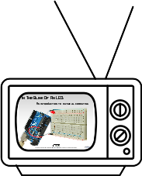
Previously On...
Voltage, Current and Resistance
Inputs and Outputs
Digital Vs. Analog
Commands
  pinMode(pin, INPUT/OUTPUT);
  digitalWrite(pin, HIGH/LOW);
  delay(ms);
  analogWrite(pin, 0-255);
Functions
  void setup() {}
  void loop() {}
Comments
  // Keep things clear
Variables
  int led = 9;
  int brightness = brightness + 1;

Slide 2

Ohm’s Law

Slide 3
Previously On...
Voltage, Current and Resistance
Inputs and Outputs
Digital Vs. Analog
Commands
  pinMode(pin, INPUT/OUTPUT);
  digitalWrite(pin, HIGH/LOW);
  delay(ms);
  analogWrite(pin, 0-255);
Functions
  void setup() {}
  void loop() {}
Comments
  // Keep things clear
Variables
  int led = 9;
  int brightness = brightness + 1;

Slide 4

The Most Important Lesson
Notes:
This is why there’s a diversity problem in Engineering

Slide 5
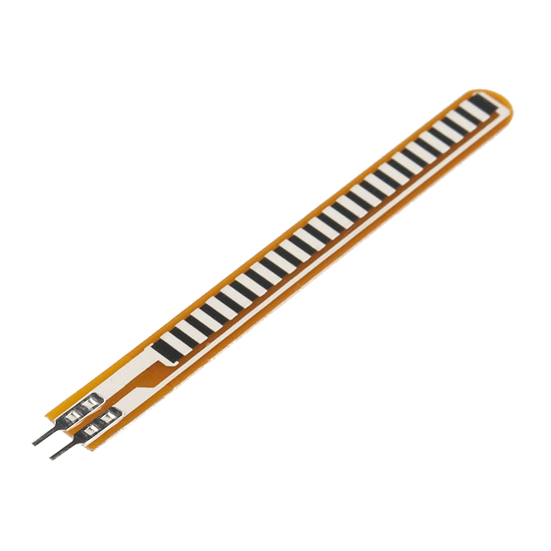
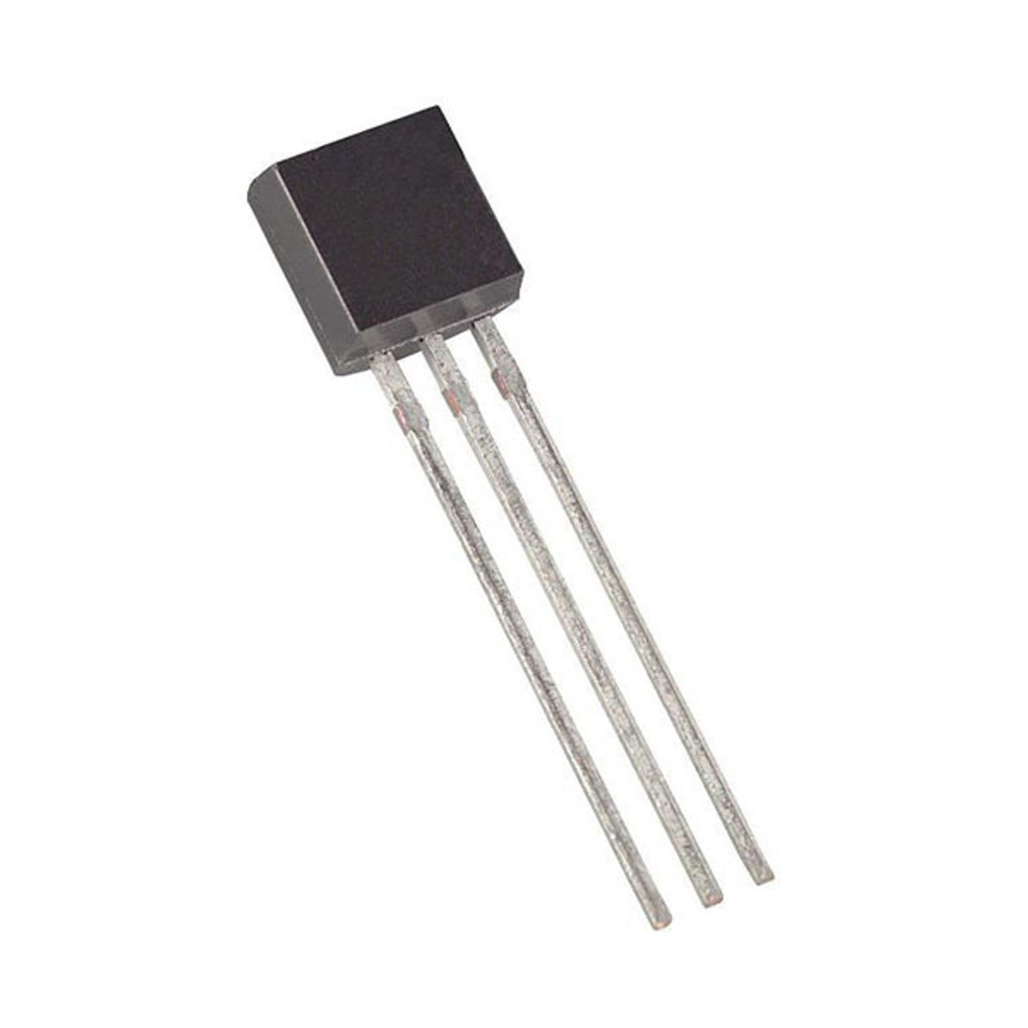

Inputs!
Input is any signal entering an electrical system
Both digital and analog sensors are forms of input
Input can also take many other forms: a keyboard, a mouse, infrared sensors, biometric sensors, touch sensors or just plain voltage from a circuit
This is what makes interactive exhibits interactive

Slide 6
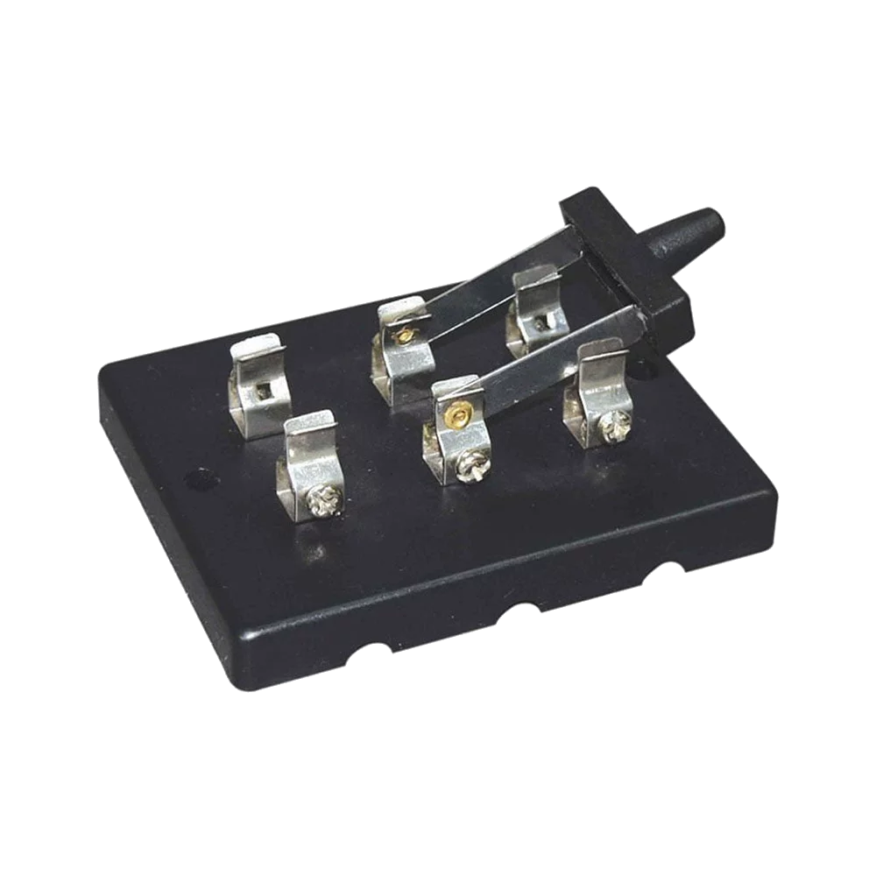
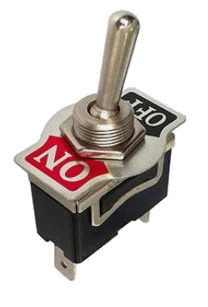
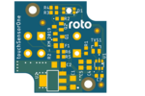

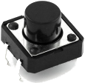
Digital Input
Like digital output, can only sense if a signal is high or low
For Arduino
  High is voltage above 3 V
  Low is voltage below 1.5 V
General category is “switches”
Includes push buttons (momentary switches), toggle switches, knife switches (maintained switches), capacitive/touch switches, and many other sensors

Slide 7
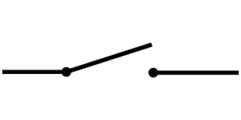
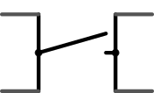
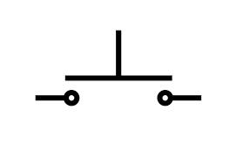
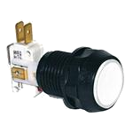
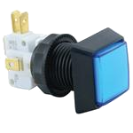
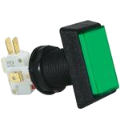
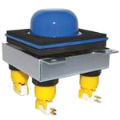
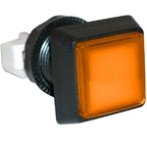
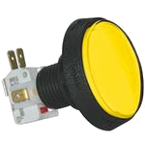
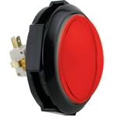
Component Spotlight: The Push Button /
Momentary Switch

Slide 8
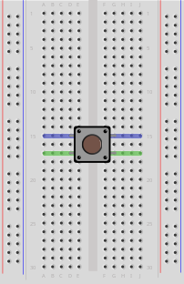
Push Button and Breadboard Connections
Our buttons have to bridge the gap on our breadboards
The top pins are connected to each other and so are the bottom ones

Slide 9
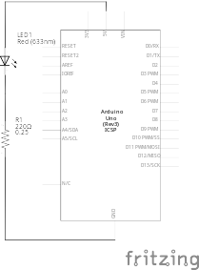
Using the Breadboard to Built a Simple Input Circuit
Remember our original circuit?

Slide 10
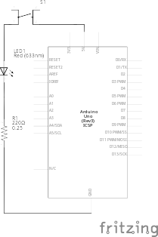
Using the Breadboard to Built a Simple Input Circuit
Remember our original circuit?
We’re going to wire that up again, but this time with a switch

Slide 11
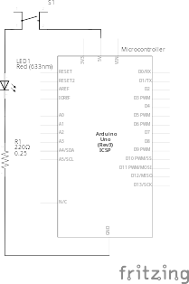
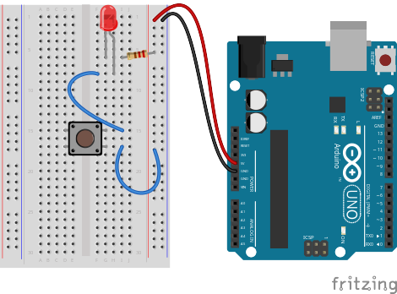
Using the Breadboard to Built a Simple Input Circuit

Slide 12

Using the Breadboard to Built a Simple Input Circuit

Slide 13



Go ahead and plug your board in!

Slide 14
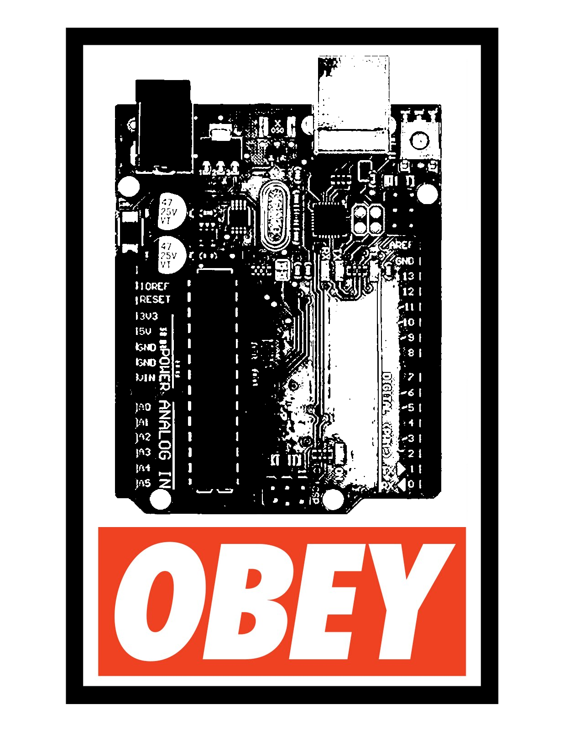
Adding Control

Slide 15
Adding Control
Any circuit that has meaningful input has some degree of control

Slide 16
Adding Control
Any circuit that has meaningful input has some degree of control
Microcontrollers allow us to assign different relationships between inputs and outputs

Slide 17
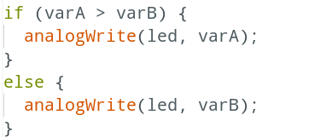
Project #3 – Lie Detector
Conditional Statements
the if() statement

Slide 18
Project #3 – Lie Detector
Conditional Statements
If this is true

Slide 19
Project #3 – Lie Detector
Conditional Statements
If this is true
Do this

Slide 20
Project #3 – Lie Detector
Conditional Statements
If this is true
Do this
Otherwise

Slide 21
Project #3 – Lie Detector
Conditional Statements
If this is true
Do this
Otherwise
Do this

Slide 22
Boolean Operators
<Boolean> | True if:
(a) | a is true, HIGH or does not equal zero
(!a) | a is false, LOW or equals zero
(a) == (b) | a is equal to b
(a) != (b) | a is not equal to b
(a) > (b) | a is greater than b
(a) >= (b) | a is greater than or equal to b
(a) < (b) | a is less than b
(a) <= (b) | a is less than or equal to b
(a) && (b) | both a is true AND b is true
(a) || (b) | either a is true OR b is true

Slide 23

Déjà Vu

Slide 24

digitalRead()
Project #4 – Button/Maintained Switch Switch
Who you callin’ momentary?
Psuedo-code – how should this work?
LED turns off
Button Pressed?
LED
status?
ON
Rinse & Repeat
YES
OFF
LED turns on

Slide 25
digitalRead()
Project #4 – Button/Maintained Switch Switch
Who you callin’ momentary?
Psuedo-code – how should this work?
LED turns off
Button Pressed?
Pressed Before?
LED
status?
ON
Rinse & Repeat
YES
NO
OFF
LED turns on

Slide 26
Project #4 – Button/Maintained Switch Switch
Inputs and Outputs
LED turns off
Button Pressed?
Pressed Before?
LED
status?
ON
Rinse & Repeat
YES
NO
OFF
LED turns on
Inputs | Outputs
Push Button | LED
Notes:
Our program is running hundreds of thousands of times every second

Slide 27
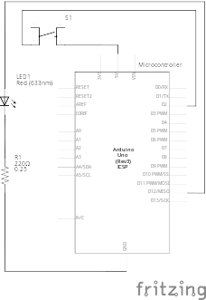
Transitioning to Micro-control
Output & Input

Slide 28
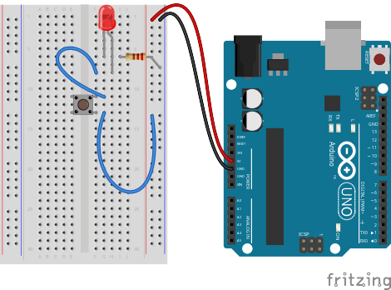
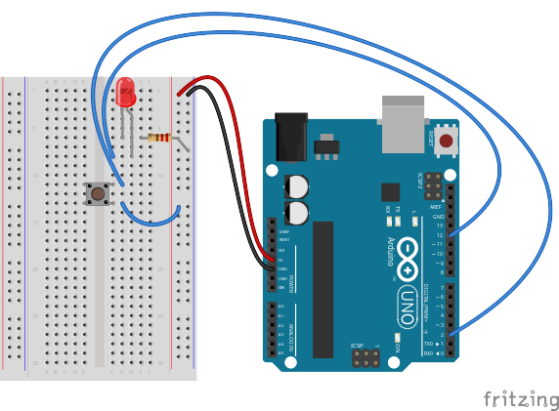
Transitioning to Micro-control
Output & Input

Slide 29
Project #4 – Button/Maintained Switch Switch
Wiring Diagram

Slide 30
Project #4 – Button/Maintained Switch Switch
Wiring Diagram
WRONG!!!

Slide 31
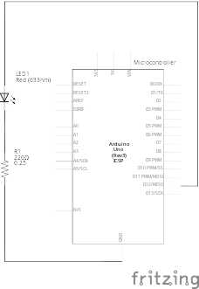
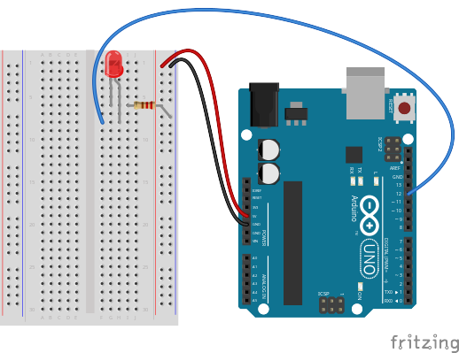
This Part Is Good

Slide 32
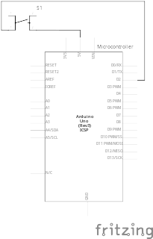
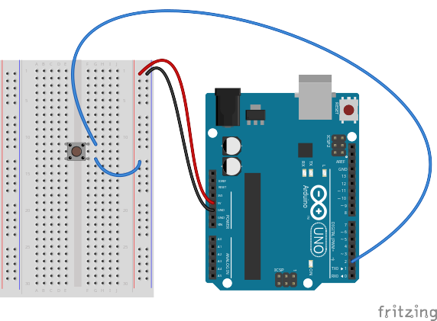
So This Must Be Bad…

Slide 33
So This Must Be Bad…
But Why?!

Slide 34
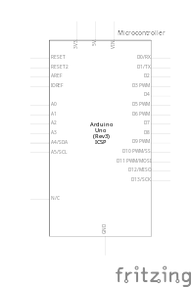

Another Water Analogy

Slide 35
Analogy Continued...

Slide 36
Analogy Continued...
?

Slide 37

All Stopped Up

Slide 38

All Stopped Up
(kinda)

Slide 39
Switch Off

Slide 40

Switch On

Slide 41

Switch Off?!

Slide 42

Analogy Extended
(Thin but holding)

Slide 43
So This Approach...

Slide 44
Doesn’t Work!

Slide 45
What About...

Slide 46
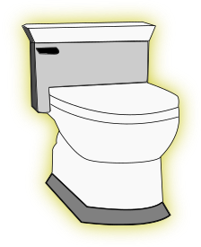
Changing Bathroom Fixtures?

Slide 48
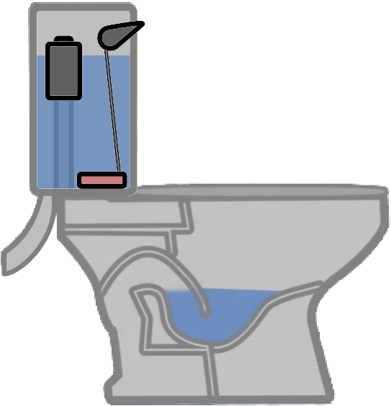
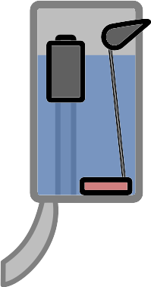
Getting Rid of the Unnecessary Crap

Slide 49
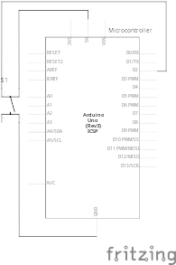
Changing the Viewpoint

Slide 50
Changing the Viewpoint

Slide 51
Changing the Viewpoint

Slide 52
Changing the Viewpoint

Slide 53
Switch Off

Slide 54

Switch On

Slide 55
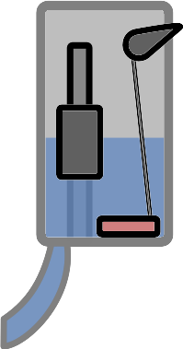
Switch Right After Off

Slide 56
Switch Off

Slide 57
Stop Playin’ With the Commode!!

Slide 58

Possible Solution

Slide 59
How Do We Get Here?
?

Slide 60


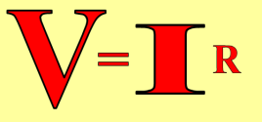
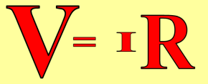
Resistance Analogy
Water
Tower
Water
Tower
V
Big Pipe == Lower Resistance
Small Pipe == Higher Resistance

Slide 61
How Do We Get Here?
?

Slide 62
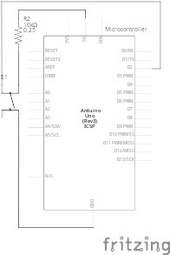
The Pull-Up Resistor!

Slide 63
But There’s A Trade-Off Between This...

Slide 64
…And This

Slide 65
It’s All About Compromise
10kΩ is a good value
(brown-black-black-red-gold)
or
(brown-black-orange-gold)

Slide 66

Decoding Resistor Values

Slide 67
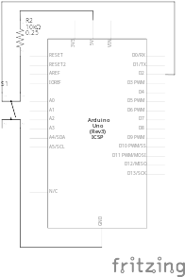
Project #4 – Button/Maintained Switch Switch
Input Schematic
Schematic of Pull-Up Resistor and Switch

Slide 68
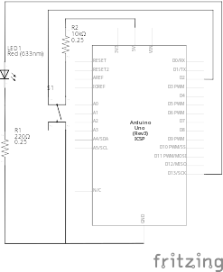
Project #4 – Button/Maintained Switch Switch
Full Schematic
And the output is still the same as Project 1!

Slide 69
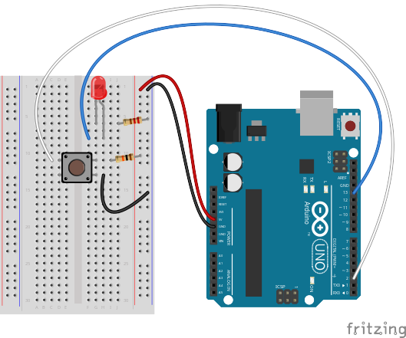
Project #4 – Button/Maintained Switch Switch
Wiring Diagram

Slide 70
Project #4 – Button/Maintained Switch Switch
Our First Input Commands!
pinMode(pin, INPUT/OUTPUT);
Notes:
Three commands to rule the world… or at least do 80% of cool Arduino projects.

Slide 71
Project #4 – Button/Maintained Switch Switch
Our First Input Commands!
pinMode(pin, INPUT/OUTPUT);
ex: pinMode(2, INPUT);
Notes:
Three commands to rule the world… or at least do 80% of cool Arduino projects.

Slide 72
Project #4 – Button/Maintained Switch Switch
Our First Input Commands!
pinMode(pin, INPUT/OUTPUT);
ex: pinMode(2, INPUT);
digitalRead(pin);
Notes:
Three commands to rule the world… or at least do 80% of cool Arduino projects.

Slide 73
Project #4 – Button/Maintained Switch Switch
Our First Input Commands!
pinMode(pin, INPUT/OUTPUT);
ex: pinMode(2, INPUT);
digitalRead(pin);
ex: digitalRead(2);
Notes:
Three commands to rule the world… or at least do 80% of cool Arduino projects.

Slide 74
Project #4 – Button/Maintained Switch Switch
Our First Input Commands!
pinMode(pin, INPUT/OUTPUT);
ex: pinMode(2, INPUT);
digitalRead(pin);
ex: digitalRead(2);
ex: int button_state = digitalRead(2);
Notes:
Three commands to rule the world… or at least do 80% of cool Arduino projects.

Slide 75
Project #4 – Button/Maintained Switch Switch
Our First Input Commands!
pinMode(pin, INPUT/OUTPUT);
ex: pinMode(2, INPUT);
digitalRead(pin);
ex: digitalRead(2);
ex: int button_state = digitalRead(2);
button_state will either be HIGH or LOW
HIGH if switch is off, LOW if switch is on
Notes:
Three commands to rule the world… or at least do 80% of cool Arduino projects.

Slide 76
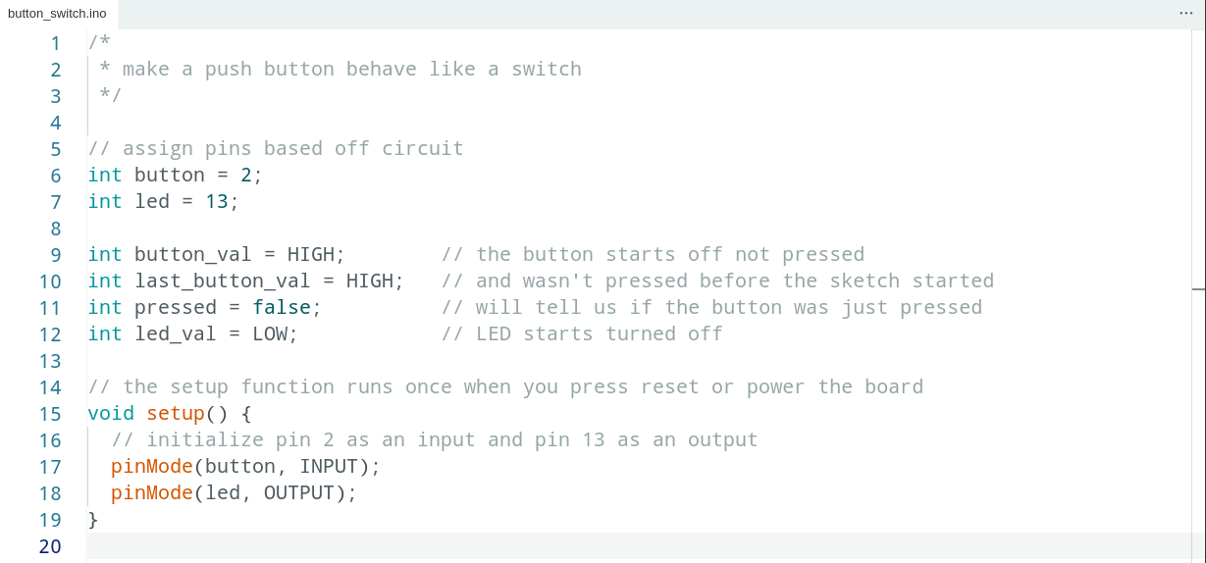
Project #4 – Button/Maintained Switch Switch
Code Review

Slide 77
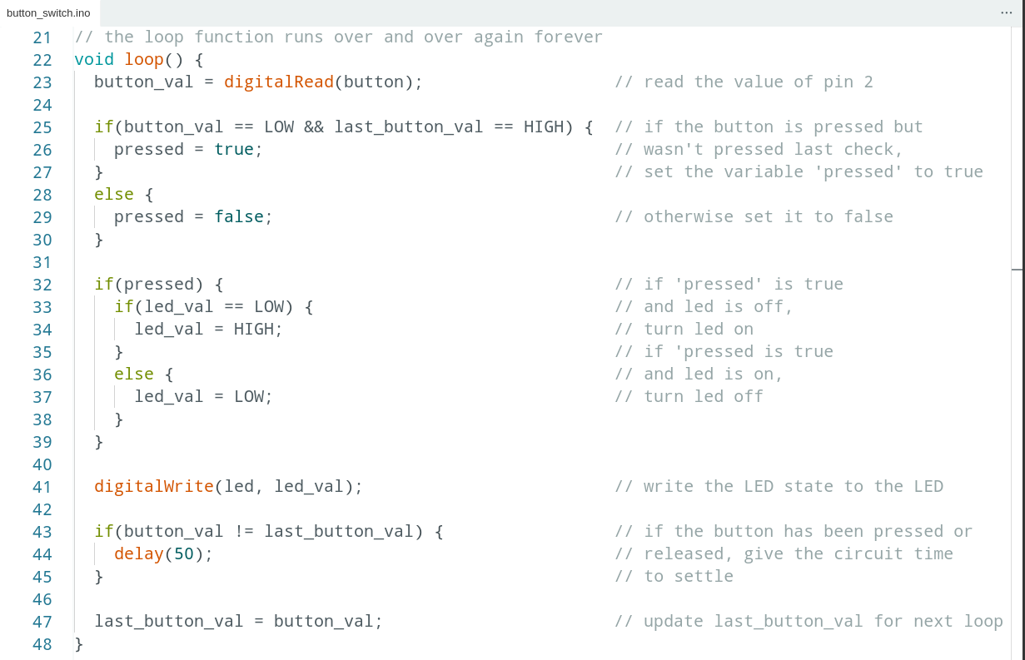
Code Review Continued

Slide 78
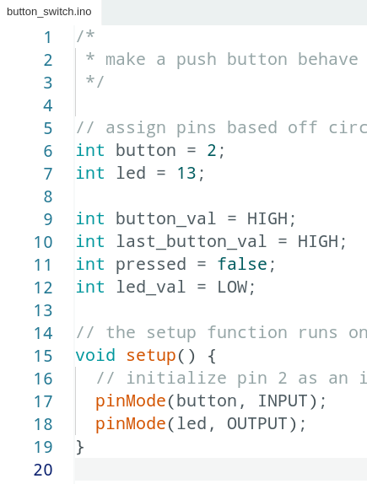
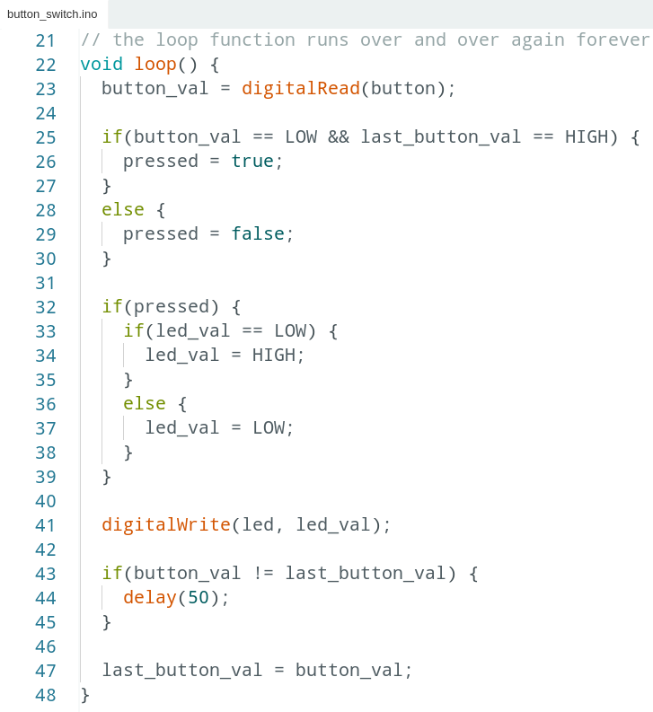
Code Review Continued

Slide 79
Project #4 – Button/Maintained Switch Switch
Puzzles
Challenge 4a – Wire another LED. Make the button turn one off and the other on
Challenge 4b – Make an LED blink when you press the button (hint: look at File>Examples>Digital>Blink Without Delay)
Challenge 4c – Make an LED alternate between off, on and blink by pressing the button

Slide 80
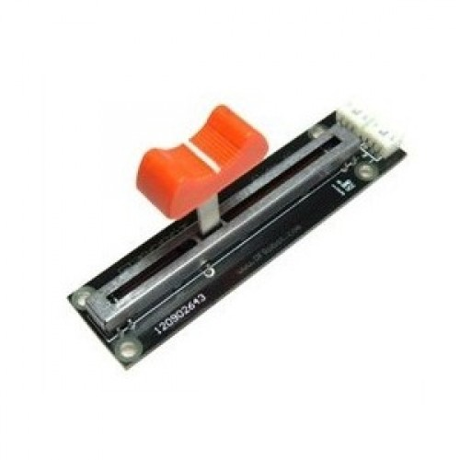
analogRead()
Project #4 – Night Light
How Dark Is Too Dark?
Psuedo-code – how should this work?
LED turns on
TOO DARK!
Check How Dark It Is
How Dark Is It?
Rinse & Repeat
IT’S FINE
LED turns off

Slide 81
Project #4 - Night Light
Inputs and Outputs
LED turns on
TOO DARK!
Check How Dark It Is
How Dark Is It?
Rinse & Repeat
IT’S FINE
LED turns off
Inputs | Outputs
Photoresistor | LED

Slide 82
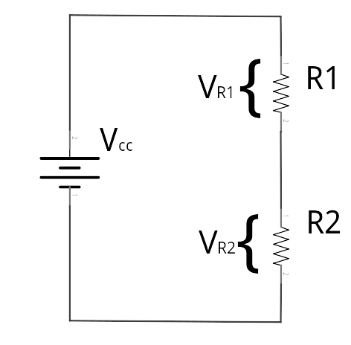
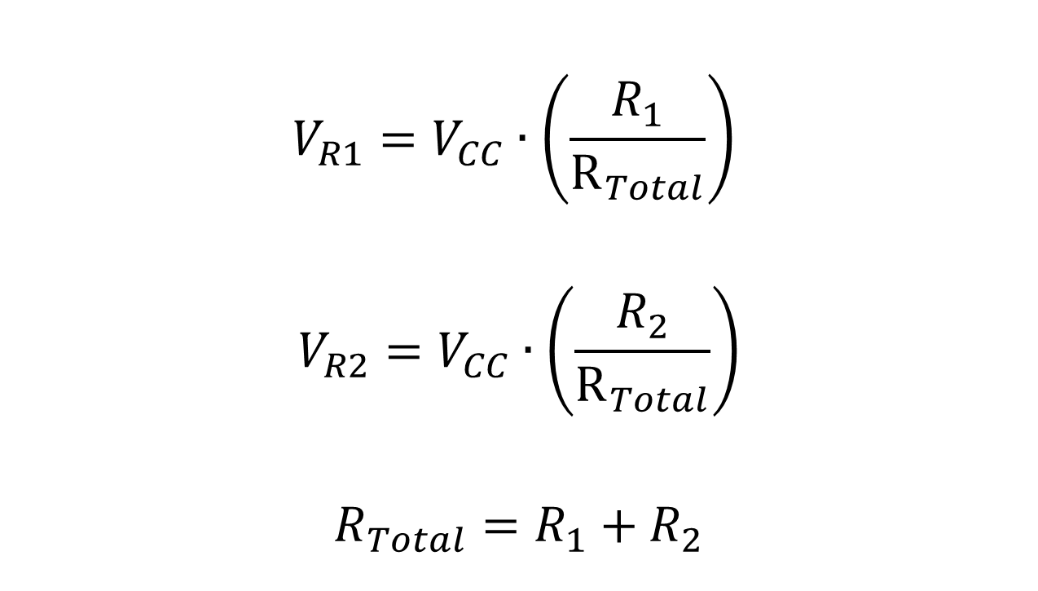
The Voltage Divider

Slide 83

The Voltage Divider

Slide 84

The Voltage Divider
“From each according to their ability, to each according to their need.”

Slide 85

The Voltage Divider
How many carrots does the fairy have left at this point?

Slide 86

The Voltage Divider
How many carrots does the fairy have left at this point?

Slide 87

The Voltage Divider
How many carrots does the fairy have left at this point?

Slide 88

The Voltage Divider
How many carrots does the fairy have left at this point?

Slide 89

The Voltage Divider
How many carrots does the fairy have left at this point?

Slide 90

The Switch-Over

Slide 91

Project #4 – Night Light
Schematic

Slide 92

Project #4 – Night Light
Wiring Diagram

Slide 93

Project #4 – Night Light
int sensor_val = analogRead(pin);
pin – refers to the analog input pin (limited to pins A0, A1, A2, A3, A4 and A5)
Arduino uses a 10-bit analog-to-digital converter (ADC):
This means that sensor_val is always a number between 0 and 1023
  Minimum Carrots → 0
  Maximum Carrots → 1023

Slide 94
Determining Analog Values
But the top bunny is always going to get some carrots, so we can’t really get to 1023
And we can’t really make our bottom bunny so small that it gets 0 carrots
So how do we determine the minimum and maximum numbers for our circuit?
Do math

Slide 95
Determining Analog Values
But the top bunny is always going to get some carrots, so we can’t really get to 1023
And we can’t really make our bottom bunny so small that it gets 0 carrots
So how do we determine the minimum and maximum numbers for our circuit?
Do math
Ask the microcontroller

Slide 96




Using Serial Communication
Method used to transfer data between two devices.
Data passes between the computer and Arduino through the Universal Serial Bus (USB!) cable. Data is transmitted as zeros (‘0’) and ones (‘1’) sequentially.
Arduino dedicates Digital I/O pin # 0 to receiving and Digital I/O pin #1 to transmit.
Notes:
Serial is the same for novels, soldiers, murders, killers, communication
For this reason, we typically do not use Digital I/O 0 or 1 for anything in our designs.

Slide 97

Displaying the Serial Monitor

Slide 98

A Tour of the Serial Monitor

Slide 99

A Tour of the Serial Monitor

Slide 100

A Tour of the Serial Monitor

Slide 101

A Tour of the Serial Monitor

Slide 102

A Tour of the Serial Monitor

Slide 103

A Tour of the Serial Monitor

Slide 104


Baud Rate
How do we know how many 0’s and 1’s there are?
We tell how the computer and microcontroller how long a signal has to be high or low to count as a 1 or a 0 by setting the baud rate
For our purposes it doesn’t really matter what the baud rate is, it’s just important that the microcontroller and computer agree!

Slide 105
Serial Commands
Serial.begin(baud_rate);
ex: Serial.begin(9600);
Serial.print(“Text”);
Serial.print(variable);
Serial.println(“Text”);
Serial.println(variable);

Slide 106

Ask Arduino - Code Review

Slide 107

Serial Communication:
Serial Debugging
void loop()
{
int xVar = 10;
Serial.print ( “Variable xVar is “ ) ;
Serial.println ( xVar ) ;
}

Slide 108

Serial Communication:
Serial Troubleshooting
void loop ( )
{
Serial.print (“Digital pin 9: “);
Serial.println (digitalRead(9));
}

Slide 109

Night Light - Code Review

Slide 110
Analog Sensors
Examples:
Sensors | Variables
Photoresistor | light_level
Microphone | sound_volume
Temp Sensor | temp
Flex Sensor | bend
Accelerometer | tilt, acceleration

Slide 111

Trimpot (Potentiometer)
Variable Resistor
fixed
end
wiper
fixed
end

Slide 112
Trimpot (Potentiometer)
Variable Resistor

Slide 113
Trimpot (Potentiometer)
What does it mean?
Since we’re controlling the size of both bunnies:
We can make either bunny so small it gets zero carrots
We get the full range of 0-1023!
  This makes potentiometers excellent controllers for physical computing “settings”
  Can we think of any examples?
  But what if the setting we want to control has less (or more) than 1023 values? Or if we want it not to start at 0?
    Do math

Slide 114
Trimpot (Potentiometer)
What does it mean?
Since we’re controlling the size of both bunnies:
We can make either bunny so small it gets zero carrots
We get the full range of 0-1023!
  This makes potentiometers excellent controllers for physical computing “settings”
  Can we think of any examples?
  But what if the setting we want to control has less (or more) than 1023 values? Or if we want it not to start at 0?
    Do math
    Get the microcontroller to do it for us

Slide 115
Map Command
int new_var = map(old_var, old_low, old_high, new_low, new_high);
ex: offset_val = map(val, 0, 100, -50, 50);
ex: reverse_val = map(val, 1, 100, 100, 1);
ex: write_val = map(read_val, 0, 1023, 0, 255);

Slide 116
Project #5 – Real Time Color Mixer
Tying it all together...
Psuedo-code – how should this work?
Change to green
Light green LED
RED
Button A Pressed?
Pressed Before?
Current LED?
Change to blue
Light yellow LED
YES
NO
GREEN
BLUE
Change to red
Light red LED
Write a scaled trimpot value to red pin of RGB LED
RED
Button B Pressed?
Read trimpot
Current LED?
Write a scaled trimpot value to green pin of RGB LED
YES
GREEN
BLUE
Write a scaled trimpot value to blue pin of RGB LED

Slide 117
Project #5 – Inputs and Outputs
Inputs | Outputs
a “Select” Button | Red Indicator
an “Adjust” Button | Green Indicator
Trimpot | Blue Indicator
 | RGB LED

Slide 118

Project #5 – Real Time Color Mixer
Schematic

Slide 119

Project #5 – Real Time Color Mixer
Wiring Diagram

Slide 120

Where To Go From Here:

Slide 121


Special Thanks:
www.sparkfun.com
6175 Longbow Drive, Suite 200
Boulder, Colorado 80301

