Slide 1
Overview of Class
Getting Started:
Context, Components, Software Installation
Electrical:
Ohm's Law, Input and Output, Analog and Digital
Microcontrollers:
Digital Outputs, Digital Inputs, Analog Outputs, Analog Inputs, Serial Communication

Slide 2


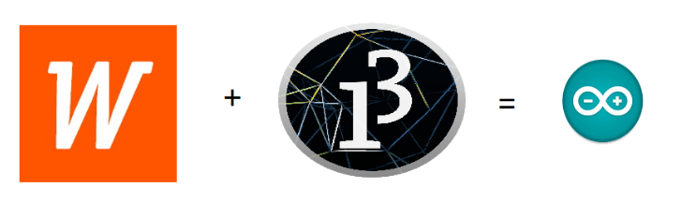
Wiring Library, Processing
(and Arduino)
Open Source Hardware/Software
Processor
Coding is accessible & transferrable
(C++, Processing, java)

Slide 3

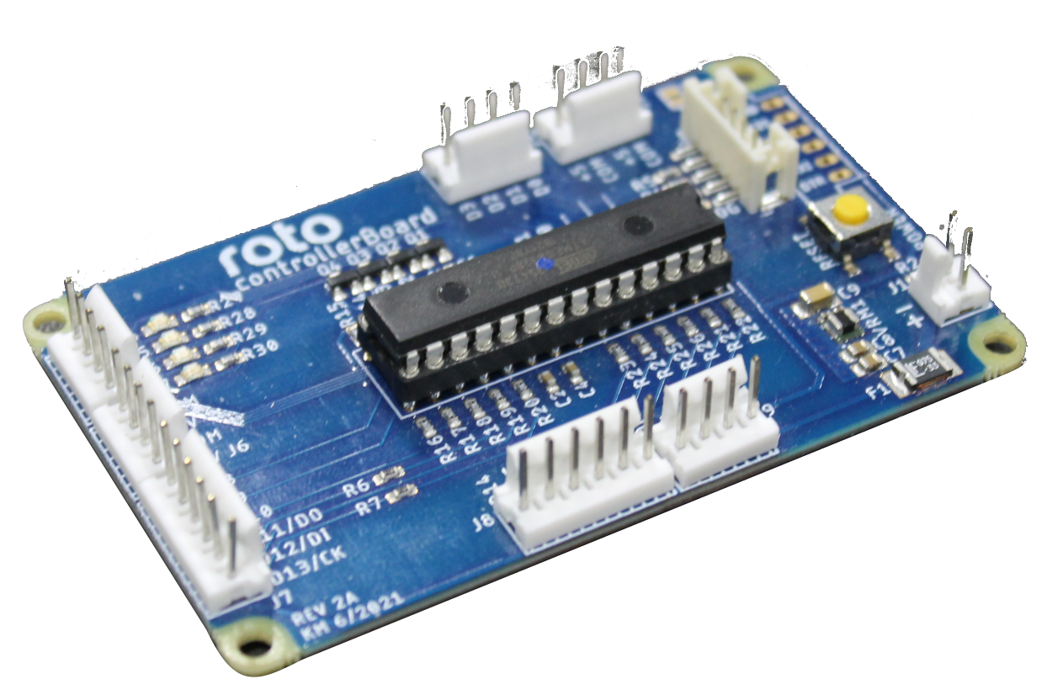
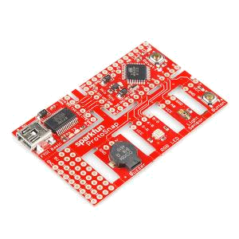
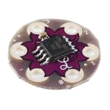
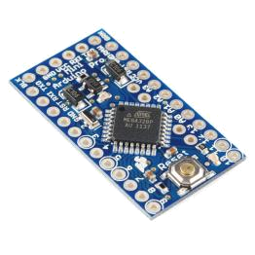
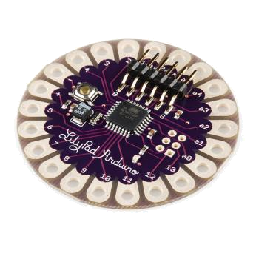
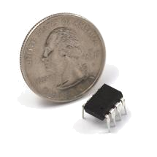
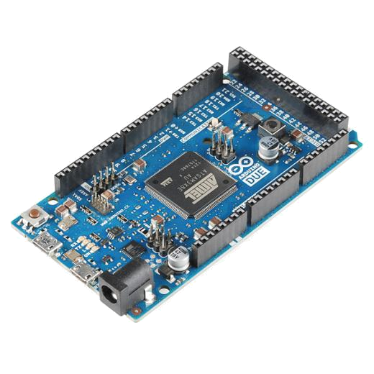
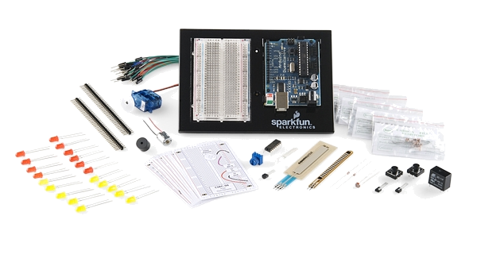
Arduino & Arduino Compatible Boards

Slide 4

USB
(to Computer)
PWR IN
RESET
SCL\SDA
(I2C Bus)
POWER
5V / 3.3V / GND
Digital I\O Pins
PWM(3, 5, 6, 9, 10, 11)
Analog INPUTS
Notes:
Look up analog ref

Slide 5
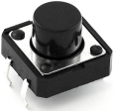
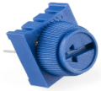
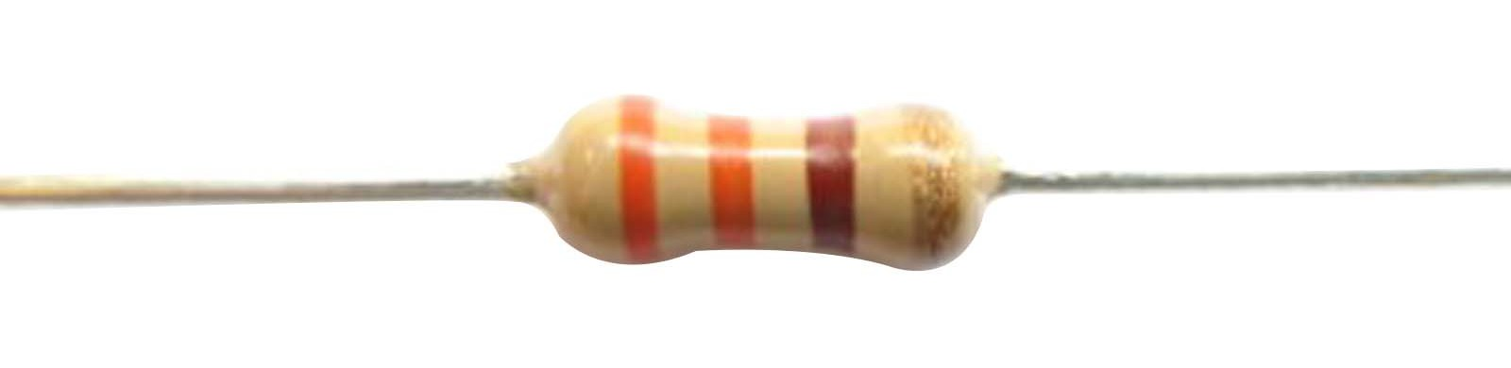




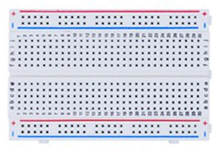
Included Components
Name | Image | Type | Function | Notes
Push Button |  | Digital Input | Switch - Closes or opens circuit
Trim potentiometer |  | Analog Input | Variable resistor | Also called a Trimpot.
Resistor |  | Passive Component | Drops Voltage | Color-Coded for Different Values
Photoresistor |  | Analog Input | Light Dependent Resistor (LDR) | Resistance varies with light.
LED |  | Digital & Analog Output | Emits a single wavelength light
RGB LED |  | Digital & Analog Output | 16,777,216 different colors | Ooh... So pretty.
Jumper Wires |  | Interconnect | Connects other components | Your extroverted friend
Breadboard |  | Interconnect | Where the connections happen | The neighborhood pub

Slide 6
Getting Started
SW Installation: Arduino (v.1.0+)

Slide 7
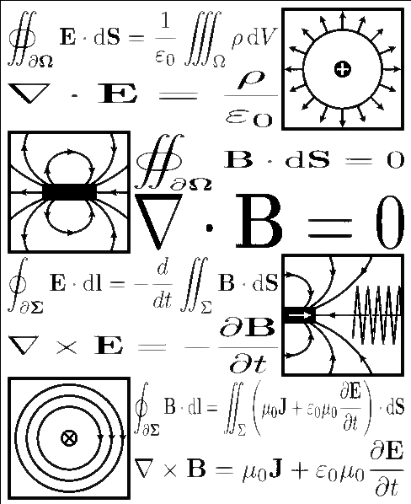
Electricity \ Electronics Basic Concepts
Ohms Law
Voltage
Current
Resistance
Using a Multimeter

Slide 8

Ohm’s Law

Slide 9
Electrical Properties
Voltage
V
Current
I
Resistance
R
  Defined as the amount of potential energy in a circuit.
  Units: Volts (V)
  The rate of charge flow in a circuit.
  Units: Amperes (A)
  Opposition to charge flow.
  Units: Ohms (Ω)

Slide 10



Current Flow Analogy
High Current
Low Current

Slide 11

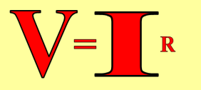

Voltage Analogy
Water
Tower
Water
Tower
V
V
More Energy == Higher Voltage
Less Energy == Lower Voltage

Slide 12
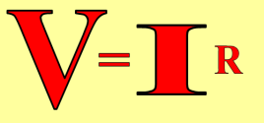
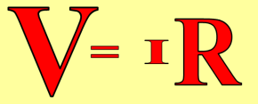
Resistance Analogy
Water
Tower
Water
Tower
V
Big Pipe == Lower Resistance
Small Pipe == Higher Resistance

Slide 13
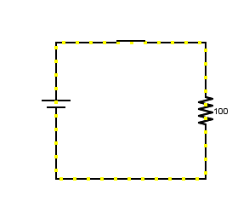
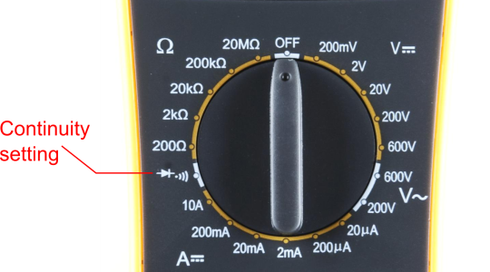
Continuity – Is it a Circuit?
The word “circuit” is derived from the circle. An Electrical Circuit must have a continuous LOOP from Power (V_{cc}) to Ground (GND).
Continuity is important to make portions of circuits are connect. Continuity is the simplest and possibly the most important setting on your multimeter. Sometimes we call this “ringing out” a circuit.

Slide 14
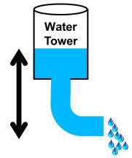

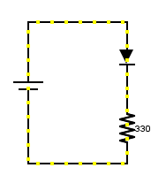

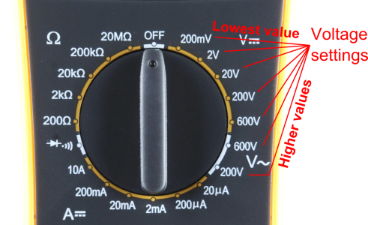
Measuring Electricity – Voltage
Voltage is a measure of potential electrical energy. A voltage is also called a potential difference – it is measured between two points in a circuit – across a device.

Slide 15
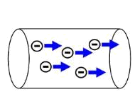
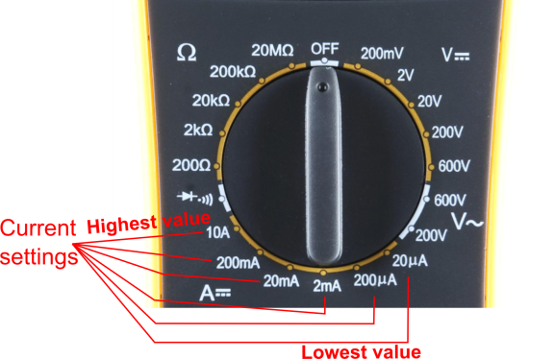
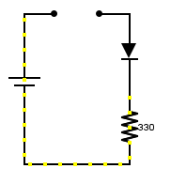
Measuring Electricity -- Current
Current is the measure of the rate of charge flow. For Electrical Engineers – we consider this to be the movement of electrons.
In order to measure this – you must break the circuit or insert the meter in-line (series).

Slide 16
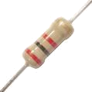
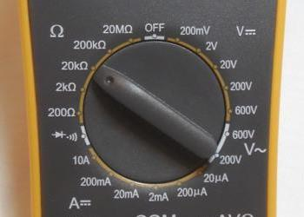

Measuring Electricity -- Resistance
Resistance is the measure of how much opposition to current flow is in a circuit.
Components should be removed entirely from the circuit to measure resistance. Note the settings on the multimeter. Make sure that you are set for the appropriate range.
Resistance
settings

Slide 17
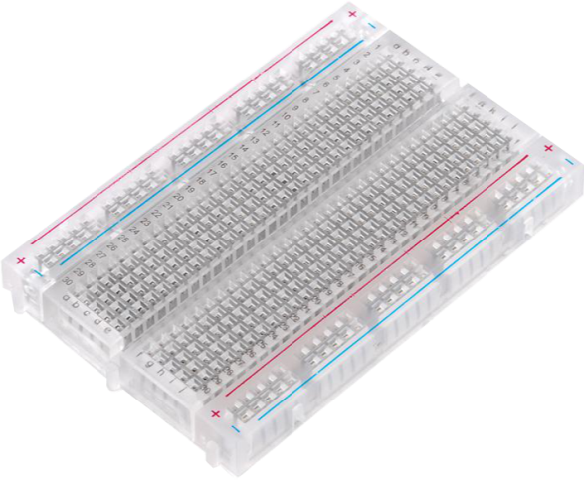
Prototyping Circuits
Solderless Breadboard
One of the most useful tools in an engineer or Maker’s toolkit. The three most important things:
  A breadboard is easier than soldering
  A lot of those little holes are connected, which ones?
  Sometimes breadboards break

Slide 18
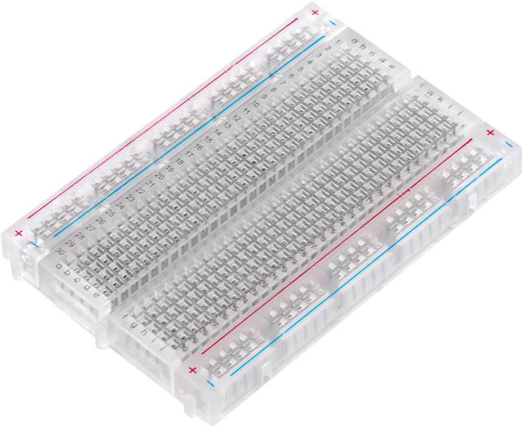
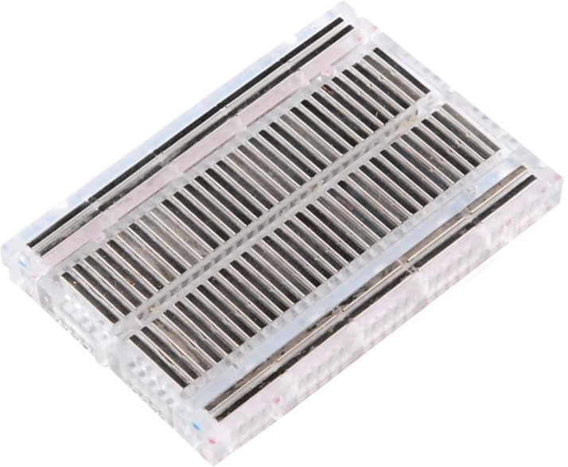
What’s a Breadboard?

Slide 19
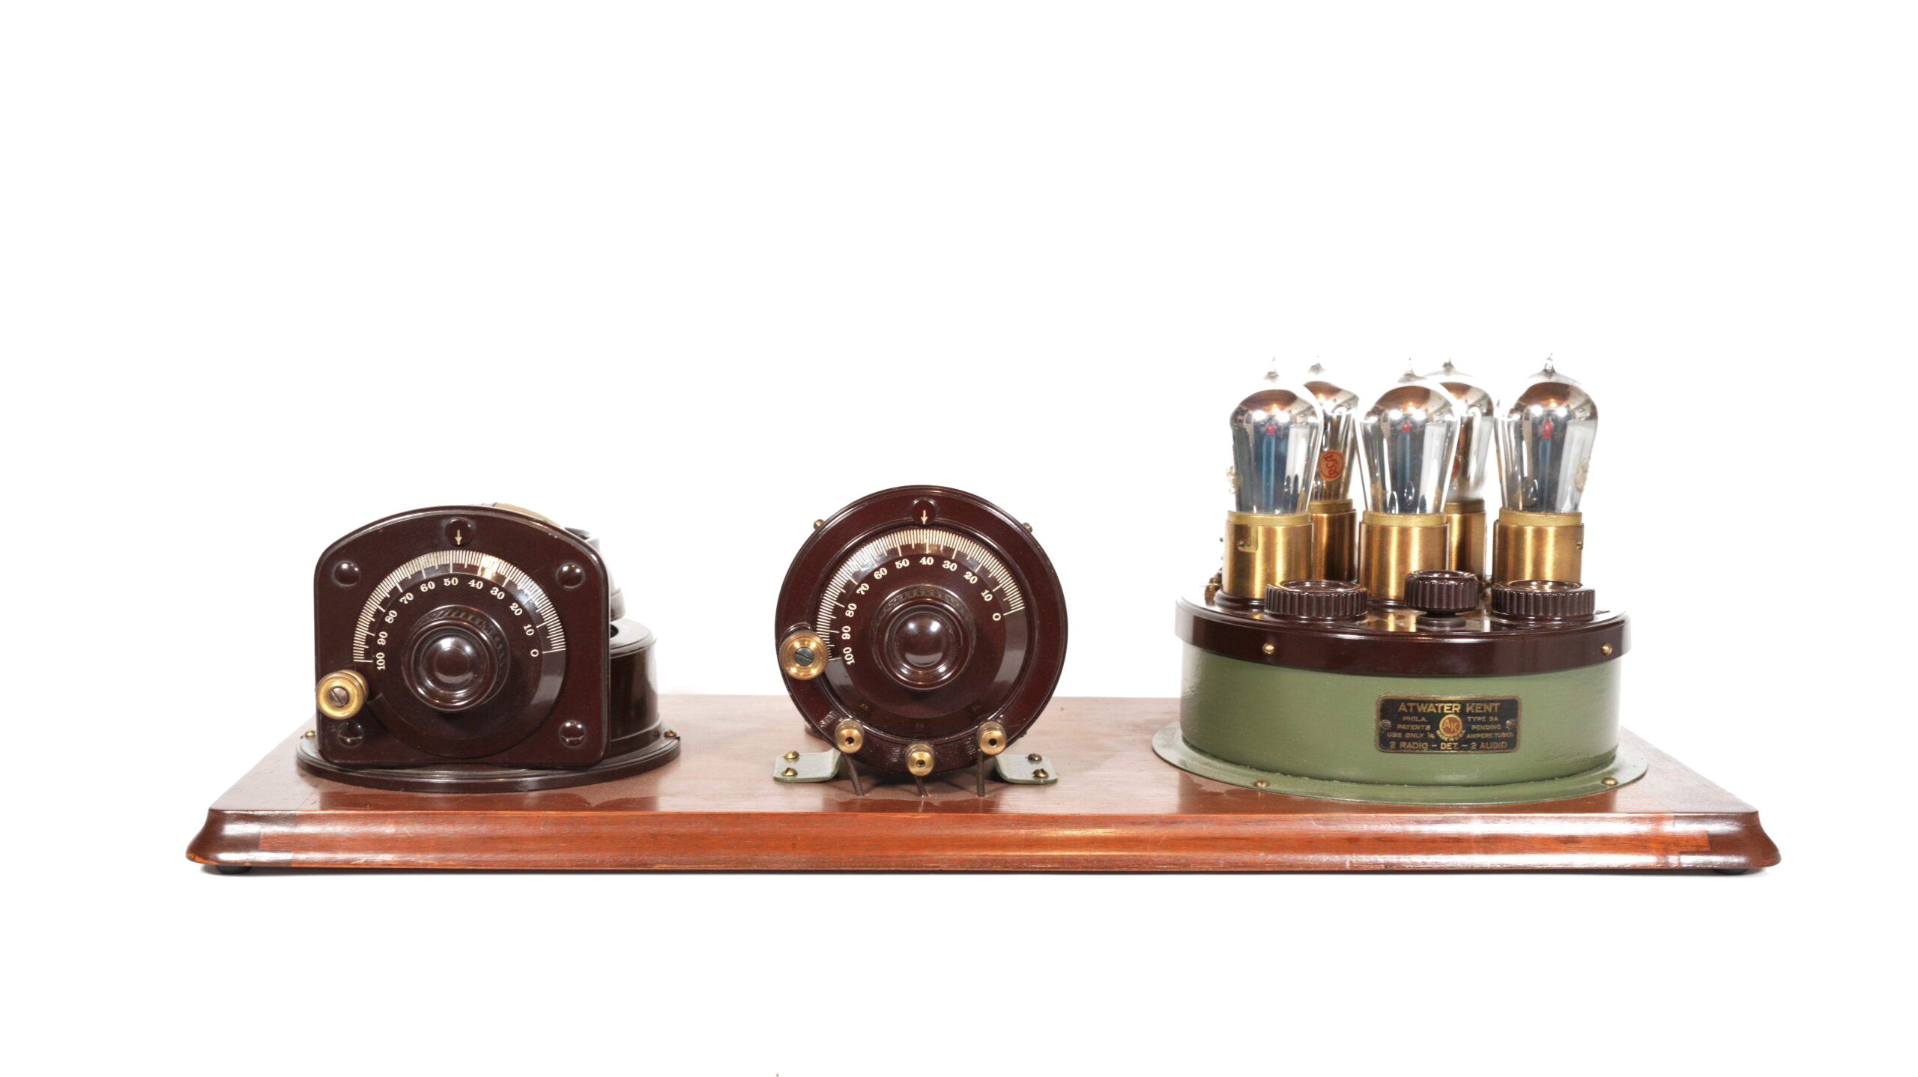
Why a Breadboard?

Slide 20
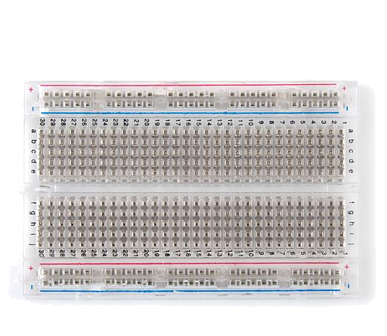
Solderless Breadboard
Each row (horizontal) of 5 holes are connected
Vertical columns- called power buses- are connected vertically

Slide 21
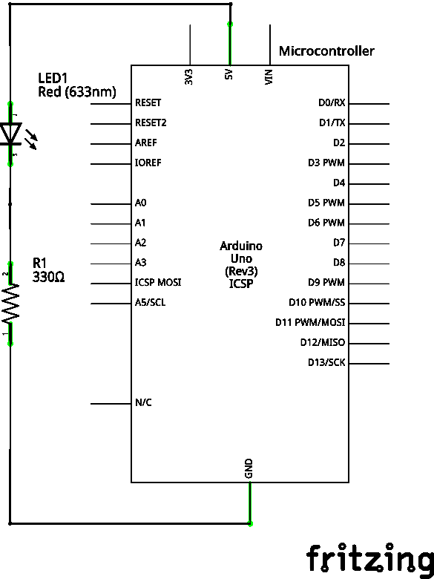
Using the Breadboard to built a simple circuit
Use the breadboard to wire up a single LED with a 330 Ω Resistor (Orange-Orange-Brown).
Note: the longer leg on the LED is the positive leg and the shorter leg is the negative

Slide 22
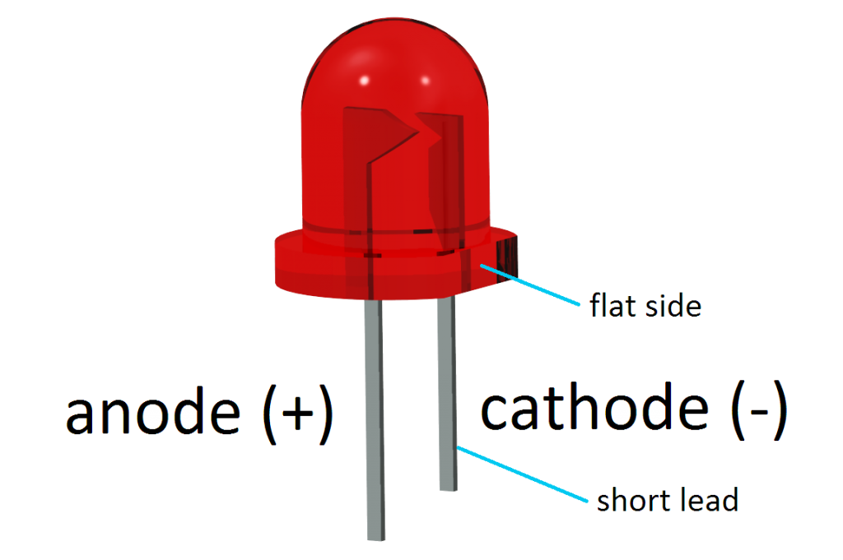

Mnemonic for LEDs
Cathode, like Cathy, is short and negative

Slide 23
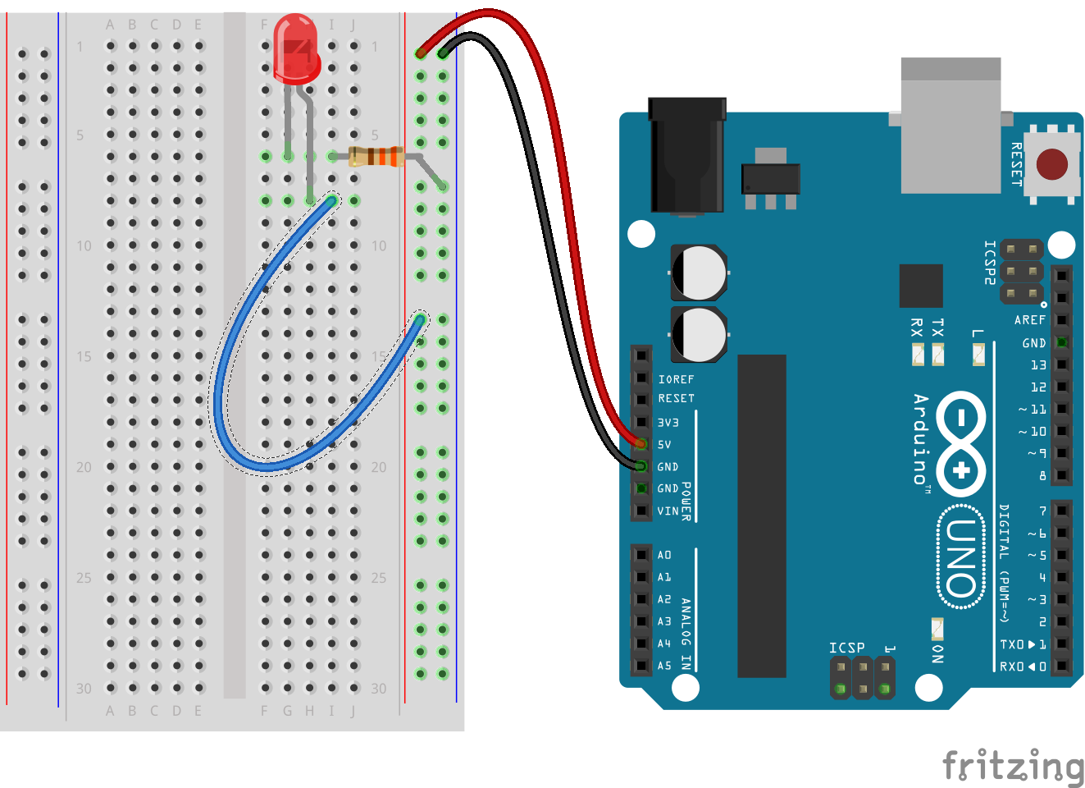
Using the Breadboard to built a simple circuit

Slide 24



Go ahead and plug your board in!

Slide 25
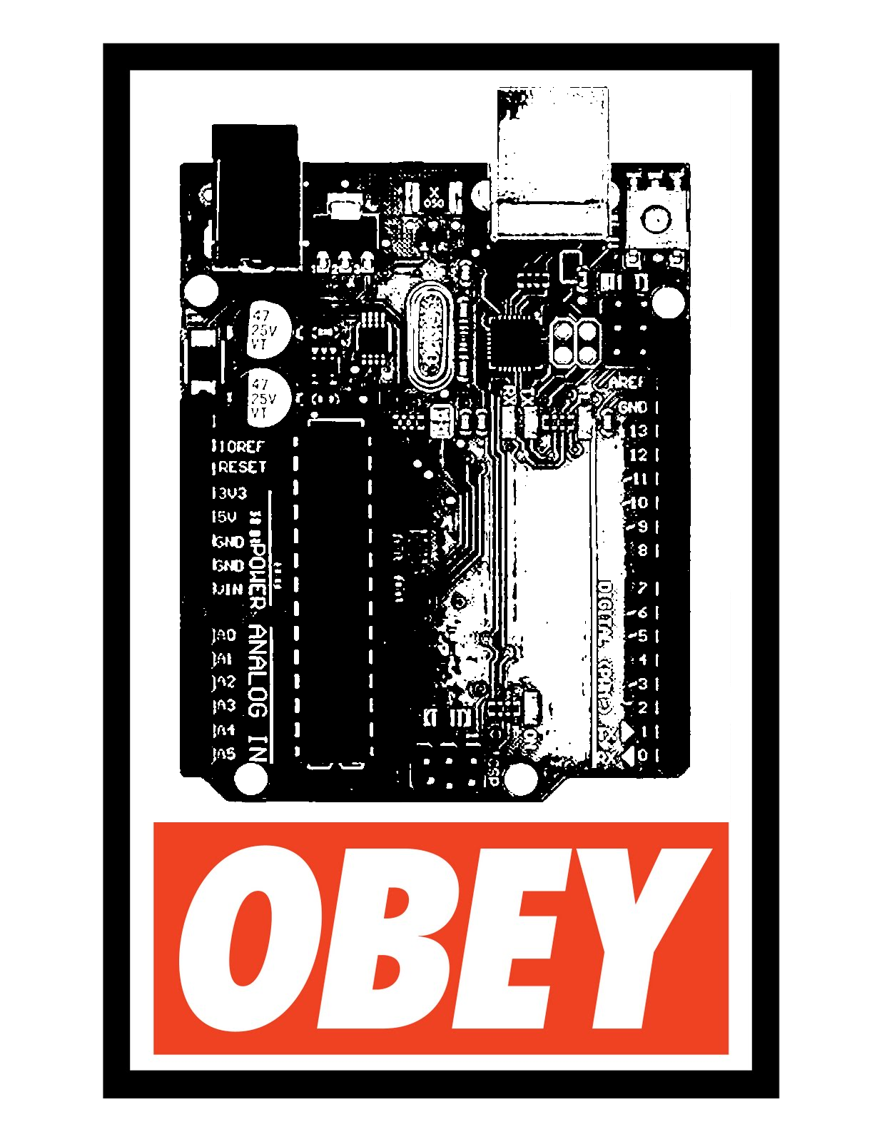
Adding Control

Slide 26

Concepts: INPUT vs. OUTPUT
Referenced from the perspective of the microcontroller
Inputs is a signal / information going into the board.
Output is any signal exiting the board.
Almost all systems that use physical computing will have some form of output
What are some examples of Outputs?

Slide 27
Concepts: INPUT vs. OUTPUT
Referenced from the perspective of the microcontroller
Inputs is a signal / information going into the board.
Output is any signal exiting the board.
Examples: Buttons Switches, Light Sensors, Flex Sensors, Humidity Sensors, Temperature Sensors…
Examples: LEDs, DC motor, servo motor, a piezo buzzer, relay, an RGB LED, speaker

Slide 28
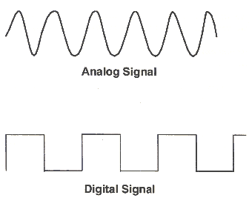
Concepts: Analog vs. Digital
Microcontrollers are digital devices – ON or OFF. Also called – discrete.
analog signals are anything that can be a full range of values. What are some examples? More on this later…
5 V
5 V
0 V
0 V

Slide 29
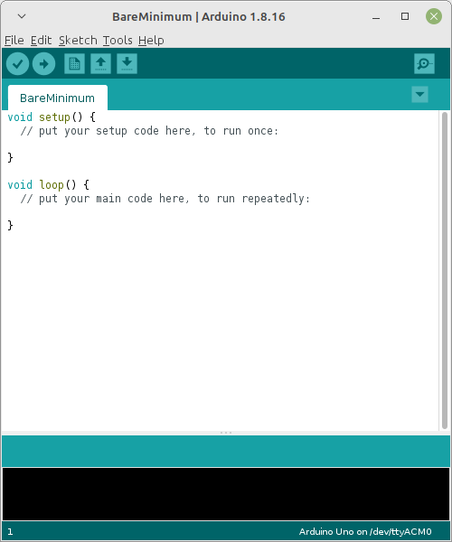
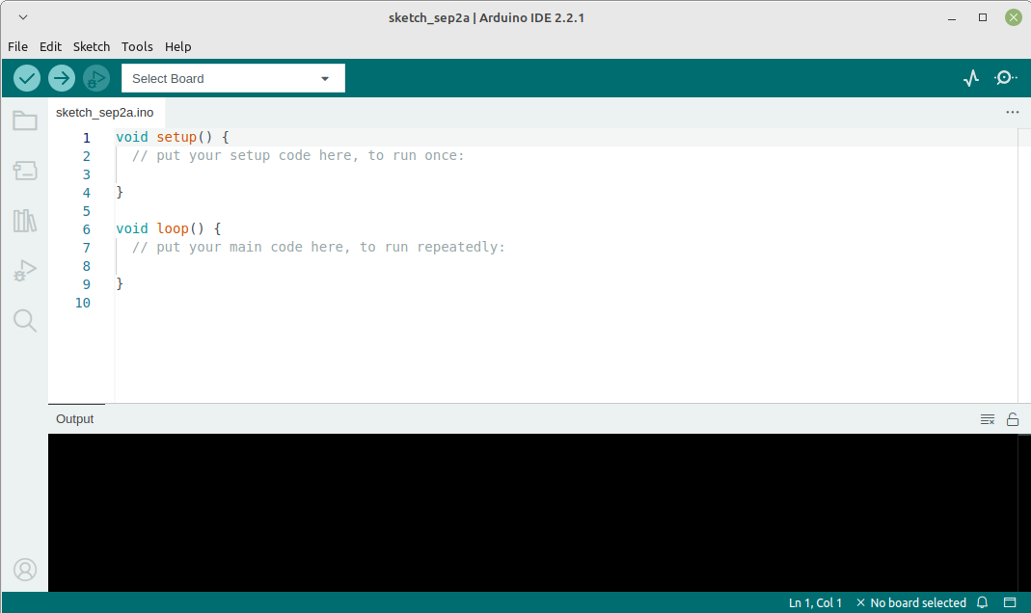
Open up Arduino IDE
IDE → Integrated Development Environment
Lets you write, compile (and upload) code all in the same place
Versions 1 and 2 are aesthetically different, functionally the same (for our purposes)

Slide 30
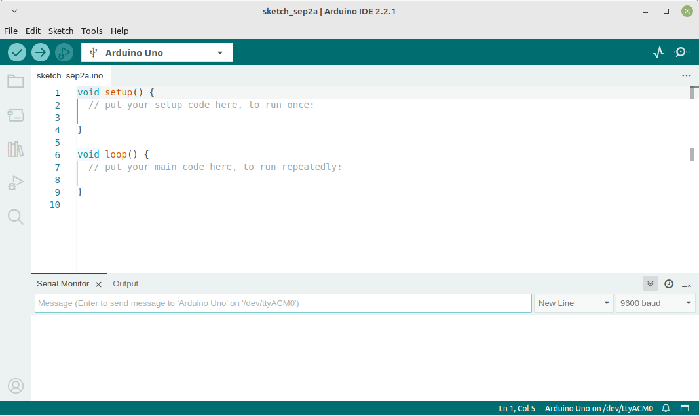
Exploring the Arduino IDE
CODING WINDOW
Port / Board Selection
Verify
Button
Upload
Button
SERIAL / OUTPUT WINDOW

Slide 31
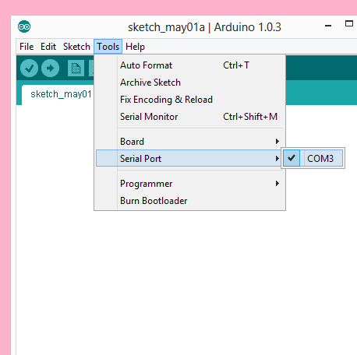
Settings: Tools → Serial Port
Your computer communicates to the microcontroller via a serial port through a USB-Serial adapter.
Check to make sure that the drivers are properly installed.
Notes:
All connections to computers- mice, printers etc use a serial port. Gotta pick the right one.

Slide 32
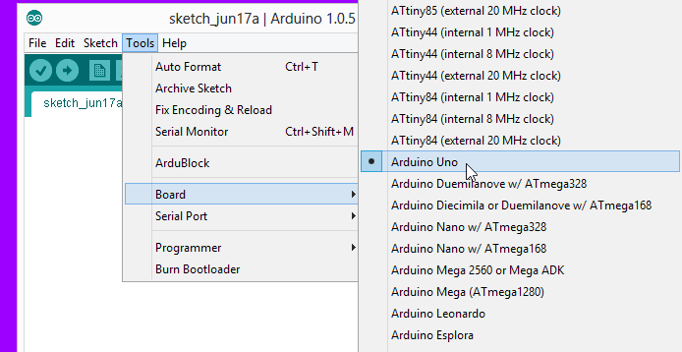
Settings: Tools → Board
Next, double-check that the proper board is selected under the
Tools → Board menu.
Notes:
All connections to computers- mice, printers etc use a serial port. Gotta pick the right one.

Slide 33
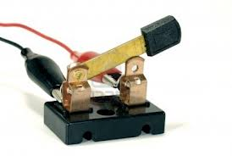
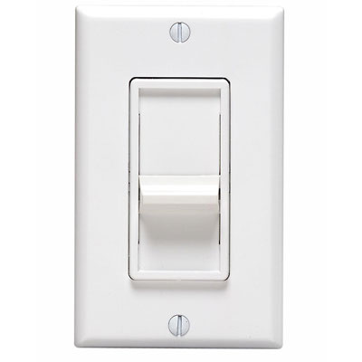


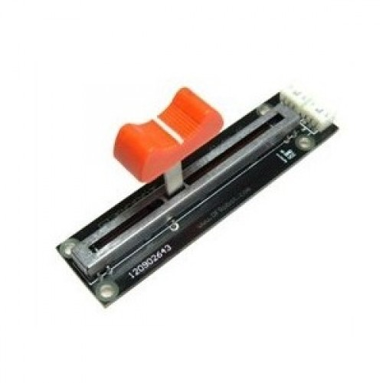
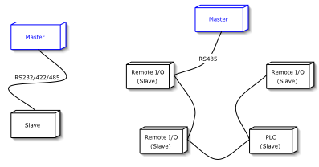
digitalWrite()
analogWrite()
digitalRead()
BIG 6 CONCEPTS
if() statements / Boolean logic
analogRead()
Serial communication
This work is licensed under a Creative Commons Attribution-ShareAlike 3.0 United States License.

Slide 34
digitalWrite()
Project #1 – Blink
“Hello World” of Physical Computing
Psuedo-code – how should this work?
Turn LED ON
Wait
Turn LED OFF
Wait
Rinse & Repeat

Slide 35
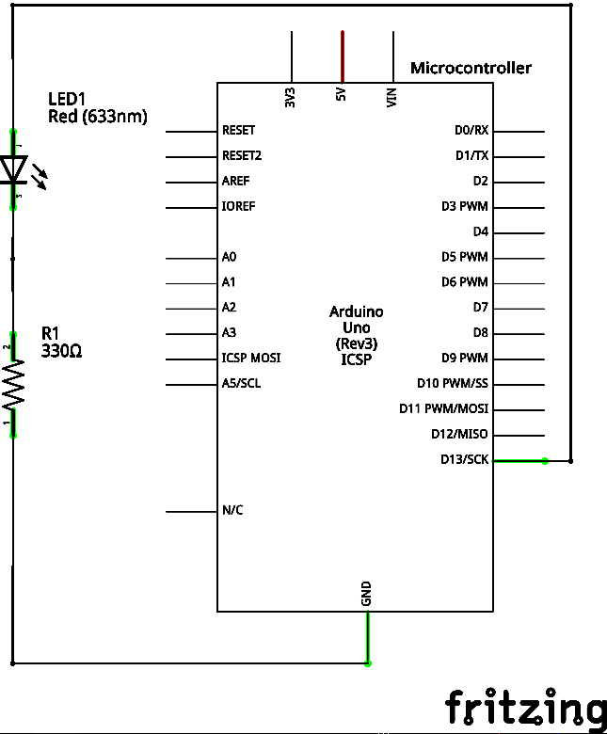
Project #1: Schematic
Move the blue wire from the power bus to pin 13 (or any other Digital I/O pin) on the microcontroller board.

Slide 36
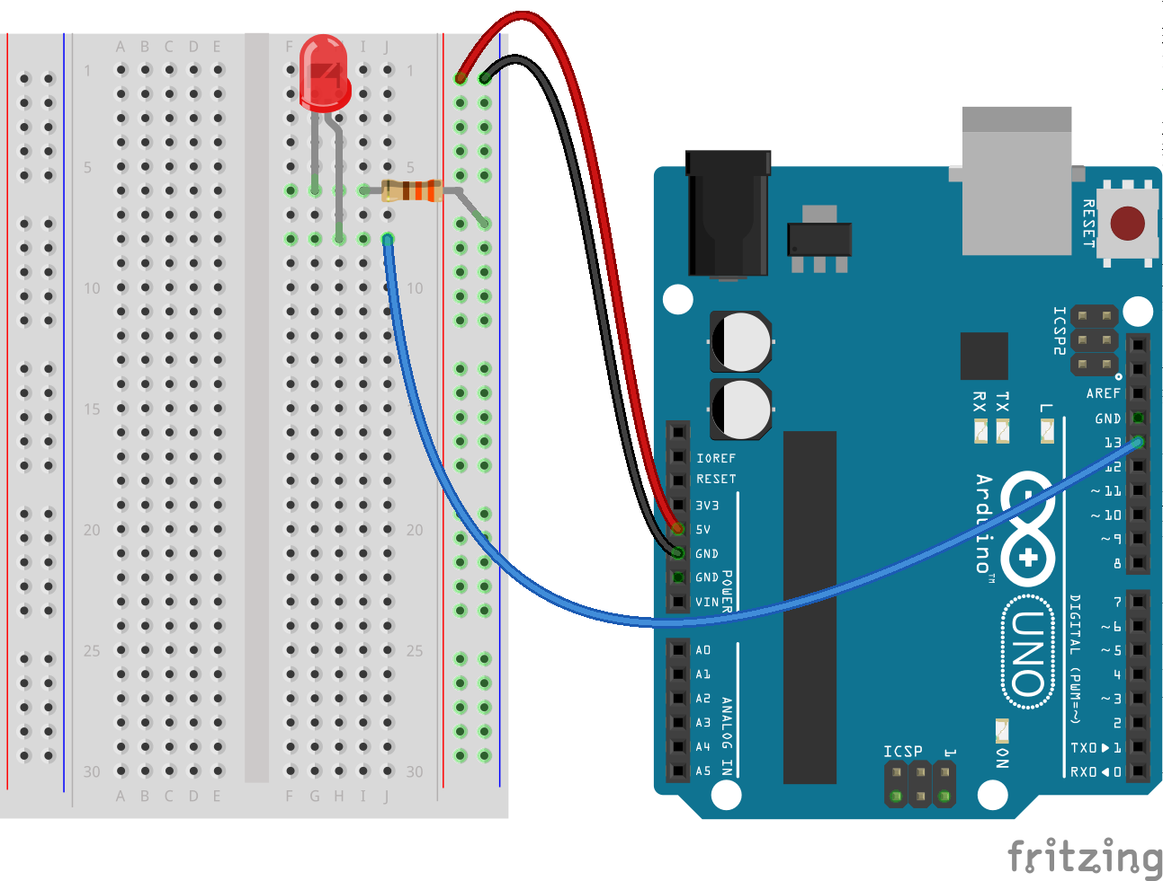
Project #1: Wiring Diagram

Slide 37
Comments, Comments, Comments
Comments are for you – the programmer and your friends…or anyone else human that might read your code.
// this is for single line comments
// it’s good to put a description at the top and before anything ‘tricky’
/* this is for multi-line comments
Like this…
And this….
*/

Slide 38
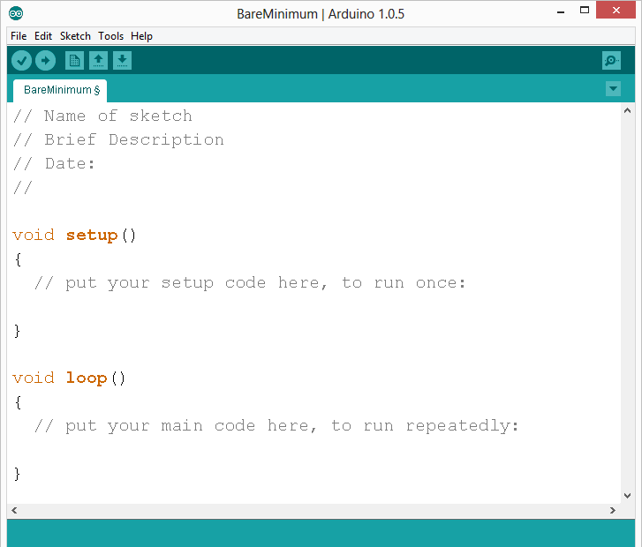
comments
Notes:
Review the two main parts of the sketch – void setup() and void loop()
Provide rationale for good commenting.
Emphasize the need for good / clean coding practices like indenting.

Slide 39
Three commands to know…
pinMode(pin, INPUT/OUTPUT);
ex: pinMode(13, OUTPUT);
digitalWrite(pin, HIGH/LOW);
ex: digitalWrite(13, HIGH);
delay(time_ms);
ex: delay(2500); // delay of 2.5 sec.
// NOTE: -> commands are CASE-sensitive
Notes:
Three commands to rule the world… or at least do 80% of cool Arduino projects.

Slide 40
Project #1- Puzzles
Challenge 1a – blink with a 200 ms second interval.
Challenge 1b – blink to mimic a heartbeat
Challenge 1c – find the fastest blink that the human eye can still detect…
1 ms delay? 2 ms delay? 3 ms delay???

Slide 41
analogWrite()
Project #2 – Fade
Not so fast, Jack
Psuedo-code – how should this work?
LED Gets Brighter
Achieves Maximum Brightness
LED Dims
Goes completely off
Rinse & Repeat

Slide 42
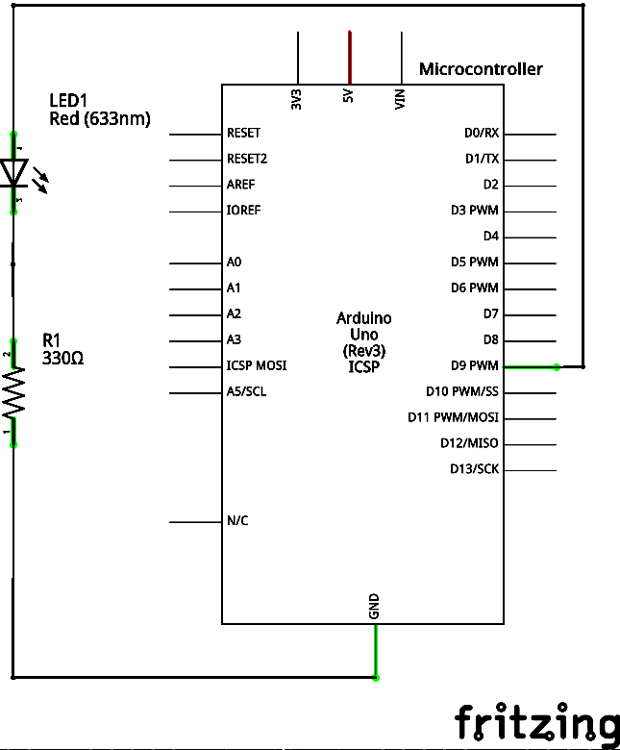
Project #2: Schematic
Move the blue wire to pin 9 (or 3, 5, 6, 10 or 11) on the microcontroller board.

Slide 43

Project #2: Wiring Diagram

Slide 44
Fading in and Fading Out
(Analog or Digital?)
A few pins on the Arduino allow for us to modify the output to “mimic” an analog signal.
This is done by a technique called:
Pulse Width Modulation (PWM)

Slide 45





Concepts: Analog vs. Digital
To create an analog signal, the microcontroller uses a technique called PWM. By varying the duty cycle, we can fool the eye into seeing an average brightness.
Pulse Width Modulation (PWM)

Slide 46

Programming Concepts: Variables
Variable Scope
Global
---
Function-level

Slide 47



Programming Concepts: Variable Types
Variable Types:
8 bits
16 bits
32 bits
byte/char
2⁸ = 256 values
int/ unsigned int
2¹⁶ = 65,536 values
long/unsigned long/ float
2³² = 4,294,967,296

Slide 48
How Big Is 2³²?
The function millis() returns the number of milliseconds since the program started
The type of data millis() returns is an unsigned long int
4,294,967,296 milliseconds is 49.71 days

Slide 49

Project #2 – Fade
analogWrite(pin, val);
pin – refers to the OUTPUT pin (limited to pins 3, 5, 6, 9, 10, 11.) – denoted by a ~ symbol
val – 8 bit value (0 – 255).
0 => 0V | 255 => 5V

Slide 50

Fade - Code Review

Slide 51

Fade - Code Review

Slide 52
Project #2 - Puzzles
Challenge 2a – Change the rate of the fading in and out. There are at least two different ways to do this – can you figure them out?
Challenge 2b – Use 2 (or more) LEDs – so that one fades in as the other one fades out.

Slide 53



Project #2.1- Color Mixing
RGB LED
R
G
B
Common Cathode LED
This means the negative side of the LED is all tied to Ground.

Slide 54


Project 2.1- Schematic
Note: The longest leg of the RGB LED is the Common Cathode. This goes to GND.
Use pins 5, 6, & 9

Slide 55

Project 2.1- Wiring Diagram

Slide 56


How many unique colors can you create?
Use https://smallseo.tools/color-picker or experiment on your own.
Pick out a few colors that you want to try re-creating for a lamp or lighting display...
Play around with this with the analogWrite() command.

Slide 57
RGB LED Color Mixing
int redPin = 5;
int greenPin = 6;
int bluePin = 9;
void setup()
{
pinMode(redPin, OUTPUT);
pinMode(greenPin, OUTPUT);
pinMode(bluePin, OUTPUT);
}

Slide 58
RGB LED Color Mixing
void loop()
{
analogWrite(redPin, 255);
analogWrite (greenPin, 255);
analogWrite (bluePin, 255);
}

Slide 59



Project: Mood Lamp / Light Sculpture
Notes:
Here are a few examples of project ideas that you can extend this to in the class.

Slide 60



Input
Input is any signal entering an electrical system
Both digital and analog sensors are forms of input
Input can also take many other forms: a keyboard, a mouse, infrared sensors, biometric sensors, touch sensors or just plain voltage from a circuit
This is what makes interactive exhibits interactive

Slide 61

Using the Breadboard to built a simple input circuit
Remember our original circuit?
We’re going to wire that up again, but this time with a switch

Slide 62


Using the Breadboard to built a simple input circuit
Any kind of meaningful input implies some control, even without a microcontroller.
Microcontrollers give us options for the relationship between the input and output

Slide 63
digitalRead()
Project #3 – Button Switch
Who you callin’ momentary?
Psuedo-code – how should this work?
LED On
LED turns off
Wait for button press
Button Pressed
LED status?
LED Off
LED turns on

Slide 64


Switch Input Circuit

Slide 65
Switch Input Circuit
WRONG!
But WHY?!

Slide 66


Another Water Analogy

Slide 67
Analogy Continued…

Slide 68

All Stopped Up

Slide 69

All Stopped Up
(kinda)

Slide 70
Switch Input Circuit

Slide 71

Switch Input Circuit

Slide 72

Switch Input Circuit

Slide 73

Extended Analogy
Thin but Holding...

Slide 74

Changing the Viewpoint

Slide 75

Changing the Viewpoint

Slide 76

Changing the Viewpoint
?

Slide 77

Changing the Viewpoint

Slide 78


Digital Sensors (a.k.a. Switches)
Add an indicator LED to Pin 13
This is just like our 1st circuit!

Slide 79
Digital Input
Connect digital input to your Arduino using Pins # 0 – 13 (Although pins # 0 & 1 are also used for programming)
Digital Input needs a pinMode command:
pinMode (pinNumber, INPUT);
Make sure to use ALL CAPS for INPUT
To get a digital reading:
int buttonState = digitalRead (pinNumber);
Digital Input values are only HIGH (On) or LOW (Off)
Notes:
Put together circuit # 7 and leave in

Slide 80
Digital Sensors
Digital sensors are more straight forward than Analog
No matter what the sensor there are only two settings: On and Off
Signal is always either HIGH (On) or LOW (Off)
Voltage signal for HIGH will be a little less than 5V on your Uno
Voltage signal for LOW will be 0V on most systems

Slide 81


Slide 82

Programming: Conditional Statements if()

Slide 83

Programming: Conditional Statements if()
void loop()
{
int buttonState = digitalRead(5);
if(buttonState == LOW)
{ // do something
}
else
{ // do something else
}
}
DIG INPUT

Slide 84
Boolean Operators
<Boolean> | Description
( ) == ( ) | is equal?
( ) != ( ) | is not equal?
( ) > ( ) | greater than
( ) >= ( ) | greater than or equal
( ) < ( ) | less than
( ) <= ( ) | less than or equal

Slide 85

Trimpot (Potentiometer)
Variable Resistor
fixed
end
wiper
fixed
end

Slide 86



Analog Sensors
3 Pin Potentiometer = var. resistor (circuit) a.k.a. Voltage Divider Circuit
wiper
fixed
ends
1.0 V
1.0 V

Slide 87

Ohms Law… (just the basics)
Actually, this is the “voltage divider”

Slide 88
analogRead()
Arduino uses a 10-bit A/D Converter:
this means that you get input values from 0 to 1023
  0 V → 0
  5 V → 1023
Ex:
int sensorValue = analogRead(A0);

Slide 89




Using Serial Communication
Method used to transfer data between two devices.
Data passes between the computer and Arduino through the USB cable. Data is transmitted as zeros (‘0’) and ones (‘1’) sequentially.
Arduino dedicates Digital I/O pin # 0 to receiving and Digital I/O pin #1 to transmit.
Notes:
For this reason, we typically do not use Digital I/O 0 or 1 for anything in our designs.

Slide 90

Serial Monitor & analogRead()
Initializes the Serial Communication
9600 baud data rate
prints data to serial bus

Slide 91
Serial Monitor & analogRead()
Opens up a Serial Terminal Window

Slide 92





Analog Sensors
2 Pin Analog Sensors = var. resistor
Take two sensors -- Use the Serial Monitor and find the range of input values you get for each sensor.
MaxAnalogRead = _________
MinAnalogRead = _________

Slide 93
Analog Sensors
Examples:
Sensors | Variables
Mic | soundVolume
Photoresistor | lightLevel
Potentiometer | dialPosition
Temp Sensor | temperature
Flex Sensor | bend
Accelerometer | tilt/acceleration

Slide 94
Additional Serial Communication
Sending a Message
void loop ( )
{
Serial.print(“Hands on “) ;
Serial.print(“Learning ”) ;
Serial.println(“is Fun!!!”) ;
}

Slide 95


Slide 96

Serial Communication:
Serial Debugging
void loop()
{
int xVar = 10;
Serial.print ( “Variable xVar is “ ) ;
Serial.println ( xVar ) ;
}

Slide 97

Serial Communication:
Serial Troubleshooting
void loop ( )
{
Serial.print (“Digital pin 9: “);
Serial.println (digitalRead(9));
}

Slide 98

www.sparkfun.com
6175 Longbow Drive, Suite 200
Boulder, Colorado 80301

