Slide 1
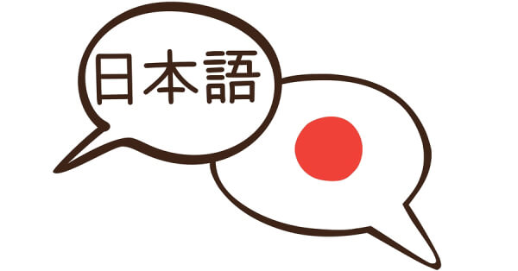

KANJI STUDY APP
-
STATE OF ART
In support of the Japanese language
By Sergio Páramo
Powered by:

Slide 2
1 - Introduction
Kanji Study is an app that contains all the Japanese Kanjis and Kanas on a database system created and designed to self-learners and presented in an intuitive user interface to interact, listen, and learn through the process.

Slide 3
1.1 - Target
The app is aimed to those interested in Japanese Kanjis and Kanas (hiragana and katakana) and are seeking an easy and convenient way to improve their japanese daily.

Slide 4
1.2 - Solution
Japanese Database with:
more than 13.000 Kanjis
23 Hiragana
23 Katakana

Slide 5
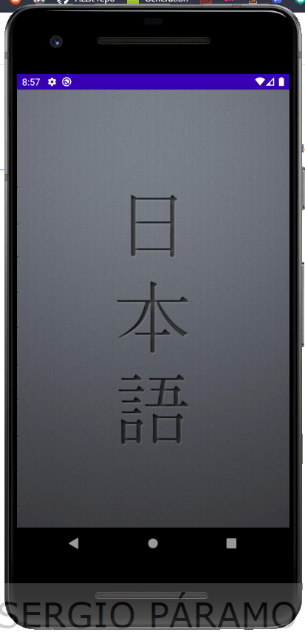
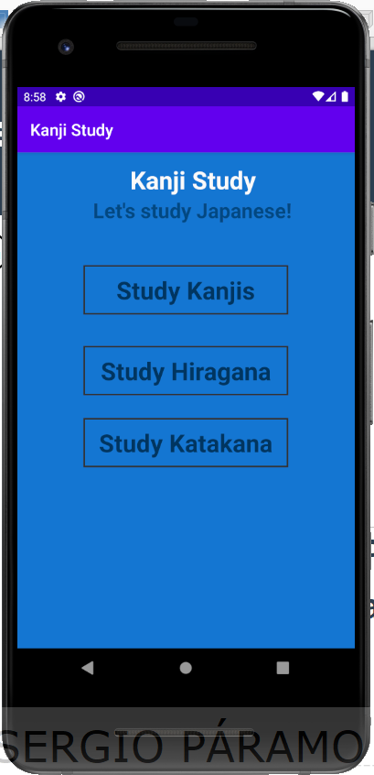
2. - UX Design (Beta release) Main section
Splash screen
Main screen

Slide 6
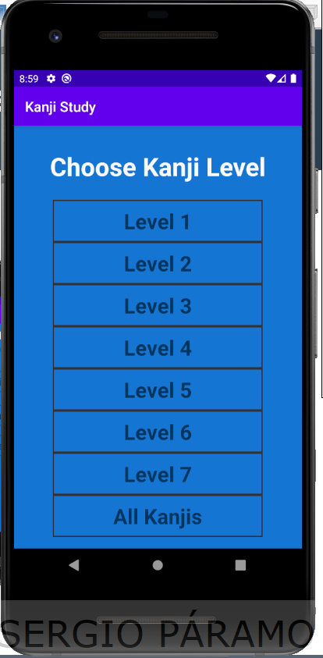
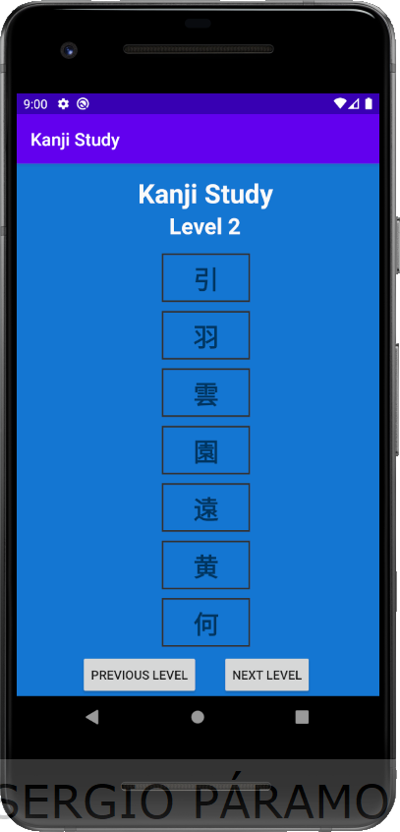
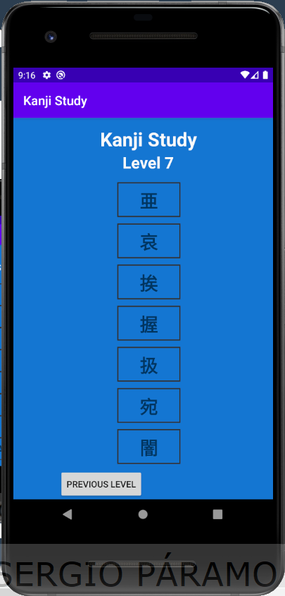
2.1 – Kanji Navigation Graph
Main screen
Options menu
Kanji level screen
Visibility-control-buttons
When reaching the last or first page

Slide 7
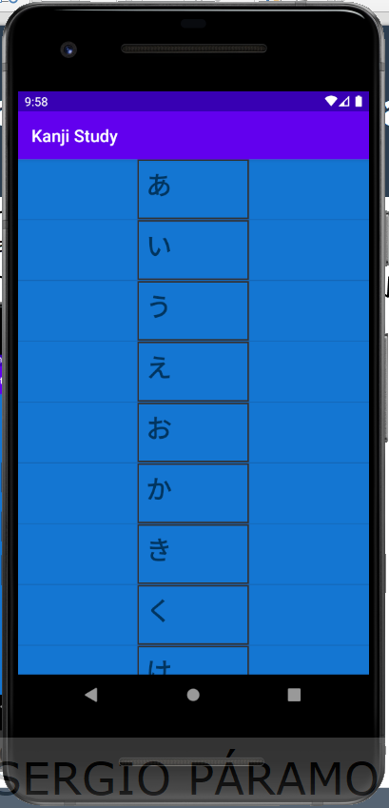
2.2 – Hiragana Navigation Graph
Main screen
Hiragana screen

Slide 8
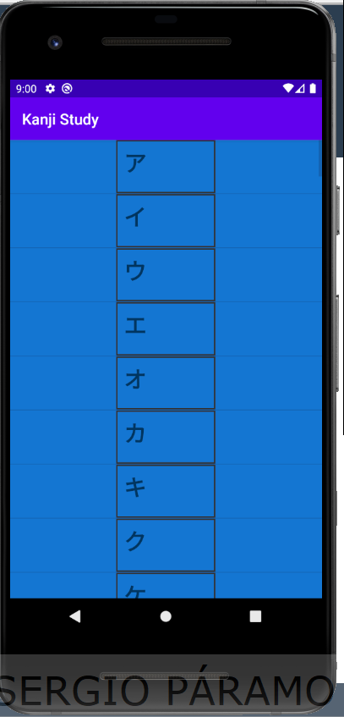
2.3 Katakana Navigation Graph
Main screen
Katakana screen

Slide 9




3 - Colours
Background color Splash screen color
            Font colors:

Slide 10
4 – Styles used
ItemsStyle (For Textviews that contains info)
Android:textSize = 30sp
Android:textStyle = bold
android:clickable = true
android:focusable = true
Android:background = @drawable/border (to make the border)

Slide 11
4 – Styles used
TextSyle (For text)
FontFamily: Verdana
Android:textSize = 36sp
Android:textStyle = bold

