Slide 1


KANJI STUDY APP
-
STATE OF ART
In support of the Japanese language
By Sergio Páramo
Powered by:

Slide 2
1 - Introduction
Kanji Study is an app that contains all the Japanese Kanjis and Kanas on a database system created and designed to self-learners and presented in an intuitive user interface to interact, listen, and learn through the process.

Slide 3
1.1 - Target
The app is aimed to those interested in Japanese Kanjis and Kanas (hiragana and katakana) and are seeking an easy and convenient way to improve their japanese daily.

Slide 4
1.2 - Solutions
Japanese Database with:
more than 13.000 Kanjis
23 Hiragana
23 Katakana

Slide 5
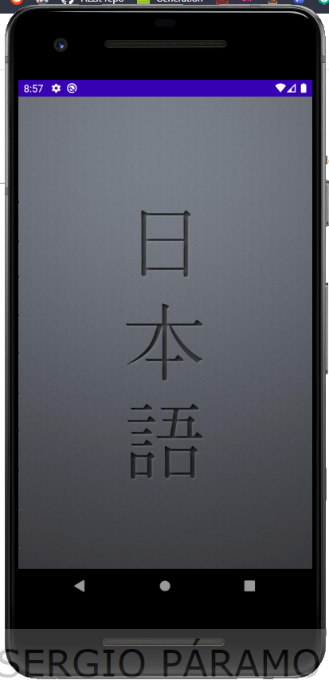
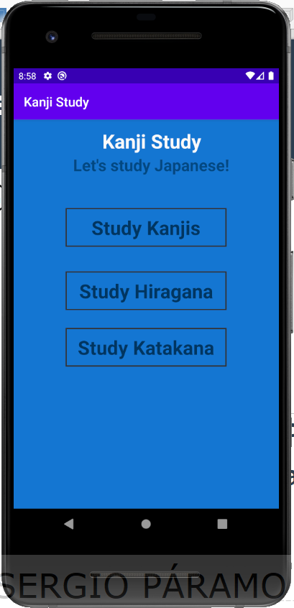
2. - UX Design (Beta release) Main section
Splash screen
Main screen

Slide 6
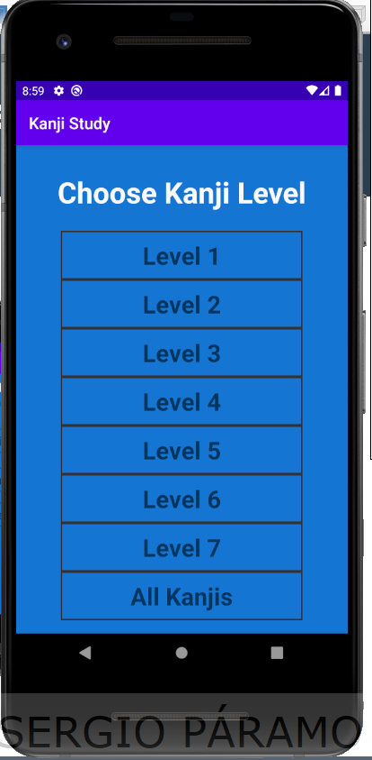
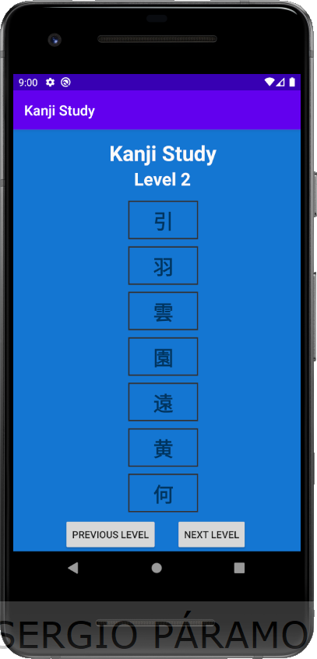
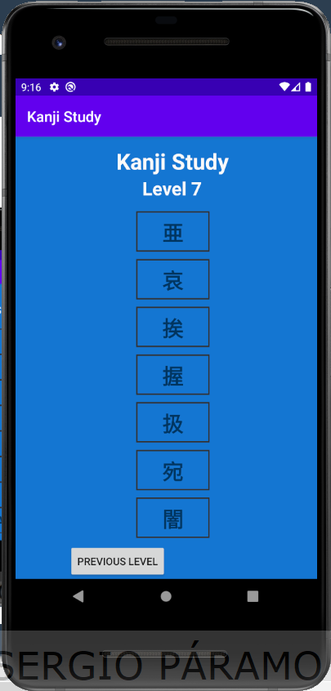
2.1 – Kanji Navigation Graph
Main screen
Options menu
Kanji level screen
Visibility-control-buttons
When reaching the last or first page

Slide 7
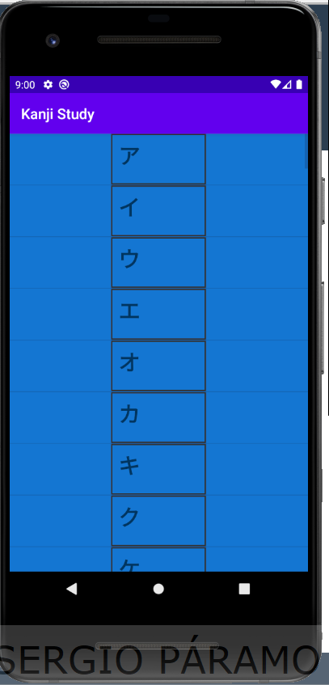
2.2 – Hiragana section
Main screen
Hiragana screen

Slide 8
2.3 Katakana section
Main screen
Katakana screen

Slide 9
2.3 - Database
I have used Room for the database
We have 2 differents Databases
Kanji Database
Kana Database

Slide 10
2.3.1 – Kanji Database
Fields:
String kanji

Slide 11
2.3.2 – Kana Database
Fields:
String hiragana
String katakana
String romaji
String vowel
String consonant
String type

Slide 12
6. - Main issues
I tried to retrieve the data from an API but it was not possible since the object returned wasn’t suitable for the purposes of the app.

Slide 13
7. - Concepts learned
Room (Repository, Entity, Database, etc)
RecyclerView
Adapter

Slide 14
8. - Final product

Slide 15




Open source resources

Slide 16
Any questions?

