Slide 1
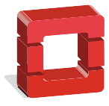
Development of an
OpenStack Cloud deployment tool

Slide 2


Motivation
- Distributed systems course
- Professional internships
Notes:
Hablar de :
“Asignatura sistemas distribuidos”
Había una lista en la que elegir etc
“Apache Spark”
Tuve que hacer un despliegue etc
“El presente y el futuro”
(Sistemas distribuidos) (?)

Slide 3
What Cloud Computing is
- Model for enabling ubiquitous, convenient, on-demand network access to a shared pool of computing resources
Notes:
National Institute of Standars and Technology
yo͞oˈbikwətəs

Slide 4
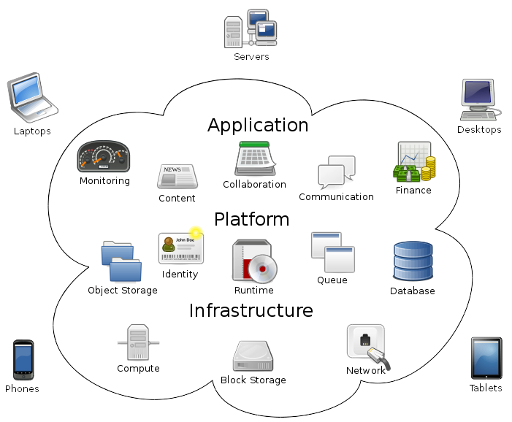
Cloud computing service models
Notes:
What are cloud services
TODO: Poner en algún sitio
'Imagen por Sam Johnston'

Slide 5


Some available services
- Cloud Virtual machines
- Cloud storage
- Cloud databases
- Cloud containers
- Much more!
Notes:
Services available

Slide 6

What OpenStack is
Three main services
Notes:
What is OpenStack
Several modules
Nova
Neutron
Swift

Slide 7
Other OpenStack services
- Cinder (Block storage)
- Keystone (Authentication)
- Glance (Image)
- Horizon (Dashboard)
- Heat (Orchestration)
More at:
https://www.openstack.org/software/project-navigator/

Slide 8
Deploying OpenStack
Three main steps:
- Set up an environment in all nodes
- Install different services in the infrastructure
- Configure each one of the services
Notes:
Deploying OpenStack intro
(Horrible slide)
In next slides, probably show it more detailed

Slide 9
Problems deploying OpenStack
- A lot of packages which are needed taking into account the services that are installed
- Several configuration files which must be edited properly
- It is common to have mistakes

Slide 10



Deployment automation
- OpenStack Ansible
  http://docs.openstack.org/developer/openstack-ansible/
- Packstack
  https://wiki.openstack.org/wiki/Packstack
- OpenStack Autopilot
  http://www.ubuntu.com/cloud/openstack/autopilot
Notes:
Available deployers

Slide 11
Initial ideas
- Automatic deployment
- SaaS design
- Web interface
- API behavior
Notes:
Initial ideas for the deployer
Used technologies

Slide 12
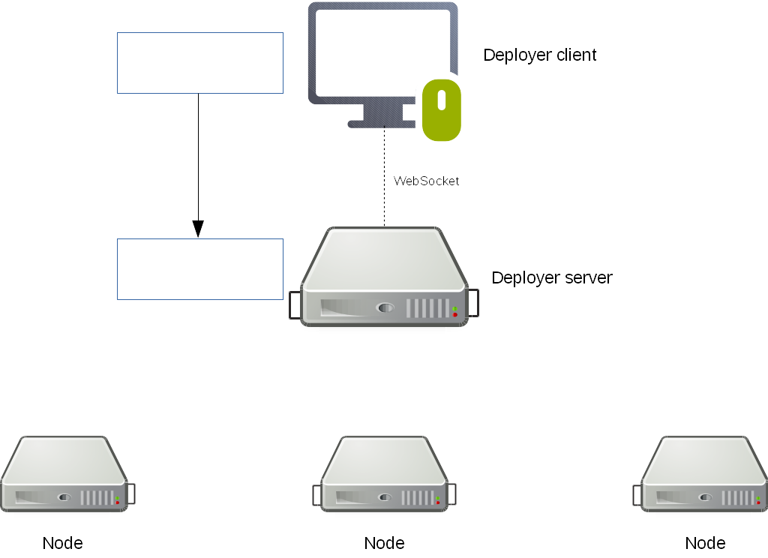
Application design (1/5)
Notes:
Frontend: (Say what it is done with it)
-HTML/JS/WebSockets
Backend:
Server which receives the message and process it starting a deployment
-websocketd, Ruby
(Show backend behavior 'animated like')

Slide 13
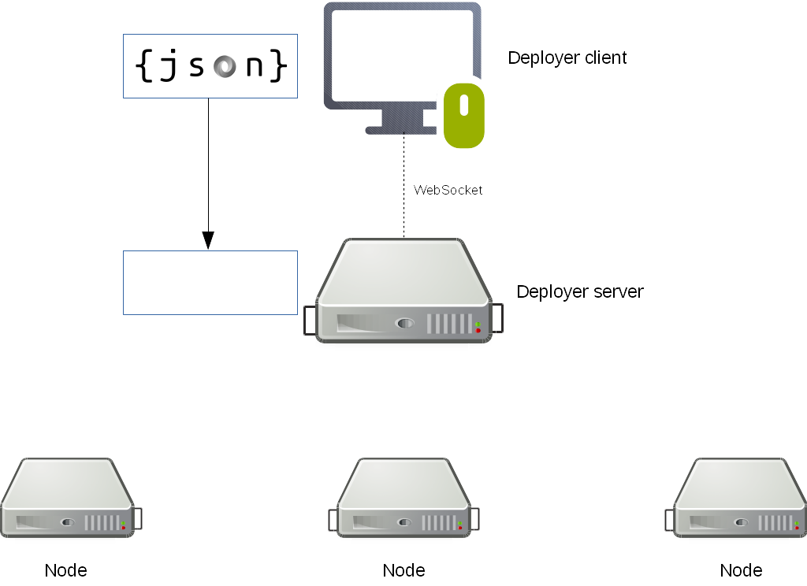
Application design (2/5)

Slide 14
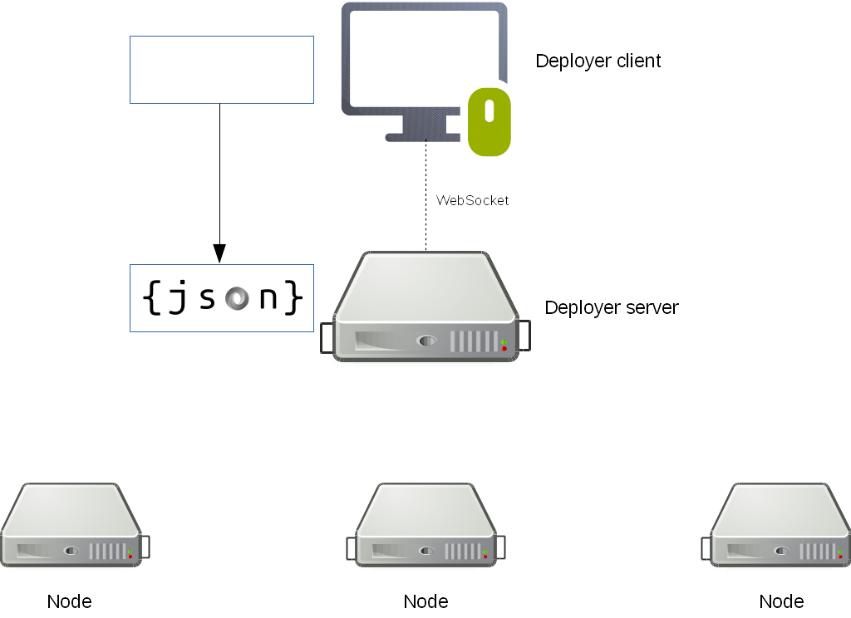
Application design (3/5)

Slide 15
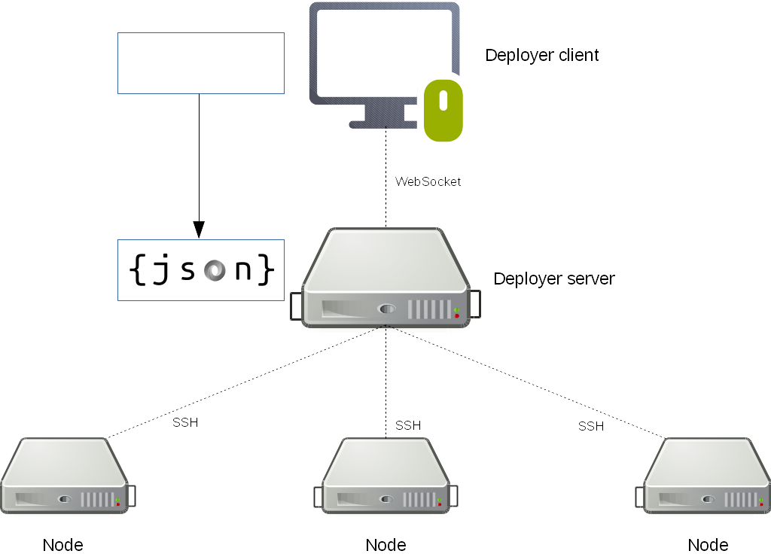
Application design (4/5)

Slide 16
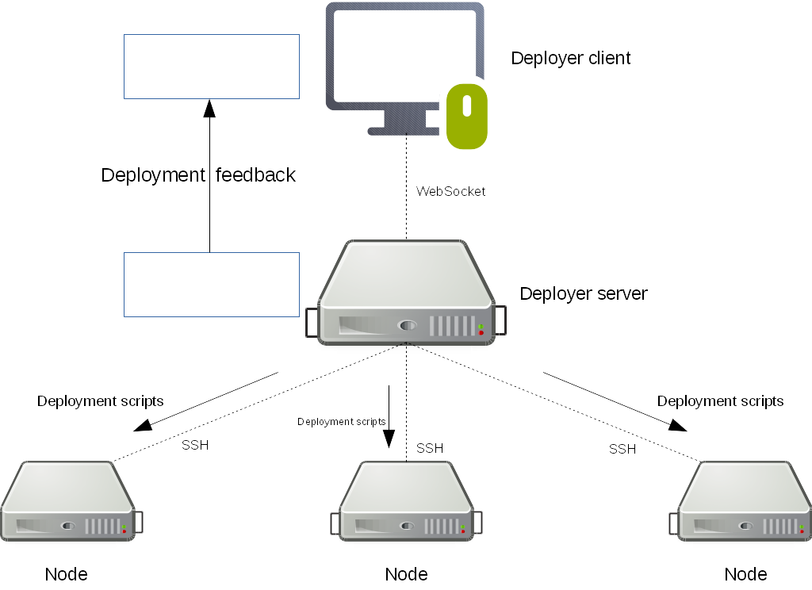
Application design (5/5)

Slide 17
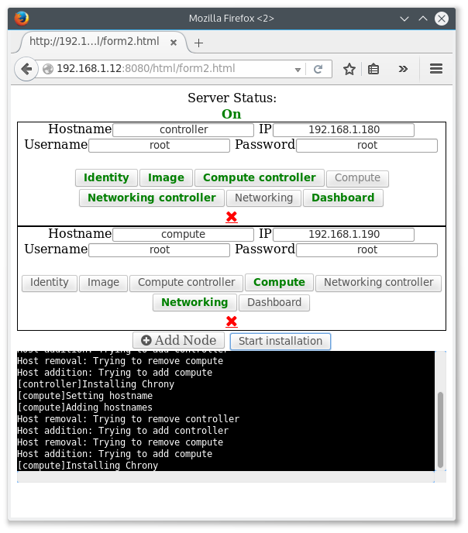
Frontend
- Sends a JSON to the deployment server
- Shows the feedback received from the server
Notes:
Development planning/organization

Slide 18
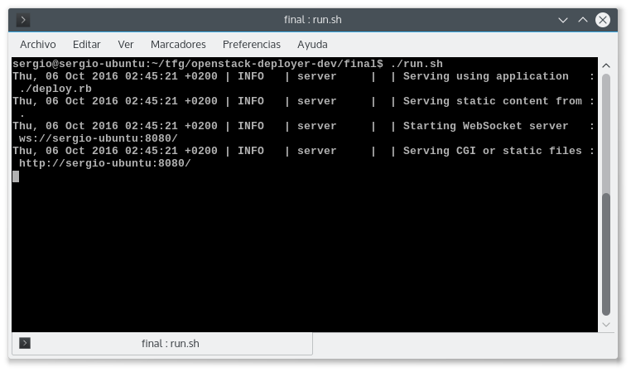


Backend
- websocketd
- Ruby
- SSH
- JSON

Slide 19




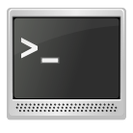


Software used at the project
Notes:
Free software

Slide 20
Conclusions
- Worked with distributed systems
- Worked creating a distributed deployment tool
- Learned a lot about OpenStack
Notes:
Conclusions

Slide 21
Future work
- Publish the project
- Support more OpenStack services
- Jump to HTTPs in websocketd
- Add support for more GNU/Linux distributions
Notes:
Future work

Slide 22
Deployer video
https://www.youtube.com/watch?v=7boUenbvm4c
Notes:
Deploying OpenStack using the tool (video)

Slide 23
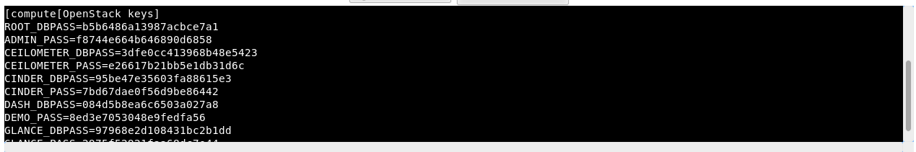
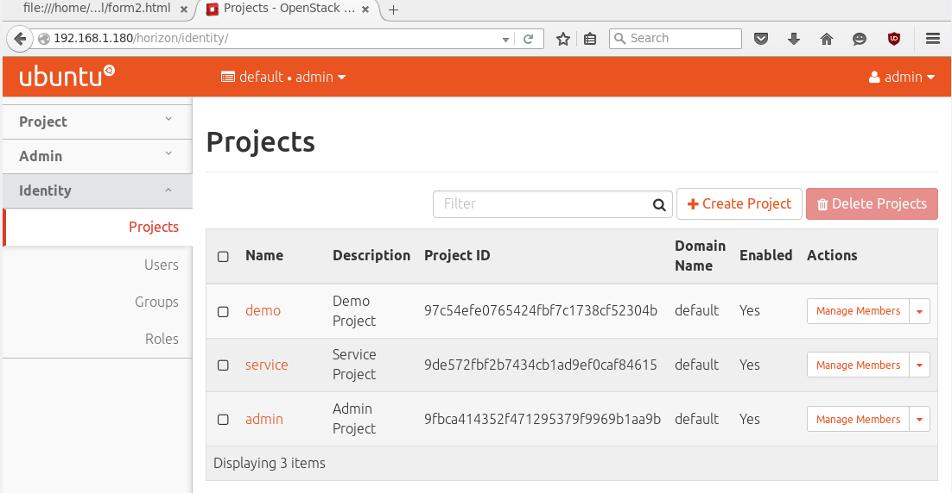
Deployer results

Slide 24
Questions

