Slide 1

Machine Learning Challenge

Slide 2
Overview
Objective
Build a model that predicts the number of hits per session based on a database of user sessions of Trivago
Methodology used
Cross Industry Standard Process for Data Mining (CRISP-DM)
Business Understanding
Data Understanding
Data Preparation
Modeling
Evaluation
Deployment (not applied on this case)
Results
After testing some models, the finalist was a Gradient Boosting with the best Mean Squared Error

Slide 3
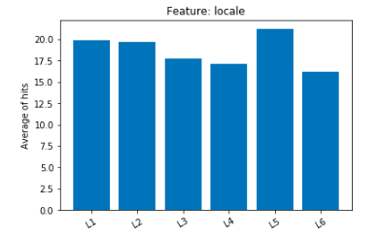
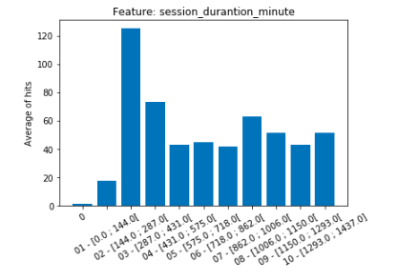
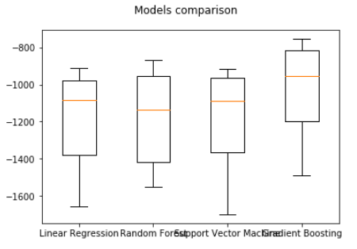
Project highlights
Business Understanding
Research about trivago and deep understanding about the project objective
Data Understanding
I read the provided metadata and did an exploratory analysis:
feature format (string or numeric)
feature type (discrete or continuous)
feature distribution
Two examples of feature distribution (one discrete and one continuous):
Data Preparation
Creation of new features, example: a feature that counts how many paths id were visited, from the original feature 'path_id_set’
Handle data so it's suitable for applying any model from the python package used and split the data in training and test datasets
Modeling
Training of four different models using k-fold cross-validation and selected the one with the lowest mean squared error (gradient boosting). Tuned the parameters of gradient boosting and applied to the test dataset (with MSE of 930 (training) and 991 (test))
1
2
Evaluation
Scored the result dataset using the model created in the modeling step
How to enhance?
feature engineering
normalization of features
other distribution analysis
other models
1
category 'L5' has an average of hits a little bit higher than the rest of the categories
2
band '01' that contemplates between 0 and 144 minutes has a high average of hits
* Python Cross-validation uses negative squared error, that’s why the best is the highest

Slide 4
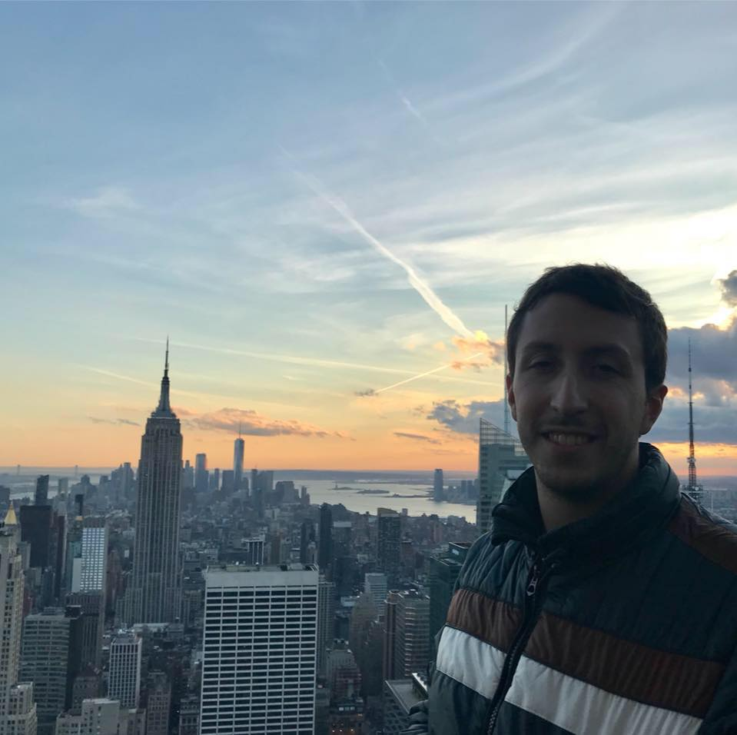
About me
Bio:
I'm from Brazil, I've 5+ years of experience in data science, bachelor in Mathematics and master in Statistics.
I speak English, Spanish (lived for a year in Spain), Portuguese (native) and starting to learn (up to 12 months now) German using Rosetta Stone app.
Info:
lucas.bruscato@gmail.com
linkedin.com/in/lucasbruscato
github.com/lucasbruscato
+55 11 985071210
Plus:
You can find the project and this presentation on https://github.com/lucasbruscato/trivago

