Slide 1
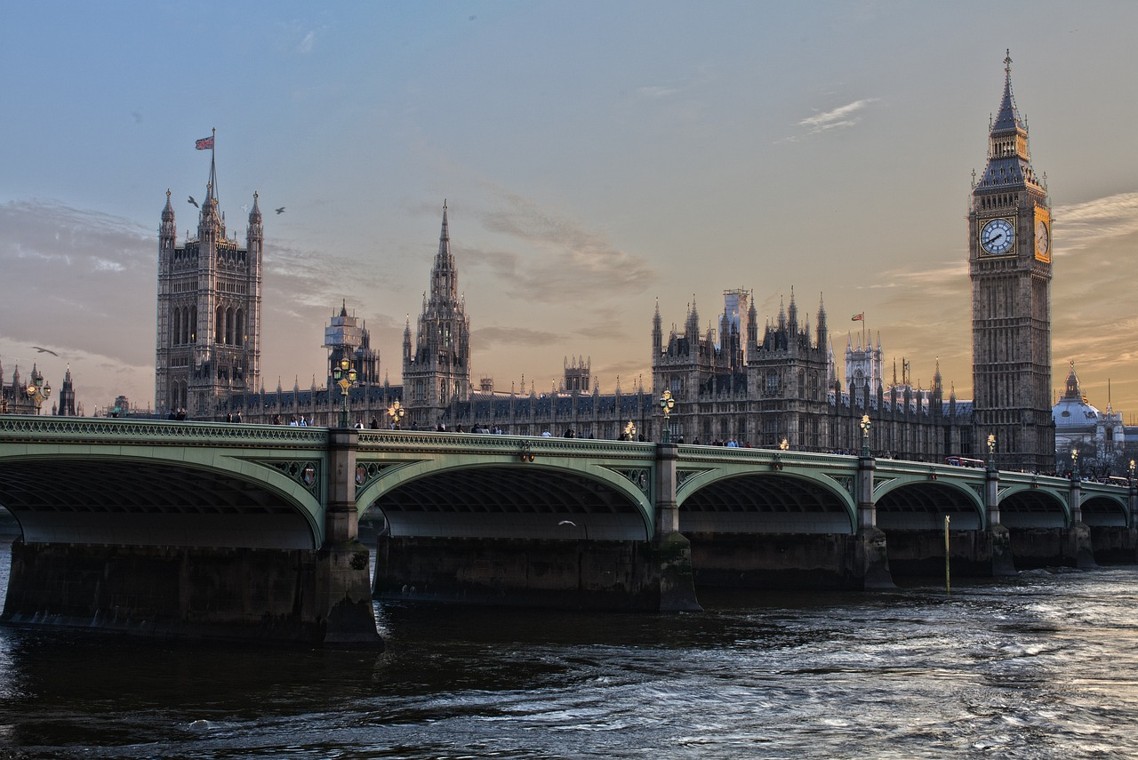
------------
LONDON
Once upon a midnight dreary, while I pondered, weak and weary. Over many a quaint and curious volume of forgotten lore. While I nodded, nearly napping, suddenly there came a tapping.
Notes:
1, Put the letter – (hyphen) 12 times
2. Select all letters, shape format > text effects > transform > wave 1
3. Rezise to fit width
4. Select shape, format shape pane > text options > text fill > picture > clipboard

Slide 2
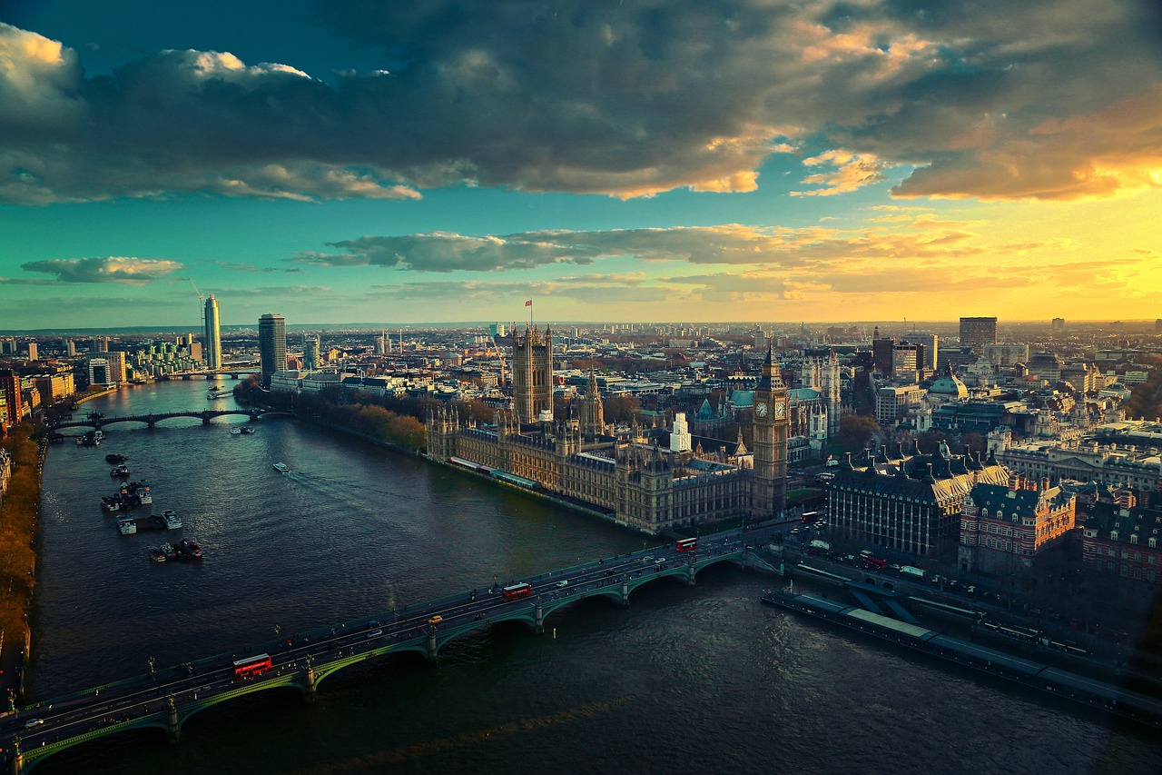
AWESOME
LONDON
I went to the woods because I wished to live deliberately
Notes:
Insert picture, cover whole slide
Cover it with rectangle
Insert shape round-corner rectangle, duplicate twice (as seen above, there are 3 of them)
Position the 3 shapes like above
Select all 3, shape format>merge>combine
Select combined shapes first, then select the rectangle from step 2, shape format>merge>combine
Select the new combined shape (if you go to selection pane, it will be the freeform item), put white background and no line fill
Select the free form, animations>path animation>lines
Configure the animation: auto-reverse;start with previous;duration 6 seconds;no repeat

