Slide 1
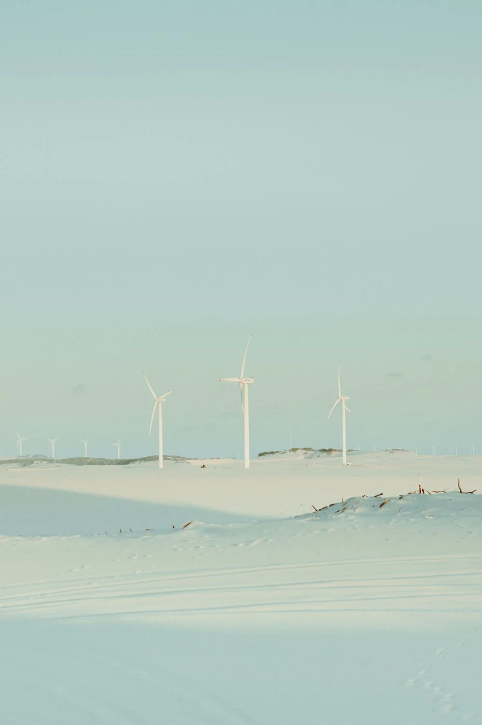
WIND IS A CLEAN SOURCE OF ENERGY AND IT IS ALWAYS WINDY IN THE NETHERLANDS
HOW CAN NETHERLANDS PREPARE FOR ENERGY CRISIS?

Slide 2
HOW CAN NETHERLANDS PREPARE FOR ENERGY CRISIS?
WIND IS A CLEAN SOURCE OF ENERGY AND IT IS ALWAYS WINDY IN THE NETHERLANDS

Slide 3


