Slide 1
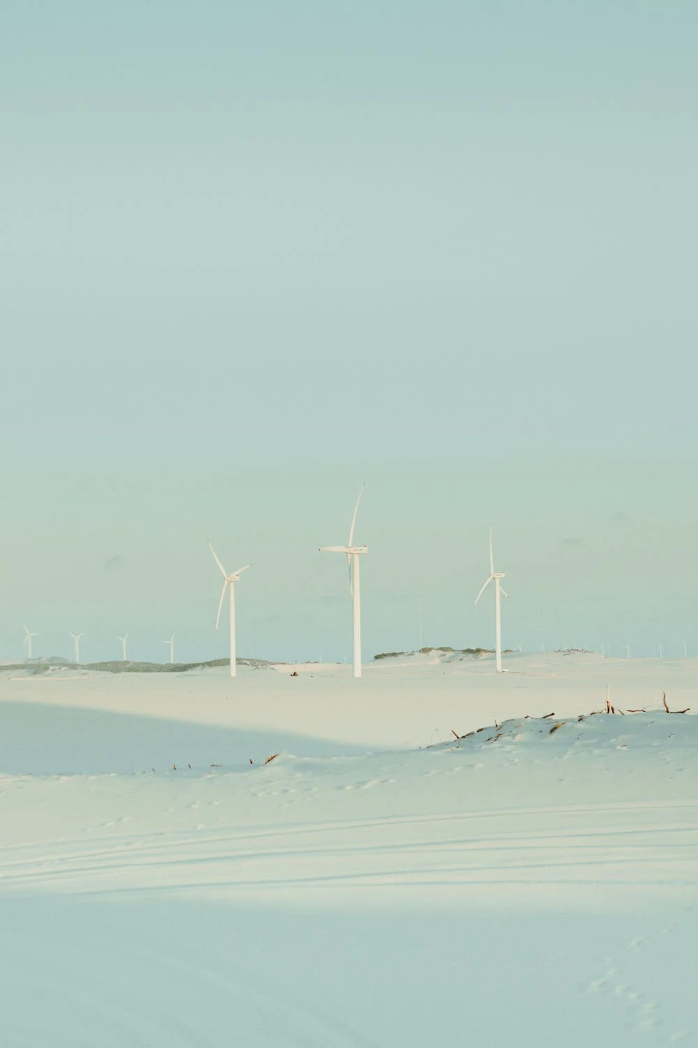
WIND IS A CLEAN SOURCE OF ENERGY AND IT IS ALWAYS WINDY IN THE NETHERLANDS
HOW CAN NETHERLANDS PREPARE FOR ENERGY CRISIS?

Slide 2
HOW CAN NETHERLANDS PREPARE FOR ENERGY CRISIS?
WIND IS A CLEAN SOURCE OF ENERGY AND IT IS ALWAYS WINDY IN THE NETHERLANDS

Slide 3


Slide 4
Notes:
NOTE THAT THE RECTANGLE WITH THE TEXT SHOULD BE RIDICULOUS BIG TO HAVE ROOM FOR THE IMAGE DON’T HAVE ANY WHITES ON IT

