Slide 1
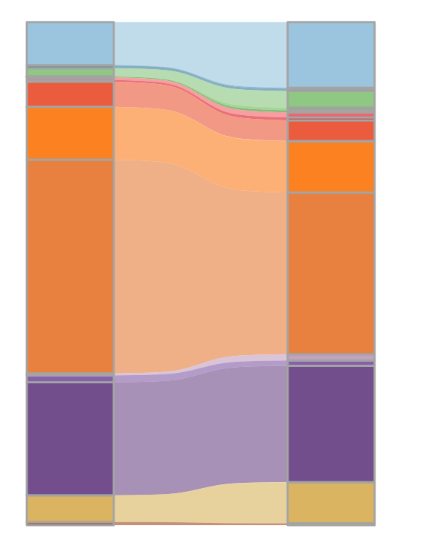
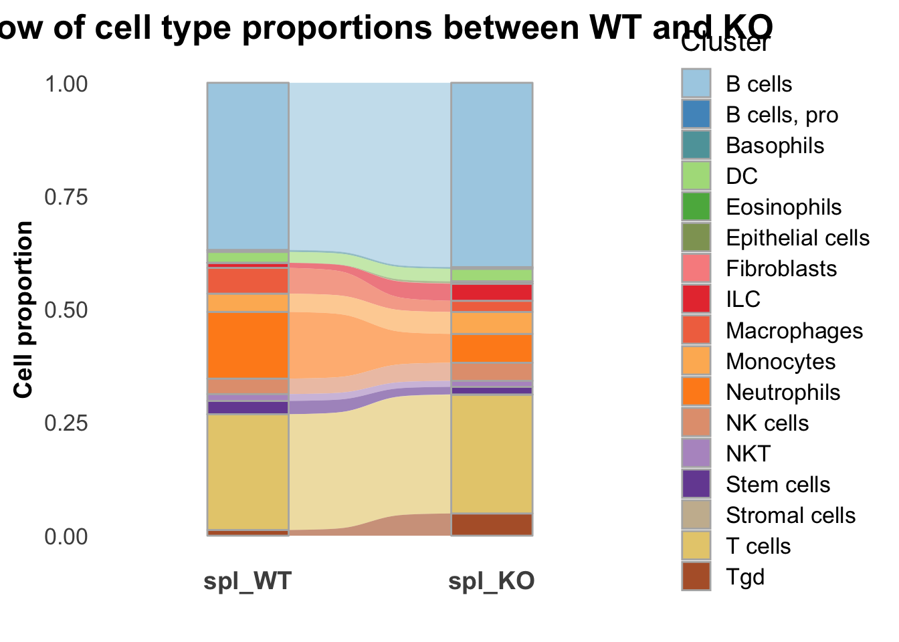
Bone marrow
Spleen
*
*
*
*
*
*
Cell proportion
*
*
*
*
WT
PrimPol KO
WT
PrimPol KO
For each cluster, a Fisher’s exact test was performed on a 2x2 contingency table comparing its cell counts between WT and KO conditions, testing whether the cluster is over- or under-represented in KO relative to WT; clusters with BH-adjusted p < 0.05 are considered statistically significant (*).

Slide 2
