Slide 1
A Warm Welcome To Careerera Family

Slide 2
Exploratory Data Analysis

Slide 3

WHAT IS EXPLORATORY DATA ANALYSIS?
Exploratory Data Analysis (EDA) is an approach to analyzing datasets to summarize their main characteristics, often with visual methods.
EDA is used for seeing what the data can tell us before the modeling task.

Slide 4
HOW CAN EXPLORATORY DATA ANALYSIS BE USED IN REAL LIFE SITUATION?
There are dress shoes, hiking boots, sandals, etc. Using EDA, you are open to the fact that any number of people might buy any number of different types of shoes.
You visualize the data using exploratory data analysis to find that most customers buy 1-3 different types of shoes.

Slide 5
WHAT ARE THE ADVANTAGES OF EXPLORATORY DATA ANALYSIS ?
1. It gives us valuable insights into the data.
2. It helps us with feature selection
3. Visualization is an effective way of detecting outliers.
WHAT ARE THE DISADVANTAGES OF EXPLORATORY DATA ANALYSIS ?
1. If not perform properly EDA can misguide a problem.
2. EDA does not effective when we deal with high-dimensional data.

Slide 6
HOW TO HANDLE MISSING VALUES ?
WAYS TO HANDLE MISSING VALUES:-
1. DELETING ROWS
2. REPLACING WITH MEAN/MEDIAN/MODE
3. ASSIGNING AN UNIQUE CATEGORY
4. PREDICTING THE MISSING VALUES
5. USING ALGORITHM WHICH SUPPORT MISSING VALUES

Slide 7
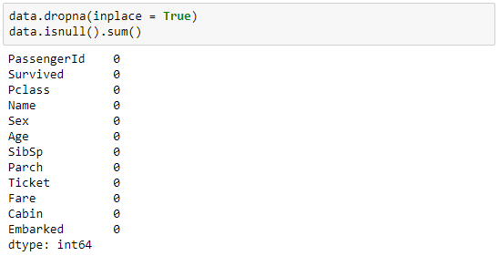
DELETING ROWS
This method commonly used to handle the null values.
Here, we either delete a particular row if it has a null value for a particular feature and a particular column if it has more than 70-75% of missing values.
This method is advised only when there are enough samples in the data set.
One has to make sure that after we have deleted the data, there is no addition of bias.
Removing the data will lead to loss of information which will not give the expected results while predicting the output.

Slide 8
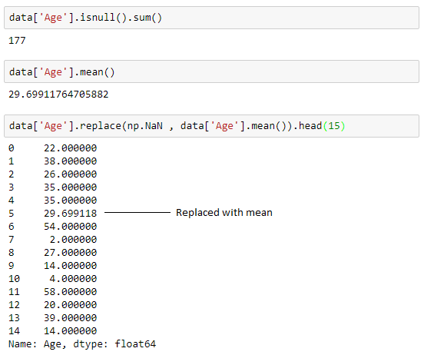
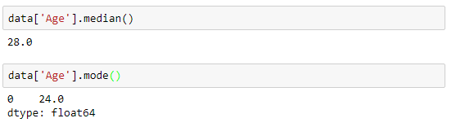
REPLACING WITH MEAN / MEDIAN / MODE
This strategy can be applied on a feature which has numeric data like the age of a person or the ticket fare.
We can calculate the mean, median or mode of the feature and replace it with the missing values.

Slide 9
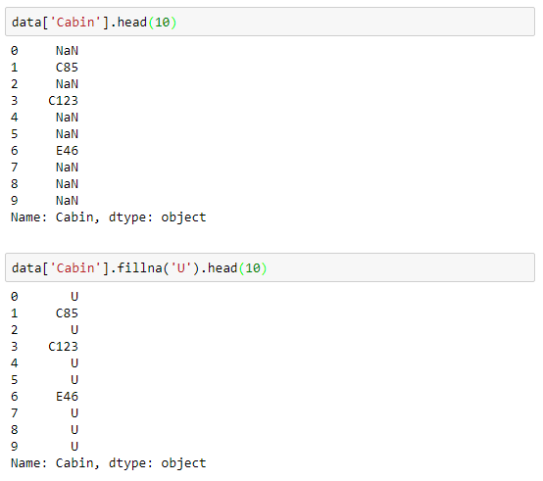
ASSIGNING AN UNIQUE CATEGORY
A categorical feature will have a definite number of possibilities, such as gender.
Since they have a definite number of classes, we can assign another class for the missing values.
Here, the features Cabin and Embarked have missing values which can be replaced with a new category, say, U for ‘unknown’.

Slide 10
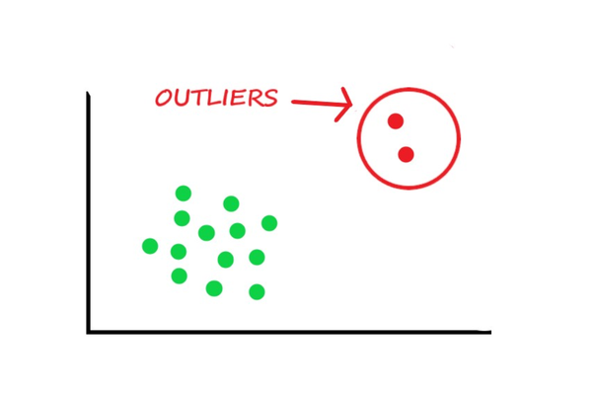
OUTLIERS
Outliers are the values that look different from the other values in the data.

Slide 11
WHAT ARE THE METHODS TO IDENTIFY OUTLIERS IN DATA ?
Box plots
IQR method
Z-score method
‘Distance from the mean’ method (Multivariate method)

Slide 12
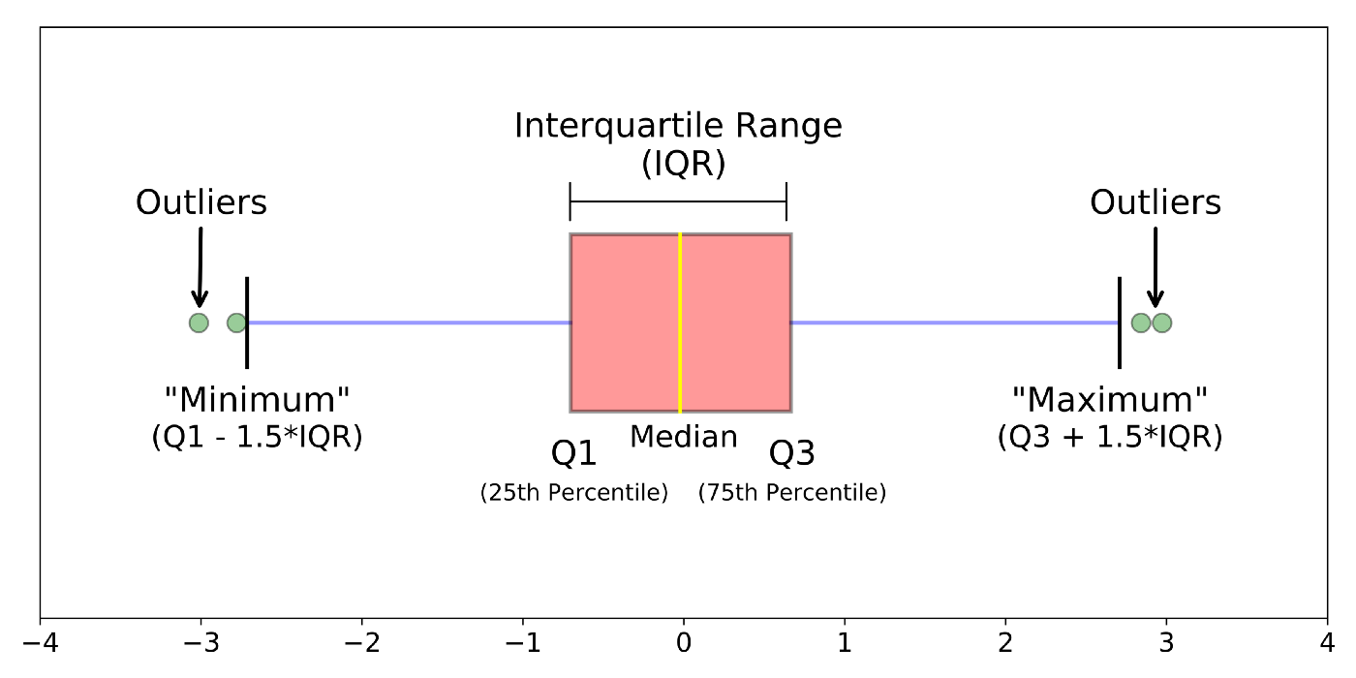
BOX PLOT
Box plots are a visual method to identify outliers.
Box plots is one of the many ways to visualize data distribution.
Box plot plots the q1 (25th percentile), q2 (50th percentile or median) and q3 (75th percentile) of the data along with (q1–1.5*(q3-q1)) and (q3+1.5*(q3-q1)).

Slide 13
IQR METHOD
IQR method is used by box plot to highlight outliers.
IQR stands for interquartile range, which is the difference between q3 (75th percentile) and q1 (25th percentile).
The IQR method computes lower bound and upper bound to identify outliers.
Lower Bound = q1–1.5*IQR
Upper Bound = q3+1.5*IQR

Slide 14
Z-SCORE METHOD
Z-score method is another method for detecting outliers.
This method is generally used when a variable’ distribution looks close to Gaussian.
Z-score is the number of standard deviations a value of a variable is away from the variable’ mean.
Z-Score = (X-mean) / Standard deviation
When the values of a variable are converted to Z-scores, then the distribution of the variable is called standard normal distribution with mean=0 and standard deviation=1.
The Z-score method requires a cut-off specified by the user, to identify outliers.

Slide 15
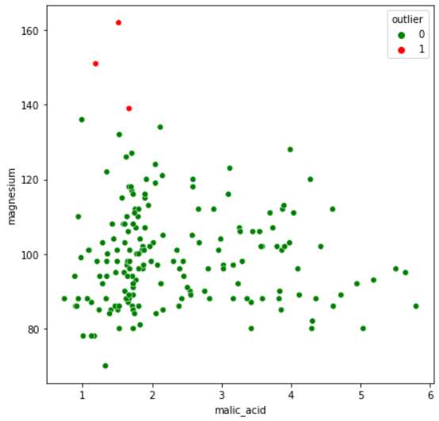
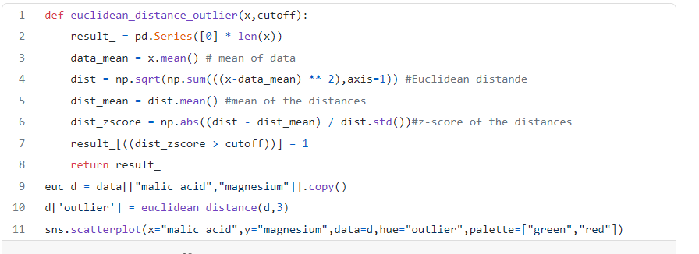
“DISTANCE FROM THE MEAN” METHOD(MULTIVARIATE METHOD)
This method calculates the Euclidean distance of the data points from their mean and converts the distances into absolute z-scores.
Any z-score greater than the pre-specified cut-off is considered to be an outlier.

Slide 16
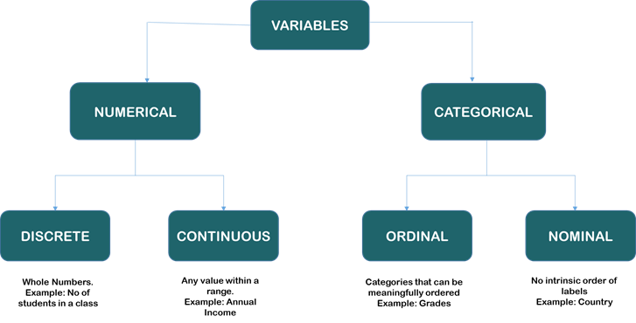
WHAT ARE THE TYPES OF VARIABLE ?

Slide 17
WHAT ARE CATEGORICAL VARIABLE AND CONTINUOUS VARIABLE?
Categorical Variables: Categorical variables are those data fields that can be divided into definite groups.
In this case, Gender(Male OR Female), Married(Yes Or No), Education(Graduate Or Not Graduate), Self_Employed(Yes Or No), Loan_Status(Y Or N) are categorical variables.
Numerical or Continuous Variables: Numerical variables are those that can take up any value within a given range.
For example, ApplicantIncome, CoapplicantIncome, Loan_Term, Loan_Amount, Credit_History.

Slide 18
WHAT IS UNIVARIATE ,BIVARIATE AND MULTIVARIATE IN STATISTICS?
UNIVARIATE:- Univariate involves the analysis of a single variable.
BIVARIATE:- Bivariate statistics compare two variables.
MULTIVARIATE:- Multivariate analysis examines two or more variables.

Slide 19

THANK YOU !!!
(USA)
2-Industrial Park Drive, E-Waldorf, MD, 20602,
United States
(USA)
+1-844-889-4054
(Singapore)
3 Temasek Avenue, Singapore 039190
info@careerera.com www.careerera.com
(INDIA)
B-44, Sector-59, Noida Uttar Pradesh 201301
(INDIA)
+91-92-5000-4000

