Slide 1
A Warm Welcome To Careerera Family

Slide 2

WHAT IS STATISTICS?
“Statistics is defined as Collection, Presentation, Analysis and Interpretation of Numerical Data.”
Statistics is the science and art of dealing with figure and facts.
DESCRIPTIVE STATISTICS
Collecting, Summarizing and Describing Data
INFERENCIAL STATISTICS
Drawing conclusion and/or making decision concerning a population based on sample data.

Slide 3
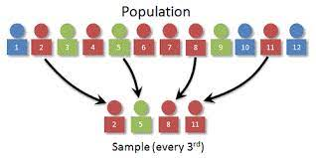
WHAT IS POPULATION AND SAMPLE IN STATISTICS?
POPULATION:- A population is the entire group that you want to draw conclusions about.
SAMPLE:- A sample is the specific group that you will collect data from.

Slide 4
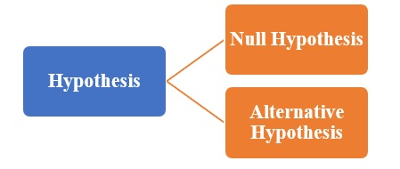
WHAT IS HYPOTHESIS TESTING ?
Hypothesis testing is a well defined procedure which helps us to decide objectively whether to accept or reject the hypothesis based on the information available from the sample.

Slide 5
WHAT IS NULL HYPOTHESIS ?
Null Hypothesis (H₀) is the hypothesis which is tested for the possible rejection under the assumption that is true.
It is used to determine whether the hypothesis assumed for the sample of data stands true for the entire population or not.
A null hypothesis proposes that no statistical significance exists in a set of given observations.
The hypothesized value of the parameter is called the null hypothesis.

Slide 6
WHAT IS ALTERNATIVE HYPOTHESIS ?
Alternative Hypothesis (H_{a}) is the logical opposite of the null hypothesis
The alternative hypothesis is a statement that will be accepted as a result of the null hypothesis being rejected.
The alternative hypothesis is the residual of the null hypothesis
Alternative Hypothesis includes the outcomes not covered by the null hypothesis.

Slide 7
WHAT ARE THE STEPS OF HYPOTHESIS TESTING ?
Step 1: Specify the Null Hypothesis. ...
Step 2: Specify the Alternative Hypothesis. ...
Step 3: Set the Significance Level (a) ...
Step 4: Calculate the Test Statistic and Corresponding P-Value. ...
Step 5: Drawing a Conclusion.

Slide 8
QUESTIONS ON HYPOTHESIS TESTING
Q1. A test of H0:μ=20H0:μ=20 versus Ha: μ>20Ha:μ>20 rejects the null hypothesis. Later it is discovered that μ=19.9μ=19.9. What type of error, if any, has been made?
Soln : Null Hypothesis:
H0:μ=20H0:μ=20
Alternative Hypothesis:
Ha:μ>20
The new population mean, μ=19.9
Conclusion:
In this question, we are rejecting the null hypothesis when it is false because the actual mean is μ=19.9μ=19.9. Therefore, it is neither a type I error nor a type II error. Option (c) is correct.

Slide 9
QUESTIONS ON HYPOTHESIS TESTING
Q2. Assume that the difference between the observed, paired sample values is defined in the same manner and that the specified significance level is the same for both hypothesis tests. Using the same data, the statement that “a paired/dependent two sample t-test is equivalent to a one sample t-test on the paired differences, resulting in the same test statistic, same p-value, and same conclusion” is:
a. Always True b. Never True
c. Sometimes True d. Not Enough Information.
Soln : a . Always True

Slide 10
QUESTIONS ON HYPOTHESIS TESTING
Q3. A statistics instructor believes that fewer than 20% of Evergreen Valley College (EVC) students attended the opening night midnight showing of the latest Harry Potter movie. She surveys 84 of her students and finds that 11 attended the midnight showing. An appropriate alternative hypothesis is:
1.p=0.20 2. p>0.20
3.p<0.20 4. p≤0.20
Soln : 3. p<0.20

Slide 11
WHAT IS CRITICAL VALUE IN HYPOTHESIS TESTING ?
The critical value approach involves determining "likely" or "unlikely" by determining whether or not the observed test statistic is more extreme than would be expected if the null hypothesis were true.
That is, it entails comparing the observed test statistic to some cutoff value, called the "critical value."
If the test statistic is more extreme than the critical value, then the null hypothesis is rejected in favor of the alternative hypothesis.
If the test statistic is not as extreme as the critical value, then the null hypothesis is not rejected.

Slide 12
WHAT IS Type 1 error ?
Type 1 error, in statistical hypothesis testing, is the error caused by rejecting a null hypothesis when it is true.
Type I error is denoted by α (alpha) known as an error, also called the level of significance of the test.
Type 1 error occurs when the null hypothesis is rejected even when there is no relationship between the variables.

Slide 13
WHAT IS Type II error ?
Type II error is the error that occurs when the null hypothesis is accepted when it is not true.
The type II error results in a false negative result.
The Type II error is denoted by β (beta) and is also termed as the beta error.
The null hypothesis is set to state that there is no relationship between two variables and the cause-effect relationship between two variables, if present, is caused by chance.

Slide 14
WHAT IS THE DIFFERENCE BETWEEN Type I error AND Type II error?
Type I error | Type II error
Type 1 error, in statistical hypothesis testing, is the error caused by rejecting a null hypothesis when it is true. | Type II error is the error that occurs when the null hypothesis is accepted when it is not true.
It is a false rejection of a true hypothesis. | It is the false acceptance of an incorrect hypothesis.
Type I error is denoted by α. | Type II error is denoted by β.
The probability of type I error is equal to the level of significance. | The probability of type II error is equal to one minus the power of the test.
It can be reduced by decreasing the level of significance. | It can be reduced by increasing the level of significance.
Type I error is similar to a false hit. | Type II error is similar to a miss.

Slide 15
WHAT IS ONE SAMPLE T-TEST ?
The One Sample T-Test (Student’s T Test) allows to compares the (small) population mean to some hypothesized value or one sample mean to determine if they are significantly different.
T test is used when the population standard deviation is unknown .
T- test is applied when the sample size is below 30, otherwise use Z-test (for known variance)

Slide 16
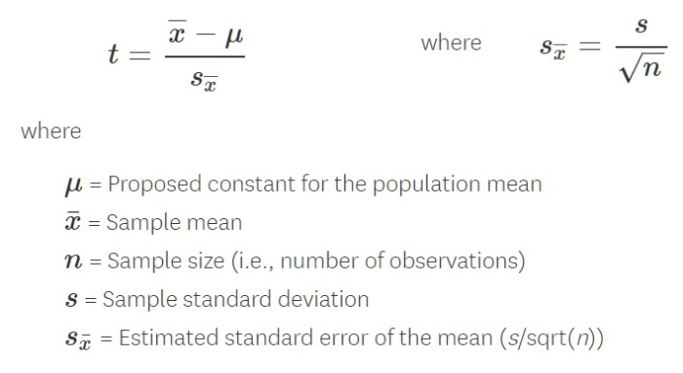
WHAT IS THE FORMULA OF ONE SAMPLE T-TEST ?

Slide 17
WHAT IS TWO-SAMPLE T-TEST ?
The two-sample t-test (also known as the independent samples t-test) is a method used to test whether the unknown population means of two groups are equal or not.
The assumptions of the two-sample t-test are:
1. The data are continuous.
2. The data follow the normal probability distribution.
3. The variances of the two populations are equal.
4. The two samples are independent.

Slide 18
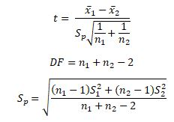
WHAT IS THE FORMULA OF TWO SAMPLE T-TEST ?
Where n1 and n2 are sample sizes
x̅1 and x̅2 are means of sample sizes
Sp is the pooled standard deviation

Slide 19
WHAT IS Z-TEST ?
Z-test is a statistical test to determine whether two population means are different when the variances are known and the sample size is large.
Z-test is a hypothesis test in which the z-statistic follows a normal distribution.
A z-statistic, or z-score, is a number representing the result from the z-test.
Z-tests assume the standard deviation is known

Slide 20
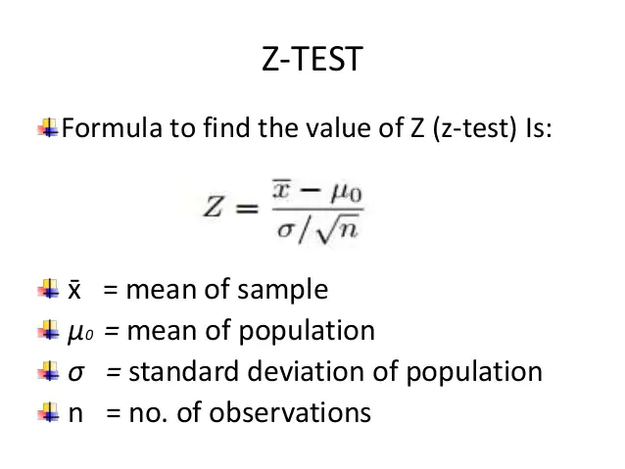
WHAT IS THE FORMULA OF Z TEST ?

Slide 21
WHAT IS ANOVA ?
Analysis of variance, or ANOVA, is a statistical method that separates variance data into different components to use for additional tests.
A one-way ANOVA is used for three or more groups of data, to gain information about the relationship between the dependent and independent variables.
If no true variance exists between the groups, the ANOVA's F-ratio should equal close to 1.

Slide 22
WHAT IS THE NEED OF ANOVA ?
The ANOVA test allows a comparison of more than two groups at the same time to determine whether a relationship exists between them.
The result of the ANOVA formula, the F statistic (also called the F-ratio), allows for the analysis of multiple groups of data to determine the variability between samples and within samples.

Slide 23
WHAT IS CHI-SQUARE ?
The Chi Square test is a type of Non-Parametric test, which deals with multiple samples with categorical data.
Chi-square is a statistical test commonly used to compare observed data with data we would expect to obtain according to a specific hypothesis.
Chi square is used when we have categorical data

Slide 24
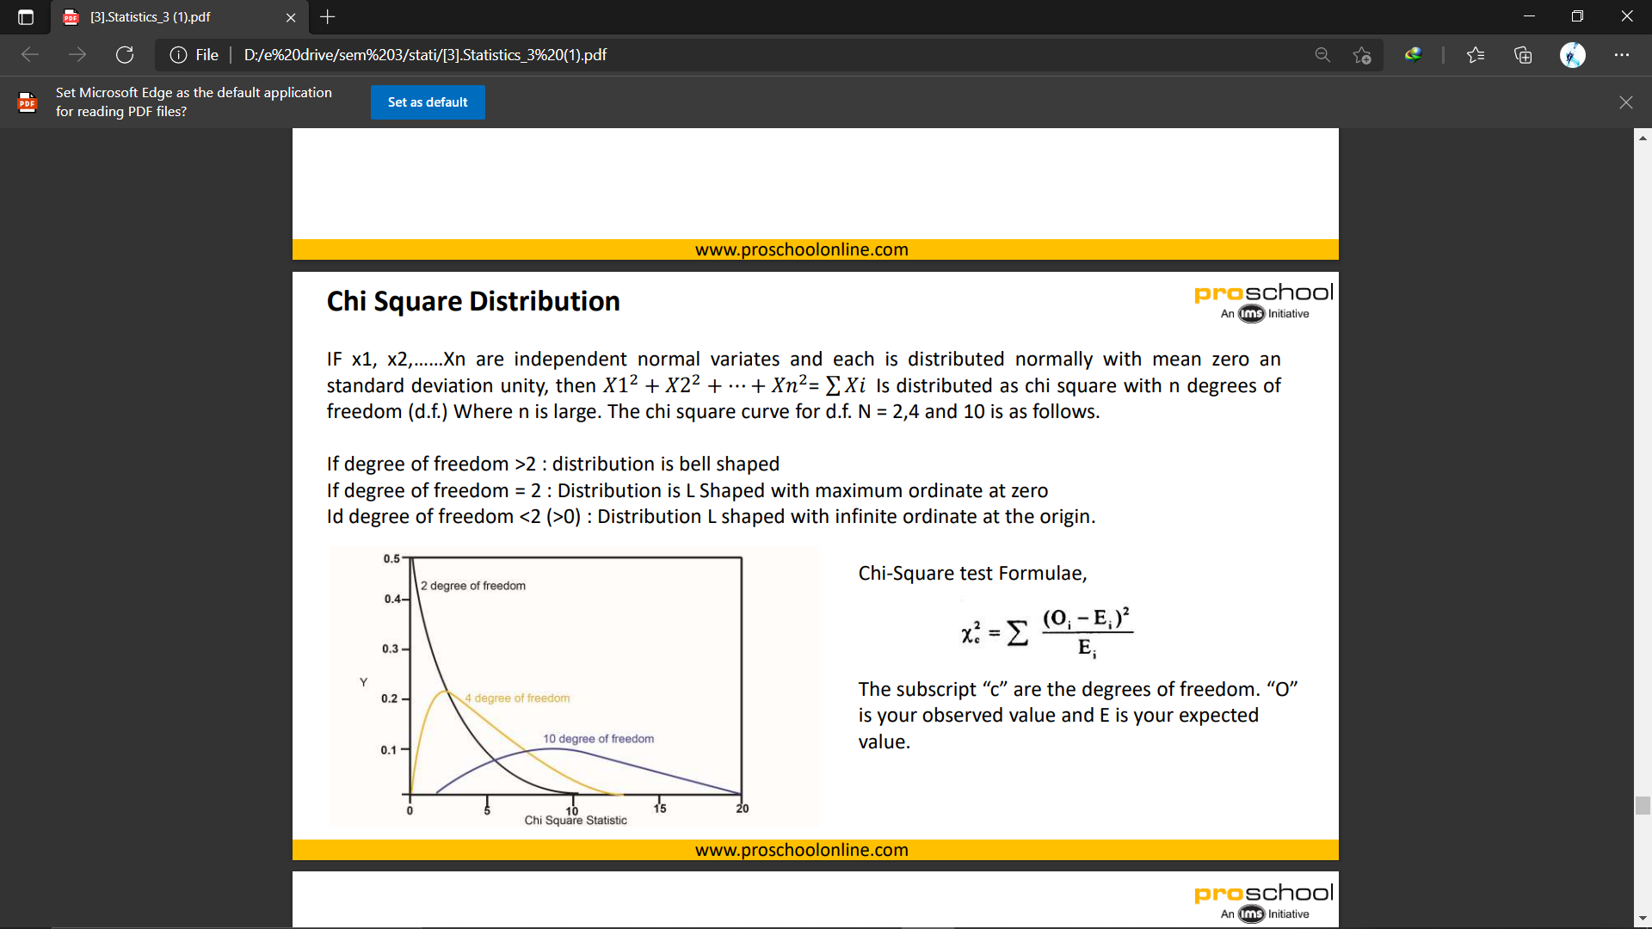
WHAT IS THE FORMULA OF CHI SQUARE TEST ?
The Chi Square Test is a statistical test which consists of three different types of analysis
1) Test for Homogeneity
2) Chi Square test of Association or Test of Independence
3) Goodness of fit

Slide 25
WHAT IS CHI-SQUARE TESTING ?
In the chi-square test, two hypotheses are tested.
The null hypothesis (H0) states that there is no difference between the two observed and expected values; they are statistically the same and any difference that may be detected is due to chance.
The alternative hypothesis (Ha) states that the two sets of data, the observed and expected values, are different; the difference is statistically significant and must be due to some reason other than chance.
χ2=∑(observed−expected) 2 /expected

Slide 26
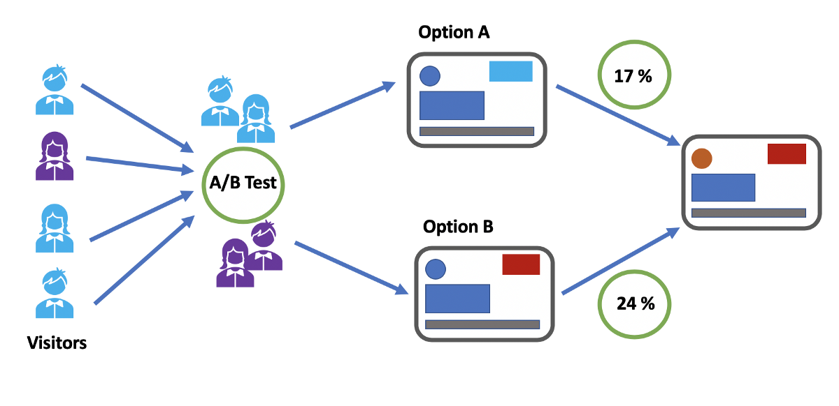
WHAT IS A/B TESTING?
A/B testing is a basic randomized control experiment. It is a way to compare the two versions of a variable to find out which performs better in a controlled environment.

Slide 27
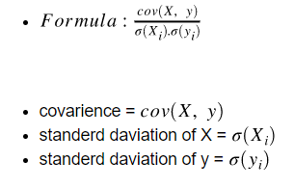
WHAT IS PEARSON CORRELATION ?
Pearson's correlation coefficient is the test statistics that measures the statistical relationship, or association, between two continuous variables.
It is known as the best method of measuring the association between variables of interest because it is based on the method of covariance.

Slide 28
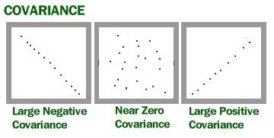
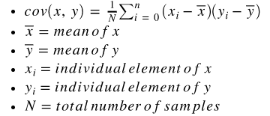
WHAT IS CO-VARIANCE?
Covariance is a measure of how much two random variables vary together.
It’s similar to variance, but where variance tells you how a single variable varies, co variance tells you how two variables vary together.

Slide 29
WHAT IS CHEBYSHEV’S INEQUALITY?
Chebyshev's inequality then states that the probability that an observation will be more than k standard deviations from the mean is at most 1/k².
Chebyshev used the inequality to prove his version of the law of large numbers.

Slide 30

Thank You !!!
(USA)
2-Industrial Park Drive, E-Waldorf, MD, 20602,
United States
(USA)
+1-844-889-4054
(Singapore)
3 Temasek Avenue, Singapore 039190
info@careerera.com www.careerera.com
(INDIA)
B-44, Sector-59, Noida Uttar Pradesh 201301
(INDIA)
+91-92-5000-4000

