Slide 1
A Warm Welcome To Careerera Family

Slide 2
MATPLOTLIB

Slide 3

WHAT IS Matplotlib?
Matplotlib is a low level graph plotting library in python that serves as a visualization utility.
Matplotlib was created by John D. Hunter.
Matplotlib is open source and we can use it freely.
Matplotlib is mostly written in python, a few segments are written in C, Objective-C and JavaScript for Platform compatibility.

Slide 4

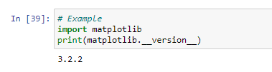
HOW TO IMPORT Matplotlib?
Once Matplotlib is installed, import it in your applications by adding the import module statement:
Checking Matplotlib Version

Slide 5

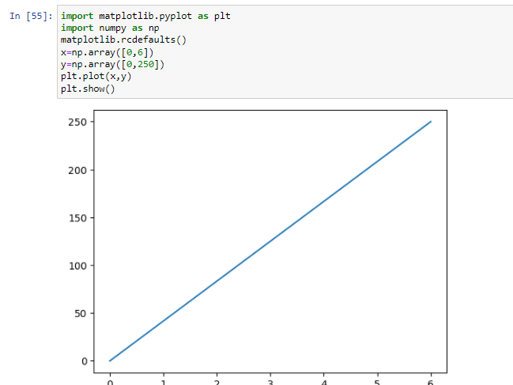
WHAT IS Pyplot ?
Most of the Matplotlib utilities lies under the pyplot submodule, and are usually imported under the plt alias:
EXAMPLE:-
Draw a line in a diagram from position (0,0) to position (6,250):

Slide 6
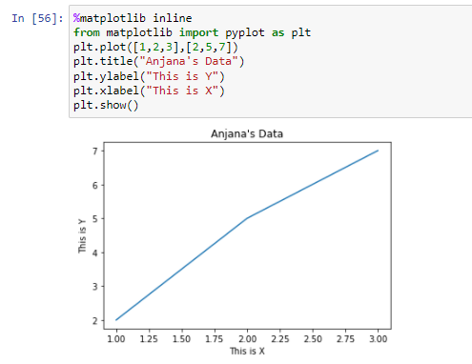
HOW TO CREATE Pyplot?
EXAMPLE:-

Slide 7
HOW TO PLOT x and y POINTS IN Pyplot?
The plot() function is used to draw points (markers) in a diagram.
By default, the plot() function draws a line from point to point.
The function takes parameters for specifying points in the diagram.
Parameter 1 is an array containing the points on the x-axis.
Parameter 2 is an array containing the points on the y-axis.
If we need to plot a line from (1, 3) to (8, 10), we have to pass two arrays [1, 8] and [3, 10] to the plot function.

Slide 8
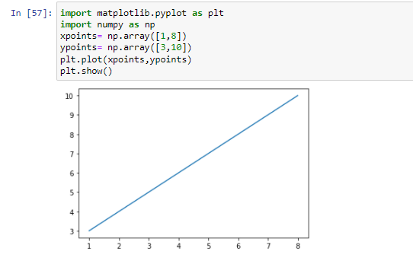
HOW TO PLOT x and y POINTS IN Pyplot?
Example:-
Draw a line in a diagram from position (1, 3) to position (8, 10):
The x-axis is the horizontal axis.
The y-axis is the vertical axis.

Slide 9
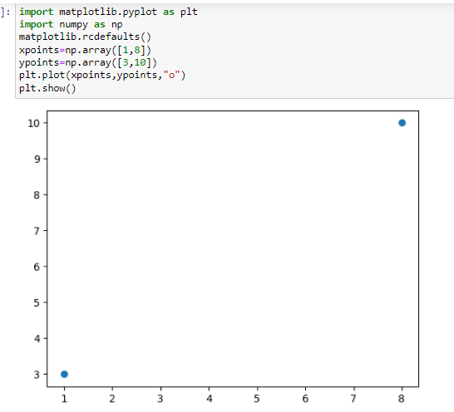
HOW TO PLOT POINTS WITHOUT LINE?
To plot only the markers, you can use shortcut string notation parameter 'o', which means 'rings'.
Example :-
Draw two points in the diagram, one at position (1, 3) and one in position (8, 10):

Slide 10
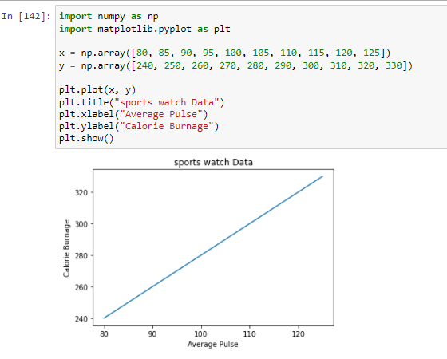
WHAT ARE LABELS AND TITLE IN MATPLOTLIB?
With Pyplot, you can use the xlabel() and ylabel() functions to set a label for the x- and y-axis.
With Pyplot, you can use the title() function to set a title for the plot.
Example:-
Add a plot title and labels for the x- and y-axis:

Slide 11
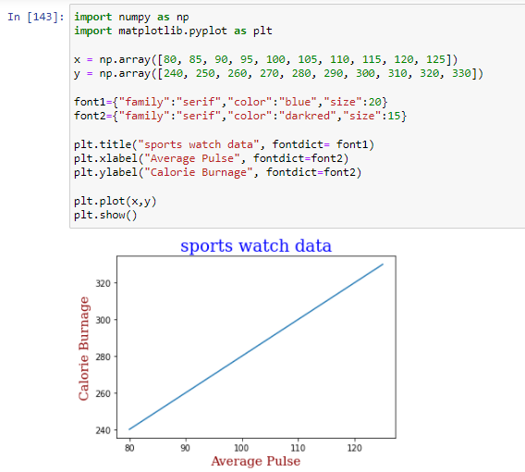
HOW TO SET FONT PROPERTIES FOR TITLE AND LABELS?
You can use the fontdict parameter in xlabel(), ylabel(), and title() to set font properties for the title and labels.
Example:-
Set font properties for the title and labels:

Slide 12
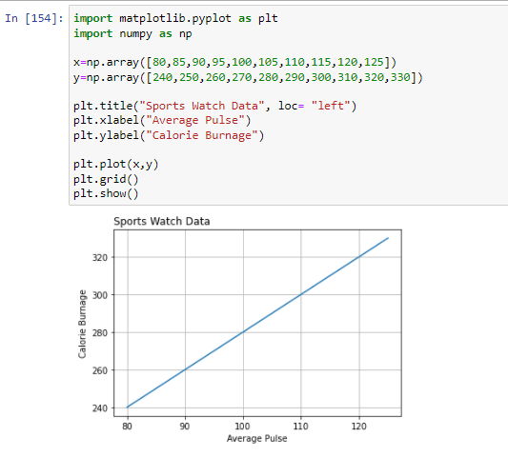
HOW TO ADD GRID LINES IN MATPLOTLIB?
Add Grid Lines to a Plot
With Pyplot, you can use the grid() function to add grid lines to the plot.

Slide 13
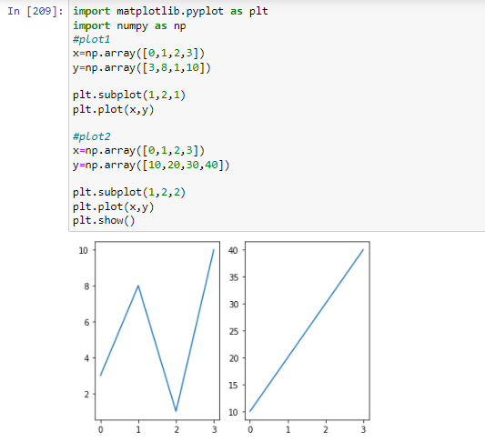
WHAT IS Subplots IN MATPLOTLIB?
Display Multiple Plots
With the subplots() function you can draw multiple plots in one figure:

Slide 14
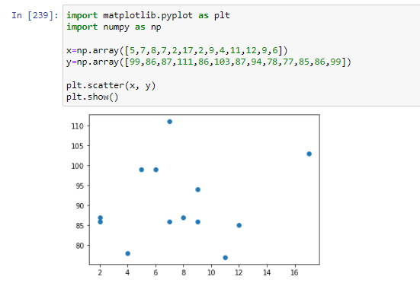
WHAT IS Scatter IN MATPLOTLIB?
With Pyplot, you can use the scatter() function to draw a scatter plot.
The scatter() function plots one dot for each observation. It needs two arrays of the same length, one for the values of the x-axis, and one for values on the y-axis:

Slide 15
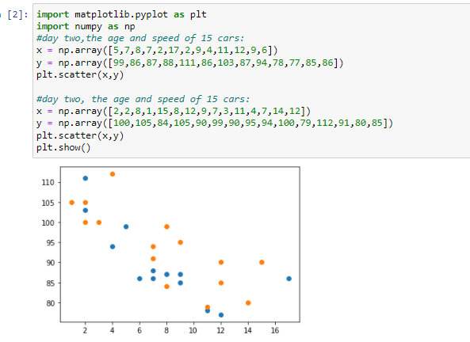
HOW TO COMPARE PLOTS?
There seems to be a relationship between speed and age, but what if we plot the observations from another day as well? Will the scatter plot tell us something else?

Slide 16
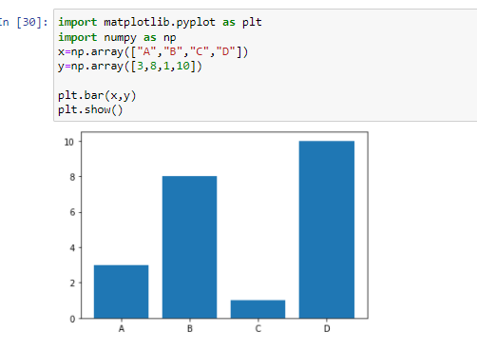
HOW TO CREATE Bars USING MATPLOTLIB?
Creating Bars
With Pyplot, you can use the bar() function to draw bar graphs:
The bar() function takes arguments that describes the layout of the bars.
The categories and their values represented by the first and second argument as arrays.

Slide 17
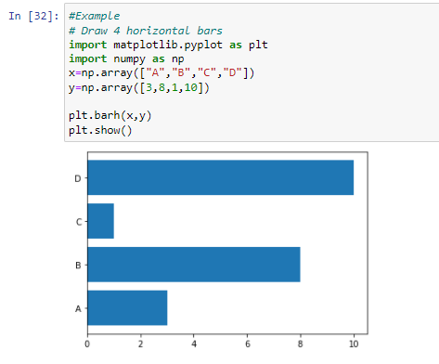
HOW TO CREATE Horizontal Bars USING MATPLOTLIB?
If you want the bars to be displayed horizontally instead of vertically, use the barh() function:

Slide 18
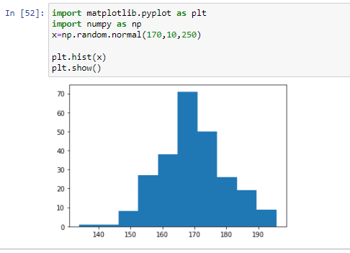
HOW TO CREATE Histograms USING MATPLOTLIB?
A histogram is a graph showing frequency distributions.
It is a graph showing the number of observations within each given interval.
Example: Say you ask for the height of 250 people, you might end up with a histogram like this:

Slide 19
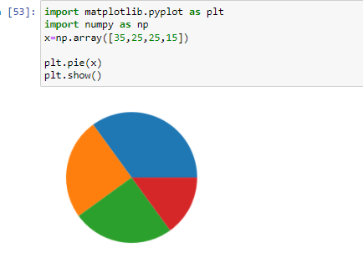
HOW TO CREATE Pie Charts USING MATPLOTLIB?
With Pyplot, you can use the pie() function to draw pie charts:

Slide 20

THANK YOU !!!
(USA)
2-Industrial Park Drive, E-Waldorf, MD, 20602,
United States
(USA)
+1-844-889-4054
(Singapore)
3 Temasek Avenue, Singapore 039190
info@careerera.com www.careerera.com
(INDIA)
B-44, Sector-59, Noida Uttar Pradesh 201301
(INDIA)
+91-92-5000-4000

