Slide 1
A Warm Welcome To Careerera Family

Slide 2
NUMPY(Numerical Python)

Slide 3

WHAT IS NumPy?
NumPy is a Python library used for working with arrays.
NumPy is a package which contains classes, functions, variables , large library of mathematical functions etc. to work with scientific calculation.
NumPy can be used to create n dimensional array where n is any integer . we can create 1 dimensional array , 2 dimensional array, 3 dimensional array and n dimensional array.

Slide 4
WHY USE NumPy?
In Python we have lists that serve the purpose of arrays, but they are slow to process.
NumPy aims to provide an array object that is up to 50x faster than traditional Python lists.
The array object in NumPy is called ndarray, it provides a lot of supporting functions that make working with ndarray very easy.
Arrays are very frequently used in data science, where speed and resources are very important.

Slide 5
WHY IS NumPy FASTER THAN LISTS?
NumPy arrays are stored at one continuous place in memory unlike lists, so processes can access and manipulate them very efficiently.
This behavior is called locality of reference in computer science.
This is the main reason why NumPy is faster than lists. Also it is optimized to work with latest CPU architectures.

Slide 6
HOW TO IMPORT NumPy?
There are two ways to import NumPy :-
import NumPy:- this will import the intire NumPy module.
from NumPy import*:- this will import all class, objects, variables etc. from NumPy package. here * means all.

Slide 7
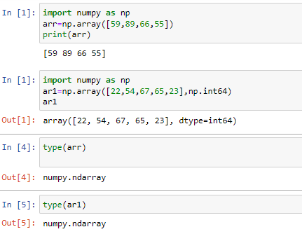
WHAT ARE THE STEPS TO IMPORT NumPy?

Slide 8
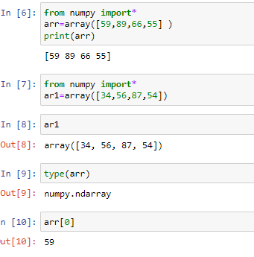
HOW TO IMPORT NumPy USING FROM NumPy import*

Slide 9
HOW TO ASSIGN NumPy AS np?
NumPy is usually imported under the np alias.
alias: In Python alias are an alternate name for referring to the same thing.
Create a NumPy ndarray Object
NumPy is used to work with arrays. The array object in NumPy is called ndarray.
We can create a NumPy ndarray object by using the array() function.
To create an ndarray, we can pass a list, tuple or any array-like object into the array() method, and it will be converted into an ndarray

Slide 10
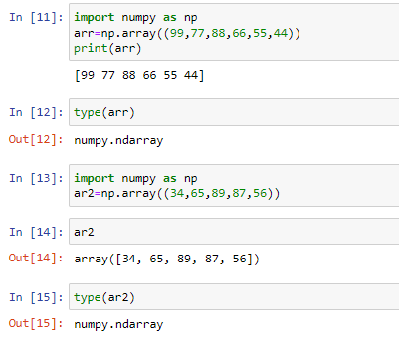
HOW TO CREATE A NumPy ndarray OBJECT?

Slide 11
WHAT ARE THE DIMENSIONS IN ARRAYS?
A dimension in arrays is one level of array depth (nested arrays).
nested array: are arrays that have arrays as their elements.
0-D Arrays
1-D Arrays
2-D Arrays
3-D Arrays

Slide 12
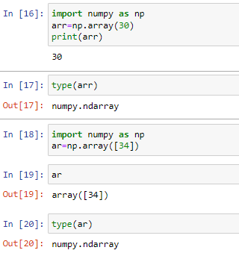
WHAT ARE 0-D ARRAYS?
0-D arrays, or Scalars, are the elements in an array. Each value in an array is a 0-D array.

Slide 13
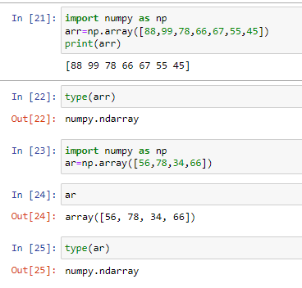
WHAT ARE 1-D ARRAYS?
An array that has 0-D arrays as its elements is called uni-dimensional or 1-D array.
These are the most common and basic arrays.

Slide 14
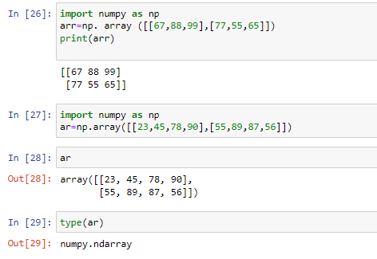
WHAT ARE 2-D ARRAYS?
An array that has 1-D arrays as its elements is called a 2-D array.
These are often used to represent matrix or 2nd order tensors.

Slide 15
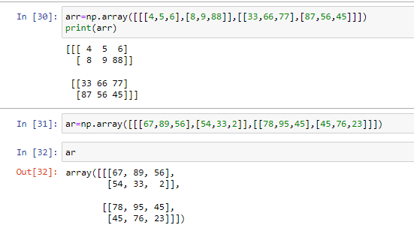
WHAT ARE 3-D ARRAYS?
An array that has 2-D arrays (matrices) as its elements is called 3-D array.
These are often used to represent a 3rd order tensor.

Slide 16
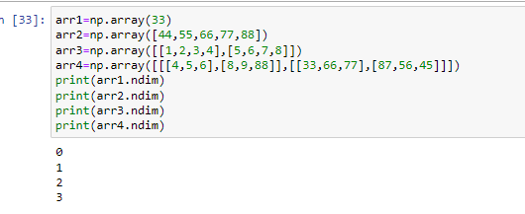
HOW TO CHECK NUMBER OF DIMENSIONS?
NumPy Arrays provides the ndim attribute that returns an integer that tells us how many dimensions the array have.

Slide 17
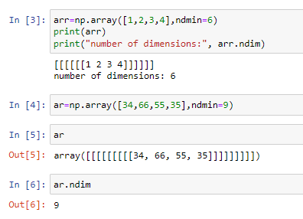
HOW TO ASSIGN HIGHER DIMENSIONAL ARRAYS?
An array can have any number of dimensions.
When the array is created, you can define the number of dimensions by using the ndim argument.

Slide 18
WHAT IS NumPy ARRAY INDEXING?
Access Array Elements
Array indexing is the same as accessing an array element.
You can access an array element by referring to its index number.
The indexes in NumPy arrays start with 0, meaning that the first element has index 0, and the second has index 1 etc.

Slide 19
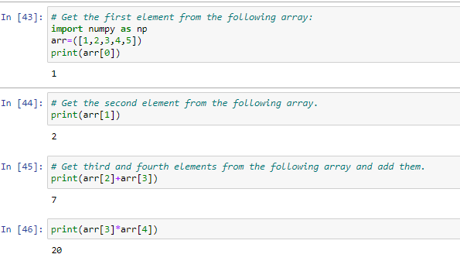
HOW TO PERFORM NumPy ARRAY INDEXING?

Slide 20
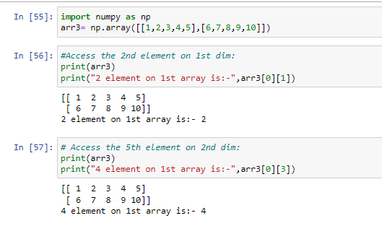
HOW TO ACCESS 2-D ARRAYS?
To access elements from 2-D arrays we can use comma separated integers representing the dimension and the index of the element.

Slide 21
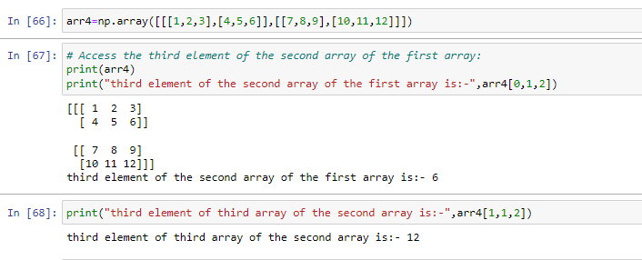
HOW TO ACCESS 3-D ARRAYS?
To access elements from 3-D arrays we can use comma separated integers representing the dimensions and the index of the element.

Slide 22
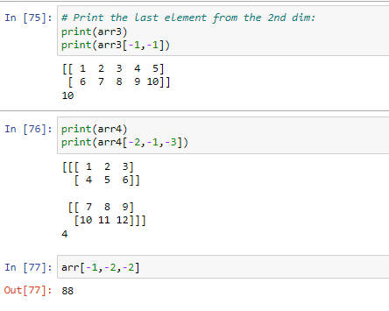
WHAT IS NEGATIVE INDEXING?
Use negative indexing to access an array from the end.

Slide 23
WHAT IS NumPy ARRAY SLICING?
Slicing in python means taking elements from one given index to another given index.
We pass slice instead of index like this: [start: end].
We can also define the step, like this: [start:end:step].
If we don't pass start its considered 0
If we don't pass end its considered length of array in that dimension
If we don't pass step its considered 1
Note: The result includes the start index, but excludes the end index.

Slide 24
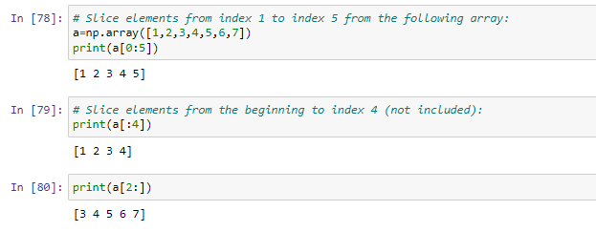
HOW TO PERFORM NumPy ARRAY SLICING?

Slide 25
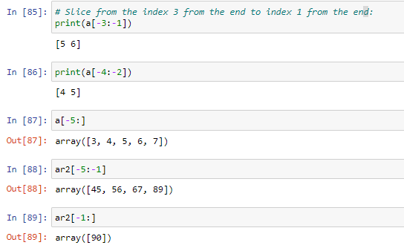
HOW TO PERFORM NEGATIVE SLICING?
Use the minus operator to refer to an index from the end:

Slide 26
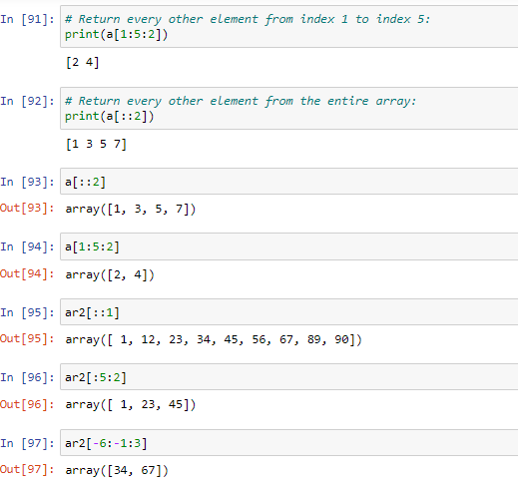
WHAT ARE THE STEPS TO PERFORM SLICING?
Use the step value to determine the step of the slicing:

Slide 27
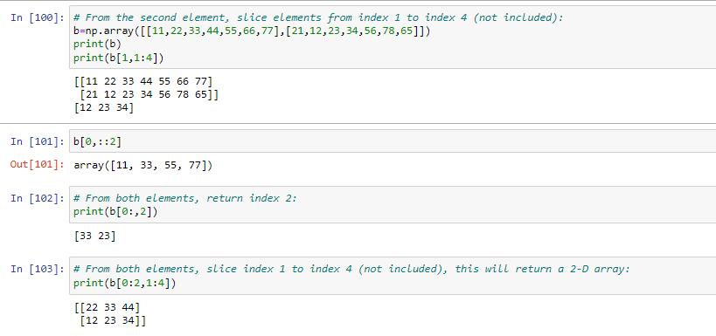
HOW TO PERFORM SLICING ON 2-D ARRAYS?

Slide 28
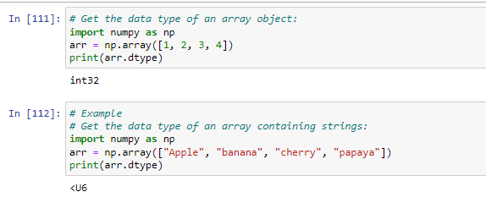
HOW TO CHECK THE DATA TYPE OF AN ARRAY?
The NumPy array object has a property called dtype that returns the data type of the array:

Slide 29
WHAT IS DIFFERENCE BETWEEN COPY & VIEW IN NumPy ARRAY?
The main difference between a copy and a view of an array is that the copy is a new array, and the view is just a view of the original array.
The copy owns the data and any changes made to the copy will not affect original array, and any changes made to the original array will not affect the copy.
The view does not own the data and any changes made to the view will affect the original array, and any changes made to the original array will affect the view.

Slide 30
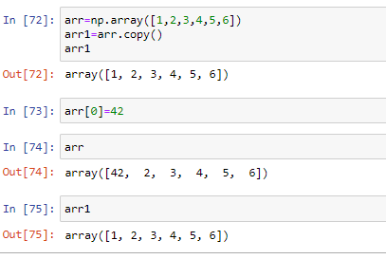
WHAT IS COPY IN NumPy ARRAY ?
Make a copy, change the original array, and display both arrays:
The copy SHOULD NOT be affected by the changes made to the original array.

Slide 31
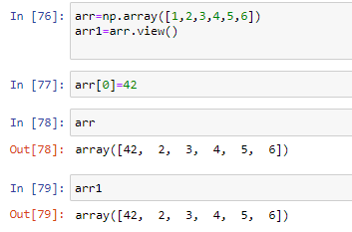
WHAT IS VIEW IN NumPy ARRAY?
Make a view, change the original array, and display both arrays.
The view SHOULD be affected by the changes made to the original array.

Slide 32
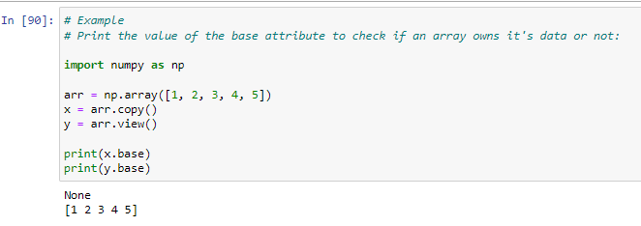
HOW TO CHECK IF ARRAY OWNS IT‘S DATA ?
As mentioned above, copies owns the data, and views does not own the data, but how can we check this?
Every NumPy array has the attribute base that returns None if the array owns the data.
Otherwise, the base attribute refers to the original object.

Slide 33
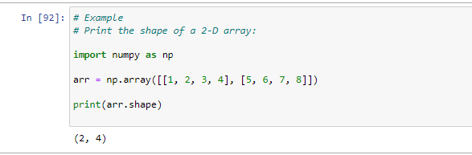
HOW TO CHECK NumPy ARRAY SHAPE?
The shape of an array is the number of elements in each dimension.
NumPy arrays have an attribute called shape that returns a tuple with each index having the number of corresponding elements.

Slide 34
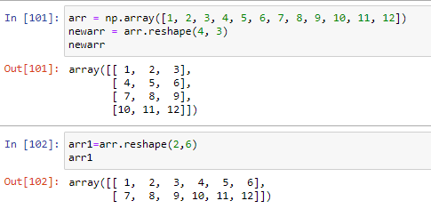
HOW TO PERFORM NumPy ARRAY RESHAPING?
Reshaping means changing the shape of an array.
The shape of an array is the number of elements in each dimension.
By reshaping we can add or remove dimensions or change number of elements in each dimension.
Reshape From 1-D to 2-D

Slide 35

THANK YOU !!!
(USA)
2-Industrial Park Drive, E-Waldorf, MD, 20602,
United States
(USA)
+1-844-889-4054
(Singapore)
3 Temasek Avenue, Singapore 039190
info@careerera.com www.careerera.com
(INDIA)
B-44, Sector-59, Noida Uttar Pradesh 201301
(INDIA)
+91-92-5000-4000

