Slide 1
A Warm Welcome To Careerera Family

Slide 2
PANDAS

Slide 3

WHAT IS PANDAS?
Pandas is a Python library used for working with data sets.
It has functions for analyzing, cleaning, exploring, and manipulating data.
The name "Pandas" has a reference to both "Panel Data", and "Python Data Analysis" and was created by Wes McKinney in 2008.

Slide 4
WHY USE PANDAS?
Pandas allows us to analyze big data and make conclusions based on statistical theories.
Pandas can clean messy data sets, and make them readable and relevant.
Relevant data is very important in data science.

Slide 5
WHAT CAN PANDAS DO?
Pandas gives you answers about the data. Like:
Is there a correlation between two or more columns?
What is average value?
Max value? Min value? Pandas are also able to delete rows that are not relevant, or contains wrong values, like empty or NULL values. This is called cleaning the data.

Slide 6
HOW TO IMPORT PANDAS?
There are two ways to import pandas
import pandas:- This will import the entire pandas module.
from pandas import*:- This will import all class, objects, variables etc. from pandas package. here * means all.

Slide 7
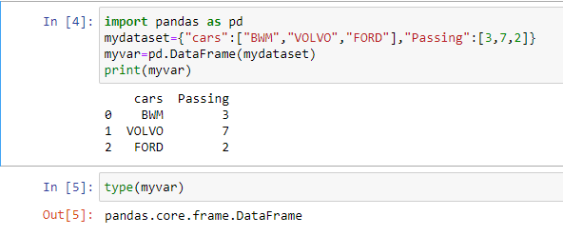
HOW TO USE import pandas?

Slide 8
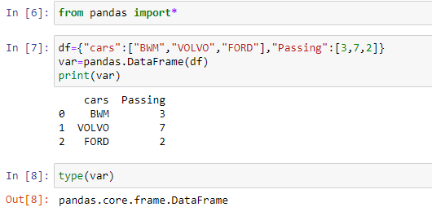
HOW TO USE from pandas import*

Slide 9
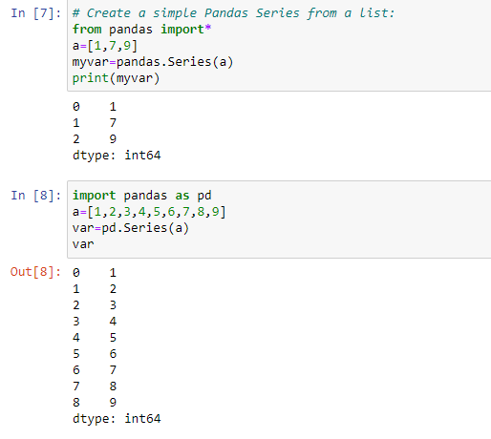
WHAT IS SERIES?
A Pandas Series is like a column in a table.
It is a one-dimensional array holding data of any type.

Slide 10
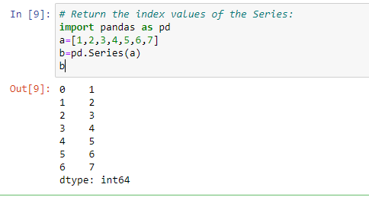
WHAT IS LABLES?
If nothing else is specified, the values are labeled with their index number. First value has index 0, second value has index 1 etc.
This label can be used to access a specified value.

Slide 11
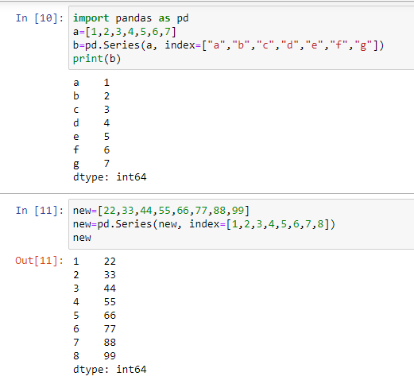
HOW TO CREATE LABLES?
With the index argument, you can name your own labels.

Slide 12
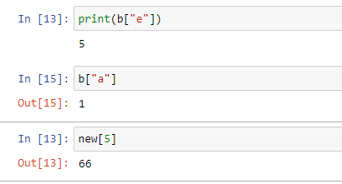
HOW TO ACCESS VALUES IN LABELS?
When you have created labels, you can access an item by referring to the label.

Slide 13
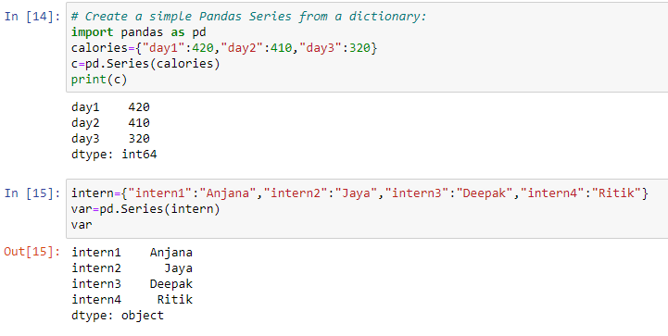
WHAT IS KEY/VALUE OBJECTS AS SERIES ?
We can also use a key/value object, like a dictionary, when creating a Series.
Note: The keys of the dictionary become the labels.

Slide 14
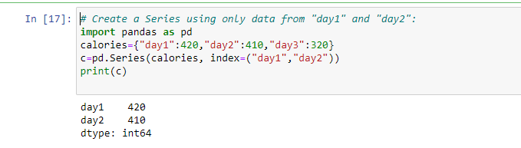
HOW TO INCLUDE SPECIFIC ITEMS IN SERIES?
To select only some of the items in the dictionary, use the index argument and specify only the items you want to include in the Series.

Slide 15
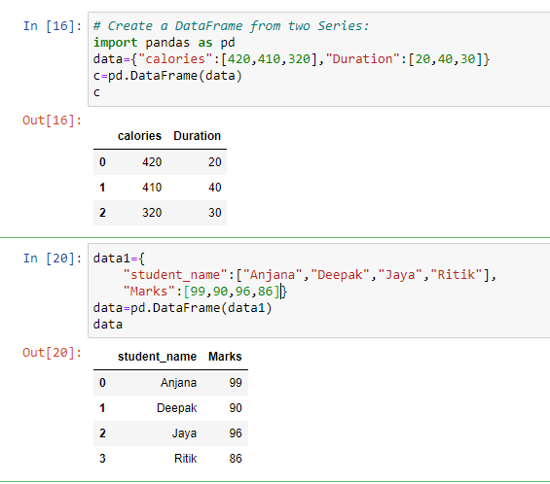
WHAT IS DATAFRAME?
Data sets in Pandas are usually multi-dimensional tables, called DataFrames.
Series is like a column, a DataFrame is the whole table.

Slide 16
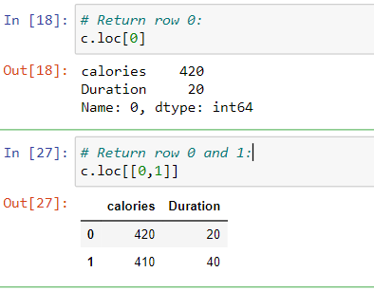
WHAT IS LOCATE ROW?
As you can see from the result above, the DataFrame is like a table with rows and columns.
Pandas use the loc attribute to return one or more specified row(s)
NOTE : When using [], the result is a Pandas DataFrame.

Slide 17
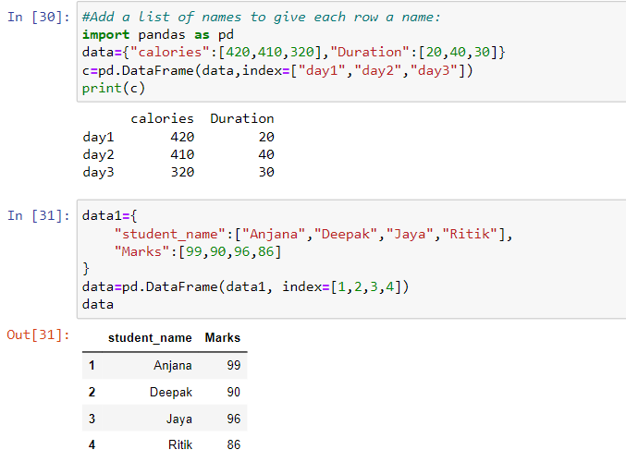
HOW TO NAMED INDEXES?
With the index argument, you can name your own indexes.

Slide 18
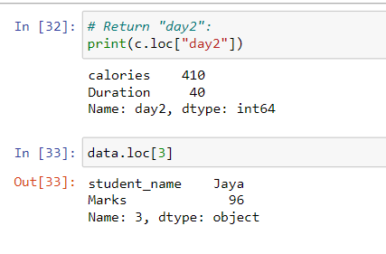
HOW TO LOCATE NAMED INDEXES?
Use the named index in the loc attribute to return the specified row(s).

Slide 19
HOW TO USE READ CSV IN PANDAS?
A simple way to store big data sets is to use CSV files (comma separated files).
CSV files contains plain text and is a well know format that can be read by everyone including Pandas.
Tip: use to_string() to print the entire DataFrame. By default, when you print a DataFrame, you will only get the first 5 rows, and the last 5 rows:

Slide 20
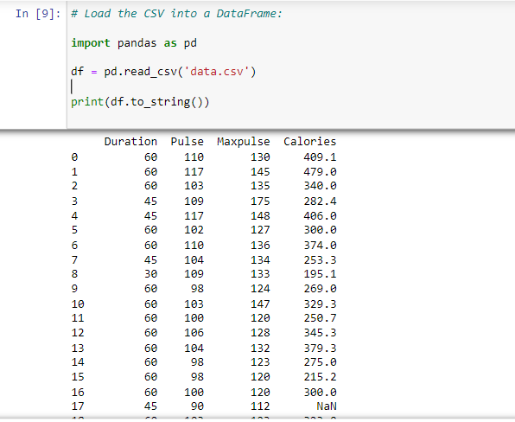
HOW TO LOAD FILES INTO A DataFrame?
If your data sets are stored in a file, Pandas can load them into a DataFrame.

Slide 21
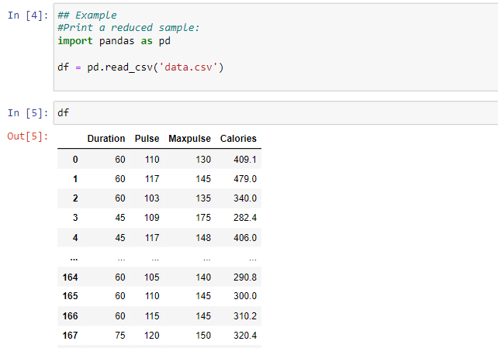
HOW TO ANALYZE DataFrame?
By default, when you print a DataFrame, you will only get the first 5 rows, and the last 5 rows:

Slide 22
HOW TO VIEW & ANALYZE THE DATA?
One of the most used method for getting a quick overview of the DataFrame, is the head() method.
The head() method returns the headers and a specified number of rows, starting from the top.
Note: if the number of rows is not specified, the head() method will return the top 5 rows.

Slide 23
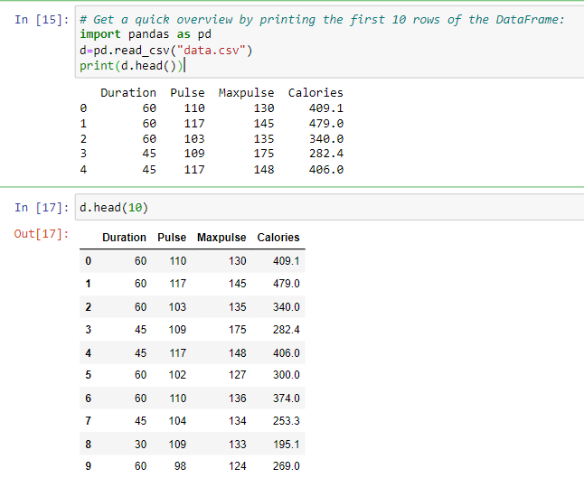
HOW TO VIEW & ANALYZE THE HEAD OF DATA?

Slide 24
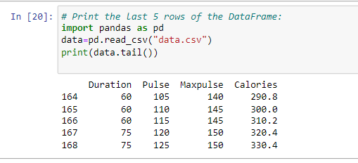
HOW TO VIEW & ANALYZE THE TAIL OF DATA?
There is also a tail() method for viewing the last rows of the DataFrame.
The tail() method returns the headers and a specified number of rows, starting from the bottom.

Slide 25
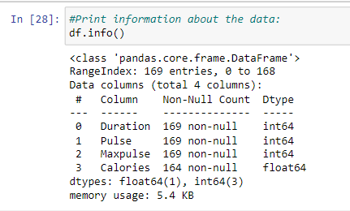
HOW TO CHECK INFO ABOUT THE DATA?
The DataFrames object has a method called info(), that gives you more information about the data set.

Slide 26
HOW TO PERFORM DATA CLEANING?
Data cleaning means fixing bad data in your data set.
Bad data could be:
Empty cells
Data in wrong format
Wrong data
Duplicates

Slide 27
WHAT IS PANDAS - CLEANING EMPTY CELLS?
Empty cells can potentially give you a wrong result when you analyze data.
Remove Rows
One way to deal with empty cells is to remove rows that contain empty cells.
This is usually OK, since data sets can be very big, and removing a few rows will not have a big impact on the result.
Note: By default, the dropna() method returns a new DataFrame, and will not change the original.
If you want to change the original DataFrame, use the inplace = True argument:

Slide 28
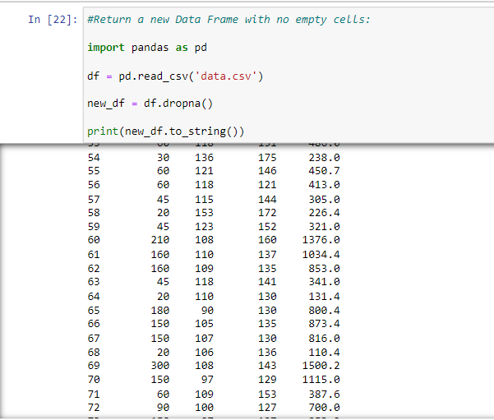
HOW TO PERFORM PANDAS - CLEANING EMPTY CELLS?

Slide 29
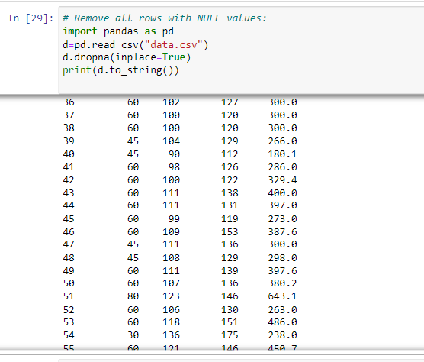
HOW TO PERFORM PANDAS - CLEANING EMPTY CELLS?

Slide 30
HOW TO REPLACE EMPTY VALUES?
Another way of dealing with empty cells is to insert a new value instead.
This way you do not have to delete entire rows just because of some empty cells.
The fillna() method allows us to replace empty cells with a value.

Slide 31
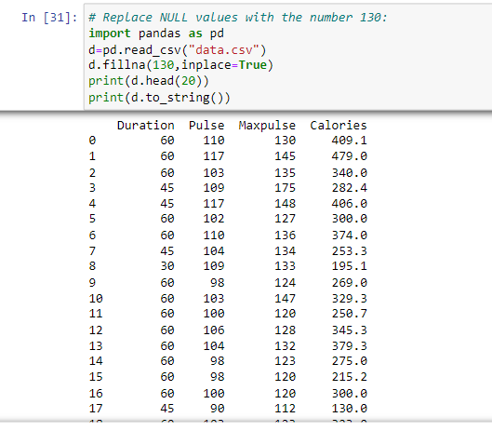
WHAT ARE THE STEPS TO REPLACE EMPTY VALUES?

Slide 32
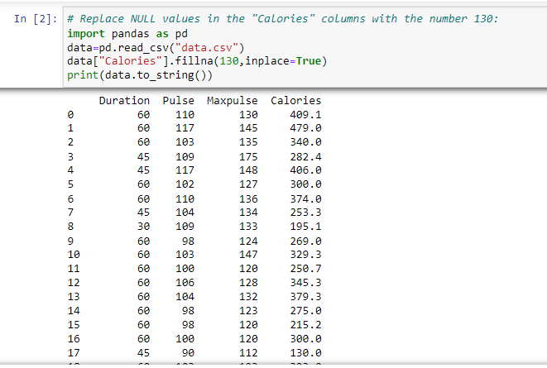
HOW TO REPLACE EMPTY VALUES ONLY FOR A SPECIFIED COLUMNS?
To only replace empty values for one column, specify the column name for the DataFrame:

Slide 33
HOW TO FILL EMPTY VALUES USING MEAN, MEDIAN, or MODE?
A common way to replace empty cells, is to calculate the mean, median or mode value of the column.
Pandas uses the mean() median() and mode() methods to calculate the respective values for a specified column:
Mean = the average value (the sum of all values divided by number of values).
Median = the value in the middle, after you have sorted all values ascending.
Mode = the value that appears most frequently.

Slide 34
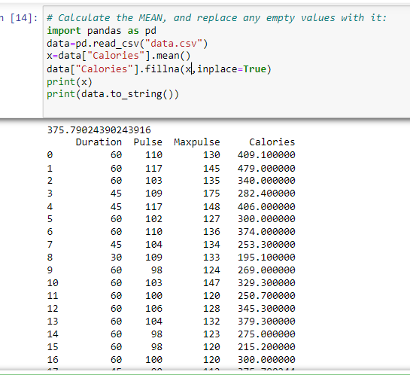
HOW TO FILL EMPTY VALUES USING MEAN ?

Slide 35
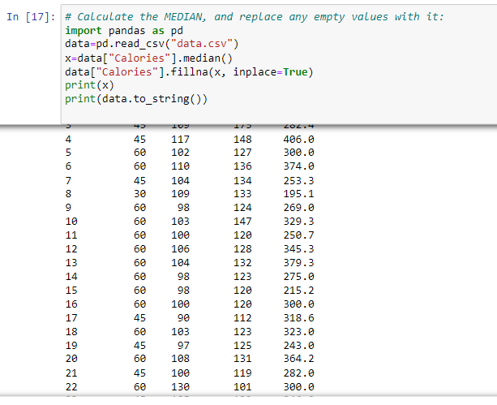
HOW TO FILL EMPTY VALUES USING MEDIAN ?

Slide 36
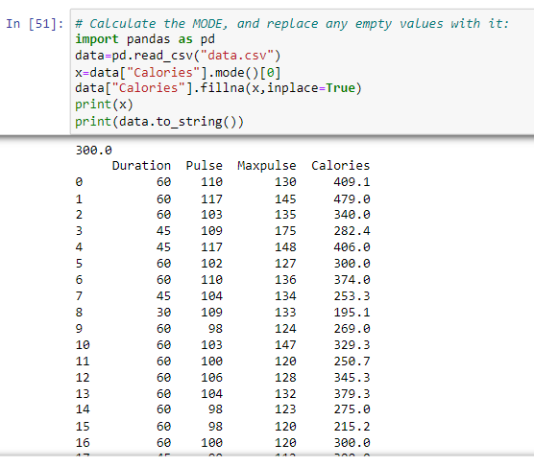
HOW TO FILL EMPTY VALUES USING MODE ?

Slide 37
HOW TO PERFORM PANDAS-CLEANING DATA OF WRONG FORMAT?
Cells with data of wrong format can make it difficult, or even impossible, to analyze data.
To fix it, you have two options: remove the rows, or convert all cells in the columns into the same format.

Slide 38
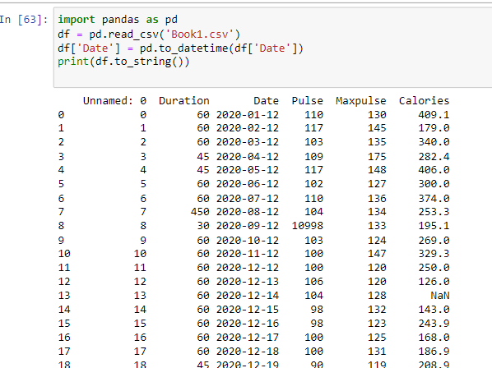
WHAT ARE THE STEPS TO CONVERT INTO A CORRECT FORMAT?
# Convert To DATE

Slide 39
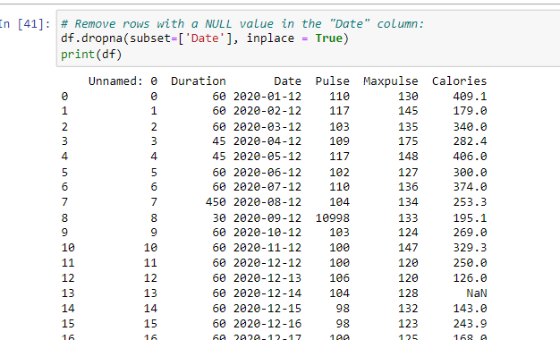
HOW TO REMOVE UNWANTED ROWS?
The result from the converting in the example above gave us a Na value, which can be handled as a NULL value, and we can remove the row by using the dropna() method.

Slide 40
HOW TO FIX WRONG DATA?
"Wrong data" does not have to be "empty cells" or "wrong format", it can just be wrong, like if someone registered "199" instead of "1.99".
Sometimes you can spot wrong data by looking at the data set, because you have an expectation of what it should be.
If you take a look at our data set, you can see that in row 7, the duration is 450, but for all the other rows the duration is between 30 and 60.
It doesn't have to be wrong, but taking in consideration that this is the data set of someone's workout sessions, we conclude with the fact that this person did not work out in 450 minutes.

Slide 41

WHAT IS REPLACING VALUES?
One way to fix wrong values is to replace them with something else.
For small data sets you might be able to replace the wrong data one by one, but not for big data sets.
To replace wrong data for larger data sets you can create some rules, e.g. set some boundaries for legal values, and replace any values that are outside of the boundaries.

Slide 42
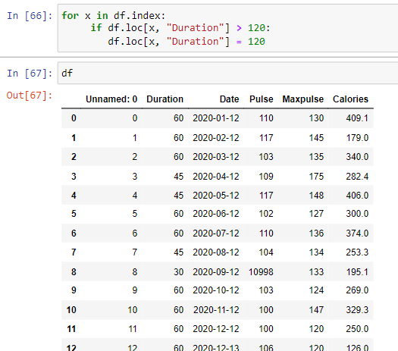
HOW TO PERFORM REPLACE VALUES?
Loop through all values in the "Duration" column.
If the value is higher than 120, set it to 120:

Slide 43
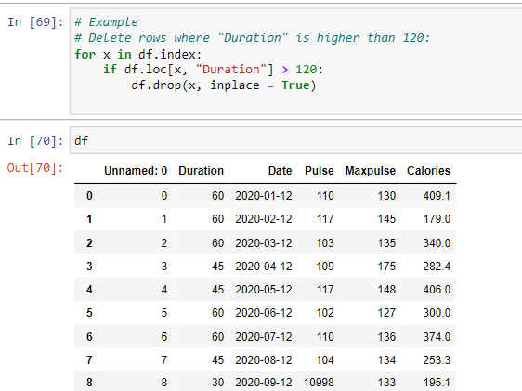
HOW TO PERFORM REMOVING ROWS?
Another way of handling wrong data is to remove the rows that contains wrong data.
This way you do not have to find out what to replace them with, and there is a good chance you do not need them to do your analyses.

Slide 44
WHAT ARE DUPLICATES?
Duplicate rows are rows that have been registered more than one time.
By taking a look at our test data set, we can assume that row 11 and 12 are duplicates.
To discover duplicates, we can use the duplicated() method.
The duplicated() method returns a Boolean values for each row:

Slide 45
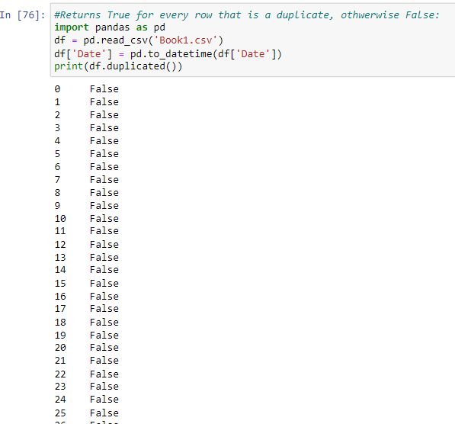
HOW TO DISCOVER DUPLICATES?

Slide 46
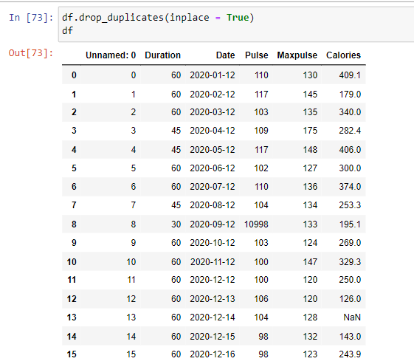
HOW TO REMOVE DUPLICATES?
To remove duplicates, use the drop_duplicates() method.

Slide 47
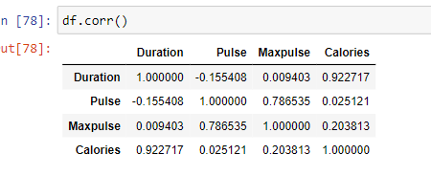
HOW TO CHECK PANDAS - DATA CORRELATION?
A great aspect of the Pandas module is the corr() method.
The corr() method calculates the relationship between each column in your data set.

Slide 48
WHAT IS PANDAS - DATA CORRELATION?
The corr() method ignores "not numeric" columns.
Result Explained The Result of the corr() method is a table with a lot of numbers that represents how well the relationship is between two columns.
The number varies from -1 to 1.
1 means that there is a 1 to 1 relationship (a perfect correlation), and for this data set, each time a value went up in the first column, the other one went up as well.
0.9 is also a good relationship, and if you increase one value, the other will probably increase as well.

Slide 49
WHAT ARE THE TYPES OF PANDAS - DATA CORRELATION?
-0.9 would be just as good relationship as 0.9, but if you increase one value, the other will probably go down.
0.2 means NOT a good relationship, meaning that if one value goes up does not mean that the other will.
What is a good correlation? It depends on the use, but I think it is safe to say you have to have at least 0.6 (or -0.6) to call it a good correlation.
Perfect Correlation:
We can see that "Duration" and "Duration" got the number 1.000000, which makes sense, each column always has a perfect relationship with itself.

Slide 50
WHAT ARE THE TYPES OF PANDAS - DATA CORRELATION?
Good Correlation:
"Duration" and "Calories" got a 0.922721 correlation, which is a very good correlation, and we can predict that the longer you work out, the more calories you burn, and the other way around: if you burned a lot of calories, you probably had a long work out.
Bad Correlation:
"Duration" and "Maxpulse" got a 0.009403 correlation, which is a very bad correlation, meaning that we can not predict the max pulse by just looking at the duration of the work out, and vice versa.

Slide 51

THANK YOU !!!
(USA)
2-Industrial Park Drive, E-Waldorf, MD, 20602,
United States
(USA)
+1-844-889-4054
(Singapore)
3 Temasek Avenue, Singapore 039190
info@careerera.com www.careerera.com
(INDIA)
B-44, Sector-59, Noida Uttar Pradesh 201301
(INDIA)
+91-92-5000-4000

