Slide 1
A warm welcome to Careerera family

Slide 2
REINFORCEMENT LEARNING

Slide 3

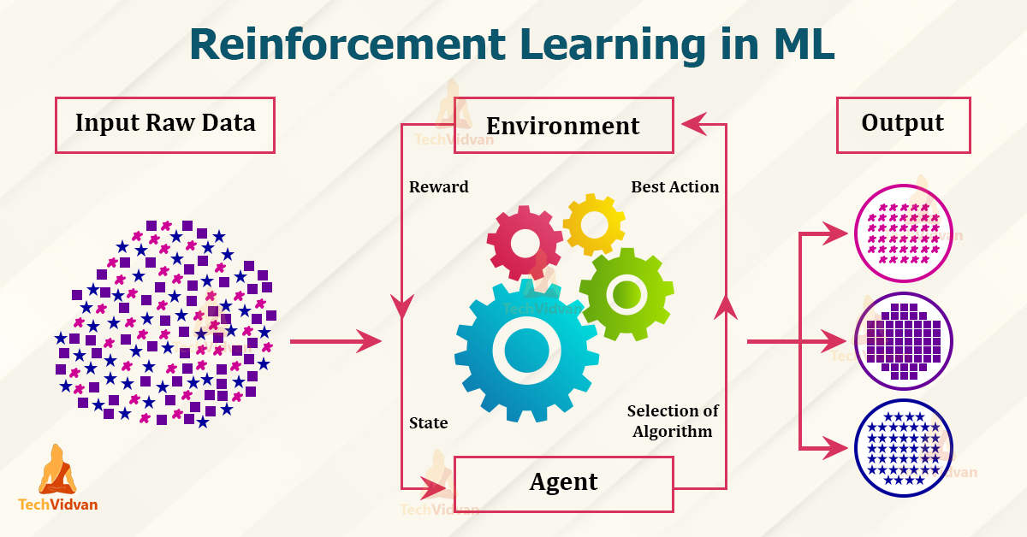
WHAT IS REINFORCEMENT LEARNING ?

Slide 4
CONTENT OF REINFORCEMENT LEARNING :
Introduction to Reinforcement Learning
Reinforcement Learning Framework and Elements
Markov Decision Process
Q-value and Advantage based Algorithms
Multi-Arm Bandit
Notes:
Careerera is one of the leading providers of Higher Education Professional Certification Training, Test Preparation, K -12 Education, Language Training, and other skill training for Adults and kids in the field of IT, Management, Software Development, Project Management, Quality Assurance and many more.
NEET, JEE Mains, AIEEE and more

Slide 5
INTRODUCTION TO REINFORCEMENT LEARNING

Slide 6
WHAT IS REINFORCEMENT LEARNING ?
Reinforcement Learning is a feedback-based Machine learning technique in which an agent learns to behave in an environment by performing the actions and seeing the results of actions.
For each good action, the agent gets positive feedback, and for each bad action, the agent gets negative feedback or penalty.
In Reinforcement Learning, the agent learns automatically using feedbacks without any labeled data, unlike supervised learning.
Since there is no labeled data, so the agent is bound to learn by its experience only.
Reinforcement Learning solves a specific type of problem where decision making is sequential, and the goal is long-term, such as game-playing, robotics, etc.

Slide 7
REINFORCEMENT LEARNING
The agent interacts with the environment and explores it by itself.
The primary goal of an agent in reinforcement learning is to improve the performance by getting the maximum positive rewards.
The agent learns with the process of hit and trial, and based on the experience, it learns to perform the task in a better way.
It is a core part of Artificial intelligence, and all AI agent works on the concept of reinforcement learning.
Here we do not need to pre-program the agent, as it learns from its own experience without any human intervention.
The agent continues doing these three things (take action, change state/remain in the same state, and get feedback), and by doing these actions, he learns and explores the environment.

Slide 8
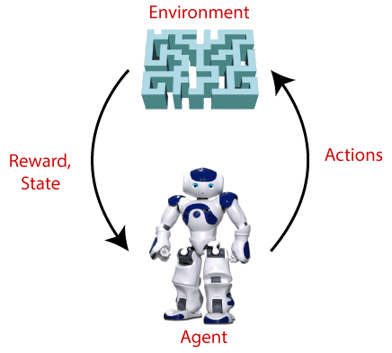
REINFORCEMENT LEARNING

Slide 9
TERMS USED IN REINFORCEMENT LEARNING
Agent(): An entity that can perceive/explore the environment and act upon it.
Environment(): A situation in which an agent is present or surrounded by. In RL, we assume the stochastic environment, which means it is random in nature.
Action(): Actions are the moves taken by an agent within the environment.
State(): State is a situation returned by the environment after each action taken by the agent.

Slide 10
TERMS USED IN REINFORCEMENT LEARNING
Reward(): A feedback returned to the agent from the environment to evaluate the action of the agent.
Policy(): Policy is a strategy applied by the agent for the next action based on the current state.
Value(): It is expected long-term retuned with the discount factor and opposite to the short-term reward.
Q-Value(): It is expected long-term retuned with the discount factor and opposite to the short-term reward.

Slide 11
APPROACHES TO IMPLEMENT REINFORCEMENT LEARNING
There are mainly three ways to implement reinforcement-learning in ML(Machine Learning), which are :
1. Value Based : The value-based approach is about to find the optimal value function, which is the maximum value at a state under any policy.
Therefore, the agent expects the long-term return at any state(s) under policy π.
2. Policy-Based : Policy-based approach is to find the optimal policy for the maximum future rewards without using the value function.
In this approach, the agent tries to apply such a policy that the action performed in each step helps to maximize the future reward.

Slide 12
APPROACHES TO IMPLEMENT REINFORCEMENT LEARNING
The policy-based approach has mainly two types of policy:
Deterministic: The same action is produced by the policy (π) at any state.
Stochastic: In this policy, probability determines the produced action
3. Model-Based : In the model-based approach, a virtual model is created for the environment, and the agent explores that environment to learn it.
There is no particular solution or algorithm for this approach because the model representation is different for each environment.

Slide 13
HOW DOES REINFORCEMENT LEARNING WORK ?
To Understand and Working process of the Reinforcement Learning, We need to consider two main things:
Environment : It can be anything such as a room, maze, football ground, etc.
Agent : An intelligent agent such as AI robot.

Slide 14
HOW IS REINFORCEMENT LEARNING DIFFERENT FROM SUPERVISED LEARNING ?
Reinforcement learning differs from supervised learning in a way that in supervised learning the training data has the answer key with it so the model is trained with the correct answer itself whereas in reinforcement learning, there is no answer but the reinforcement agent decides what to do to perform the given task.

Slide 15
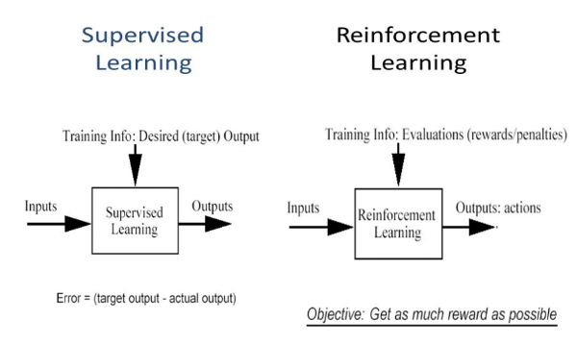
HOW IS REINFORCEMENT LEARNING DIFFERENT FROM SUPERVISED LEARNING ?

Slide 16
CHARACTER OF REINFORCEMENT LEARNING
No Supervision, only a real value or reward signal.
Decision making is Sequential.
Time Plays a major role in reinforcement Problems.
Feedback isn't Prompt but delayed.
The following data is receive is determined by the agent’s actions.

Slide 17
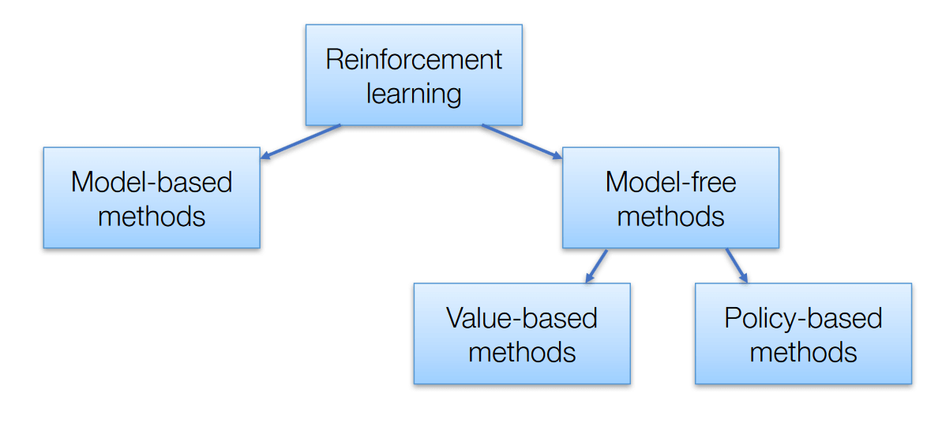
REINFORCEMENT LEARNING ALGORITHMS
There are 3 Approaches to implement reinforcement Learning Algorithms.

Slide 18
REINFORCEMENT LEARNING ALGORITHMS
Value-Based: The main goal of this method is to maximize a value function.
Here, an agent through a policy expects a long-term return of the current states.
Policy-Based: In policy-based, you enable to come up with a strategy that helps to gain maximum rewards in the future through possible actions performed in each state.
Two types of policy-based methods are deterministic and stochastic.
Model-Based: In this method, we need to create a virtual model for the agent to help in learning to perform in each specific environment

Slide 19
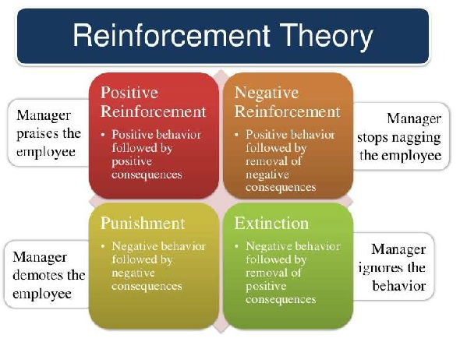
TYPES OF REINFORCEMENT LEARNING
There are 2 types of Reinforcement Learning

Slide 20
TYPES OF REINFORCEMENT LEARNING
Positive Reinforcement Learning :-
Positive Reinforcement is defined as when an event, occurs due to specific behavior, increase the strength and frequency of the behavior. It has a positive impact on behavior.
Advantages
Maximizes the performance of an action
Sustain change for a longer period
Disadvantage
Excess reinforcement can lead to an overload of states which would minimize the results.

Slide 21
TYPES OF REINFORCEMENT LEARNING
Negative Reinforcement Learning :-
Negative Reinforcement is represented as the strengthening of a behavior.
In other ways, when a negative condition is barred or avoided, it tries to stop this action in the future.
Advantages
Maximized Behavior
Provide a decent to minimum standard of performance.
Disadvantage
It just limits itself enough to meet up a minimum Behavior.

Slide 22
REINFORCEMENT LEARNING FRAMEWORK AND ELEMENTS

Slide 23
MAJOR 5 FRAMEWORK FOR REINFORCEMENT LEARNING
Keras-RL
Keras-RL2
OpenAI Baselines
Stable Baselines
ACME

Slide 24
WHAT IS KERAS-RL ?
keras-RL implements some state-of-the art deep Reinforcement learning algorithms in Python and seamlessly integrates with the deep learning library Keras.
keras-RL works with OpenAI Gym out of the box.
This means that evaluating and playing around with different algorithms is easy.
Of course you can extend keras-RL according to your own needs.
You can use built-in Keras callbacks and metrics or define your own.
Even more so, it is easy to implement your own environments and even algorithms by simply extending some simple abstract classes.

Slide 25
WHAT IS KERAS-RL2 ?
keras-rl2 implements some state-of-the art deep reinforcement learning algorithms in Python and seamlessly integrates with the deep learning library Keras.
keras-rl2 works with OpenAI Gym out of the box.
This means that evaluating and playing around with different algorithms is easy.
Of course you can extend keras-rl2 according to your own needs.
You can use built-in Keras callbacks and metrics or define your own.
Even more so, it is easy to implement your own environments and even algorithms by simply extending some simple abstract classes.

Slide 26
WHAT IS OPEN-AI BASELINES ?
OpenAI Baselines is a set of high-quality implementations of reinforcement learning algorithms.
These algorithms will make it easier for the research community to replicate, refine, and identify new ideas, and will create good baselines to build research on top.
Our DQN implementation and its variants are roughly on par with the scores in published papers.
We expect they will be used as a base around which new ideas can be added, and as a tool for comparing a new approach against existing ones.

Slide 27
WHAT IS STABLE BASELINES ?
Stable Baselines is a set of improved implementations of reinforcement learning algorithms based on OpenAI Baselines.
These algorithms will make it easier for the research community and industry to replicate, refine, and identify new ideas, and will create good baselines to build projects on top of.
We expect these tools will be used as a base around which new ideas can be added, and as a tool for comparing a new approach against existing ones.
We also hope that the simplicity of these tools will allow beginners to experiment with a more advanced toolset, without being buried in implementation details.

Slide 28
WHAT IS ACME ?
Acme is a library of reinforcement learning (RL) agents and agent building blocks.
Acme strives to expose simple, efficient, and readable agents, that serve both as reference implementations of popular algorithms and as strong baselines, while still providing enough flexibility to do novel research.
The design of Acme also attempts to provide multiple points of entry to the RL problem at differing levels of complexity.

Slide 29
WHAT ARE THE ELEMENTS OF REINFORCEMENT LEARNING ?
There are four main Elements of reinforcement Learning which are given below:
Policy
Reward Signal
Value Function
Model of the Environment

Slide 30
WHAT IS POLICY ?
A policy can be defined as a way how an agent behaves at a given time.
It maps the perceived states of the environment to the actions taken on those states.
A policy is the core element of the RL as it alone can define the behavior of the agent.
In some cases, it may be a simple function or a lookup table, whereas, for other cases, it may involve general computation as a search process.
It could be deterministic or a stochastic policy:

Slide 31
WHAT IS REWARD SIGNAL ?
The goal of reinforcement learning is defined by the reward signal.
At each state, the environment sends an immediate signal to the learning agent, and this signal is known as a reward signal.
These rewards are given according to the good and bad actions taken by the agent.
The agent's main objective is to maximize the total number of rewards for good actions.
The reward signal can change the policy, such as if an action selected by the agent leads to low reward, then the policy may change to select other actions in the future.

Slide 32
WHAT IS VALUE FUNCTION ?
The value function gives information about how good the situation and action are and how much reward an agent can expect.
A reward indicates the immediate signal for each good and bad action, whereas a value function specifies the good state and action for the future.
The value function depends on the reward as, without reward, there could be no value.
The goal of estimating values is to achieve more rewards.

Slide 33
WHAT IS MODEL OF THE ENVIRONMENT ?
The last element of reinforcement learning is the model, which mimics the behavior of the environment.
With the help of the model, one can make inferences about how the environment will behave.
Such as, if a state and an action are given, then a model can predict the next state and reward.
The model is used for planning, which means it provides a way to take a course of action by considering all future situations before actually experiencing those situations.
The approaches for solving the RL problems with the help of the model are termed as the model-based approach.
Comparatively, an approach without using a model is called a model-free approach.

Slide 34
MULTI-ARM BANDIT

Slide 35
WHAT IS THE MULTI-ARMED BANDIT PROBLEM ?
The term "multi-armed bandit" comes from a hypothetical experiment where a person must choose between multiple actions (i.e., slot machines, the "one-armed bandits"), each with an unknown payout.
The goal is to determine the best or most profitable outcome through a series of choices.
At the beginning of the experiment, when odds and payouts are unknown, the gambler must determine which machine to pull, in which order and how many times.
This is the “multi-armed bandit problem.”

Slide 36
MULTI-ARMED BANDIT EXAMPLES
One real-world example of a multi-armed bandit problem is when a news website has to make a decision about which articles to display to a visitor.
With no information about the visitor, all click outcomes are unknown.
The first question is, which articles will get the most clicks?
And in which order should they appear?
The website’s goal is to maximize engagement, but they have many pieces of content from which to choose, and they lack data that would help them to pursue a specific strategy.
The news website has a similar problem in choosing which ads to display to its visitors..
In this case, they want to maximize advertising revenue, but they may be lacking enough information about the visitor to pursue a specific advertising strategy.

Slide 37
MULTI-ARMED BANDIT SOLUTIONS
There are many different solutions that computer scientists have developed to tackle the multi-armed bandit problem.
Below is a list of some of the most commonly used multi-armed bandit solutions:
Epsilon-greedy
Upper confidence bound
Thompsons Sampling(Bayesian)

Slide 38
WHAT IS EPSILON-GREEDY ?
This is an algorithm for continuously balancing exploration with exploitation.
(In ‘greedy’ experiments, the lever with highest known payout is always pulled except when a random action is taken).
A randomly chosen arm is pulled a fraction ε of the time.
The other 1-ε of the time, the arm with highest known payout is pulled.

Slide 39
WHAT IS UPPER CONFIDENCE BOUND ?
This strategy is based on the Optimism in the Face of Uncertainty principle, and assumes that the unknown mean payoffs of each arm will be as high as possible, based on observable data.

Slide 40
WHAT IS THOMPSONS SAMPLING(BAYESIAN) ?
With this randomized probability matching strategy, the number of pulls for a given lever should match its actual probability of being the optimal lever.

Slide 41
MARKOV DECISION PROCESS

Slide 42
WHAT IS MARKOV DECISION PROCESS ?
Reinforcement Learning is a type of Machine Learning.
It allows machines and software agents to automatically determine the ideal behavior within a specific context, in order to maximize its performance.
Simple reward feedback is required for the agent to learn its behavior; this is known as the reinforcement signal.
There are many different algorithms that tackle this issue.
As a matter of fact, Reinforcement Learning is defined by a specific type of problem, and all its solutions are classed as Reinforcement Learning algorithms.
In the problem, an agent is supposed to decide the best action to select based on his current state.
When this step is repeated, the problem is known as a Markov Decision Process.

Slide 43
MARKOV DECISION PROCESS (MDP)
A Markov Decision process (MDP) model contains:
A Set of possible world states S.
A set of Models.
A set of possible actions A.
Areal value reward function R(s , a).
A Policy the Solution of Markov Decision process.

Slide 44
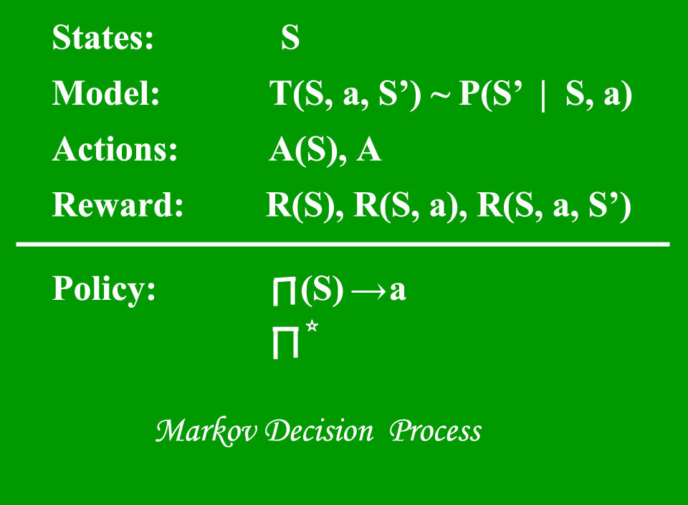
MARKOV DECISION PROCESS (MDP)

Slide 45
Q-VALUE AND ADVANTAGE BASED ALGORITHMS
In a value-based approach, the random value function is selected initially, then find new value function.
This process repeated until it finds the optimal value function.
The intuition here is the policy that follows the optimal value function will be optimal policy.
Here, the policy is implicitly updated through value function.
In Q-learning updating the value function(Q-value) to find the optimal policy.

Slide 46
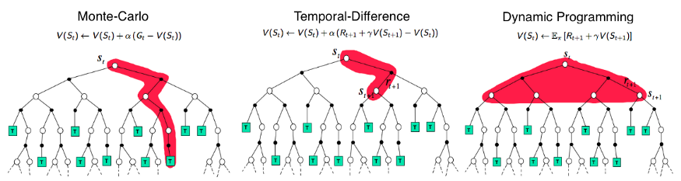
THREE BASIC APPROACHES OF RL ALGORITHMS

Slide 47
THREE BASIC APPROACHES OF RL ALGORITHMS
Temporal-Difference(TD) learning is a combination of Monte-Carlo and Dynamic Programming (DP) methods.
Like the Monte-Carlo method, TD method can learn directly from raw experience without a model of the environment’s dynamics.
Like DP, TD methods update estimates based in part on other learned estimates, without waiting for a final outcome (they call bootstrapping).
Basically, in Q-learning, we are using 1 step TD learning approach.

Slide 48
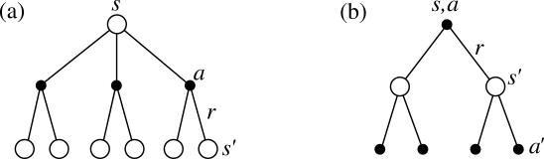
WHAT IS VALUE FUNCTIONS ?
The value function measures the goodness of the state(state-value) or how good is to perform an action from the given state(action-value)

Slide 49
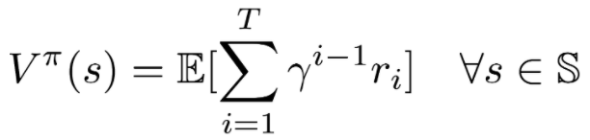
WHAT IS STATE-VALUE FUNCTION ?
The state-value Vπ(s) is the expected total reward, starting from state s and acts according to policy π.
If the agent uses a given policy π to select actions, the corresponding value function is given by:

Slide 50
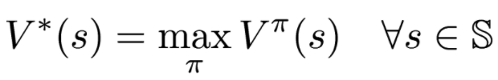
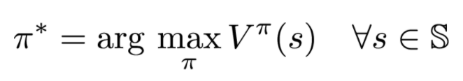
WHAT IS OPTICAL STATE-VALUE FUNCTION ?
It has high possible value function compared to other value function for all states
In a value-based RL, If we know optimal value function, then the policy that corresponds to optimal value function is optimal policy 𝛑*.

Slide 51

THANK YOU !!!
(USA)
2-Industrial Park Drive, E-Waldorf, MD, 20602,
United States
(USA)
+1-844-889-4054
(Singapore)
3 Temasek Avenue, Singapore 039190
info@careerera.com www.careerera.com
(INDIA)
B-44, Sector-59, Noida Uttar Pradesh 201301
(INDIA)
+91-92-5000-4000

