Slide 1
A Warm Welcome To Careerera Family

Slide 2

WHAT IS STATISTICS?
“Statistics is defined as Collection, Presentation, Analysis and Interpretation of Numerical Data.”
Statistics is the science and art of dealing with figure and facts.
DESCRIPTIVE STATISTICS
Collecting, Summarizing and Describing Data
INFERENCIAL STATISTICS
Drawing conclusion and/or making decision concerning a population based on sample data.

Slide 3
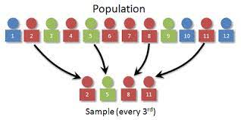
WHAT IS POPULATION AND SAMPLE IN STATISTICS?
POPULATION:- A population is the entire group that you want to draw conclusions about.
SAMPLE:- A sample is the specific group that you will collect data from.

Slide 4
WHAT ARE THE LEVELS OF MEASUREMENT ?
RATIO
MEASUREMENT OF NUMERICAL VALUE
The relation between two numbers which shows how much bigger one quantity is than another.
INTERVAL
MEASUREMENT OF NUMERICAL VALUE
An interval scale is one where there is order and the difference between two values is meaningful.
ORDINAL
NOMINAL
RANKING ORDERED CATEGORIES
Ordinal numbers indicate the order or rank of things in a set
CATEGORICAL CODES, ID NUMBERS & CATEGORY NAMES
Nominal numbers name or identify something

Slide 5
WHAT IS MEASURES OF CENTRAL TENDANCY ?
A measure of central tendency represents the center point.
These measures indicate where most values in a distribution fall and are also referred to as the central location of a distribution.
In statistics, the three most common measures of central tendency are the mean, median, and mode.
Each of these measures calculates the location of the central point using a different method.

Slide 6
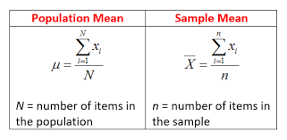
WHAT IS MEAN?
The mean is the arithmetic average, and it is probably the measure of central tendency that you are most familiar. Calculating the mean is very simple. You just add up all of the values and divide by the number of observations in your dataset.

Slide 7
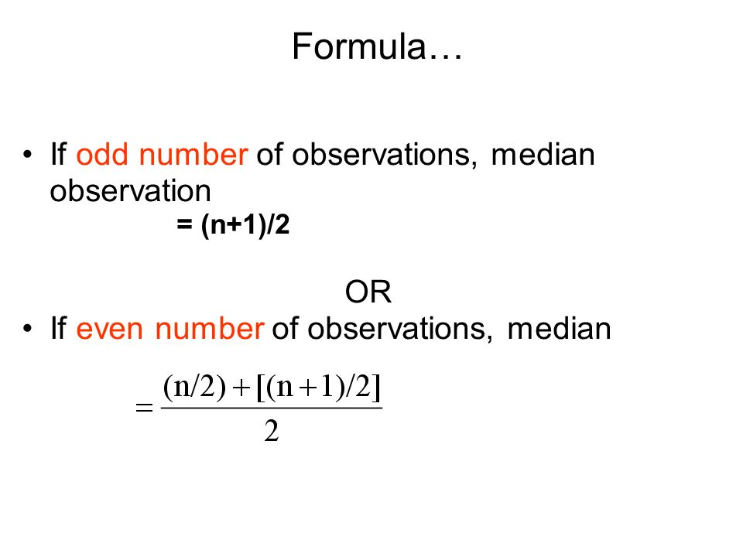
WHAT IS MEDIAN?
The median is the middle value. It is the value that splits the dataset in half. To find the median, order your data from smallest to largest, and then find the data point that has an equal amount of values above it and below it.

Slide 8
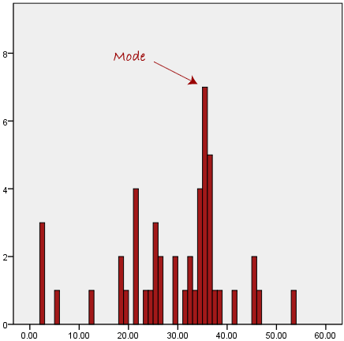
WHAT IS MODE?
The mode is the value that occurs the most frequently in your data set.

Slide 9
WHAT IS MEASURE OF VARIABILITY?
A measure of variability is a summary statistic that represents the amount of dispersion in a dataset.
Measures of variability define how far away the data points tend to fall from the center.
A low dispersion indicates that the data points tend to be clustered tightly around the center. High dispersion signifies that they tend to fall further away.

Slide 10
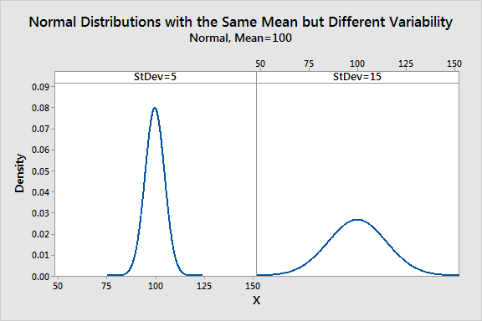
VARIABILTY

Slide 11
WHAT IS VARIANCE ?
Variance is the average squared difference of the values from the mean.
The variance includes all values in the calculation by comparing each value to the mean.
Calculate a set of squared differences between the data points and the mean, sum them, and then divide by the number of observations.

Slide 12

WHAT IS THE FORMULA OF POPULATION VARIANCE ?
σ2 is the population parameter for the variance,
μ is the parameter for the population mean,
N is the number of data points,

Slide 13

WHAT IS SAMPLE VARIANCE FORMULA ?
s2 is the sample variance, and M is the sample mean.
N-1 in the denominator corrects for the tendency of a sample to underestimate the population variance.

Slide 14
WHAT IS STANDARD DEVIATION ?
The standard deviation is just the square root of the variance.
It’s the standard or typical difference between each data point and the mean.
When the values in a dataset are grouped closer together, we have a smaller standard deviation.
On the other hand, when the values are spread out more, the standard deviation is larger because the standard distance is greater.

Slide 15
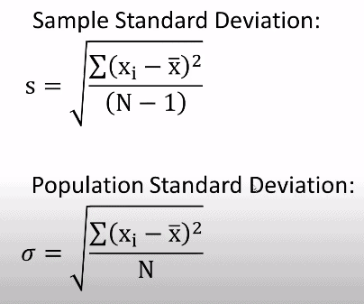
WHAT IS THE FORMULA OF STANDARD DEVIATION ?

Slide 16
WHAT IS SAMPLING ?
Sampling is technique that you can apply for selecting the predetermined number of a sample from a large population having similar characteristics.
When you perform the investigation, due to lack of resources and time you would not able to gather information from each and every one, in such case you can use sampling method for selecting participants.
Sampling is done to draw conclusions about populations from samples.

Slide 17
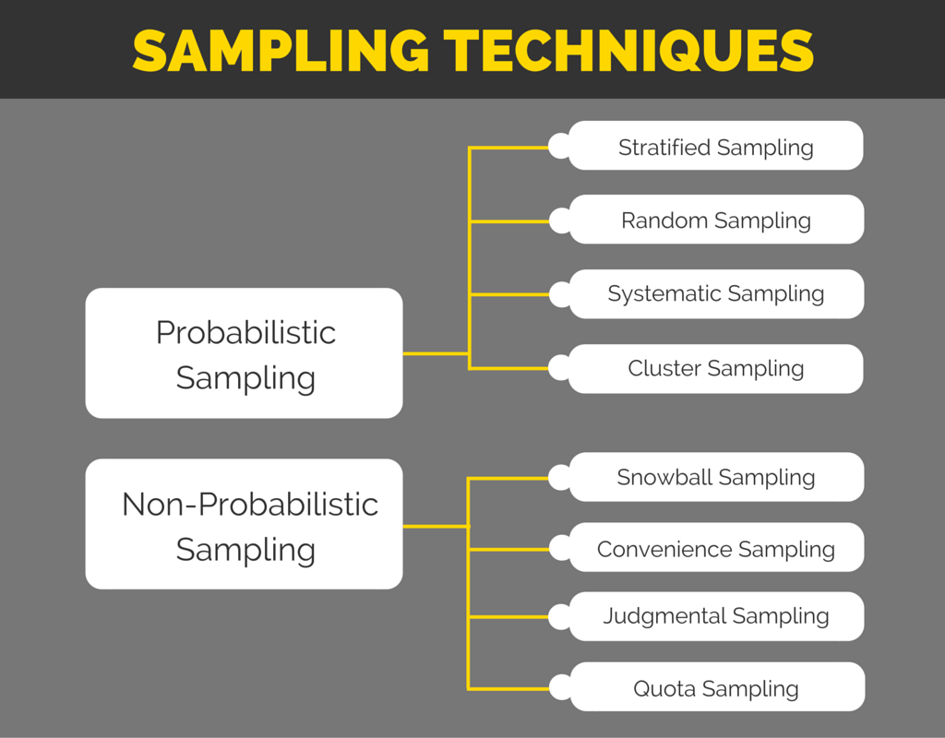
WHAT ARE THE TYPES OF SAMPLING TECHNIQUES ?

Slide 18
EXPLAIN THE TWO PARENT SAMPLING TECHNIQUES ?
The sampling method can be categorized into two these are:
Probability: It is a type of sampling method in which you need to select participants a randomly.
Non-probability: It is the type of sampling method which is most suitable for performing both qualitative and exploratory investigation.

Slide 19
WHAT IS STRATIFIED & SIMPLE RANDOM SAMPLING IN PROBABILISTIC SAMPLING ?
Stratified Sampling:
You can apply the stratified sampling method where the population involves mixed characteristics and you want to make sure that you have represent each character is equally .
Simple Random Sampling:
It is a type of probability sampling method by using which you can provide all people in the population with a chance to get select as a participant

Slide 20
WHAT IS SYSTEMATIC & CLUSTER SAMPLING IN PROBABILISTIC SAMPLING ?
Systematic Sampling:
It is a probability sampling method that includes a listing of all people. In a systematic sampling technique, all people are chosen at a regular interval of time.
Cluster Sampling:
it is a type of sampling technique that mainly includes categorizing the population into subgroups. While applying this technique you need to make sure that every group consists of similar characteristics.

Slide 21
WHAT IS SNOWBALL & CONVENIENCE SAMPLING IN NON- PROBABILISTIC SAMPLING?
Snowball Sampling:
This is sampling in which existing subjects provide referrals to recruit samples required for a research study.
Convenience Sampling:
Convenience sampling is defined as a method adopted by researchers where they collect market research data from a conveniently available pool of respondents.

Slide 22
WHAT IS JUDGMENTAL & QUOTA SAMPLING IN NON- PROBABILISTIC SAMPLING ?
Judgmental Sampling:
Judgment sampling, also referred to as judgmental sampling or authoritative sampling, is a non-probability sampling technique where the researcher selects units to be sampled based on his own existing knowledge, or his professional judgment.
Quota Sampling:
Quota sampling is a type of non-probability sampling where researchers will form a sample of individuals who are representative of a larger population.

Slide 23
WHAT IS OVER SAMPLING ?
Duplicating samples from the minority class
Random Oversampling includes selecting random examples from the minority class with replacement and supplementing the training data with multiple copies of this instance, hence it is possible that a single instance may be selected multiple times.

Slide 24
WHAT IS UNDER SAMPLING ?
Under sampling — Deleting samples from the majority class.
Under sampling attempts to reduce the bias(error) associated with imbalanced classes of data.
You can under sample the majority class, oversample the minority class, or combine the two techniques.
In general, under sampling (instead of oversampling) the majority class works best for large data sets.

Slide 25
WHAT IS PROBABILITY DISTRIBUTION ? WHAT ARE ITS TYPES?
Discrete PD
Binomial Distribution
Poisson Distribution
Continuous PD
Normal Distribution

Slide 26
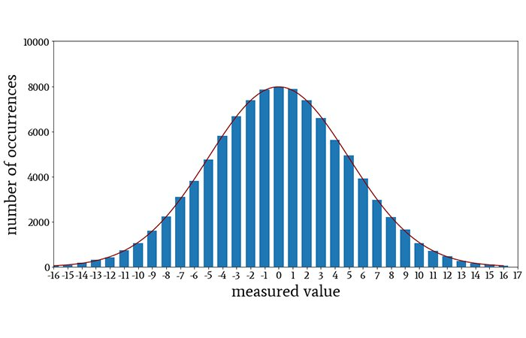
WHAT IS CONTINUOUS PROBABILITY DISTRIBUTION AND ITS TYPES ?
Normal Distribution:
It is also known as the Gaussian distribution, it is a probability distribution that is symmetric about the mean, showing that data near the mean are more frequent in occurrence than data far from the mean.
In graph form, normal distribution will appear as a bell curve.

Slide 27
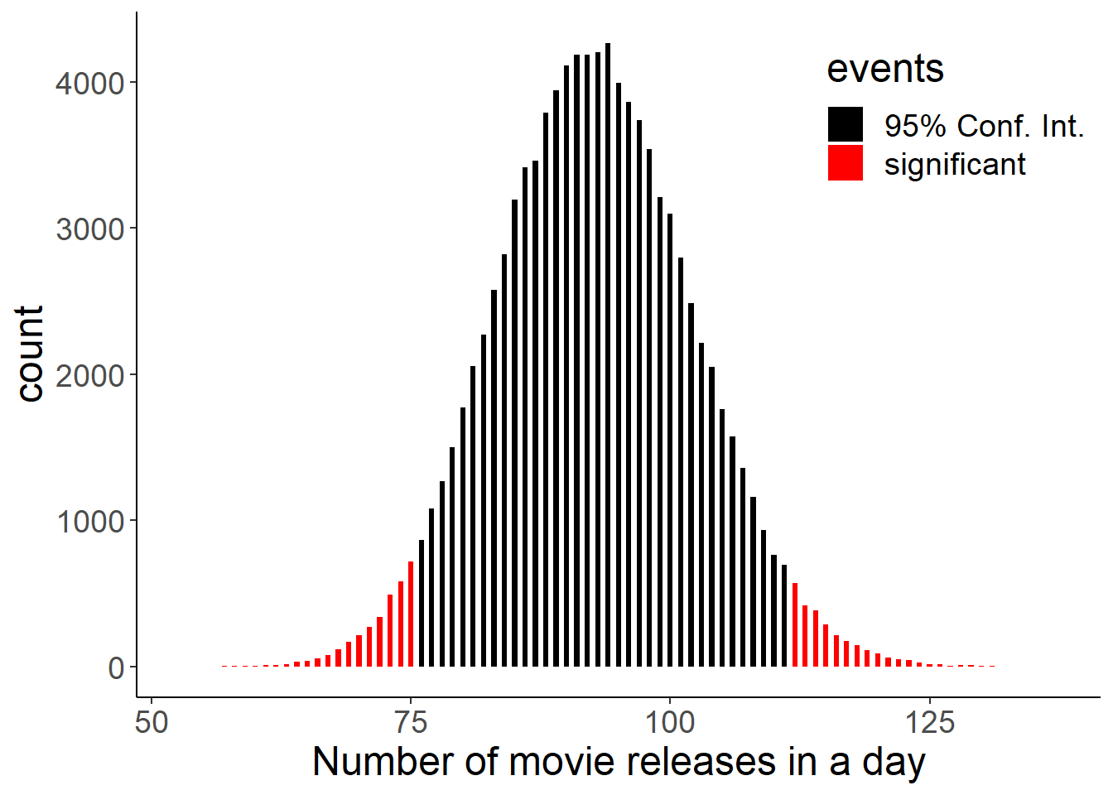
WHAT IS BINOMIAL DISTRIBUTION IN DISCRETE PROBABILITY ?
Binomial Distribution
The binomial distribution with parameters n and p is the discrete probability distribution of the number of successes in a sequence of n independent experiments, each asking a yes–no question, and each with its own Boolean-valued outcome: success or failure.

Slide 28
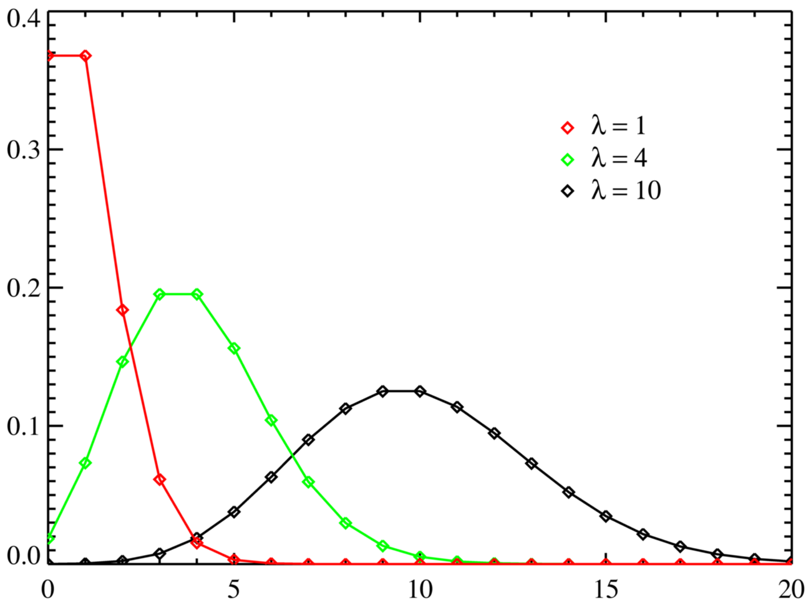
WHAT IS POISSON DISTRIBUTION IN DISCRETE PROBABILITY ?
Poisson Distribution
A Poisson distribution is a distribution that can be used to show how many times an event is likely to occur within a specified period of time﻿. Helps to understand independent events that occur at a constant rate within a given interval of time.

Slide 29
WHAT IS BAYES' THEOREM ?
Bayes' theorem is a way to figure out conditional probability.
Bayes' theorem states that the conditional probability of an event, X, given the occurrence of another event, Y, is equal to the product of the likelihood of Y given X and the probability of X.

Slide 30

WHAT ARE THE FORMULA FOR BAYES' THEOREM ?
Bayes’ Theorem (also known as Bayes’ rule) is a deceptively simple formula used to calculate conditional probability.
The Theorem was named after English mathematician Thomas Bayes (1701-1761). The formal definition for the rule is:

Slide 31
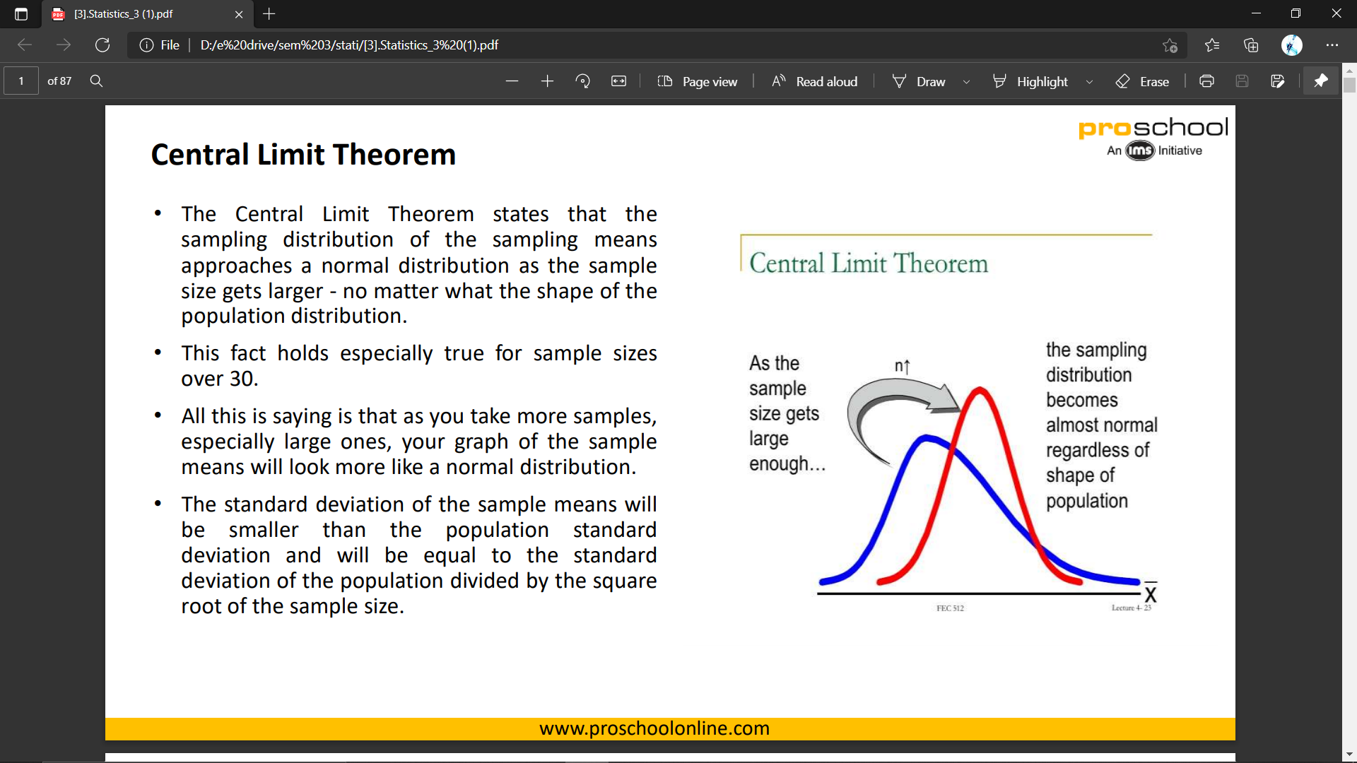
WHAT IS CENTRAL LIMIT THEOREM ?
The central limit theorem (CLT) states that the distribution of sample means approximates a normal distribution as the sample size gets larger.
Sample sizes equal to or greater than 30 are considered sufficient for the CLT to hold.

Slide 32
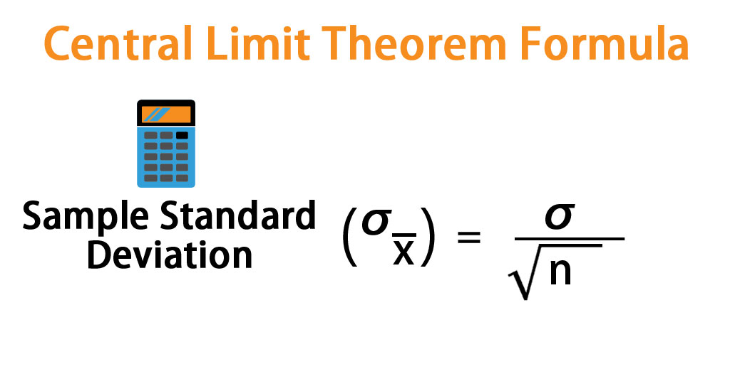
WHAT IS THE FORMULA OF CENTRAL LIMIT THEOREM ?
Central limit theorem is applicable for a sufficiently large sample sizes (n ≥ 30).
The formula for central limit theorem can be stated as follows:

Slide 33

Thank You !!!
(USA)
2-Industrial Park Drive, E-Waldorf, MD, 20602,
United States
(USA)
+1-844-889-4054
(Singapore)
3 Temasek Avenue, Singapore 039190
info@careerera.com www.careerera.com
(INDIA)
B-44, Sector-59, Noida Uttar Pradesh 201301
(INDIA)
+91-92-5000-4000

