Slide 1

MACHINE LEARNING TECHNIQUES

Slide 2

WHAT IS MACHINE LEARNING?

Slide 3
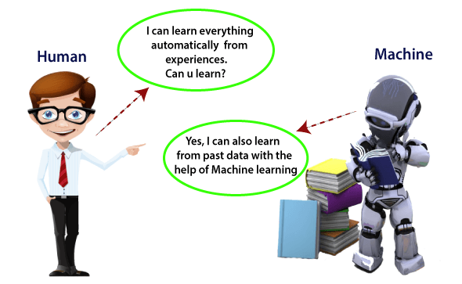

Slide 4
WHAT IS MACHINE LEARNING ?
Machine learning enables a machine to automatically learn from data, improve performance from experiences, and predict things without being explicitly programmed.
A machine has the ability to learn if it can improve its performance by gaining more data.

Slide 5
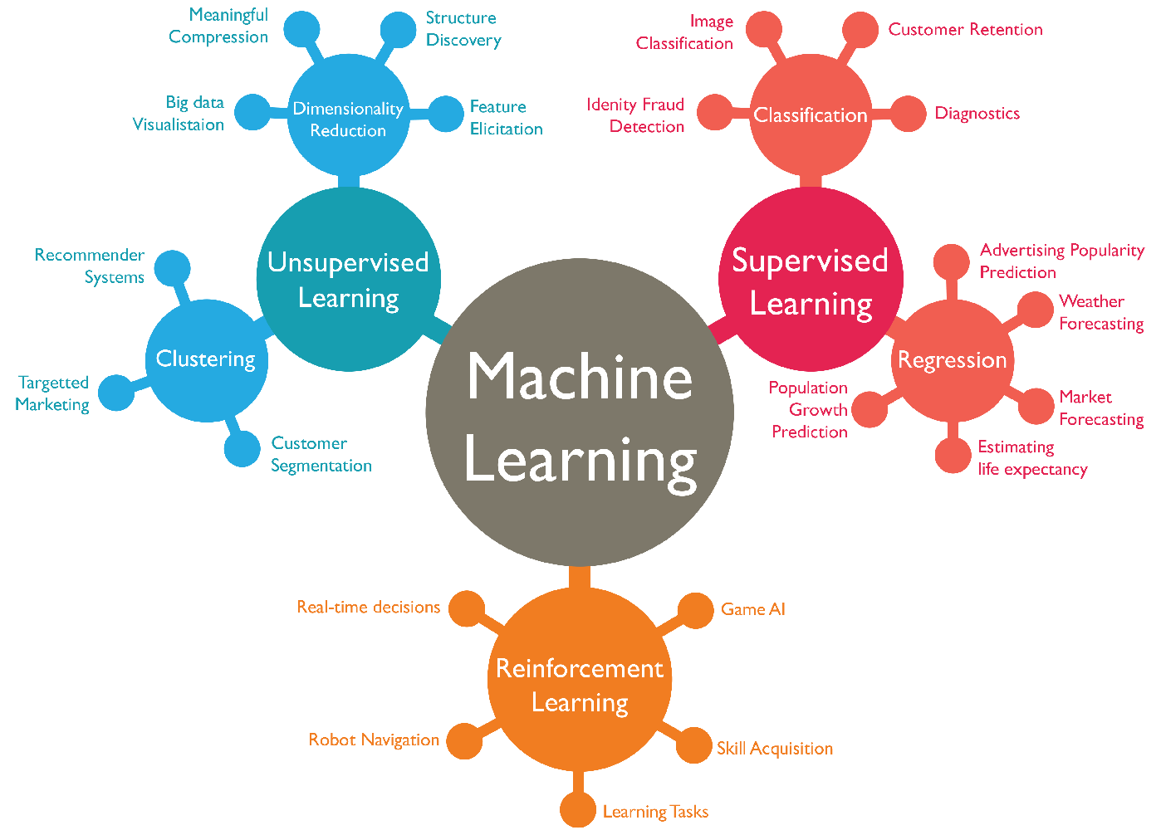

Slide 6
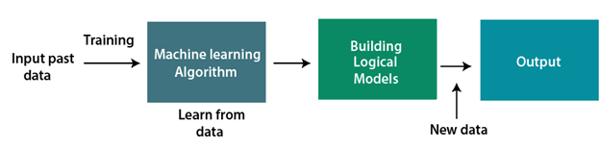
HOW DOES MACHINE LEARNING WORK?
A Machine Learning system learns from historical data, builds the prediction models, and whenever it receives new data, predicts the output for it.
The accuracy of predicted output depends upon the amount of data, as the huge amount of data helps to build a better model which predicts the output more accurately.

Slide 7
WHAT ARE THE KEY STEPS TO CREATE A MACHINE LEARNING MODEL ?
1. Choose and Prepare a Training Data Set
Training data is information that is representative of the data the machine learning application will ingest to tune model parameters.
Training data is sometimes labeled, meaning it has been tagged to call out classifications or expected values the machine learning mode is required to predict.
Other training data may be unlabeled so the model will have to extract features and assign clusters autonomously.
2. Select an Algorithm to Apply to the Training Data Set
The type of machine learning algorithm you choose will primarily depend on a few aspects:
Whether the use case is prediction of a value or classification which uses labeled training data or the use case is clustering or dimensionality reduction which uses unlabeled training data
How much data is in the training set
The nature of the problem the model seeks to solve

Slide 8
WHAT ARE THE KEY STEPS TO CREATE A MACHINE LEARNING MODEL ?
3. Train the Algorithm to Build the Model
Training the algorithm is the process of tuning model variables and parameters to more accurately predict the appropriate results.
Training the machine learning algorithm is usually iterative and uses a variety of optimization methods depending upon the chosen model.
These optimization methods do not require human intervention which is part of the power of machine learning.
The machine learns from the data you give it with little to no specific direction from the user.
4. Use and Improve the Model
The last step is to feed new data to the model as a means of improving its effectiveness and accuracy over time.
Where the new information will come from depends on the nature of the problem to be solved.
For instance, a machine learning model for self-driving cars will ingest real-world information on road conditions, objects and traffic laws.

Slide 9
WHAT ARE THE FEATURES OF MACHINE LEARNING?
Machine learning uses data to detect various patterns in a given dataset.
It can learn from past data and improve automatically.
It is a data-driven technology.
Machine learning is much similar to data mining as it also deals with the huge amount of the data.
It easily identifies the trends and patterns
There is no human intervention needed for the program as it is automated
They keep improving inaccuracy by themselves
They can handle multi-dimensional and multi-variety of data
It holds the capability to help and deliver a good experience.

Slide 10
WHY DO WE NEED MACHINE LEARNING?
The need for machine learning is increasing day by day. The reason behind the need for machine learning is that it is capable of doing tasks that are too complex for a person to implement directly. As a human, we have some limitations as we cannot access the huge amount of data manually, so for this, we need some computer systems and here comes the machine learning to make things easy for us.
We can train machine learning algorithms by providing them the huge amount of data and let them explore the data, construct the models, and predict the required output automatically. The performance of the machine learning algorithm depends on the amount of data, and it can be determined by the cost function. With the help of machine learning, we can save both time and money.

Slide 11
WHAT IS THE IMPORTANCE OF MACHINE LEARNING ?
Rapid increment in the production of data
Solving complex problems, which are difficult for a human
Decision making in various sector including finance
Finding hidden patterns and extracting useful information from data.

Slide 12
WHAT ARE THE CATEGORIES OF MACHINE LEARNING ?
MACHINE LEARNING
SUPERVISED LEARNING
UNSUPERVISED LEARNING

Slide 13
SUPERVISED LEARNING

Slide 14
WHAT IS REGRESSION ?
Regression is a statistical method used in finance, investing, and other disciplines that attempts to determine the strength and character of the relationship between one dependent variable (usually denoted by Y) and a series of other variables (known as independent variables)
Regression helps investment and financial managers to value assets and understand the relationships between variables, such as commodity prices and the stocks of businesses dealing in those commodities
Regression takes a group of random variables, thought to be predicting Y, and tries to find a mathematical relationship between them. This relationship is typically in the form of a straight line (linear regression) that best approximates all the individual data points. In multiple regression, the separate variables are differentiated by using subscripts

Slide 15
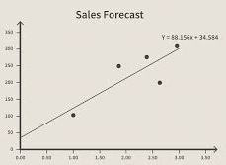
REGRESSION EXAMPLE

Slide 16
WHAT ARE THE TYPES OF REGRESSION ?
Types of Regression
Linear Regression
Logistic Regression

Slide 17
LINEAR REGRESSION

Slide 18
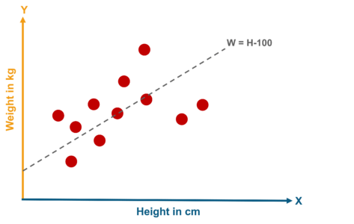
WHAT IS LINEAR REGRESSION?
Linear Regression is the supervised Machine Learning model in which the model finds the best fit linear line between the independent and dependent variable i.e it finds the linear relationship between the dependent and independent variable.
Linear Regression is of two types: Simple Linear regression and Multiple Linear regression.

Slide 19
WHAT IS SIMPLE LINEAR REGRESSION?
Simple Linear Regression is where only one independent variable is present and the model has to find the linear relationship of it with the dependent variable
Equation of Simple Linear Regression, where b_{o} is the intercept, b₁ is coefficient or slope, x is the independent variable and y is the dependent variable.
Y=b0+b1x

Slide 20
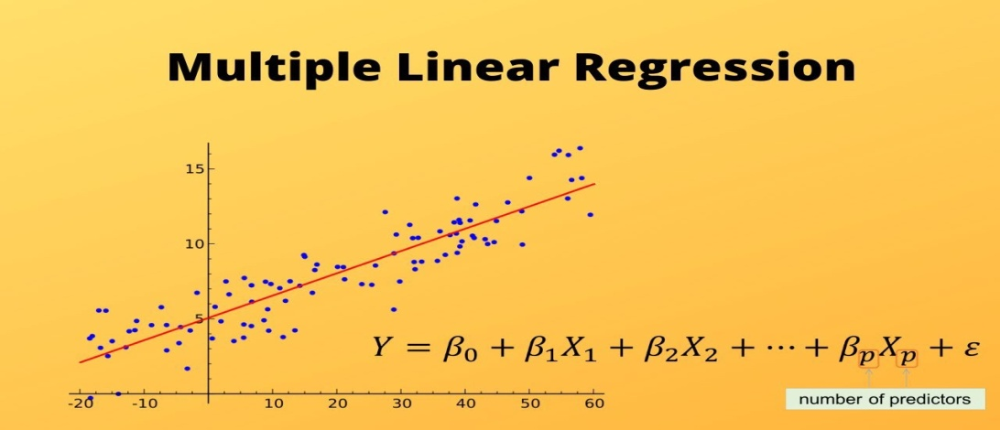
WHAT IS MULTIPLE LINEAR REGRESSION?
In Multiple Linear Regression there are more than one independent variables for the model to find the relationship.
Equation of Multiple Linear Regression, where bo is the intercept, b₁,b₂,b₃,b₄…,b_{n} are coefficients or slopes of the independent variables x₁,x₂,x₃,x₄…,x_{n} and y is the dependent variable.
y=b0+b1x1+b2x2+b3x3….+bnxn

Slide 21
PERFORMANCE METRICS

Slide 22
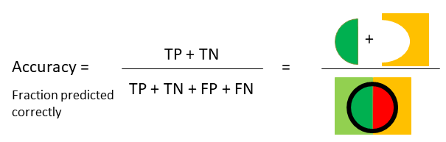
WHAT IS ACCURACY SCORE ?
Accuracy (ACC) measures the fraction of correct predictions. It is defined as “the ratio of correct predictions to total predictions made”.
Accuracy= tp+tn/tp+tn+fp+fn

Slide 23
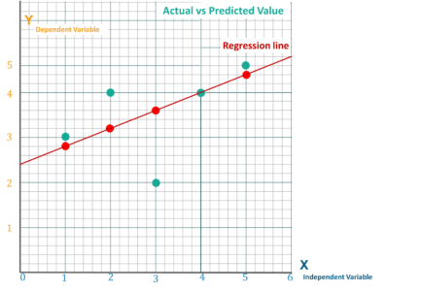
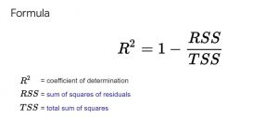
WHAT IS R SQUARED ?
R-squared measures the proportion of the variation in your dependent variable (Y) explained by your independent variables (X) for a linear regression model.

Slide 24
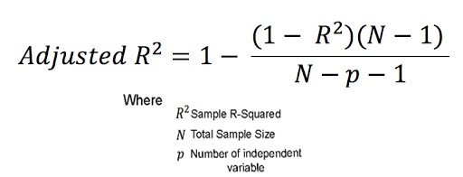
WHAT IS ADJUSTED R SQUARE ?
Adjusted R-squared adjusts the statistic based on the number of independent variables in the model.

Slide 25
APPROACHES TO FEATURE SELECTION

Slide 26
WHAT IS FEATURE SELECTION ?
Feature selection is a process where you automatically select those features in your data that contribute most to the prediction variable or output in which you are interested
Having irrelevant features in your data can decrease the accuracy of many models, especially linear algorithms like linear and logistic regression
Three benefits of performing feature selection before modeling your data are –
Reduces Overfitting – Less redundant data means less opportunity to make decisions based on noise
Improves Accuracy – Less misleading data means modeling accuracy improves
Reduces Training Time – Less data means that algorithms train faster

Slide 27
WHAT ARE THE APPROCHES OF FEATURE SELECTION?
Univariate Selection
Recursive Feature Elimination
Principal Component Analysis
Feature Importance

Slide 28
WHAT IS UNIVARIATE SELECTION ?
Univariate feature selection works by selecting the best features based on univariate statistical tests.
We compare each feature to the target variable, to see whether there is any statistically significant relationship between them. It is also called analysis of variance (ANOVA).

Slide 29
WHAT IS FEATURE IMPORTANCE ?
Feature Importance refers to techniques that calculate a score for all the input features for a given model — the scores simply represent the “importance” of each feature. A higher score means that the specific feature will have a larger effect on the model that is being used to predict a certain variable.

Slide 30
WHAT IS RECURSIVE FEATURE ELIMINATION ?
Recursive feature elimination (RFE) is a feature selection method that fits a model and removes the weakest feature (or features) until the specified number of features is reached.

Slide 31
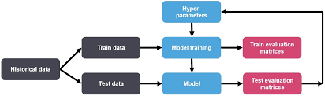
WHAT IS PARAMETER TUNING ?
Hyperparameter tuning (or hyperparameter optimization) is the process of determining the right combination of hyperparameters that maximizes the model performance.

Slide 32
WHAT IS MODEL EVALUATION ?
Model evaluation is the process of using different evaluation metrics to understand a machine learning model's performance, as well as its strengths and weaknesses. Model evaluation is important to assess the efficacy of a model during initial research phases, and it also plays a role in model monitoring.

Slide 33
DATA TRANSFORMATION
Data transformation is the process of converting data from one format to another, typically from the format of a source system into the required format of a destination system.

Slide 34
WHAT IS NORMALIZATION?
Normalization is a scaling technique in Machine Learning applied during data preparation to change the values of numeric columns in the dataset to use a common scale. It is not necessary for all datasets in a model. It is required only when features of machine learning models have different ranges.
Mathematically, we can calculate normalization with the below formula:
Xn = (X - Xminimum) / ( Xmaximum - Xminimum)
Xn = Value of Normalization
Xmaximum = Maximum value of a feature
Xminimum = Minimum value of a feature

Slide 35
WHAT IS RIDGE AND LASSO REGRESSION?
Ridge Regression : –
Performs L2 regularization, i.e. adds penalty equivalent to square of the magnitude of coefficients.
Minimization objective = LS Obj + α * (sum of square of coefficients)
Lasso Regression : –
Performs L1 regularization, i.e. adds penalty equivalent to absolute value of the magnitude of coefficients
Minimization objective = LS Obj + α * (sum of absolute value of coefficients)

Slide 36
WHAT IS RECURSIVE FEATURE ELIMINATION ?
The Recursive Feature Elimination (or RFE) works by recursively removing attributes and building a model on those attributes that remain
It uses the model accuracy to identify which attributes (and combination of attributes) contribute the most to predicting the target attribute
You can learn more about the RFE class in the scikit-learn documentation
The example below uses RFE with the logistic regression algorithm to select the top 3 features
The choice of algorithm does not matter too much as long as it is skillful and consistent

Slide 37
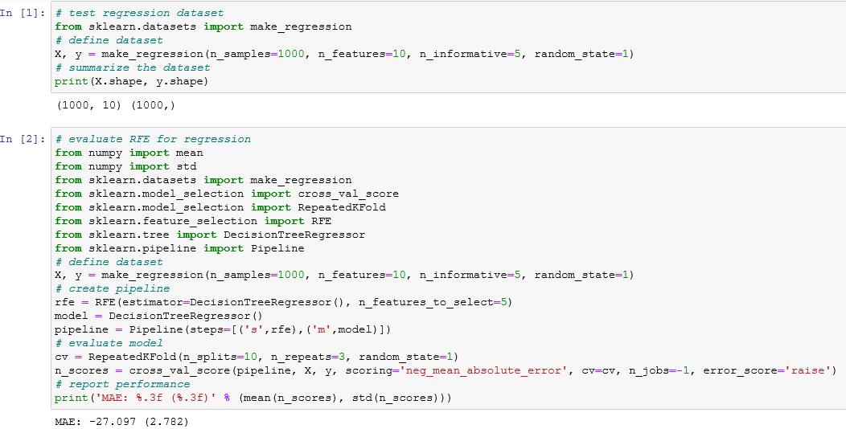
HOW TO WRITE PYTHON CODE FOR RECURSIVE FEATURE ELIMINATION ?

Slide 38
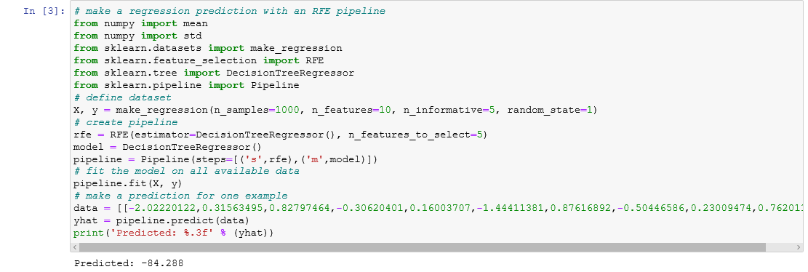
HOW TO WRITE PYTHON CODE FOR RECURSIVE FEATURE ELIMINATION ?

Slide 39
WHAT IS FEATURE IMPORTANCE ?
Bagged decision trees like Random Forest and Extra Trees can be used to estimate the importance of features
In the example below we construct a ExtraTreesClassifier classifier for the Pima Indians onset of diabetes dataset
You can learn more about the ExtraTreesClassifier class in the scikit-learn API

Slide 40
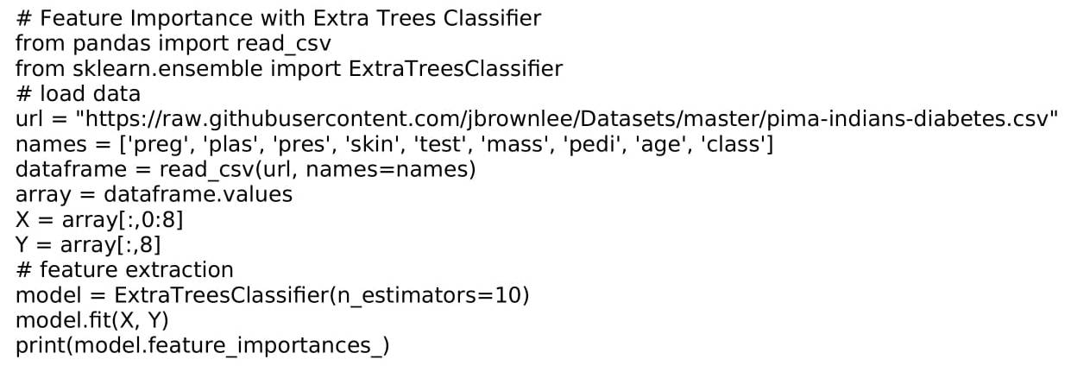
HOW TO WRITE PYTHON CODE FOR FEATURE IMPORTANCE ?

Slide 41
EXTENDING LINEAR REGRESSION

Slide 42
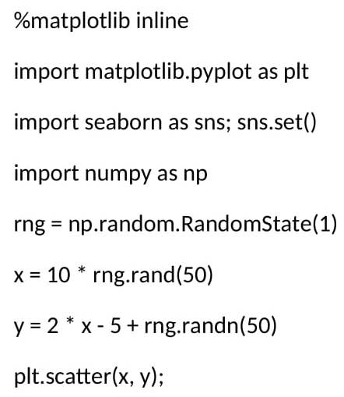
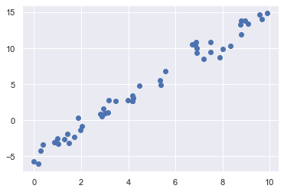
EXTENDING LINEAR REGRESSION
Beginning with standard Imports and considering the given data set

Slide 43
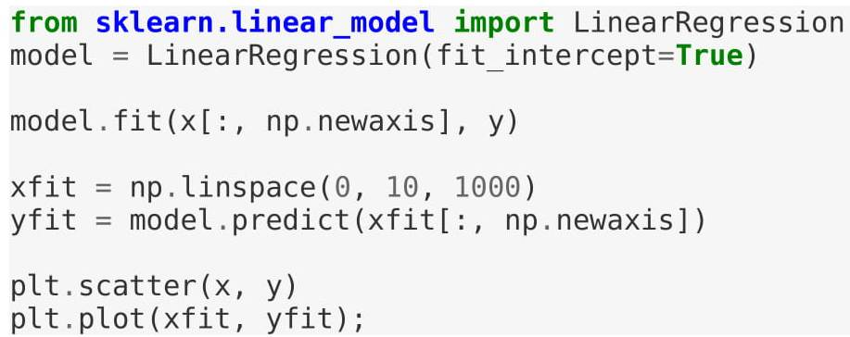
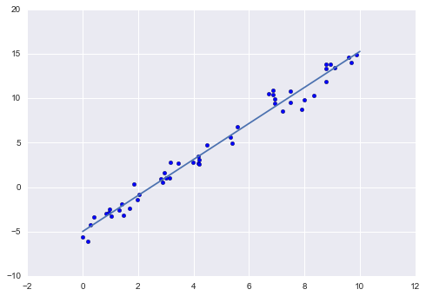
EXTENDING LINEAR REGRESSION

Slide 44


EXTENDING LINEAR REGRESSION
The slope and intercept of the data are contained in the model's fit parameters, which in Scikit-Learn are always marked by a trailing underscore. Here the relevant parameters are coef_ and intercept_.

Slide 45
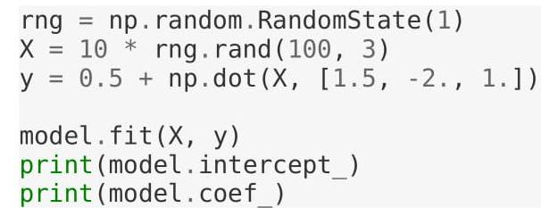

EXTENDING LINEAR REGRESSION
The multidimensional nature of such regressions makes them more difficult to visualize, but we can see one of these fits in action by building some example data, using NumPy's matrix multiplication operator

Slide 46
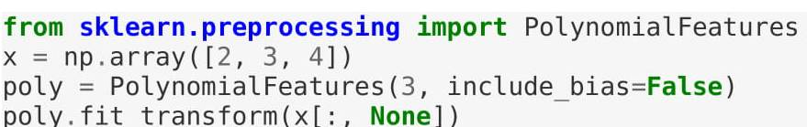
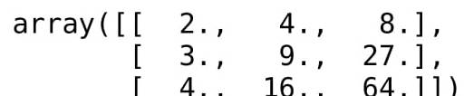
EXTENDING LINEAR REGRESSION POLYNOMIAL BASIC FUNCTIONS
This polynomial projection is useful enough that it is built into Scikit-Learn, using the Polynomial Features transformer

Slide 47
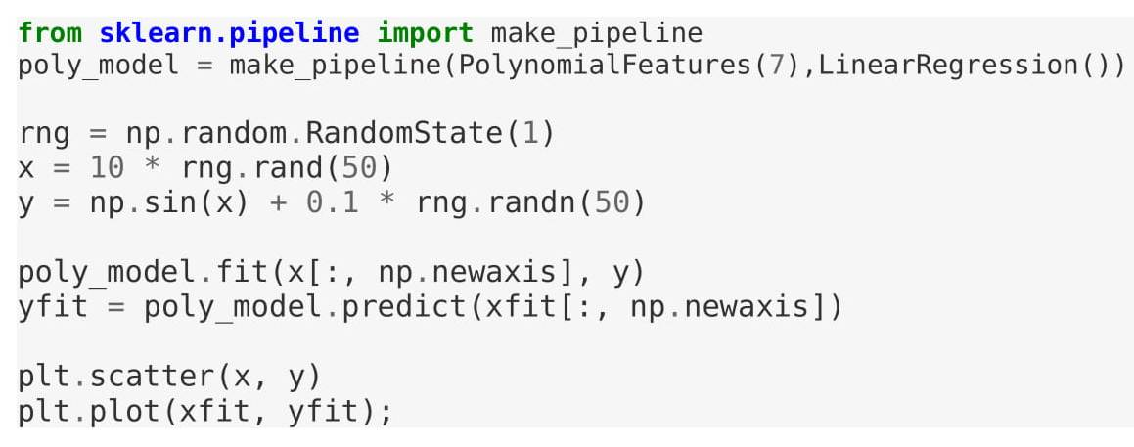
EXTENDING LINEAR REGRESSION POLYNOMIAL BASIC FUNCTIONS

Slide 48
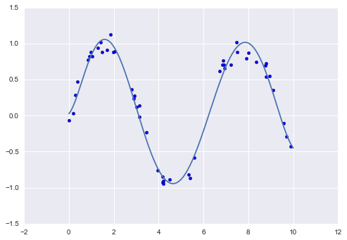
EXTENDING LINEAR REGRESSION POLYNOMIAL BASIC FUNCTIONS

Slide 49
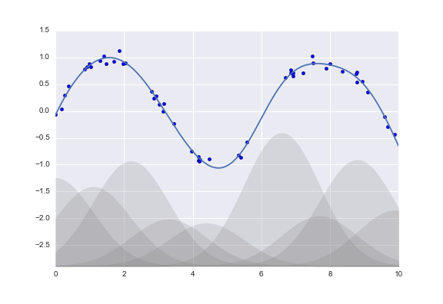
EXTENDING LINEAR REGRESSION GAUSSIAN BASIC FUNCTIONS
One useful pattern is to fit a model that is not a sum of polynomial bases, but a sum of Gaussian bases
The shaded regions in the plot are the scaled basis functions, and when added together they reproduce the smooth curve through the data
These Gaussian basis functions are not built into Scikit-Learn, but we can write a custom transformer that will create them

Slide 50
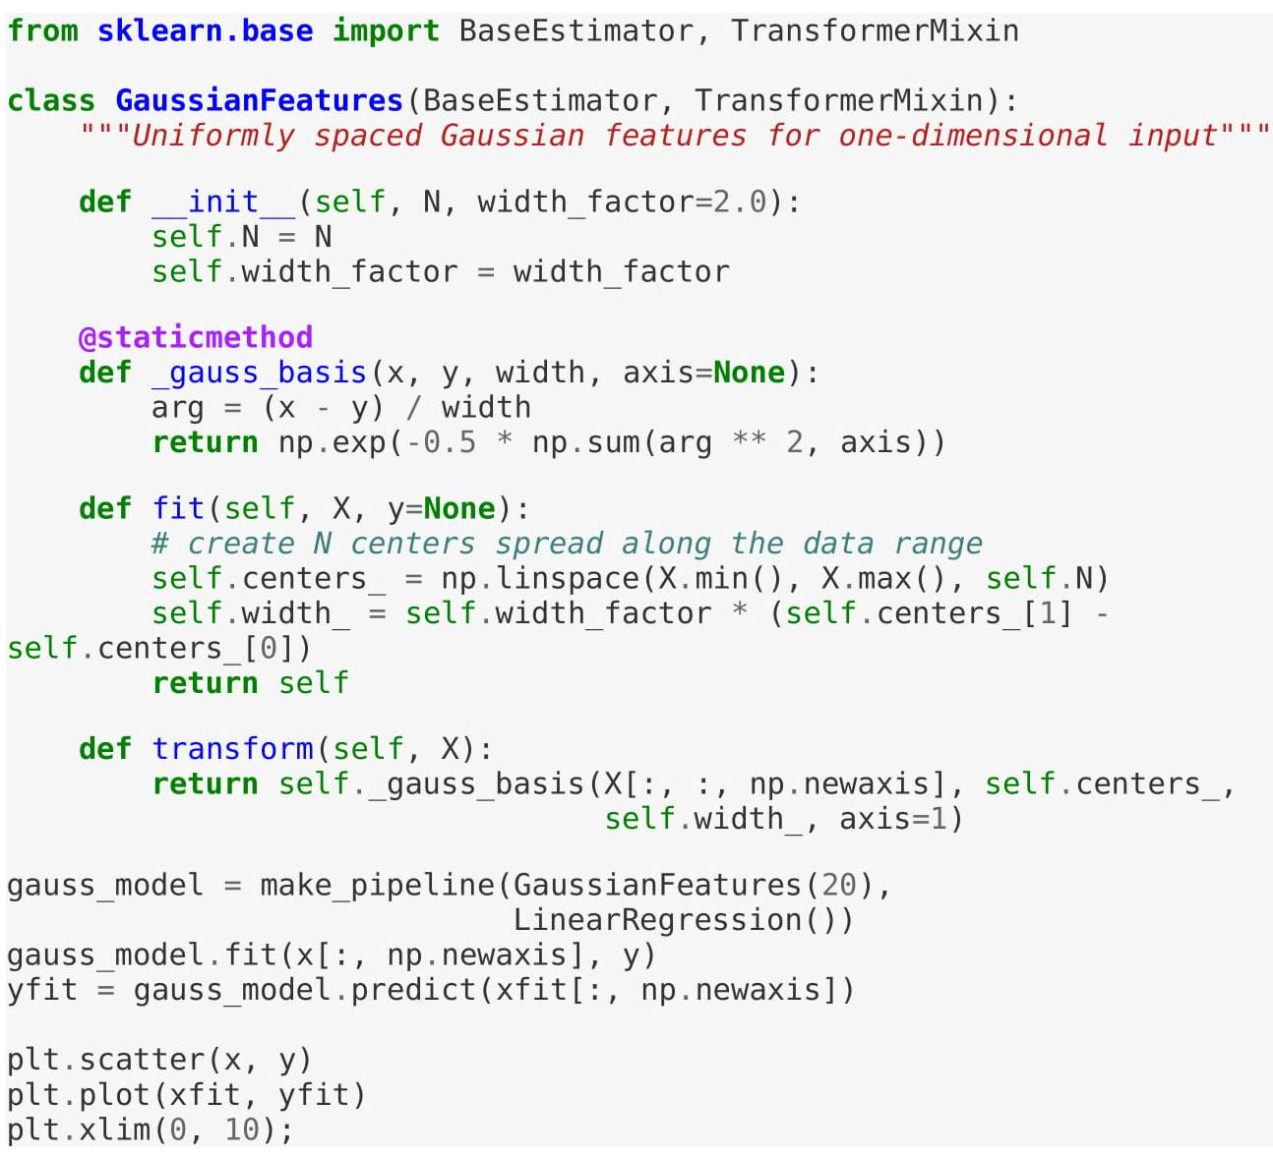
EXTENDING LINEAR REGRESSION GAUSSIAN BASIC FUNCTIONS

Slide 51
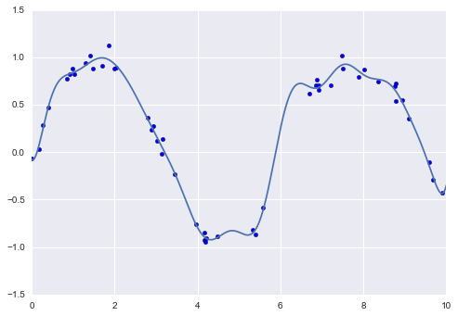
EXTENDING LINEAR REGRESSION GAUSSIAN BASIC FUNCTIONS

Slide 52
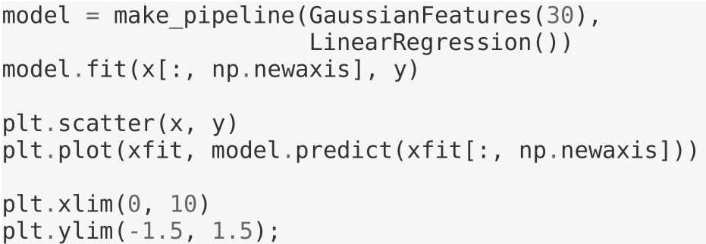
EXTENDING LINEAR REGRESSION REGULARIZATION

Slide 53
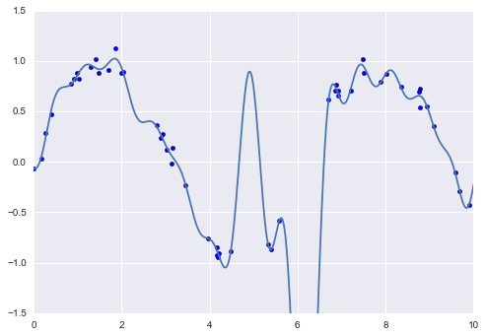
EXTENDING LINEAR REGRESSION REGULARIZATION
With the data projected to the 30-dimensional basis, the model has far too much flexibility and goes to extreme values between locations where it is constrained by data
We can see the reason for this if we plot the coefficients of the Gaussian bases with respect to their locations

Slide 54
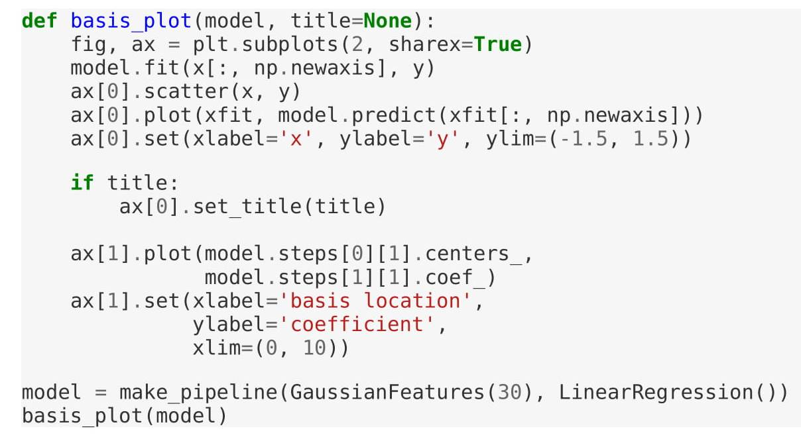
EXTENDING LINEAR REGRESSION REGULARIZATION

Slide 55
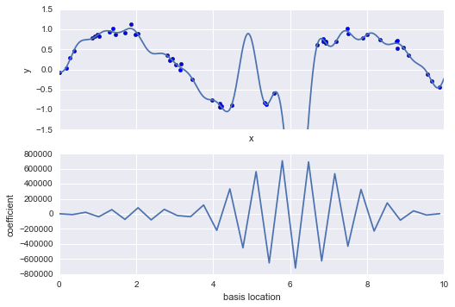
EXTENDING LINEAR REGRESSION REGULARIZATION
The lower panel of this figure shows the amplitude of the basis function at each location. This is typical over-fitting behavior when basis functions overlap: the coefficients of adjacent basis functions blow up and cancel each other out. We know that such behavior is problematic, and it would be nice if we could limit such spikes expliticly in the model by penalizing large values of the model parameters. Such a penalty is known as regularization, and comes in several forms.

Slide 56
L1 &L2 (LASSO AND RIDGE REGRESSION)

Slide 57
L1 AND L2 REGRESSION
Ridge Regression –
Performs L2 regularization, i.e. adds penalty equivalent to square of the magnitude of coefficients
Minimization objective = LS Obj + α * (sum of square of coefficients)
Lasso Regression –
Performs L1 regularization, i.e. adds penalty equivalent to absolute value of the magnitude of coefficients
Minimization objective = LS Obj + α * (sum of absolute value of coefficients)

Slide 58
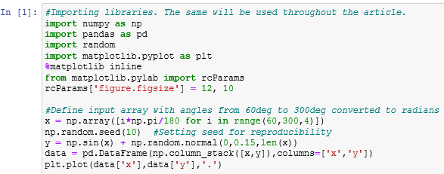
WHY PENALIZE THE MAGNITUDE OF COEFFICIENTS?

Slide 59
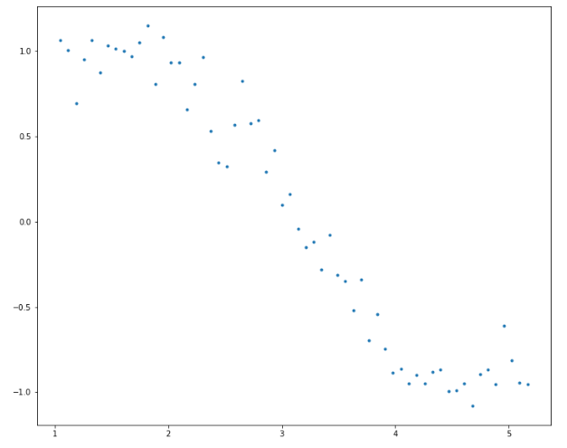
WHY PENALIZE THE MAGNITUDE OF COEFFICIENTS?

Slide 60
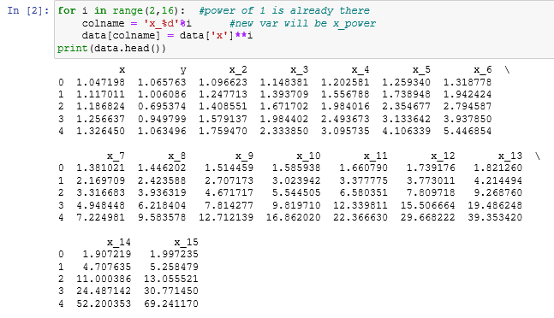
WHY PENALIZE THE MAGNITUDE OF COEFFICIENTS?

Slide 61
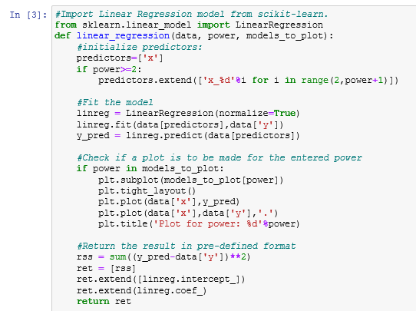
WHY PENALIZE THE MAGNITUDE OF COEFFICIENTS?

Slide 62
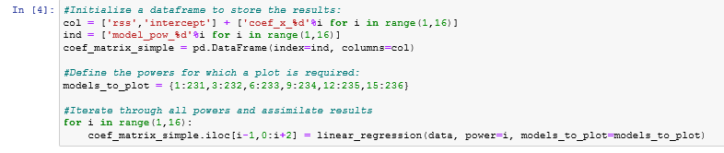
WHY PENALIZE THE MAGNITUDE OF COEFFICIENT?

Slide 63
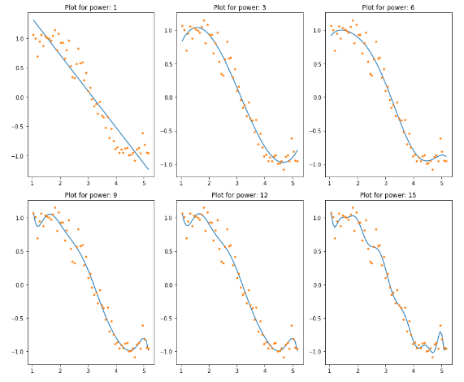
WHY PENALIZE THE MAGNITUDE OF COEFFICIENTS?

Slide 64
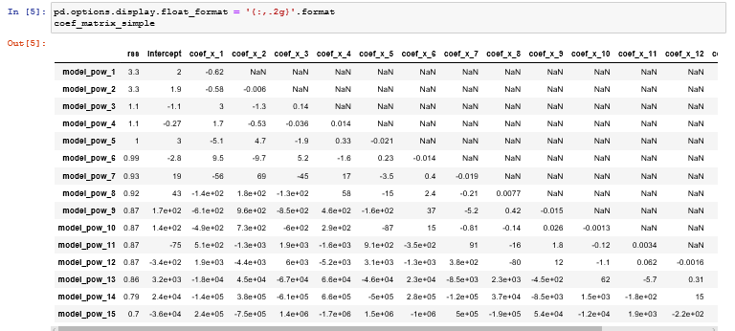
WHY PENALIZE THE MAGNITUDE OF COEFFICIENTS?

Slide 65
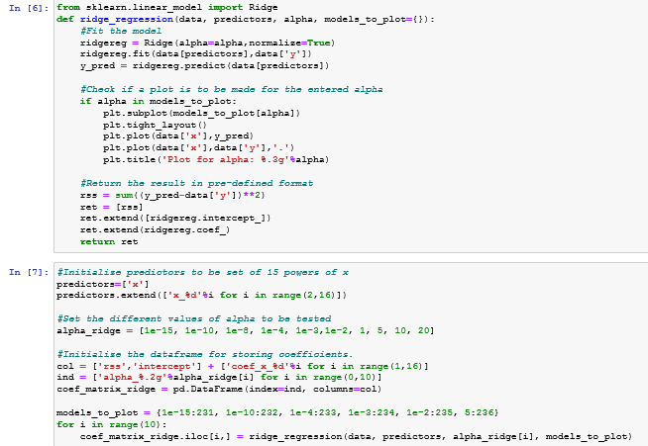
RIDGE REGRESSION

Slide 66
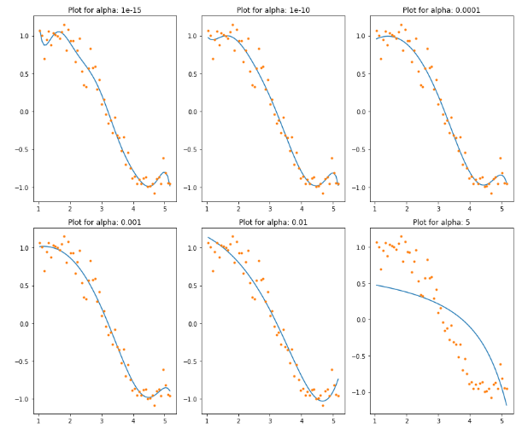
RIDGE REGRESSION

Slide 67
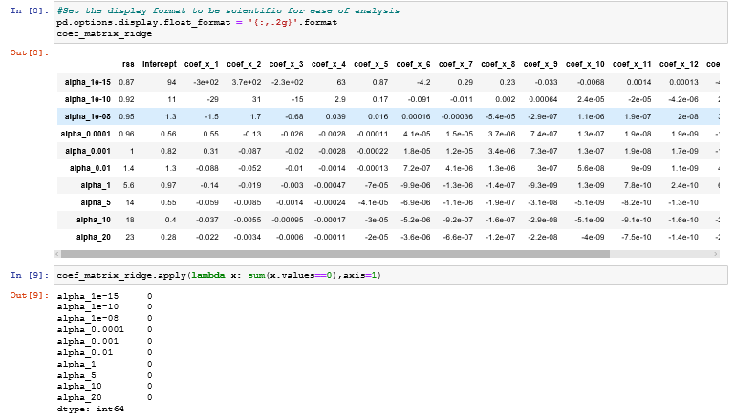
RIDGE REGRESSION

Slide 68
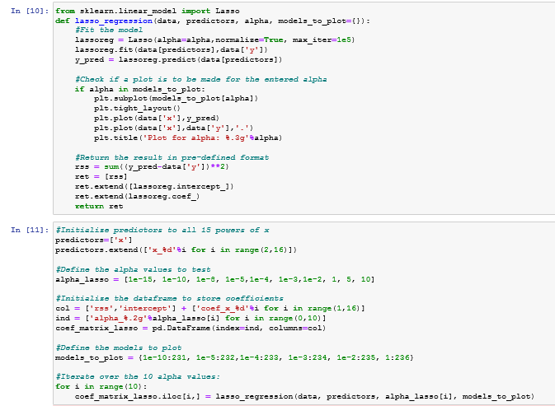
LASSO REGRESSION

Slide 69
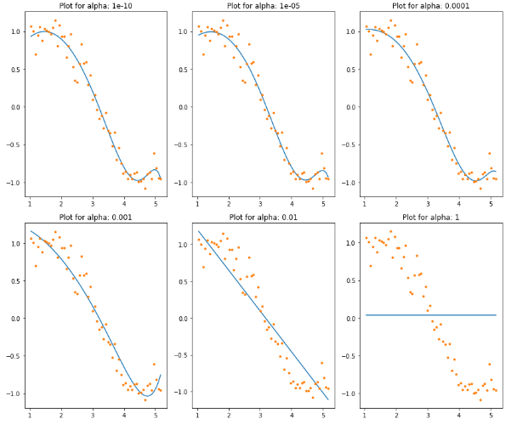
LASSO REGRESSION

Slide 70
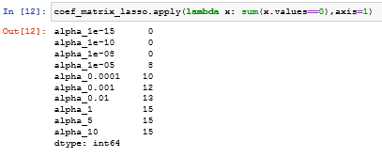
LASSO REGRESSION

Slide 71

THANK YOU !!!
(USA)
2-Industrial Park Drive, E-Waldorf, MD, 20602,
United States
(USA)
+1-844-889-4054
(Singapore)
3 Temasek Avenue, Singapore 039190
info@careerera.com www.careerera.com
(INDIA)
B-44, Sector-59, Noida Uttar Pradesh 201301
(INDIA)
+91-92-5000-4000

