Slide 1
A Warm Welcome To Careerera Family

Slide 2
SEABORN

Slide 3

WHAT IS SEABORN?
In the world of Analytics, the best way to get insights is by visualizing the data. Data can be visualized by representing it as plots which is easy to understand, explore and grasp. Such data helps in drawing the attention of key elements.
To analyse a set of data using Python, we make use of Matplotlib, a widely implemented 2D plotting library. Likewise, Seaborn is a visualization library in Python. It is built on top of Matplotlib.
Seaborn is an amazing data visualization library for statistical graphics plotting in Python.
It provides beautiful default styles and color palettes to make statistical plots more attractive.
It is built on the top of the matplotlib library and also closely integrated to the data structures from pandas.

Slide 4
WHAT IS DIFFERENCE BETWEEN SEABORN & MATPLOTLIB?
It is summarized that if Matplotlib “tries to make easy things easy and hard things possible”, Seaborn tries to make a well-defined set of hard things easy too.”
Seaborn helps resolve the two major problems faced by Matplotlib; the problems are −
Default Matplotlib parameters
Working with data frames
As Seaborn compliments and extends Matplotlib, the learning curve is quite gradual. If you know Matplotlib, you are already half way through Seaborn.

Slide 5
WHAT ARE THE IMPORTANT FEATURES OF SEABORN?
Seaborn is built on top of Python’s core visualization library Matplotlib. It is meant to serve as a complement, and not a replacement. However, Seaborn comes with some very important features. Let us see a few of them here. The features help in −
Built in themes for styling matplotlib graphics
Visualizing univariate and bivariate data
Fitting in and visualizing linear regression models
Plotting statistical time series data
Seaborn works well with NumPy and Pandas data structures
It comes with built in themes for styling Matplotlib graphics
In most cases, you will still use Matplotlib for simple plotting. The knowledge of Matplotlib is recommended to tweak Seaborn’s default plots.

Slide 6
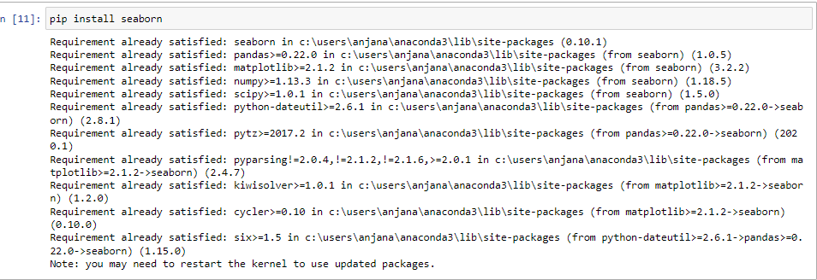
HOW TO INSTALL SEABORN?
Using Pip Installer
To install the latest release of Seaborn, you can use pip −

Slide 7

HOW TO IMPORT SEABORN?
We will import the Seaborn library with the following command −

Slide 8
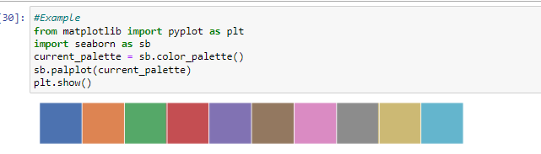
WHAT ARE THE TYPES OF COLOR PALETTES?
Qualitative Color Palettes
Qualitative or categorical palettes are best suitable to plot the categorical data.

Slide 9
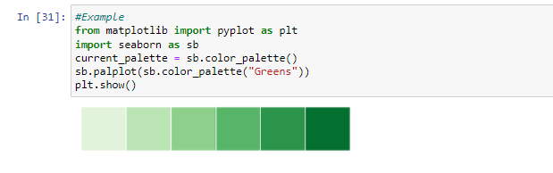
WHAT ARE THE TYPES OF COLOR PALETTES?
Sequential Color Palettes
Sequential plots are suitable to express the distribution of data ranging from relative lower values to higher values within a range.
Appending an additional character ‘s’ to the color passed to the color parameter will plot the Sequential plot.

Slide 10
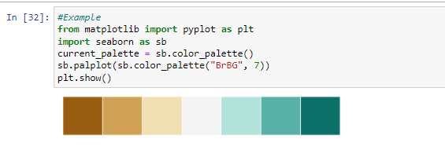
WHAT ARE THE TYPES OF COLOR PALETTES?
Diverging Color Palette
Diverging palettes use two different colors. Each color represents variation in the value ranging from a common point in either direction.
Assume plotting the data ranging from -1 to 1. The values from -1 to 0 takes one color and 0 to +1 takes another color.
By default, the values are centered from zero. You can control it with parameter center by passing a value.

Slide 11
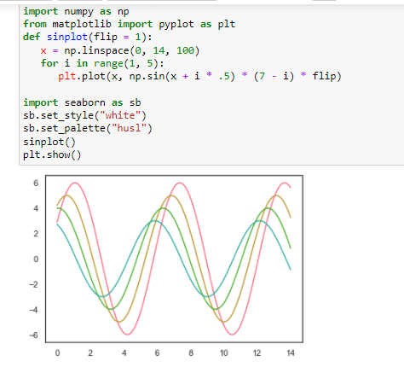
WHAT ARE THE TYPES OF COLOR PALETTES?
Setting the Default Color Palette
The functions color_palette() has a companion called set_palette() The relationship between them is similar to the pairs covered in the aesthetics chapter. The arguments are same for both set_palette() and color_palette(), but the default Matplotlib parameters are changed so that the palette is used for all plots.

Slide 12
WHAT IS HISTOGRAM ?
Histograms represent the data distribution by forming bins along the range of the data and then drawing bars to show the number of observations that fall in each bin.
Seaborn comes with some datasets and we have used few datasets in our previous chapters. We have learnt how to load the dataset and how to lookup the list of available datasets.
Seaborn comes with some datasets and we have used few datasets in our previous chapters. We have learnt how to load the dataset and how to lookup the list of available datasets.

Slide 13
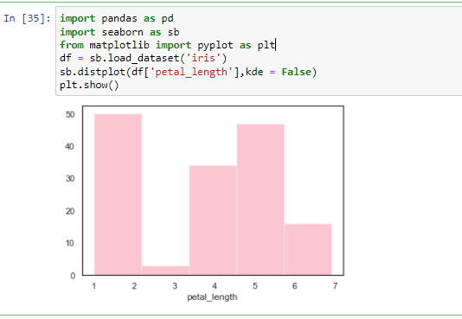
HOW TO CREATE HISTOGRAM?

Slide 14
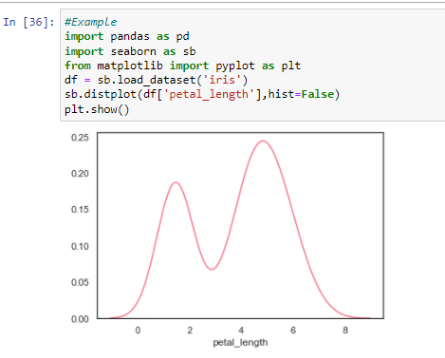
WHAT IS KERNEL DENSITY ESTIMATES?
Kernel Density Estimation (KDE) is a way to estimate the probability density function of a continuous random variable. It is used for non-parametric analysis.
Setting the hist flag to False in distplot will yield the kernel density estimation plot.

Slide 15
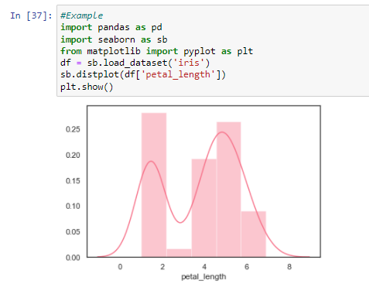
HOW TO FIT PARAMETRIC DISTRIBUTION?
distplot() is used to visualize the parametric distribution of a dataset.

Slide 16
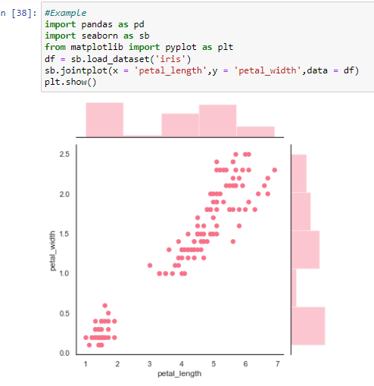
WHAT IS SCATTER PLOT?
Scatter plot is the most convenient way to visualize the distribution where each observation is represented in two-dimensional plot via x and y axis.

Slide 17
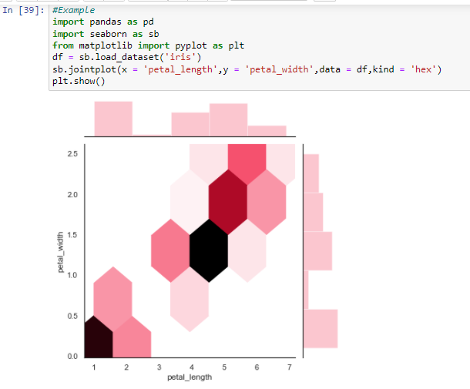
WHAT IS HEXBIN PLOT?
Hexagonal binning is used in bivariate data analysis when the data is sparse in density i.e., when the data is very scattered and difficult to analyze through scatterplots.
An addition parameter called ‘kind’ and value ‘hex’ plots the hexbin plot.

Slide 18
WHAT IS PAIRWISE RELATIONSHIP?
Datasets under real-time study contain many variables. In such cases, the relation between each and every variable should be analyzed. Plotting Bivariate Distribution for (n,2) combinations will be a very complex and time taking process.
To plot multiple pairwise bivariate distributions in a dataset, you can use the pairplot() function. This shows the relationship for (n,2) combination of variable in a DataFrame as a matrix of plots and the diagonal plots are the univariate plots.

Slide 19
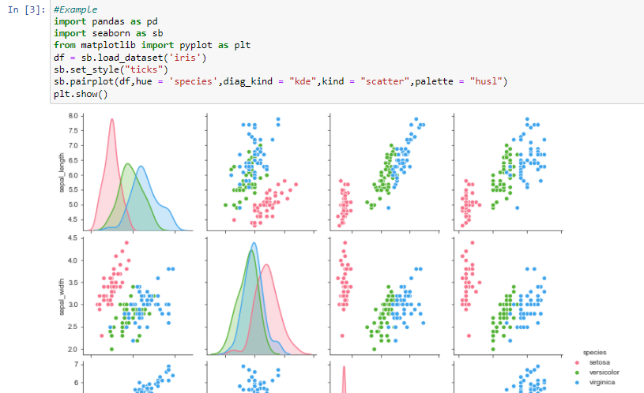
HOW TO VISUALIZE PAIRWISE RELATIONSHIP?

Slide 20
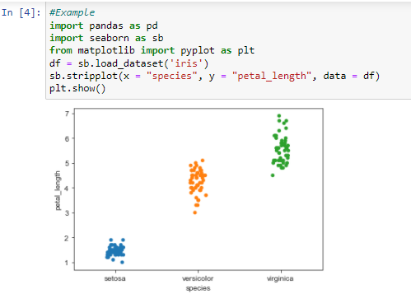
HOW TO PLOT CATEGORICAL DATA?
stripplot()
stripplot() is used when one of the variable under study is categorical. It represents the data in sorted order along any one of the axis.

Slide 21
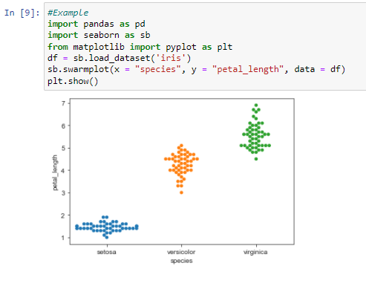
HOW TO PLOT CATEGORICAL DATA?
Swarmplot()
Another option which can be used as an alternate to ‘Jitter’ is function swarmplot(). This function positions each point of scatter plot on the categorical axis and thereby avoids overlapping points −

Slide 22
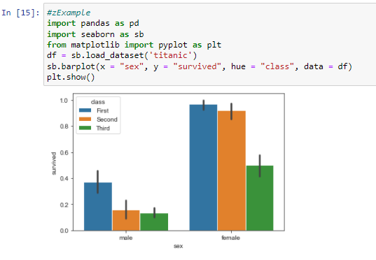
WHAT IS BAR PLOT?
The barplot() shows the relation between a categorical variable and a continuous variable. The data is represented in rectangular bars where the length the bar represents the proportion of the data in that category.

Slide 23
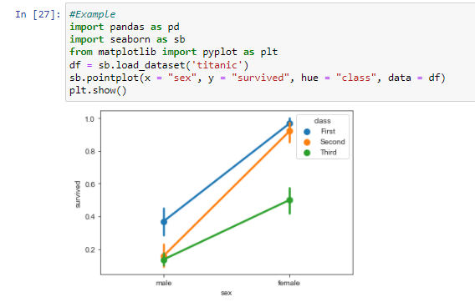
WHAT IS POINT PLOTS?
Point plots serve same as bar plots but in a different style. Rather than the full bar, the value of the estimate is represented by the point at a certain height on the other axis

Slide 24
WHAT IS BOX PLOTS?
Boxplot is a convenient way to visualize the distribution of data through their quartiles.
Box plots usually have vertical lines extending from the boxes which are termed as whiskers. These whiskers indicate variability outside the upper and lower quartiles, hence Box Plots are also termed as box-and-whisker plot and box-and-whisker diagram. Any Outliers in the data are plotted as individual points.

Slide 25
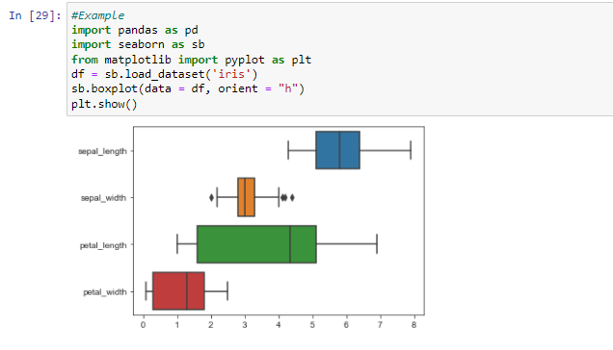
HOW TO CREATE BOX PLOTS?

Slide 26
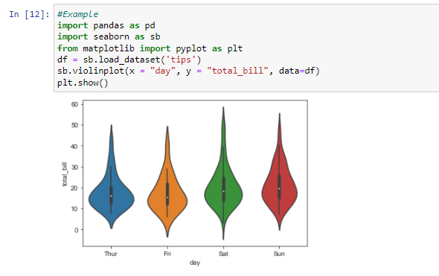
WHAT IS VIOLIN PLOTS AND HOW TO CREATE?
Violin Plots are a combination of the box plot with the kernel density estimates. So, these plots are easier to analyze and understand the distribution of the data.

Slide 27
WHAT IS LINEAR RELATIONSHIPS?
Most of the times, we use datasets that contain multiple quantitative variables, and the goal of an analysis is often to relate those variables to each other. This can be done through the regression lines.
While building the regression models, we often check for multicollinearity, where we had to see the correlation between all the combinations of continuous variables and will take necessary action to remove multicollinearity if exists. In such cases, the following techniques helps.

Slide 28
WHAT ARE THE FUNCTIONS TO DRAW LINEAR REGRESSION MODELS?
There are two main functions in Seaborn to visualize a linear relationship determined through regression. These functions are regplot() and lmplot().
regplot
accepts the x and y variables in a variety of formats including simple NumPy arrays, pandas Series objects, or as references to variables in a pandas DataFrame
lmplot
has data as a required parameter and the x and y variables must be specified as strings. This data format is called “long-form” data

Slide 29
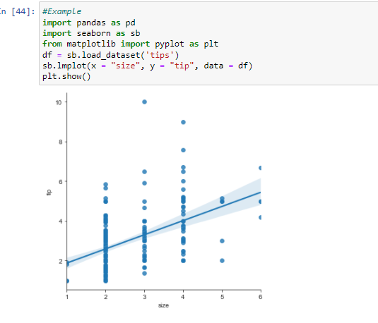
WHAT IS lmplot ?

Slide 30
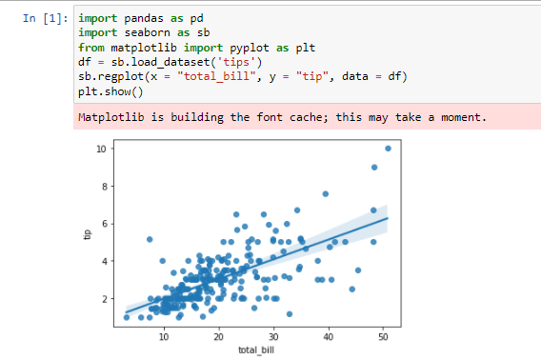
WHAT IS regplot ?

Slide 31

THANK YOU !!!
(USA)
2-Industrial Park Drive, E-Waldorf, MD, 20602,
United States
(USA)
+1-844-889-4054
(Singapore)
3 Temasek Avenue, Singapore 039190
info@careerera.com www.careerera.com
(INDIA)
B-44, Sector-59, Noida Uttar Pradesh 201301
(INDIA)
+91-92-5000-4000

