Slide 1
A Warm Welcome To Careerera Family

Slide 2

DBMS USING MYSQL

Slide 3

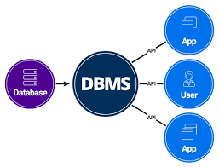
WHAT IS DATABASE MANAGEMENT SYSTEM(DBMS)?

Slide 4
INTRODUCTION TO DBMS
A Database Management System (DBMS) is defined as the software system that allows users to define, create, maintain and control access to the database.
DBMS makes it possible for end users to create, read, update and delete data in database.
A DBMS serves as an interface between an end-user.
DBMS Examples:- MySQL, Microsoft Access, SQL Server, FileMaker, Oracle, RDBMS.

Slide 5
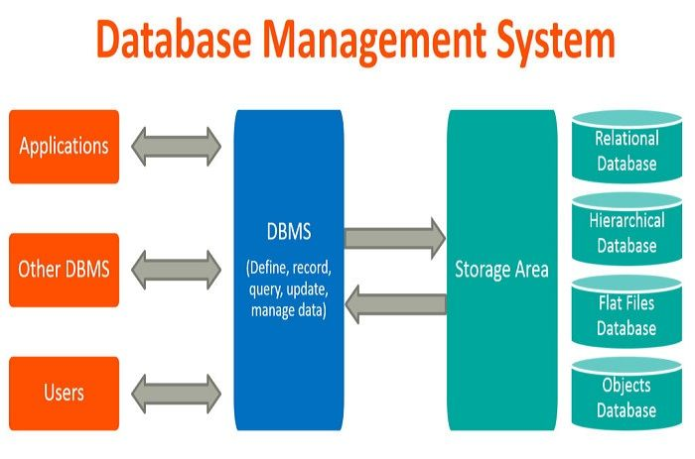

Slide 6
WHERE IS DATABASE MANAGEMENT SYSTEM (DBMS) BEING USED?
Airlines: reservations, schedules, etc
Telecom: calls made, customer details, network usage, etc
Universities: registration, results, grades, etc
Sales: products, purchases, customers, etc
Banking: all transactions etc

Slide 7
ADVANTAGES OF DBMS
Better Data Transferring
Better Data Security
Better data integration
Better decision making
Increased end-user productivity
Simple

Slide 8
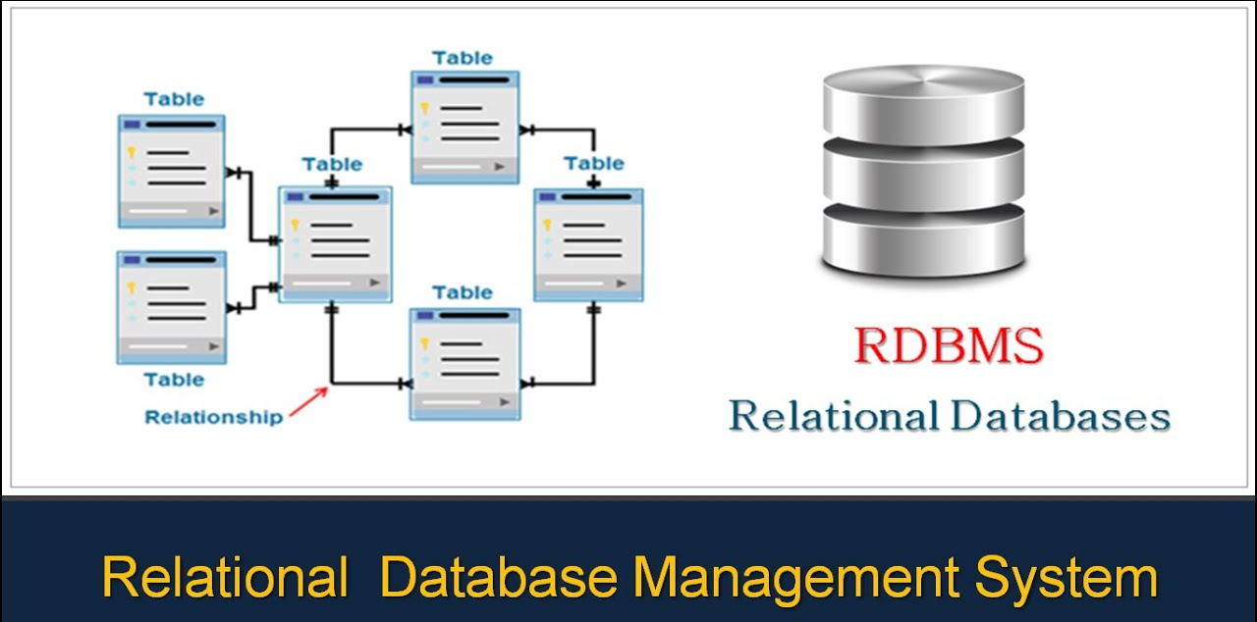
RELATIONAL DATABASE(RDMS)

Slide 9
AN INTRODUCTION TO RELATIONAL DATABASE
A relational database organizes data into tables which can be linked—or related—based on data common to each.
This capability enables you to retrieve an entirely new table from data in one or more tables with a single query.
Data is represented in the terms of rows/records and columns.
In a relational database, each row in the table is a record with a unique ID called the key.

Slide 10
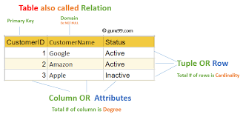
WHAT IS A TABLE?
The RDBMS database uses tables to store data. A table is a collection of related data entries and contains rows and columns to store data.

Slide 11
WHAT IS A NULL VALUE?
A NULL value in a table is a value in a field that appears to be blank, which means a field with a NULL value is a field with no value.
It is very important to understand that a NULL value is different than a zero value or a field that contains spaces. A field with a NULL value is the one that has been left blank during a record creation.

Slide 12
WHAT IS SQL?
SQL is a programming language for Relational Databases. It is designed over relational algebra and tuple relational calculus. SQL comes as a package with all major distributions of RDBMS.
SQL comprises both data definition and data manipulation languages. Using the data definition properties of SQL, one can design and modify database schema, whereas data manipulation properties allows SQL to store and retrieve data from Database.

Slide 13
SEMICOLON AFTER SQL STATEMENTS
Some database systems require a semicolon at the end of each SQL statement.
Semicolon is the standard way to separate each SQL statement in database systems that allow more than one SQL statement to be executed in the same call to the server.
In this tutorial, we will use semicolon at the end of each SQL statement.

Slide 14
ADVANTAGES OF SQL
1.No programming needed
2. High-Speed Query Processing
3. Standardized Language
4. Portability
5. Interactive language
6. More than one Data View

Slide 15
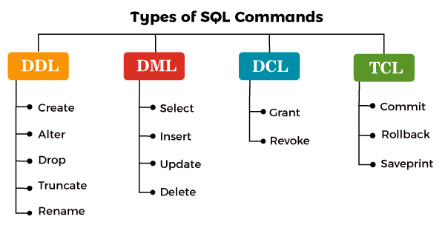

Slide 16
WHAT IS DATA DEFINITION LANGUAGE?
DDL stands for data definition language.
DDL Commands deal with the schema, i.e., the table in which our data is stored.
Example:
CREATE DATABASE DatabaseName;
All the structural changes such as creation, deletion and alteration on the table can be carried with the DDL commands in SQL.
Commands covered under DDL are:
CREATE
ALTER
DROP
TRUNCATE
RENAME

Slide 17
1.CREATE Command
In SQL, whenever we wish to create a new database or a table in
a database, we use CREATE command.
Syntax to create a new database:
CREATE DATABASE DatabaseName;
Example to create a new database:
CREATE DATABASE employee;

Slide 18
2.ALTER Command
In SQL, whenever we wish to alter the table structure, we will use the ALTER command.
Syntax of ALTER command to add a new column: ALTER TABLE table_name ADD column_name;
Example :
ALTER TABLE table_name DROP COLUMN column_name;
ALTER TABLE table_name RENAME COLUMN old_column_
name TO new_column_name;

Slide 19
3. DROP Command
DROP command is used to remove or delete the table's records and the table's structure from the database.
Syntax :
DROP TABLE table_name;
Example :
Write a query to delete the school table from the SCHOOL database.
DROP TABLE school;

Slide 20

4.TRUNCATE Command
A TRUNCATE command is used to delete the table's records, but the table's structure will remain unaffected in the database.
Syntax:
TRUNCATE TABLE table_name;
Example :
TRUNCATE TABLE t_school;

Slide 21
5.RENAME Command
Rename COMMAND is used to give a new name to an existing table.
Syntax to rename a table:
RENAME TABLE old_table_name TO new_table_name;
Example :
RENAME TABLE student TO top_student;

Slide 22
WHAT IS DATA MANIPULATION LANGUAGE?
DML stands for Data Manipulation Language. Using DML commands in SQL, we can make changes in the data present in tables.
DML commands in SQL will change the data, such as inserting new records, deleting or updating existing records from the SQL tables. We can also retrieve all the data from SQL tables according to our requirements.
Commands covered under DDL are:
INSERT
SELECT
UPDATE
DELETE

Slide 23
1.INSERT Command
INSERT command is used to insert records in a table. We can insert a single as well as multiple records for a single table at the same time.
Syntax:
INSERT INTO table_name VALUES (column_1 value,column_1value);

Slide 24
2.SELECT Command
A SELECT command is used to retrieve the records from the table. According to our requirements, we can retrieve all the records or some specific records from the table.
Syntax to retrieve all the records:
SELECT *FROM table_name;
Syntax to retrieve some specific records:
SELECT *FROM table_name WHERE condition;

Slide 25
3.UPDATE Command
UPDATE command works for the values present in the table.Whenever we wish to update a value for any record present in a table, we will use the UPDATE command in SQL.
Syntax:
UPDATE table_name SET column_name = value
WHERE condition;

Slide 26
4.DELETE Command
DELETE command is used to remove records from a table.
Syntax:
DELETE FROM table_name;

Slide 27
WHAT IS DCL Command?
DCL stands for Data Control Language.
Whenever we want to control the access to the data present in SQL tables, we will use DCL commands in SQL. Only the authorized users can access the data stored in the tables.
There are two types of DCL Commands:-
1. GRANT
Access privileges can be assigned to a user for the databases and tables using the GRANT command.
2. REVOKE
All the access privileges which are already assigned to the user can be revoked by using the REVOKE command.

Slide 28
WHAT IS TCL COMMANDS?
TCL stands for Transaction Control Language. TCL commands are generally used in transactions.
Using TCL commands in SQL, we can save our transactions to the database and roll them back to a specific point in our transaction. We can also save a particular portion of our transaction using the SAVEPOINT command.

Slide 29
Commands covered under TCL are:
1. COMMIT:
To save all the operations executed in a particular transaction, we need to execute a commit command just after the transaction completion.
2. ROLLBACK
Using the rollback command in SQL, you can roll to the last saved state of a transaction.
3. SAVEPOINT
Using the SAVEPOINT command, you can assign a name to a specific part of the transaction.

Slide 30
WHAT IS DATA QUERY LANGUAGE?
1.No programming needed
2. High-Speed Query Processing
3. Standardized Language
4. Portability
5. Interactive language
6. More than one Data View

Slide 31
MYSQL CREATE USER
The MySQL user is a record in the USER table of the MySQL server that contains the login information, account privileges, and the host information for MySQL account. It is essential to create a user in MySQL for accessing and managing the databases.
Create User statement allows us to create a new user account in the database server. It provides authentication, SSL/TLS, resource-limit, role, and password management properties for the new accounts. It also enables us to control the accounts that should be initially locked or unlocked.

Slide 32
WHY DID USERS REQUIRE IN MYSQL SERVER?
When the MySQL server installation completes, it has a ROOT user account only to access and manage the databases. But, sometimes, you want to give the database access to others without granting them full control. In that case, you will create a non-root user and grant them specific privileges to access and modify the database.
Syntax
The following syntax is used to create a user in the database server.
CREATE USER [IF NOT EXISTS] account_name IDENTIFIED BY 'password';

Slide 33
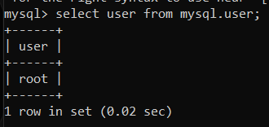
CREATE USER EXAMPLE
Step 1: Open the MySQL server by using the mysql client tool.
Step 2: Enter the password for the account and press Enter.
Enter Password: ****
Step 3: Execute the following command to show all users in the current MySQL server.
MySQL> select user from MySQL. User;

Slide 34
GRANT PRIVILEGES TO THE MYSQL NEW USER
MySQL server provides multiple types of privileges to a new user account.
Some of the most commonly used privileges are given below:
ALL PRIVILEGES: It permits all privileges to a new user account.
CREATE: It enables the user account to create databases and tables.
DROP: It enables the user account to drop databases and tables.
DELETE: It enables the user account to delete rows from a specific table.
INSERT: It enables the user account to insert rows into a specific table.
SELECT: It enables the user account to read a database.
UPDATE: It enables the user account to update table rows.

Slide 35
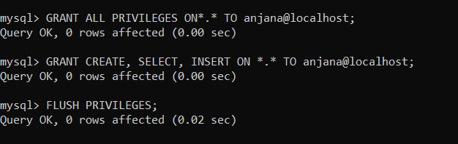
GRANT PRIVILEGES TO THE MYSQL NEW USER

Slide 36
DROP USER
The Drop User statement allows us to remove one or more user accounts and their privileges from the database server. If the account does not exist in the database server, it gives an error.
If you want to use the Drop User statement, it is required to have a global privilege of Create User statement or the DELETE privilege for the MySQL system schema.
Syntax
The following syntax is used to delete the user accounts from the database server completely.
DROP USER 'account_name';

Slide 37
DROP USER EXAMPLE
The following are the step required to delete an existing user from the MySQL server database.
Step 1: Open the MySQL server by using the mysql client tool.
Step 2: Enter the password for the account and press Enter.
Enter Password: ********
Step 3: Execute the following command to show all users in the current MySQL server.
mysql> select user from MySQL.User;

Slide 38
SHOW USERS/LIST ALL USERS
In that case, we need to see the list of all user's accounts in a database. Most times, we assume that there is a SHOW USERS command similar to SHOW DATABASES, SHOW TABLES, etc. for displaying the list of all users available in the database server.
Unfortunately, MySQL database does not have a SHOW USERS command to display the list of all users in the MySQL server. We can use the following query to see the list of all user in the database server:
-Select user from mysql.user;

Slide 39
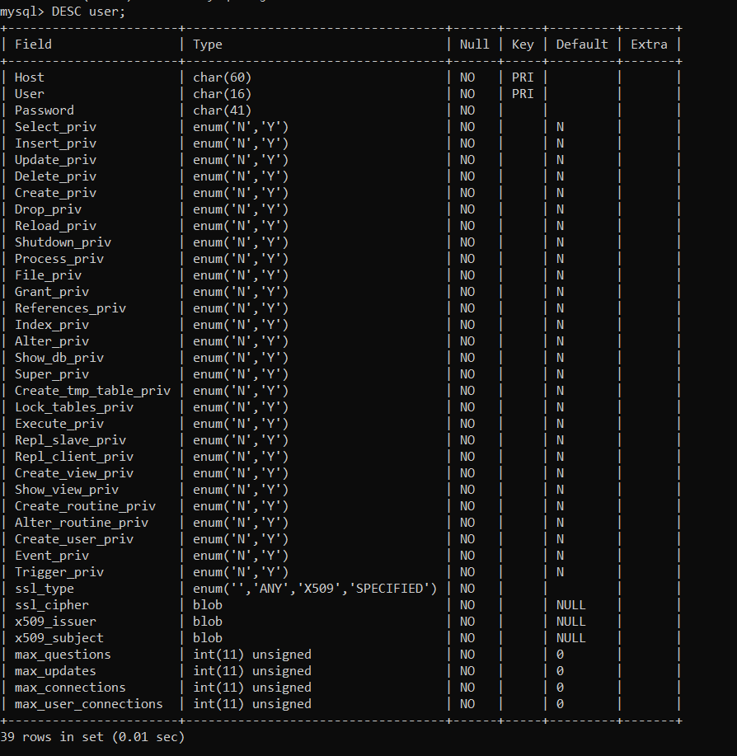
SHOW USERS/LIST ALL USERS
we want to see more information on the user table,

Slide 40
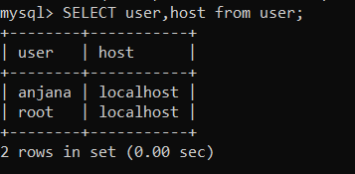
SHOW USERS/LIST ALL USERS
To get the selected information like as hostname, password expiration status, and account locking, execute the query as below:
-SELECT user, host FROM user;

Slide 41
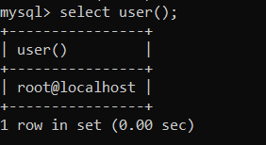
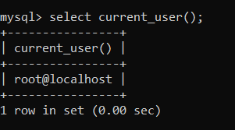
SHOW CURRENT USER
We can get information of the current user by using the user() or current_user() function

Slide 42
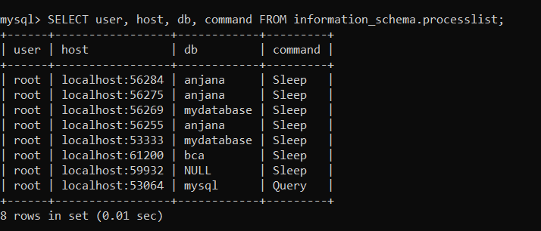
SHOW CURRENT LOGGED USER
-mysql> SELECT user, host, db, command FROM information_schema.processlist;

Slide 43
CHANGE USER PASSWORD
To change the password of any user account, you must have to keep this information in your mind:
-The details of the user account that you want to change.
-An application used by the user whose password you want to change. If you reset the user account password without changing an application connection string, then the application cannot connect with the database server.
MySQL allows us to change the user account password in three different ways, which are given below:
UPDATE Statement
SET PASSWORD Statement

Slide 44

CHANGE USER ACCOUNT PASSWORD USING THE UPDATE STATEMENT
1. USE mysql;
2. UPDATE user SET password = PASSWORD('jtp12345') WHERE user = 'peter' AND host = 'localhost';
3. FLUSH PRIVILEGES;

Slide 45
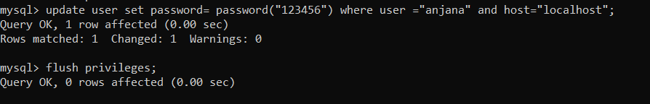
CHANGE USER ACCOUNT PASSWORD USING SET PASSWORD STATEMENT
USE mysql;
UPDATE user SET password = PASSWORD('jtp12345') WHERE user = 'peter' AND host = 'localhost';
FLUSH PRIVILEGES;

Slide 46
CREATE DATABASE
MySQL implements a database as a directory that stores all files in the form of a table.
It allows us to create a database mainly in two ways:
1.MySQL Command Line Client
We can create a new database in MySQL by using the CREATE DATABASE statement with the below syntax:
CREATE DATABASE [IF NOT EXISTS] database_name
[CHARACTER SET charset_name]
[COLLATE collation_name];
2. MySQL Workbench

Slide 47
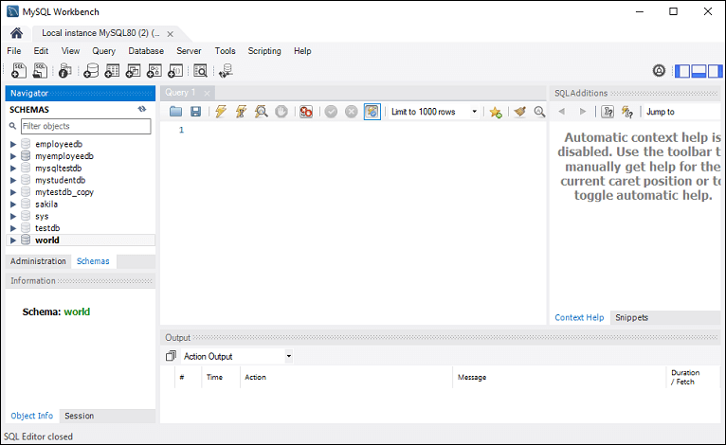
2.Using Workbench

Slide 48
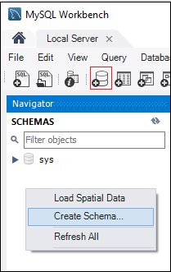

Slide 49
PARAMETER EXPLANATION
The parameter descriptions of the above syntax are as follows:
Parameter | Description
database_name | It is the name of a new database that should be unique in the MySQL server instance. The IF NOT EXIST clause avoids an error when we create a database that already exists.
charset_name | It is optional. It is the name of the character set to store every character in a string. MySQL database server supports many character sets. If we do not provide this in the statement, MySQL takes the default character set.
collation_name | It is optional that compares characters in a particular character set.

Slide 50
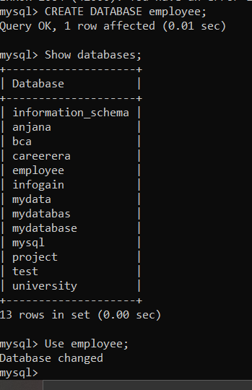
CREATE DATABASE
CREATE DATABASE employee;
Show databases;

Slide 51
SELECT DATABASE
SELECT Database is used in MySQL to select a particular database to work with. This query is used when multiple databases are available with MySQL Server.
You can use SQL command USE to select a particular database.
Syntax:
USE database_name;
For example;

Slide 52
DROP DATABASE
We can drop/delete/remove a MySQL database quickly with the MySQL DROP DATABASE command. It will delete the database along with all the tables, indexes, and constraints permanently.
Therefore, we should have to be very careful while removing the database in MySQL because we will lose all the data available in the database.
If the database is not available in the MySQL server, the DROP DATABASE statement throws an error.

Slide 53
DROP DATABASE
We can drop an existing database in MySQL by using the DROP DATABASE statement with the below syntax:
DROP DATABASE [IF EXISTS] database_name;
In MySQL, we can also use the below syntax for deleting the database. It is because the schema is the synonym for the database, so we can use them interchangeably.
DROP SCHEMA [IF EXISTS] database_name;

Slide 54
DROP DATABASE
Parameter Explanation
The parameter descriptions of the above syntax are as follows:
Parameter | Description
database_name | It is the name of an existing database that we want to delete from the server. It should be unique in the MySQL server instance.
IF EXISTS | It is optional. It is used to prevent from getting an error while removing a database that does not exist.

Slide 55
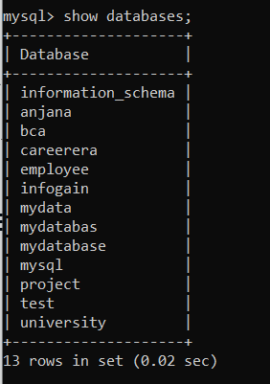

DROP DATABASE
SHOW DATABASES;
DROP DATABASE careerera;
For example:

Slide 56
CREATE TABLE
A table is used to organize data in the form of rows and columns and used for both storing and displaying records in the structure format. It is similar to worksheets in the spreadsheet application.
A table creation command requires three things:
Name of the table
Names of fields
Definitions for each field

Slide 57
CREATE TABLE
MySQL allows us to create a table into the database by using the CREATE TABLE command.
SYNTAX:
CREATE TABLE [IF NOT EXISTS] table_name(
column_definition1,
column_definition2,
........,
table_constraints
);

Slide 58
CREATE TABLE
CREATE TABLE employees (
NAME VARCHAR (20),
ID VARCHAR(15),
ADDRESS VARCHAR(50)
);
For example:

Slide 59
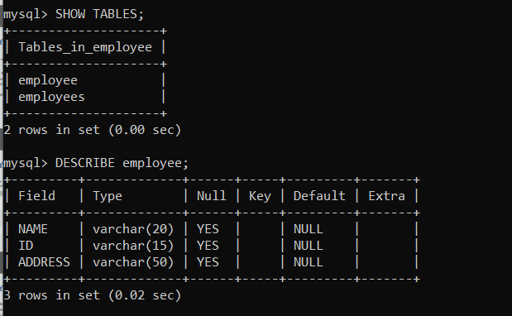
CREATE TABLE
SHOW TABLES;
DESCRIBE employee;

Slide 60
ALTER TABLE
MySQL ALTER statement is used when you want to change the name of your table or any table field. It is also used to add or delete an existing column in a table.
The ALTER statement is always used with "ADD", "DROP" and "MODIFY" commands according to the situation.
Syntax for adding single column:
ALTER TABLE table_name
ADD new_column_name column_definition
[ FIRST | AFTER column_name ];

Slide 61
ADD MULTIPLE COLUMNS IN THE TABLE
SYNTAX:
ALTER TABLE table_name
ADD new_column_name column_definition
[ FIRST | AFTER column_name ],
ADD new_column_name column_definition
[ FIRST | AFTER column_name ], ... ;
For example:

Slide 62

MODIFY COLUMN IN THE TABLE
The MODIFY command is used to change the column definition of the table.
SYNTAX:
ALTER TABLE table_name
MODIFY column_name column_definition
[ FIRST | AFTER column_name ];
For example:-

Slide 63

DROP COLUMN IN TABLE
SYNTAX:
ALTER TABLE table_name
DROP COLUMN column_name;
For example:-

Slide 64

RENAME COLUMN IN TABLE
SYNTAX:
ALTER TABLE table_name
CHANGE COLUMN old_name new_name
column_definition
[ FIRST | AFTER column_name ]
For Example:-

Slide 65
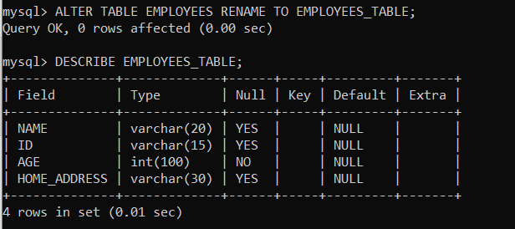
RENAME TABLE
SYNTAX:
ALTER TABLE table_name
RENAME TO new_table_name;
For example:-

Slide 66

TRUNCATE TABLE
The TRUNCATE statement in MySQL removes the complete data without removing its structure. It is a part of DDL or data definition language command.
Generally, we use this command when we want to delete an entire data from a table without removing the table structure.
SYNTAX:-
TRUNCATE [TABLE] table_name;

Slide 67
TRUNCATE TABLE
We cannot use the WHERE clause with this command so that filtering of records is not possible.
We cannot rollback the deleted data after executing this command because the log is not maintained while performing this operation.
We cannot use the truncate statement when a table is referenced by a foreign key or participates in an indexed view.
The TRUNCATE command doesn't fire DELETE triggers associated with the table that is being truncated because it does not operate on individual rows.

Slide 68
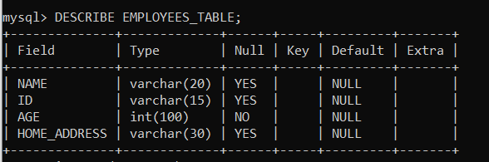
DESCRIBE TABLE
DESCRIBE means to show the information in detail.
DESCRIBE command to show the structure of our table, such as column names, constraints on column names, etc. The DESC command is a short form of the DESCRIBE command. Both DESCRIBE and DESC command are equivalent and case sensitive.
Syntax
{DESCRIBE | DESC} table_name;
For example:-

Slide 69

DROP TABLE
MYSQL uses a Drop Table statement to delete the existing table. This statement removes the complete data of a table along with the whole structure or definition permanently from the database.
Syntax:
DROP TABLE table_name;
OR,
DROP TABLE schema_name.table_name;
For example:-

Slide 70
CONSTRAINTS
SQL constraints are used to specify rules for the data in a table.
Constraints are used to limit the type of data that can go into a table. This ensures the accuracy and reliability of the data in the table. If there is any violation between the constraint and the data action, the action is aborted.
Constraints can be column level or table level. Column level constraints apply to a column, and table level constraints apply to the whole table.

Slide 71
CONSTRAINTS
The following are the most common constraints used in the MySQL:
NOT NULL
CHECK
DEFAULT
PRIMARY KEY
AUTO_INCREMENT
UNIQUE
INDEX
ENUM
FOREIGN KEY

Slide 72
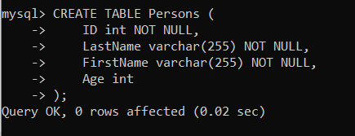
NOT NULL CONSTRAINT
By default, a column can hold NULL values.
This constraint specifies that the column cannot have NULL or empty values. The below statement creates a table with NOT NULL constraint.
NOT NULL on CREATE TABLE:

Slide 73
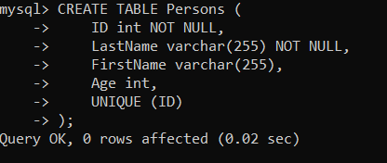
UNIQUE CONSTRAINT
The UNIQUE constraint ensures that all values in a column are different.
Both the UNIQUE and PRIMARY KEY constraints provide a guarantee for uniqueness for a column or set of columns.
A PRIMARY KEY constraint automatically has a UNIQUE constraint.
However, you can have many UNIQUE constraints per table, but only one PRIMARY KEY constraint per table.
UNIQUE CONSTRAINT ON CREATE TABLE:

Slide 74
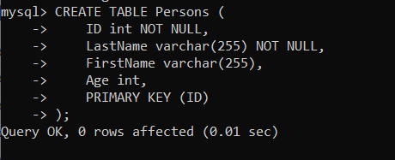
PRIMARY KEY CONSTRAINT
The PRIMARY KEY constraint uniquely identifies each record in a table.
Primary keys must contain UNIQUE values, and cannot contain NULL values.
A table can have only ONE primary key; and in the table, this primary key can consist of single or multiple columns (fields).
PRIMARY KEY of CREATE TABLE:

Slide 75


PRIMARY KEY CONSTRAINT
PRIMARY KEY on ALTER TABLE : To create a PRIMARY KEY constraint on the "ID" column when the table is already created ;
DROP A PRIMARY KEY CONSTRAINT
To drop a PRIMARY KEY constraint, use the following SQL:

Slide 76
FOREIGN KEY CONSTRAINT
The FOREIGN KEY constraint is used to prevent actions that would destroy links between tables.
A FOREIGN KEY is a field (or collection of fields) in one table, that refers to the PRIMARY KEY in another table.
The table with the foreign key is called the child table, and the table with the primary key is called the referenced or parent table.

Slide 77
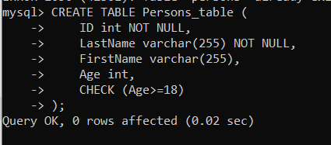
CHECK CONSTRAINT
The following SQL creates a CHECK constraint on the "Age" column when the "Persons" table is created. The CHECK constraint ensures that the age of a person must be 18, or older:

Slide 78
CHECK CONSTRAINT
CHECK ON ALTER TABLE
To create a CHECK constraint on the "Age" column when the table is already created, use the following SQL:
ALTER TABLE Persons ADD CHECK (Age>=18);

Slide 79
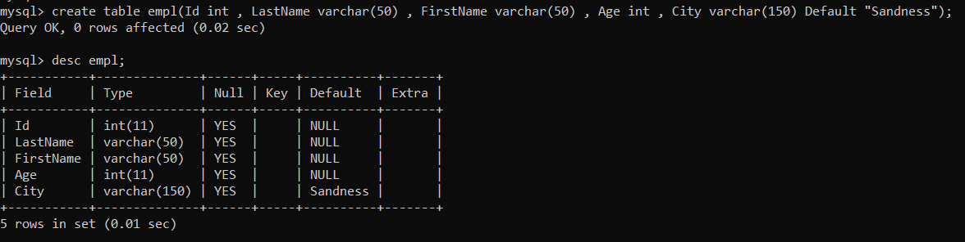
DEFAULT CONSTRAINT
The DEFAULT constraint is used to set a default value for a column.
The default value will be added to all new records, if no other value is specified
DEFAULT ON CREATE TABLE:
The following SQL sets a DEFAULT value for the "City" column when the "Persons" table is created:

Slide 80
CREATE INDEX STATEMENT
The CREATE INDEX statement is used to create indexes in tables.
Indexes are used to retrieve data from the database more quickly than otherwise. The users cannot see the indexes, they are just used to speed up searches/queries.
CREATE INDEX Syntax
Creates an index on a table. Duplicate values are allowed:
CREATE INDEX index_name ON table_name (column1, column2, ...);
CREATE UNIQUE INDEX Syntax
Creates a unique index on a table. Duplicate values are not allowed:
CREATE UNIQUE INDEX index_name ON table_name (column1, column2, ...);

Slide 81
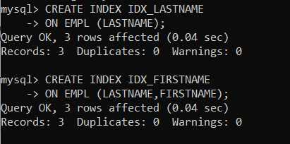
CREATE INDEX STATEMENT
Example :-
DROP INDEX Statement
The DROP INDEX statement is used to delete an index in a table.
ALTER TABLE table_name DROP INDEX index_name;

Slide 82
INSERT STATEMENT
MySQL INSERT statement is used to store or add data in MySQL table within the database.
We can perform insertion of records in two ways using a single query in MySQL:
Insert record in a single row
Insert record in multiple rows
INSERT RECORD IN A SINGLE ROW
Syntax:
INSERT INTO table_name ( field1, field2,...fieldN )
VALUES( value1, value2,...valueN );

Slide 83
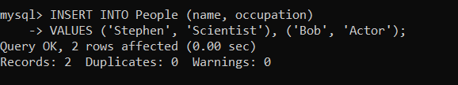
INSERT STATEMENT
If we want to store records without giving all fields, we use the following partial field statements. In such case, it is mandatory to specify field names.

Slide 84
SELECT STATEMENT
The SELECT statement in MySQL is used to fetch data from one or more tables. We can retrieve records of all fields or specified fields that match specified criteria using this statement.
SELECT STATEMENT SYNTAX
SELECT field_name1, field_name 2,... field_nameN
FROM table_name1, table_name2...
[WHERE condition]
[GROUP BY field_name(s)]
[HAVING condition]
[ORDER BY field_name(s)]
[OFFSET M ][LIMIT N];

Slide 85
PARAMETER EXPLANATION
Parameter Name | Descriptions
field_name(s) or * | It is used to specify one or more columns to returns in the result set. The asterisk (*) returns all fields of a table.
table_name(s) | It is the name of tables from which we want to fetch data.
WHERE | It is an optional clause. It specifies the condition that returned the matched records in the result set.
GROUP BY | It is optional. It collects data from multiple records and grouped them by one or more columns.
HAVING | It is optional. It works with the GROUP BY clause and returns only those rows whose condition is TRUE.
ORDER BY | It is optional. It is used for sorting the records in the result set.
OFFSET | It is optional. It specifies to which row returns first. By default, It starts with zero.
LIMIT | It is optional. It is used to limit the number of returned records in the result set.

Slide 86
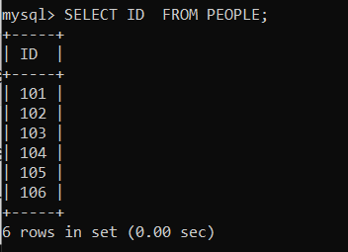
SELECT STATEMENT
If we want to retrieve a single column from the table, we need to execute the below query:

Slide 87
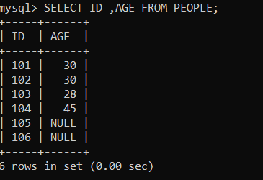
SELECT STATEMENT
If we want to query multiple columns from the table, we need to execute the below query:

Slide 88
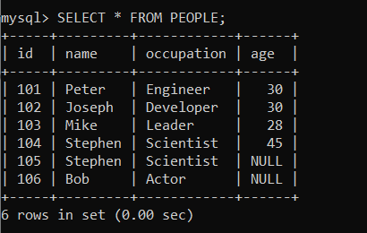
SELECT STATEMENT
If we want to fetch data from all columns of the table, we need to use all column's names with the select statement. Specifying all column names is not convenient to the user, so MySQL uses an asterisk (*) to retrieve all column data as follows:

Slide 89
WHERE CLAUSE
MySQL WHERE Clause is used with SELECT, INSERT, UPDATE and DELETE clause to filter the results. It specifies a specific position where you have to do the operation.
Syntax:
WHERE conditions;
Parameter:
conditions: It specifies the conditions that must be fulfilled for records to be selected.

Slide 90
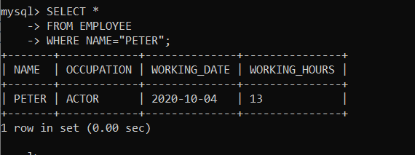
WHERE CLAUSE WITH SINGLE CONDITION
SELECT *
FROM EMPLOYEE
WHERE NAME = ’PETER';

Slide 91
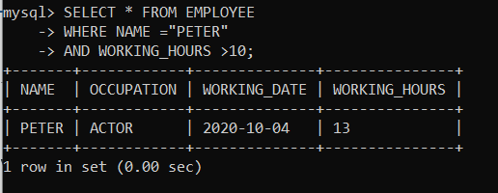
WHERE CLAUSE WITH AND CONDITION
In this example, we are retrieving data from the table "officers" with AND condition.
SELECT *
FROM officers
WHERE NAME = ’PETER'
AND WORKING_HOURS>10;

Slide 92
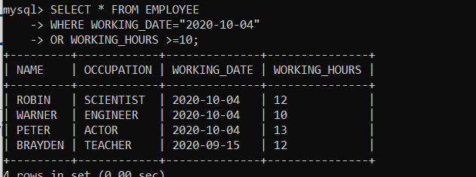
WHERE CLAUSE WITH OR CONDITION
SELECT *
FROM officers
WHERE WORKING_DATE =“2020-10-04”
OR WORKING_HOURS >=10;

Slide 93
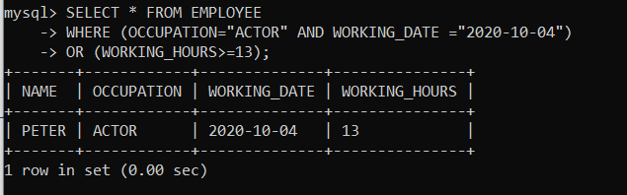
WHERE CLAUSE WITH COMBINATION OF AND & OR CONDITIONS
SELECT *
FROM officers
WHERE (OCCUPATION = ’ACTOR' AND WORKING_DATE = ’2020-10-04')
OR (WORKING_HOURS>= 13);

Slide 94
ORDER BY CLAUSE
The MYSQL ORDER BY Clause is used to sort the records in ascending or descending order.
Syntax:
SELECT expressions
FROM tables
[WHERE conditions]
ORDER BY expression [ ASC | DESC ];

Slide 95
ORDER BY CLAUSE
Parameters
expressions: It specifies the columns that you want to retrieve.
tables: It specifies the tables, from where you want to retrieve records. There must be at least one table listed in the FROM clause.
WHERE conditions: It is optional. It specifies conditions that must be fulfilled for the records to be selected.
ASC: It is optional. It sorts the result set in ascending order by expression (default, if no modifier is provider).
DESC: It is also optional. It sorts the result set in descending order by expression.

Slide 96
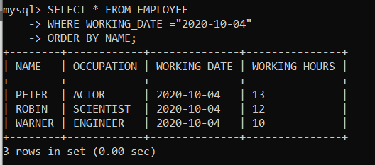
ORDER BY: WITHOUT USING ASC/DESC ATTRIBUTE
If you use MySQL ORDER BY clause without specifying the ASC and DESC modifier then by default you will get the result in ascending order.
syntax
SELECT *
FROM officers
WHERE address = 'Lucknow'
ORDER BY officer_name;

Slide 97
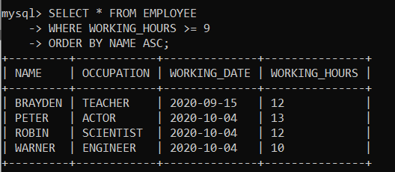
ORDER BY: WITH ASC ATTRIBUTE
Example to retrieve the data in ascending order.
SELECT *
FROM EMPLOYEE
WHERE WORKING_HOURS >=9
ORDER BY NAME ASC;

Slide 98
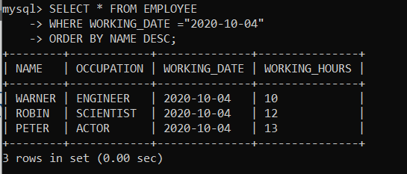
ORDER BY: WITH DESC ATTRIBUTE
SELECT *
FROM EMPLOYEE
WHERE WORKING_DATE= ’2020-10-04'
ORDER BY NAME DESC;

Slide 99
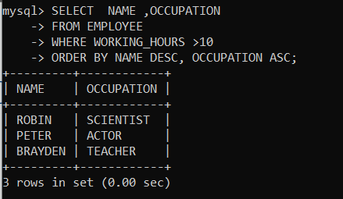
ORDER BY: USING BOTH ASC AND DESC ATTRIBUTES
SELECT NAME,OCCUPATION
FROM EMPLOYEE
WHERE WORKING_HOURS >10
ORDER BY NAME DESC, OCCUPATION ASC;

Slide 100
GROUP BY CLAUSE
The GROUP BY Clause is used to collect data from multiple records and group the result by one or more column. It is generally used in a SELECT statement.
You can also use some aggregate functions like COUNT, SUM, MIN, MAX, AVG etc. on the grouped column.
Syntax:
SELECT expression1, expression2, ... expression_n,
aggregate_function (expression)
FROM tables
[WHERE conditions]
GROUP BY expression1, expression2, ... expression_n;

Slide 101
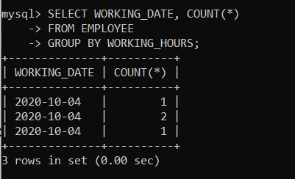
GROUP BY CLAUSE WITH COUNT FUNCTION
Let's count repetitive number of WORKING_HOURS in the column WORKING_HOURS.
SELECT WORKING_HOURS, COUNT(*)
FROM EMPLOYEE
GROUP BY WORKING_HOURS;

Slide 102
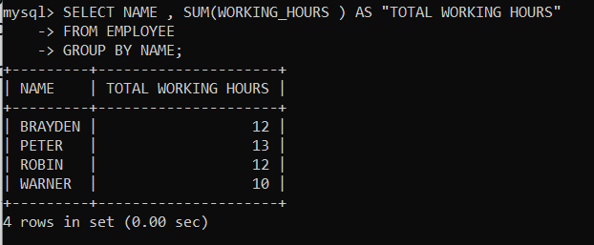
GROUP BY CLAUSE WITH SUM FUNCTION
Now, the following query will GROUP BY the example using the SUM function and return the emp_name and total working hours of each employee.
SELECT emp_name, SUM(working_hours) AS "Total working hours"
FROM employees
GROUP BY emp_name;

Slide 103
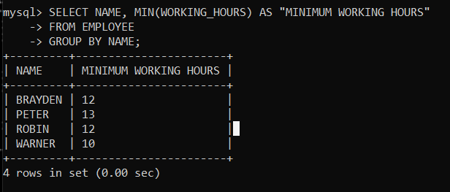
GROUP BY CLAUSE WITH MIN FUNCTION
The following example specifies the minimum working hours of the employees form the table "employees".
Syntax:
SELECT emp_name, MIN(working_hours) AS "Minimum working hour"
FROM employees
GROUP BY emp_name;

Slide 104
GROUP BY CLAUSE WITH MIN FUNCTION
The following example specifies the minimum working hours of the employees form the table "employees".
Execute the following query:
SELECT emp_name, MIN(working_hours) AS "Minimum working hour"
FROM employees
GROUP BY emp_name;

Slide 105
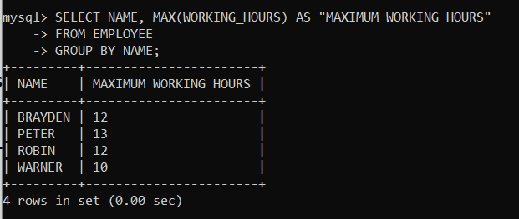
GROUP BY CLAUSE WITH MAX FUNCTION
The following example specifies the maximum working hours of the employees form the table "employees".
SELECT emp_name, MAX (working_hours) AS "Minimum working hour"
FROM employees
GROUP BY emp_name;

Slide 106
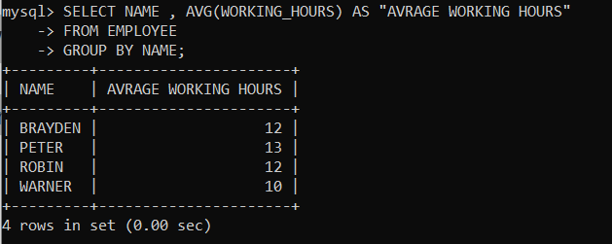
GROUP BY CLAUSE WITH AVG FUNCTION
The following example specifies the average working hours of the employees form the table "employees".
Syntax:
SELECT emp_name, AVG(working_hours) AS
"Average working hour"
FROM employees
GROUP BY emp_name;

Slide 107
JOINS
JOINS are used with SELECT statement. It is used to retrieve data
from multiple tables. It is performed whenever you need to fetch
records from two or more tables.
There are three types of MYSQL joins:
MySQL INNER JOIN (or sometimes called simple join)
MySQL LEFT OUTER JOIN (or sometimes called LEFT JOIN)
MySQL RIGHT OUTER JOIN (or sometimes called RIGHT JOIN)

Slide 108
INNER JOIN (SIMPLE JOIN)
Inner Join Syntax:
The Inner Join keyword is used with the SELECT statement and must be written after the FROM clause.
SELECT columns
FROM table1
INNER JOIN table2 ON condition1
INNER JOIN table3 ON condition2 ...;

Slide 109
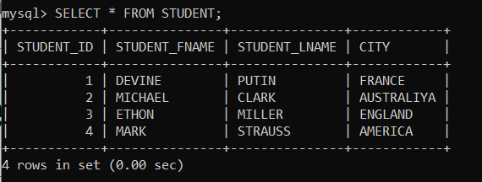
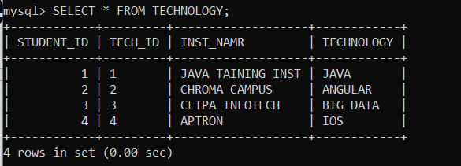
INNER JOIN (SIMPLE JOIN)
Example:
Let us first create two tables "students" and "technologies" that contains the following data:

Slide 110
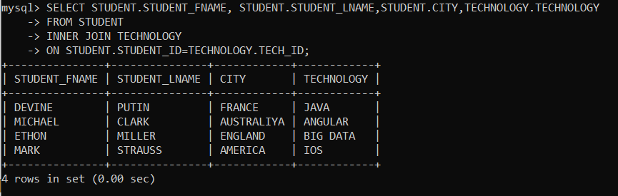
INNER JOIN (SIMPLE JOIN)
To select records from both tables, execute the following query:
SELECT STUDENT.STUDENT_FNAME, STUDENT.STUDENT_LNAME, STUDENT.CITY, TECHNOLOGY.TECHNOLOGY
FROM STUDENT
INNER JOIN TECHNOLOGY
ON STUDENTS.STUDENT_ID = TECHNOLOGY.TECH_ID;

Slide 111
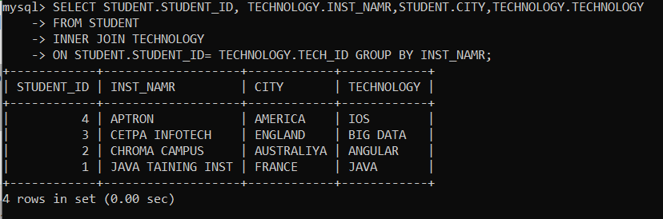
INNER JOIN WITH GROUP BY CLAUSE
The Inner Join can also be used with the GROUP BY clause.
SELECT STUDENTS.STUDENT_ID, TECHNOLOGY.INST_NAME, STUDENTS.CITY, TECHNOLOGY.TECHNOLOGY
FROM STUDENT
INNER JOIN TECHNOLOGY
ON STUDENTS.STUDENT_ID = TECHNOLOGY.TECH_ID GROUP BY INST_NAME;

Slide 112
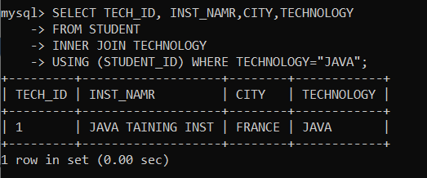
INNER JOIN WITH WHERE CLAUSE
The WHERE clause enables you to return the filter result. The following example illustrates this clause with Inner Join:
SELECT TECH_ID, INST_NAME, CITY, TECHNOLOGY
FROM STUDENTS
INNER JOIN TECHNOLOGY
USING (STUDENT_ID) WHERE TECHNOLOGY = "JAVA";

Slide 113
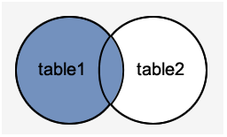
LEFT JOIN
The Left Join in MySQL is used to query records from multiple tables. This clause is similar to the Inner Join clause that can be used with a SELECT statement immediately after the FROM keyword.
When we use the Left Join clause, it will return all the records from the first (left-side) table, even no matching records found from the second (right side) table. If it will not find any matches record from the right side table, then returns null.
We can understand it with the following visual representation where Left Joins returns all records from the left-hand table and only the matching records from the right side table:

Slide 114
LEFT JOIN
LEFT JOIN Syntax
The following syntax explains the Left Join clause to join the two or more tables:
SELECT columns
FROM table1
LEFT [OUTER] JOIN table2
ON Join_Condition;

Slide 115
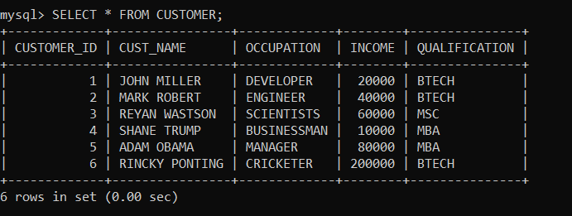

LEFT JOIN
LEFT JOIN Example
LEFT JOIN clause for joining two tables
we are going to create two tables "customers" and "orders" that contains the following data:

Slide 116

LEFT JOIN WITH GROUP BY CLAUSE
The Left Join can also be used with the GROUP BY clause. The following statement returns customer id, customer name, qualification, price, and date using the Left Join clause with the GROUP BY clause.

Slide 117

RIGHT JOIN
The Right Join is used to joins two or more tables and returns all rows from the right-hand table, and only those results from the other table that fulfilled the join condition.
If it finds unmatched records from the left side table, it returns Null value. It is similar to the Left Join, except it gives the reverse result of the join tables. It is also known as Right Outer Join. So, Outer is the optional clause used with the Right Join.
We can understand it with the following visual representation where Right Outer Join returns all records from the left-hand table and only the matching records from the other table:

Slide 118
RIGHT JOIN
RIGHT JOIN Syntax
SELECT column_list
FROM Table1
RIGHT [OUTER] JOIN Table2
ON join_condition;

Slide 119
RIGHT JOIN
RIGHT JOIN clause for joining two tables
Here, we are going to create two tables "customers" and "orders" that contains the following data:

Slide 120

RIGHT JOIN
RIGHT JOIN clause for joining two tables

Slide 121

RIGHT JOIN WITH WHERE CLAUSE
MySQL uses the WHERE clause to provide the filter result from the table. The following example illustrates this with the Right Join clause:

Slide 122

CROSS JOIN
CROSS JOIN is used to combine all possibilities of the two or more tables and returns the result that contains every row from all contributing tables.
The CROSS JOIN is also known as CARTESIAN JOIN, which provides the Cartesian product of all associated tables. The Cartesian product can be explained as all rows present in the first table multiplied by all rows present in the second table. It is similar to the Inner Join, where the join condition is not available with this clause.
We can understand it with the following visual representation where CROSS JOIN returns all the records from table1 and table2, and each row is the combination of rows of both tables.

Slide 123
CROSS JOIN
The CROSS JOIN keyword is always used with the SELECT statement and must be written after the FROM clause.
CROSS JOIN Syntax:
SELECT column-lists
FROM table1
CROSS JOIN table2;

Slide 124

CROSS JOIN
CROSS JOIN clause for joining two tables
Here,we are going to create two tables "customers" and "contacts" that contains the following data:

Slide 125

CROSS JOIN
CROSS JOIN clause for joining two tables

Slide 126
SELF JOIN
A SELF JOIN is a join that is used to join a table with itself.
There is a need to combine data with other data in the same table itself.
SELF JOIN Syntax:
SELECT s1.col_name, s2.col_name...
FROM table1 s1, table1 s2
WHERE s1.common_col_name = s2.common_col_name;

Slide 127

SELF JOIN
Example:
create a table "student" in a database that contains the following data:

Slide 128
UNION OPERATOR
The UNION operator is used to combine the result-set of two or more SELECT statements.
Every SELECT statement within UNION must have the same number of columns
The columns must also have similar data types
The columns in every SELECT statement must also be in the same order
UNION Syntax:
SELECT column_name(s) FROM table1 UNION SELECT column_name(s) FROM table2;

Slide 129
UNION OPERATOR
UNION ALL Syntax:
The UNION operator selects only distinct values by default. To allow duplicate values, use UNION ALL:
SELECT column_name(s) FROM table1 UNION ALL SELECT column_name(s) FROM table2;

Slide 130

UNION OPERATOR
UNION Example
The following SQL statement returns the cities (only distinct values) from both the "Customers" and the "Suppliers" table:

Slide 131

UNION OPERATOR
Example:
Note: If some customers or suppliers have the same city, each city will only be listed once, because UNION selects only distinct values. Use UNION ALL to also select duplicate values!

Slide 132

UNION OPERATOR
UNION ALL Example:
The following SQL statement returns the cities (duplicate values also) from both the "Customers" and the "Suppliers" table:

Slide 133

UNION OPERATOR
UNION With WHERE:
The following SQL statement returns the German cities (only
distinct values) from both the "Customers" and the "Suppliers“
table:

Slide 134

UNION OPERATOR
UNION ALL With WHERE:
The following SQL statement returns the German cities (duplicate values also) from both the "Customers" and the "Suppliers" table:

Slide 135
AGGREGATE FUNCTIONS
MySQL's aggregate function is used to perform calculations on multiple values and return the result in a single value like the average of all values, the sum of all values, and maximum & minimum value among certain groups of values.
We mostly use the aggregate functions with SELECT statements in the data query languages.
Syntax:
The following are the syntax to use aggregate functions
in MySQL:
function_name (DISTINCT | ALL expression)

Slide 136

AGGREGATE FUNCTIONS
There are various aggregate functions available in MySQL. Some
of the most commonly used aggregate functions are
summarised in the below table:

Slide 137
COUNT() FUNCTION
MySQL count() function returns the total number of values in the expression. This function produces all rows or only some rows of the table based on a specified condition, and its return type is BIGINT.
It returns zero if it does not find any matching rows. It can work with both numeric and non-numeric data types.
Suppose we want to get the total number of employees in the employee table, we need to use the count() function as shown in the following query:
Syntax:
SELECT COUNT(name) FROM employee;

Slide 138

COUNT() FUNCTION
Example

Slide 139

SUM() FUNCTION
The MySQL sum() function returns the total summed (non-NULL) value of an expression. It returns NULL if the result set does not have any rows. It works with numeric data type only.
Suppose we want to calculate the total number of working hours of all employees in the table, we need to use the sum() function as shown in the following query:
SYNTAX: SELECT SUM(working_hours) AS "Total working hours" FROM employee;

Slide 140

AVG() FUNCTION
MySQL AVG() function calculates the average of the values specified in the column. Similar to the SUM() function, it also works with numeric data type only.
Suppose we want to get the average working hours of all employees in the table, we need to use the AVG() function as shown in the following query:
Syntax: SELECT AVG(working_hours) AS "Average working hour " FROM employee;

Slide 141

MIN() FUNCTION
MySQL MIN() function returns the minimum (lowest) value of the specified column. It also works with numeric data type only.
Suppose we want to get minimum working hours of an employee available in the table, we need to use the MIN() function as shown in the following query:
Syntax:
SELECT MIN(working_hours) AS Minimum_working_hours
FROM employee;

Slide 142

MAX() FUNCTION
MySQL MAX() function returns the maximum (highest) value of the specified column. It also works with numeric data type only.
Suppose we want to get maximum working hours of an employee available in the table, we need to use the MAX() function as shown in the following query:
Syntax:
SELECT MAX(working_hours) AS Maximum_working_hours FROM employee;

Slide 143

FIRST() FUNCTION
This function returns the first value of the specified column. To get the first value of the column, we must have to use the LIMIT clause. It is because FIRST() function only supports in MS Access.
Suppose we want to get the first working date of an employee available in the table, we need to use the following query:
Syntax:
SELECT working_date FROM employee LIMIT 1;

Slide 144

LAST() FUNCTION
This function returns the last value of the specified column. To get the last value of the column, we must have to use the ORDER BY and LIMIT clause. It is because the LAST() function only supports in MS Access.
Suppose we want to get the last working hour of an employee available in the table, we need to use the following query:
Syntax:
SELECT working_hours FROM employee ORDER BY name
DESC LIMIT 1;

Slide 145
SUBQUERY
A subquery in MySQL is a query, which is nested into another SQL query and embedded with SELECT, INSERT, UPDATE or DELETE statement along with the various operators.
We can also nest the subquery with another subquery. A subquery is known as the inner query, and the query that contains subquery is known as the outer query.
The inner query executed first gives the result to the outer query, and then the main/outer query will be performed. MySQL allows us to use subquery anywhere, but it must be closed within parenthesis.

Slide 146
SUBQUERY
The following are the rules to use subqueries:
Subqueries should always use in parentheses.
If the main query does not have multiple columns for subquery, then a subquery can have only one column in the SELECT command.
We can use various comparison operators with the subquery, such as >, <, =, IN, ANY, SOME, and ALL. A multiple-row operator is very useful when the subquery returns more than one row.
We cannot use the ORDER BY clause in a subquery, although it can be used inside the main query.
If we use a subquery in a set function, it cannot be immediately enclosed in a set function.

Slide 147
SUBQUERY
The following are the advantages of using subqueries:
The subqueries make the queries in a structured form that allows us to isolate each part of a statement.
The subqueries provide alternative ways to query the data from the table; otherwise, we need to use complex joins and unions.
The subqueries are more readable than complex join or union statements.
SUBQUERY SYNTAX:
SELECT column_list (s) FROM table_name
WHERE column_name OPERATOR
SELECT column_list (s) FROM table_name [WHERE])

Slide 148

SUBQUERY
Subquery Example:
Suppose we have a table named “customer" that contains the
following data:

Slide 149

SUBQUERY
Following is a simple SQL statement that returns the employee detail whose id matches in a subquery:

Slide 150

SUBQUERY WITH COMPARISON OPERATOR
A comparison operator is an operator used to compare values and returns the result, either true or false. The following comparison operators are used in MySQL <, >, =, <>, <=>, etc.
Following is a simple SQL statement that returns the customer detail whose income is more than 20000 with the help of subquery:

Slide 151

SUBQUERY WITH COMPARISON OPERATOR
find employee details with maximum income using a subquery.

Slide 152

SUBQUERY WITH IN OR NOT-IN OPERATOR
If the subquery produces more than one value, we need to use the IN or NOT IN operator with the WHERE clause.
Suppose we have a table named "Student1" and "Student2" that contains the following data:

Slide 153

SUBQUERY WITH IN OR NOT-IN OPERATOR
The following subquery with NOT IN operator returns the student1 detail who does not belong to Los Angeles City from both tables as follows:

Slide 154

SUBQUERY IN THE FROM CLAUSE
If we use a subquery in the FROM clause, MySQL will return the output from a subquery is used as a temporary table. We called this table as a derived table, inline views, or materialized subquery.
The following subquery returns the maximum, minimum, and average number of items in the order table:

Slide 155

CORRELATED SUBQUERIES
A correlated subquery in MySQL is a subquery that depends on the outer query.
It uses the data from the outer query or contains a reference to a parent query that also appears in the outer query. MySQL evaluates it once from each row in the outer query.
EXAMPLE:
We select an customer name and city whose income is higher
than the average income of all employees in each city.

Slide 156
SUBQUERIES WITH EXISTS OR NOT EXISTS
The EXISTS operator is a Boolean operator that returns either true or false result. It is used with a subquery and checks the existence of data in a subquery.
If a subquery returns any record at all, this operator returns true. Otherwise, it will return false.
The NOT EXISTS operator used for negation that gives true value when the subquery does not return any row. Otherwise, it returns false. Both EXISTS and NOT EXISTS used with correlated subqueries.

Slide 157
SUBQUERIES WITH EXISTS OR NOT EXISTS
Suppose we have a table customer and order that contains the data as follows:

Slide 158

SUBQUERIES WITH EXISTS OR NOT EXISTS
The below SQL statements uses EXISTS operator to find the name, occupation, and Qualification of the customer who has placed at least one order.

Slide 159

SUBQUERIES WITH EXISTS OR NOT EXISTS
This statement uses NOT EXISTS operator that returns the customer details who have not placed an order.

Slide 160
SUBQUERIES WITH ALL, ANY, AND SOME
We can use a subquery which is followed by the keyword ALL, ANY, or SOME after a comparison operator. The following are the syntax to use subqueries with ALL, ANY, or SOME:
operand comparison_operator ANY (subquery)
operand comparison_operator ALL (subquery)
operand comparison_operator SOME (subquery)
The ALL keyword compares values with the value returned by a subquery. Therefore, it returns TRUE if the comparison is TRUE for ALL of the values returned by a subquery.
The ANY keyword returns TRUE if the comparison is TRUE for ANY of the values returned by a subquery. The ANY and SOME keywords are the same because they are the alias of each other.

Slide 161

SUBQUERIES WITH ALL, ANY, AND SOME
ANY OPERATOR

Slide 162

SUBQUERIES WITH ALL, ANY, AND SOME
ALL OPERATOR

Slide 163

WHAT IS ETL?
ETL, which stands for extract, transform and load, is a data integration process that combines data from multiple data sources into a single, consistent data store that is loaded into a data warehouse or other target system.

Slide 164
INTRODUCTION TO ETL
ETL is a type of data integration that refers to the three steps (extract, transform, load) used to blend data from multiple sources. It's often used to build a data warehouse .
During this process, data is taken (extracted) from a source system, converted (transformed) into a format that can be analyzed, and stored (loaded) into a data warehouse or other system. Extract, load, transform (ELT) is an alternate but related approach designed to push processing down to the database for improved performance.

Slide 165
WHY ETL IS IMPORTANT ?
When used with an enterprise data warehouse (data at rest), ETL provides deep historical context for the business.
By providing a consolidated view, ETL makes it easier for business users to analyze and report on data relevant to their initiatives.
ETL can improve data professionals’ productivity because it codifies and reuses processes that move data without requiring technical skills to write code or scripts.
ETL has evolved over time to support emerging integration requirements for things like streaming data.
Organizations need both ETL and ELT to bring data together, maintain accuracy and provide the auditing typically required for data warehousing, reporting and analytics.

Slide 166
HOW ETL WORKS
Extract
During data extraction, raw data is copied or exported from source locations to a staging area. Data management teams can extract data from a variety of data sources, which can be structured or unstructured.
Those sources include but are not limited to:
SQL or NoSQL servers
CRM and ERP systems
Flat files
Email
Web pages

Slide 167
HOW ETL WORKS
2. Transform
In the staging area, the raw data undergoes data processing. Here, the data is transformed and consolidated for its intended analytical use case.
This phase can involve the following tasks:
Filtering, cleansing, de-duplicating, validating, and authenticating the data.
Performing calculations, translations, or summarizations based on the raw data. This can include changing row and column headers for consistency, converting currencies or other units of measurement, editing text strings, and more.
Conducting audits to ensure data quality and compliance
Removing, encrypting, or protecting data governed by industry or governmental regulators
Formatting the data into tables or joined tables to match the schema of the target data warehouse.

Slide 168
HOW ETL WORKS
3. Load
In this last step, the transformed data is moved from the staging area into a target data warehouse.
Typically, this involves an initial loading of all data, followed by periodic loading of incremental data changes and, less often, full refreshes to erase and replace data in the warehouse.
For most organizations that use ETL, the process is automated, well-defined, continuous and batch-driven.
Typically, ETL takes place during off-hours when traffic on the source systems and the data warehouse is at its lowest.

Slide 169

THANK YOU !!!
(USA)
2-Industrial Park Drive, E-Waldorf, MD, 20602,
United States
(USA)
+1-844-889-4054
(Singapore)
3 Temasek Avenue, Singapore 039190
info@careerera.com www.careerera.com
(INDIA)
B-44, Sector-59, Noida Uttar Pradesh 201301
(INDIA)
+91-92-5000-4000

