Slide 1
Keyword-Driven Framework for Selenium and Protractor
Serguei Kouzmine kouzmine_serguei@yahoo.com

Slide 2
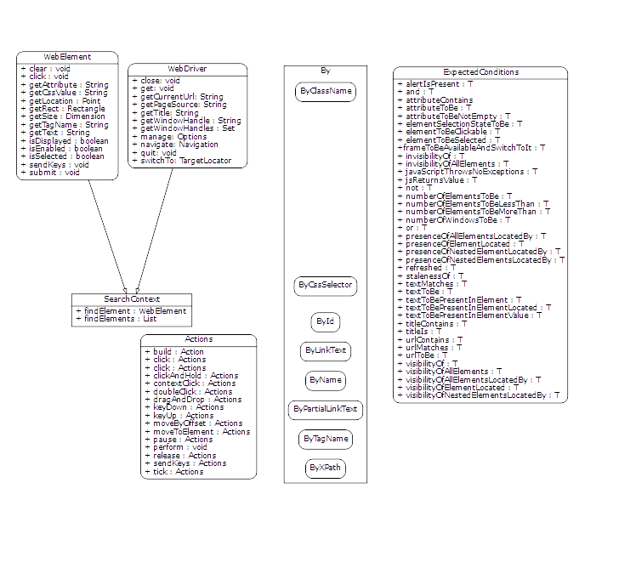
Core Selenium Class Hierarchy

Slide 3
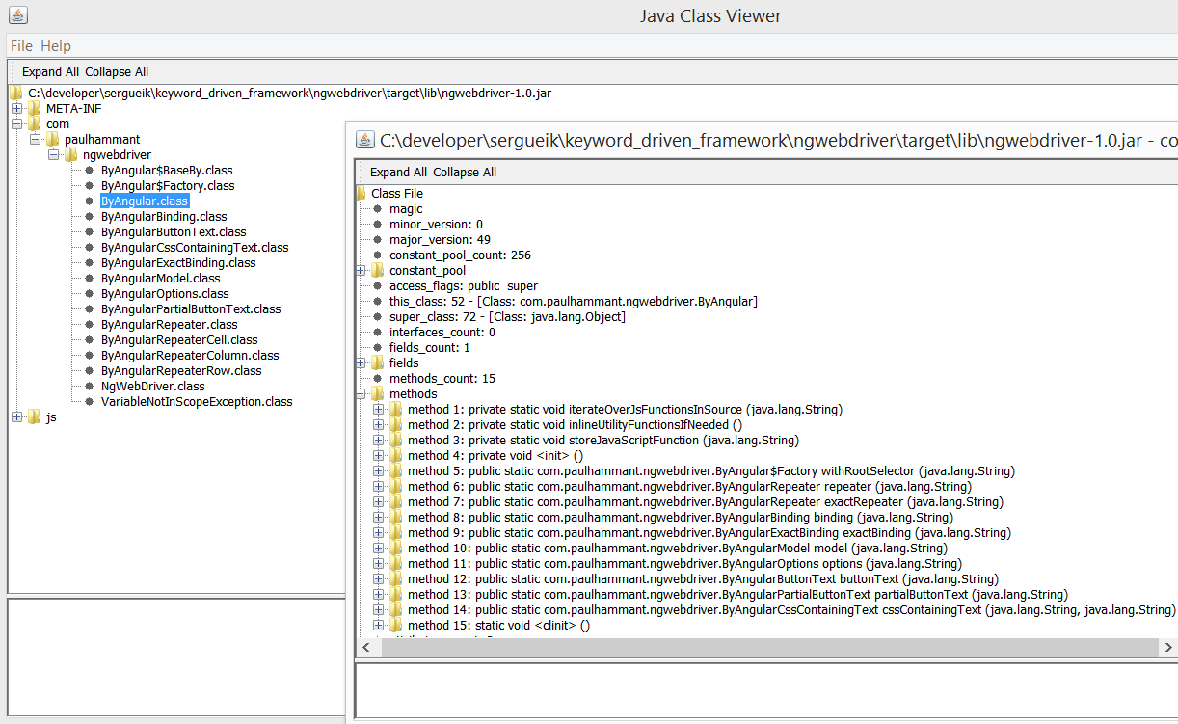
Java Protractor Wrapper Methods

Slide 4
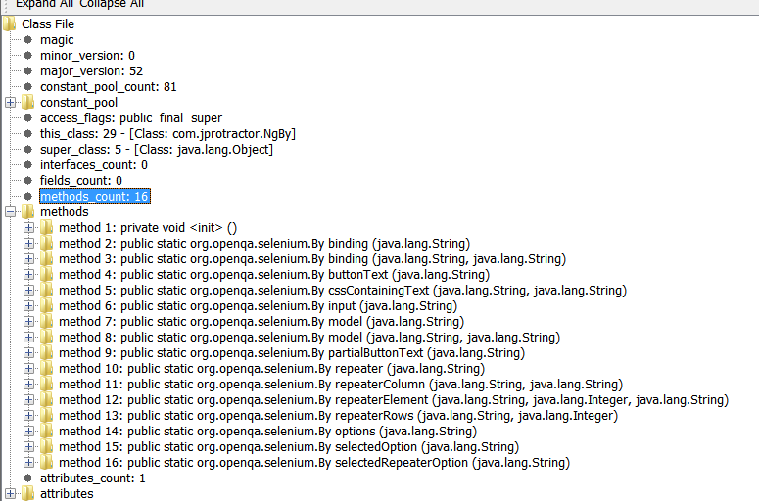
Alernative Java Protractor Wrapper Methods

Slide 5
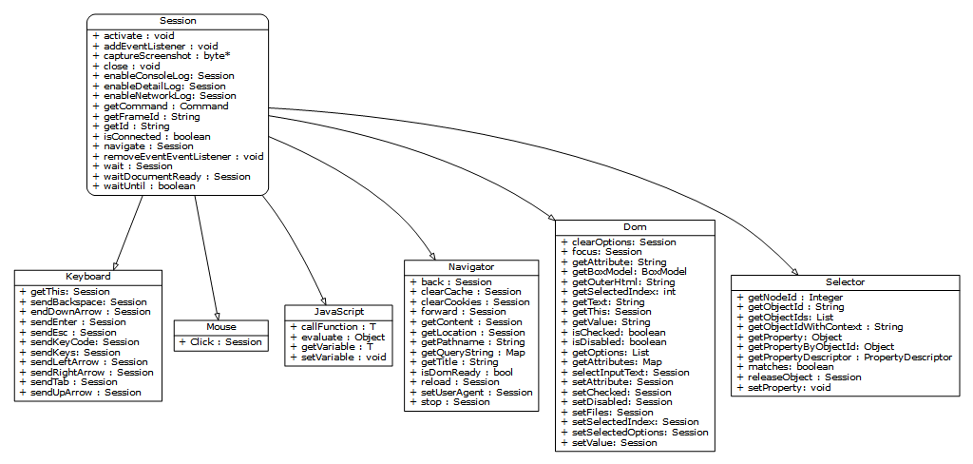
CDP Class Hierarchy

Slide 6
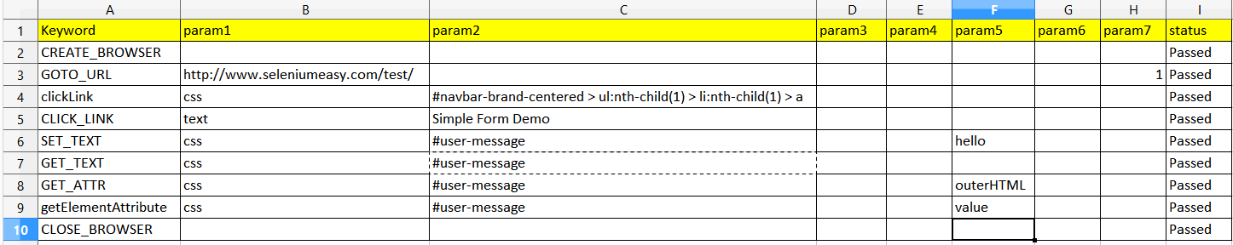
TestCase, core Selenium

Slide 7
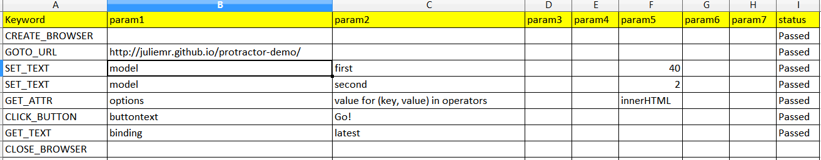
Test Case, Protractor

Slide 8
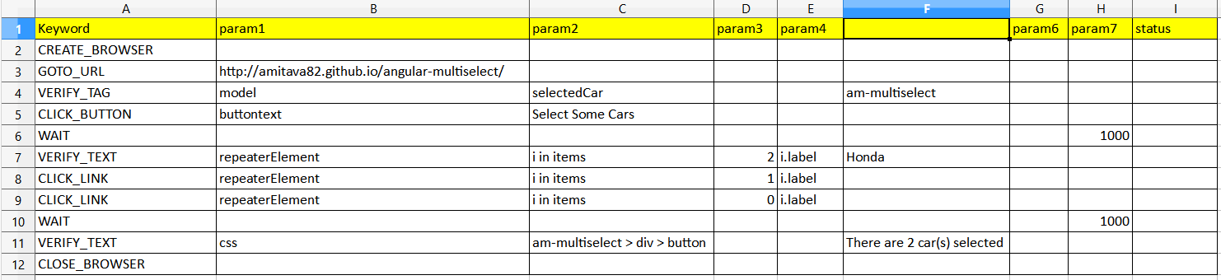
Test Case, Protractor (contd.)

