Slide 1
Circular Buffer for TimeSeries
Fixed capacity: CircularBuffer<Data>(N) stores no more than N elements

Slide 2
Computing Averages
(from row in rows select row.Value).Average()
Static Extension Methods
https://docs.microsoft.com/en-us/dotnet/csharp/programming-guide/classes-and-structs/extension-methods
Language-Integrated Query (LINQ)
https://docs.microsoft.com/en-us/dotnet/standard/linq/
http://www.java2s.com/Tutorial/CSharp/0450__LINQ/Catalog0450__LINQ.htm

Slide 3
Computing Averages
class Data {
DateTime timeStamp;
Int32 value;
}
(from row in rows
where (now – row.TimeStamp).TotalMinutes <= interval
select row.Value).Average()
Extend the buffer to more than 60 elements - compute 1 minute average

Slide 4
Computing Averages
(from row in rows
where (now – row.TimeStamp).TotalMinutes <= interval
select row.Value).Average()
Missed info and buffer spans longer than 1 minute - compute 1 minute average

Slide 5




Design
Windows Service with two timers:
collect System Performance Metric every second
calculate Averages on demand
optionally calculate Averages once per minute
Services Controller manages install, start, end of a service
does not need user to be logged on
Services respond to custom commands
https://en.wikipedia.org/wiki/Windows_service
https://en.wikipedia.org/wiki/Performance_Monitor

Slide 6
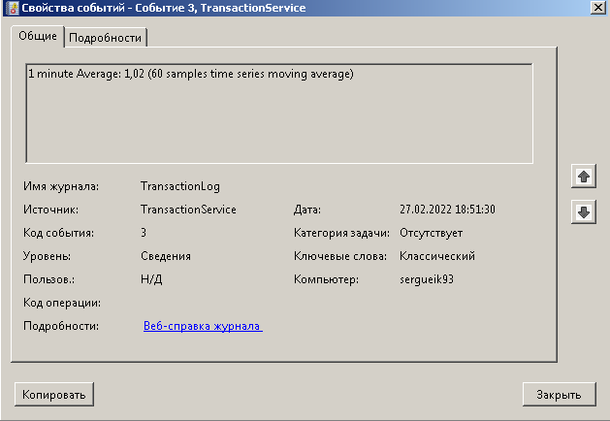
Execution Demo
LoadAverage Service is running continuously on Windows machine
PS Borg app calls the service and posts the data to Borg Server

Slide 7
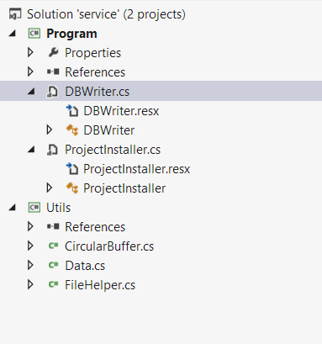
Service Component
Every Windows Service is a subclass of System.ServiceProcess.ServiceBase
The code is largely IDE-generated: Program,Service, ProjectInstaller classes
One is required to provide the constructor, override OnStart, OnStop,OnCustomCommand and Dispose
One can add method named Main with no special meaning: Windows Service cannot be run directly
One can instantiate a System.Timers.Timer and create method conventionally named OnElapsedTimer to handle Elapsed event
https://docs.microsoft.com/en-us/dotnet/api/system.serviceprocess.servicebase
https://docs.microsoft.com/en-us/dotnet/api/system.timers.timer

Slide 8
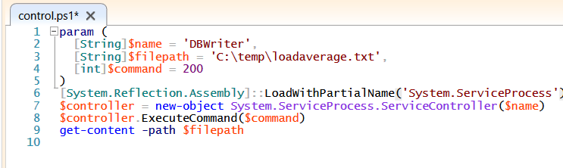
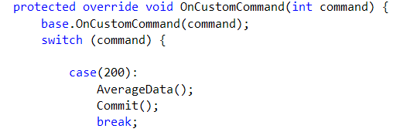
Data Collector Invocation
Powershell script
load System.ServiceProcess.dll
find Windows Service
invoke customCommand
read the results file
Application
processes the customCommand
compute load averages
save information to the file

Slide 9
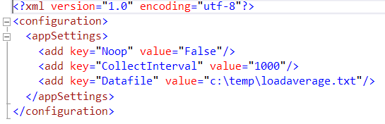
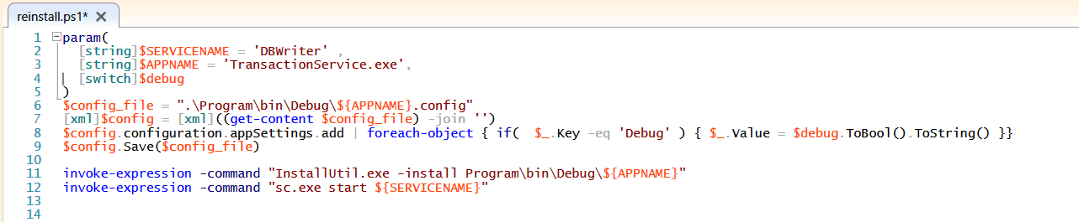
Application Configuration
Provided Installer script, Settings loaded at start of service

Slide 10
Application Configuration
entry | description | default
Autorun | perform periodic Average calculation | FALSE
Noop | Mock up / read \\System\Processor Queue Length | FALSE
Debug | Log additional information to EventLog | FALSE
CollectInterval | Interval between reads | 1000
AutoAverageInterval | Interval between computing averages | 120000
Datafile | Filename for Counters | c:\temp\loadaverage.txt

