Slide 1
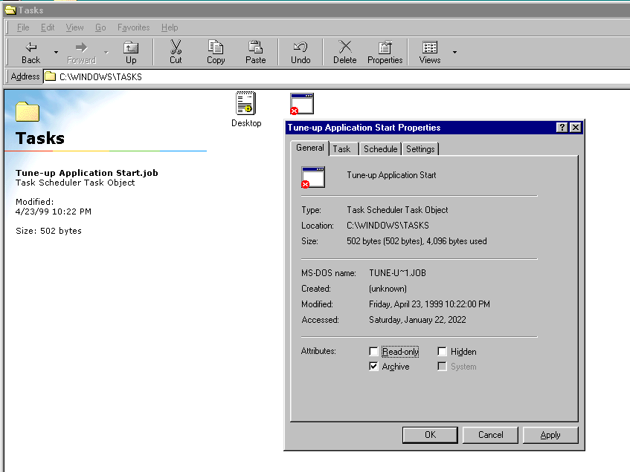
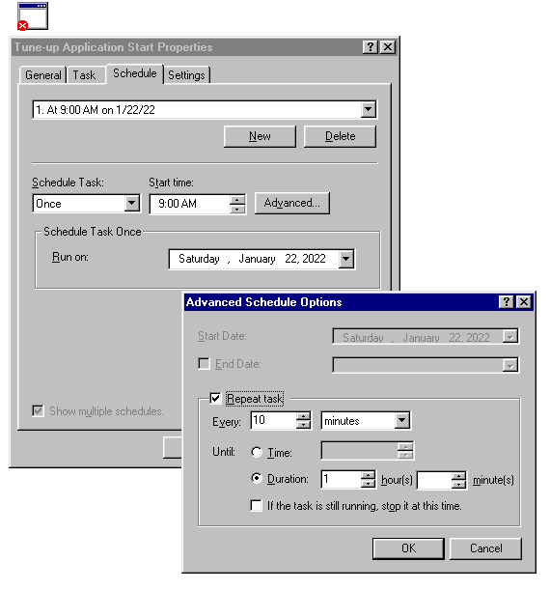
Task Scheduler Windows Vintage

Slide 2
Task XML
<Principal id="Author">
<UserId>S-1-5-21-3372308798-827487768-3212928040-1002</UserId>
<LogonType>InteractiveToken</LogonType>
<RunLevel>LeastPrivilege</RunLevel>
</Principal>
1
2
<Principal id="Author">
<UserId>S-1-5-18</UserId>
<RunLevel>HighestAvailable</RunLevel>
</Principal>

Slide 3
Windows Logon Types
https://learn.microsoft.com/en-us/previous-versions/windows/it-pro/windows-server-2003/cc787567(v=ws.10)
Logon title | Description
Interactive | A user logged on to this computer.
Network | A user or computer logged on to this computer from the network.
Batch | Batch logon type is used by batch servers, where processes may be executing on behalf of a user without their direct intervention.
Service | A service was started by the Service Control Manager.
Unlock | This workstation was unlocked.
NetworkCleartext | A user logged on to this computer from the network. The user's password was passed to the authentication package in its unhashed form. The built-in authentication packages all hash credentials before sending them across the network. The credentials do not traverse the network in plaintext (also called cleartext).
NewCredentials | A caller cloned its current token and specified new credentials for outbound connections. The new logon session has the same local identity, but uses different credentials for other network connections.
RemoteInteractive | A user logged on to this computer remotely using Terminal Services or Remote Desktop.
CachedInteractive | A user logged on to this computer with network credentials that were stored locally on the computer. The domain controller was not contacted to verify the credentials.

Slide 4
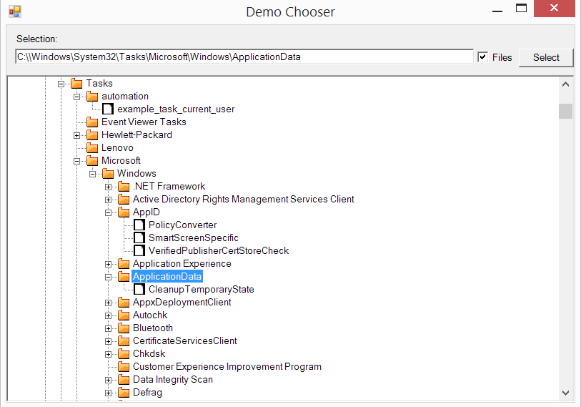
Task Directory

Slide 5
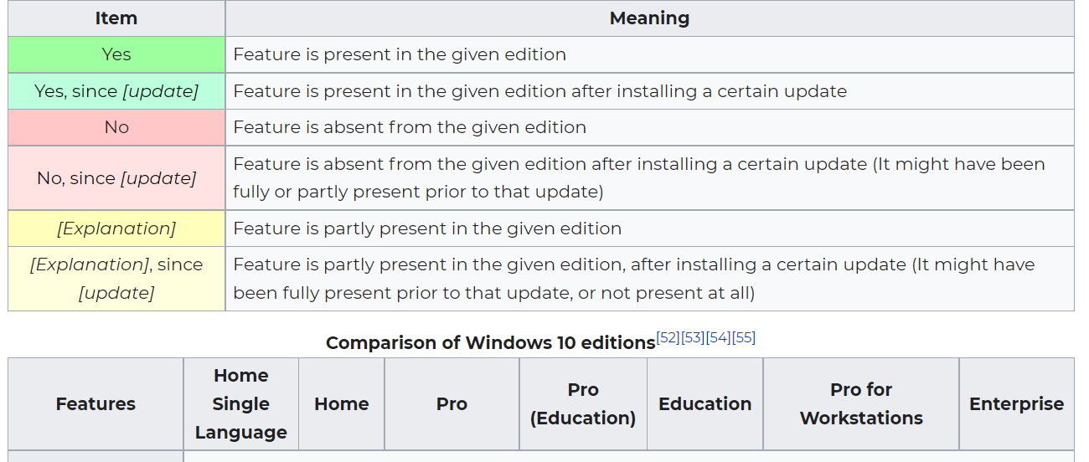
Windows SKU
https://en.wikipedia.org/wiki/Windows_10_editions
https://en.wikipedia.org/wiki/Windows_7_editions
https://en.wikipedia.org/wiki/Windows_Vista_editions
https://en.wikipedia.org/wiki/Windows_XP_editions
https://en.wikipedia.org/wiki/Windows_2000#Editions

Slide 6
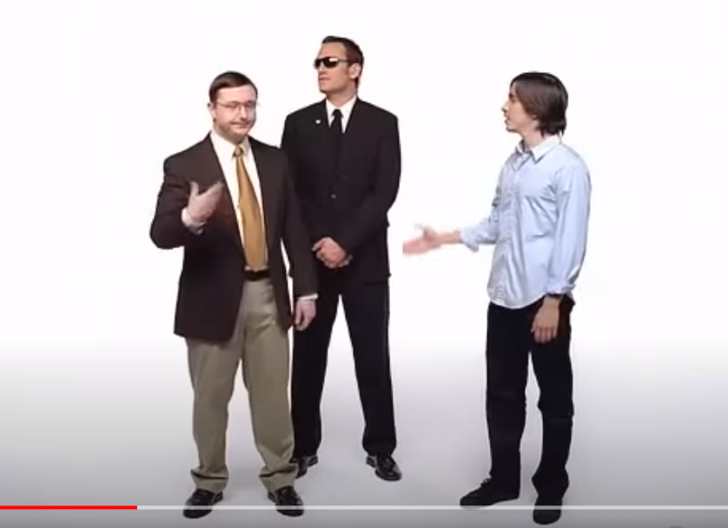
Permissions

Slide 7
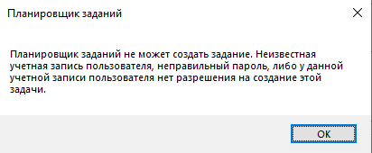
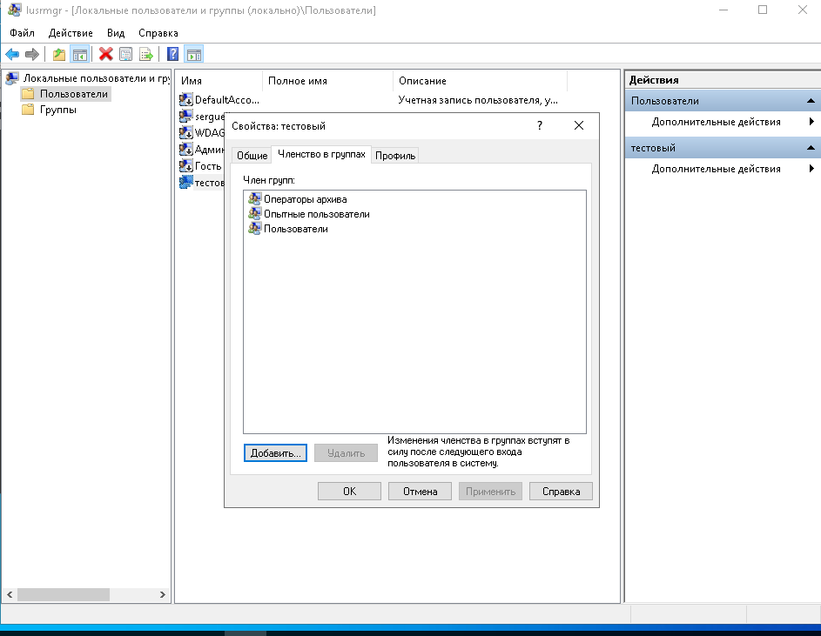
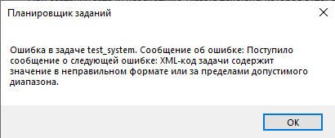
Elevation is not Allowed
1
2

