Slide 1
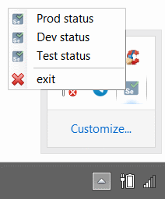
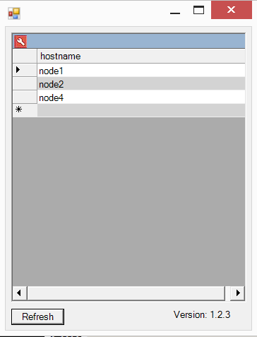
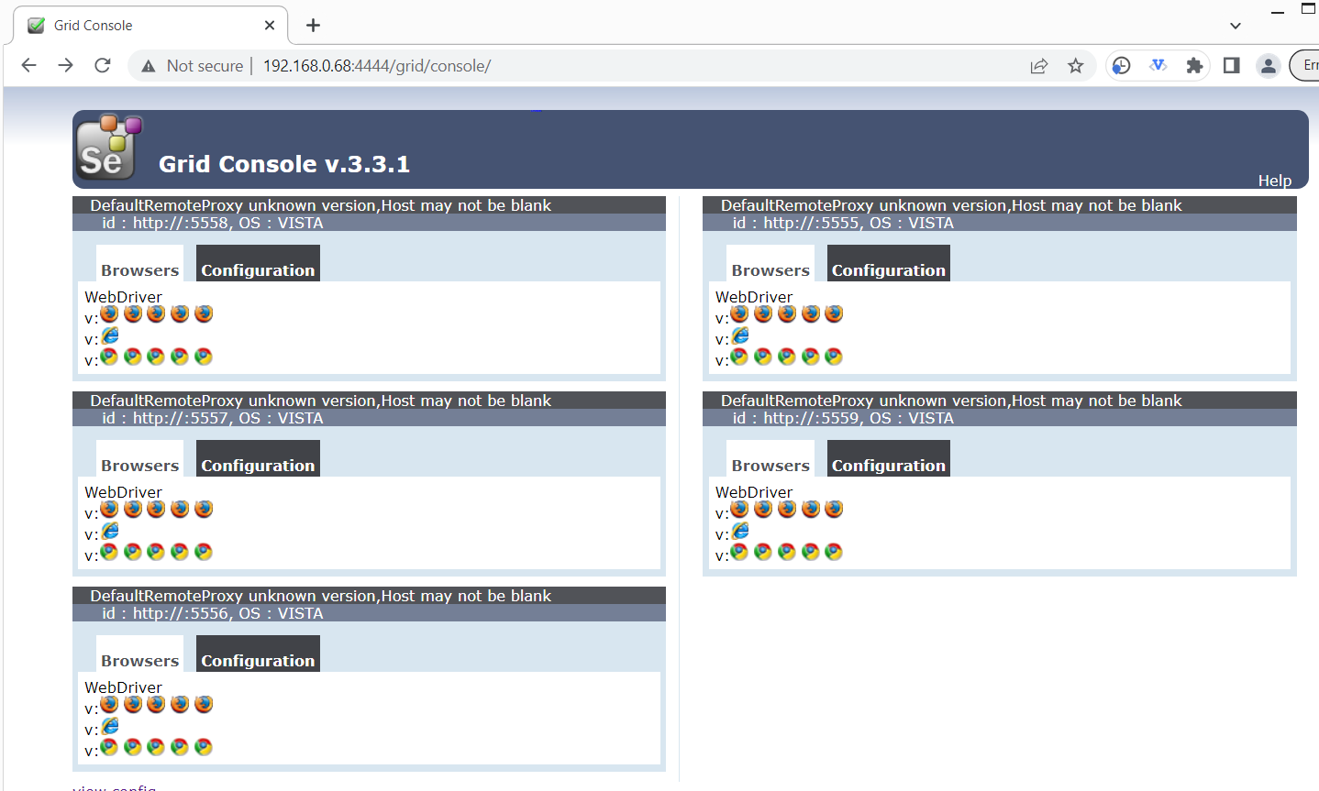
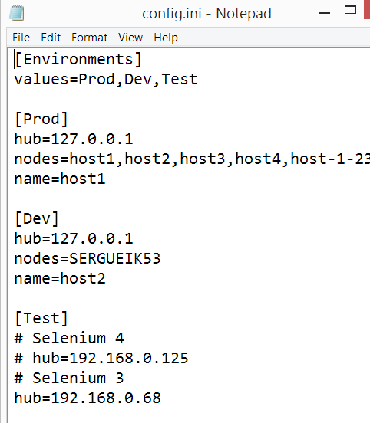
VDI Health Check Selenium 3x to 4x Migration
HTML Page scraped through
System.Windows.Forms.WebBrowser.WebBrowser

Slide 2
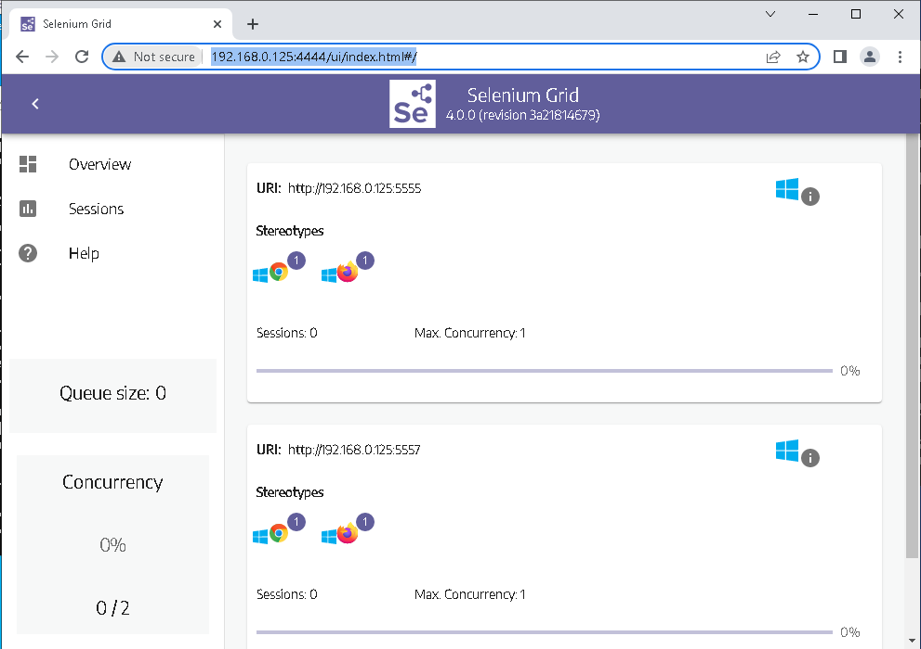
VDI Health Check Selenium 3x to 4x Migration
System.Windows.Forms.WebBrowser.WebBrowser
cannot do JQuery

Slide 3
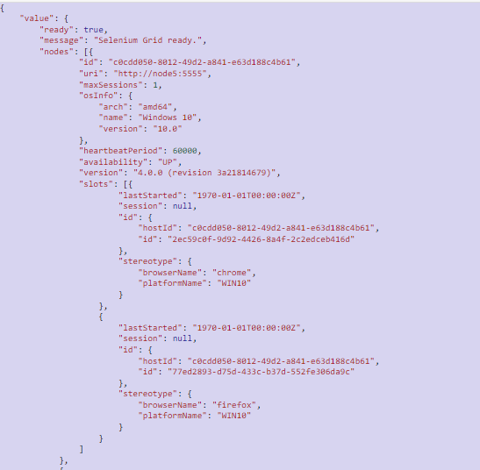
VDI Health Check Selenium 3x to 4x Migration
GET http://192.168.0.68:4444/status
REST calls done through System.Net.HttpWebRequest
JSON serialization through System.Web.Script.Serialization.JavaScriptSerializer.JavaScriptSerializer

Slide 4
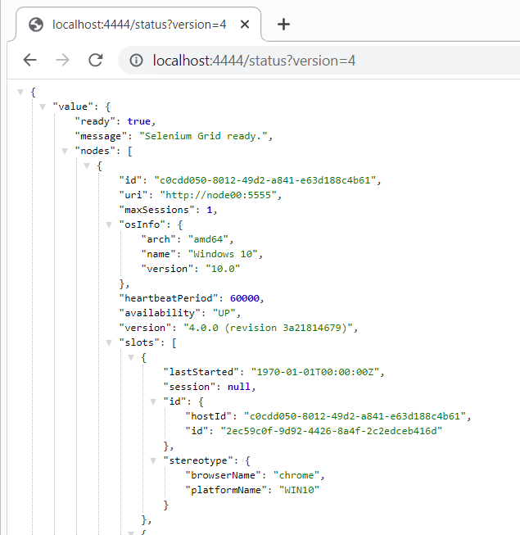
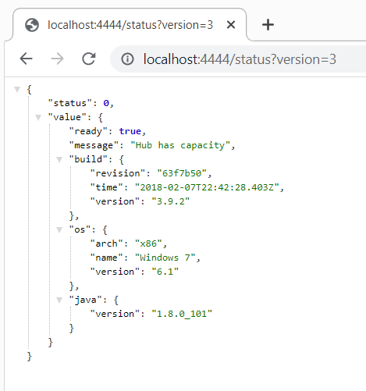
VDI Health Check Selenium 3x to 4x Migration
Selenium grid mocks done through
Java Spring app: running .Net web server on Windows requires admin privileges

Slide 5
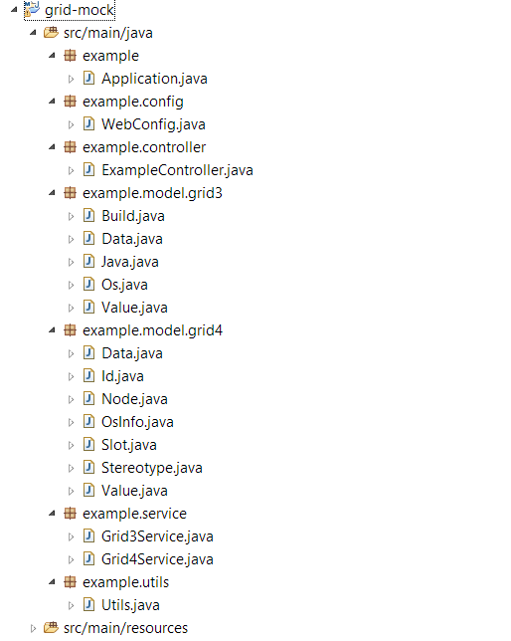
VDI Health Check Selenium 3x to 4x Migration
Selenium grid mock app internally is operating
GridStatus with full cluster detail conveyed through relevant pojo

Slide 6
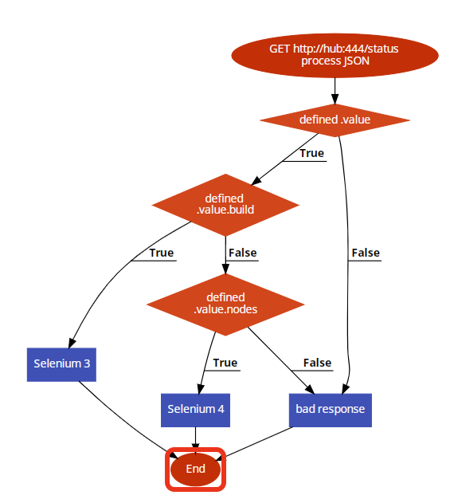
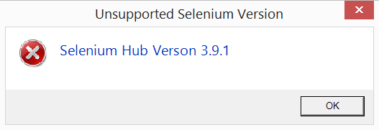
VDI Health Check Selenium 3x to 4x Migration

