Slide 1
Jsonnet Library Code Glimpse
/* Creates an SQL target */
target(
rawSql,
format='time_series',
alias=null,
):: {
[if alias != null then 'alias']: alias,
format: format,
[if rawSql != null then 'rawSql']: |||
... RAW SQL ...
|||,
groupBy:
if group_tags != null then
[{ type: 'tag', params: [tag_name] } for tag_name in group_tags] +
[{ type: 'fill', params: [fill] }]
},
} + { addMappings(mappings):: std.foldl(function(p, m) p.addMapping(m), mappings, self),}

Slide 2
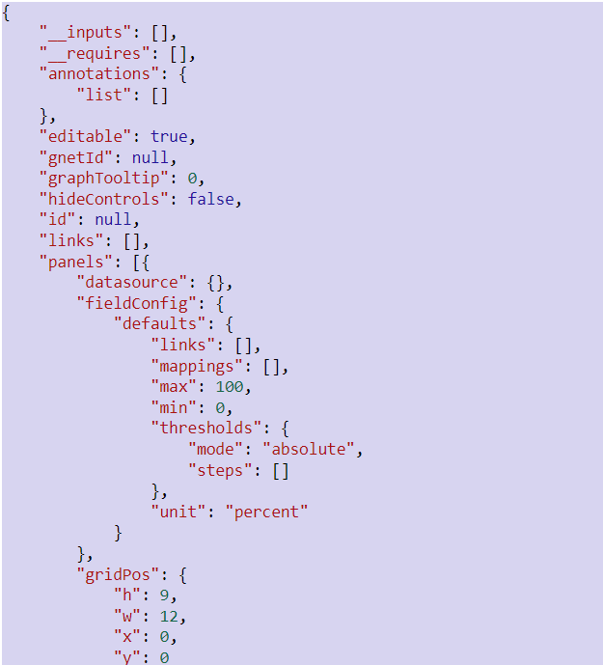
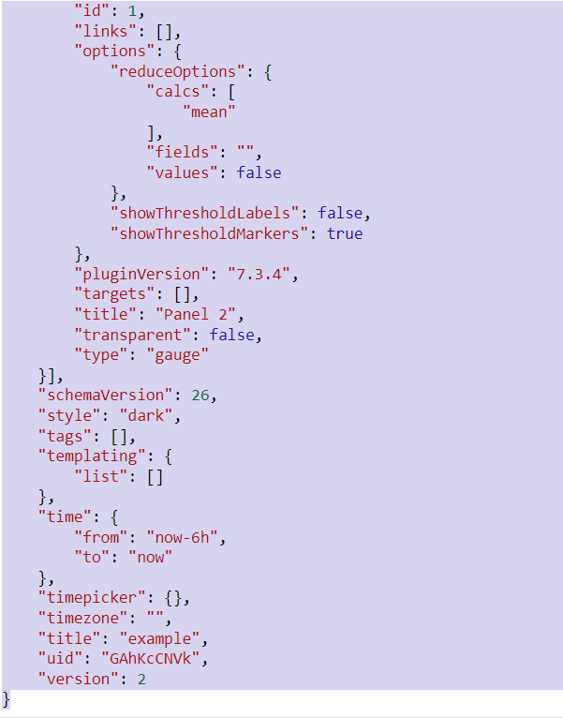
Exported Dashboard Json

Slide 3

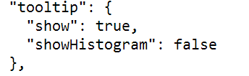
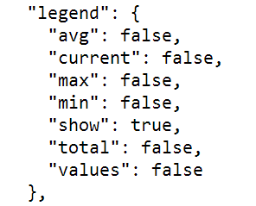
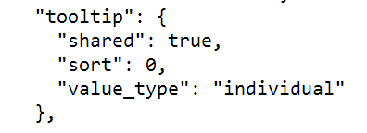
Deserialization Challenges

Slide 4
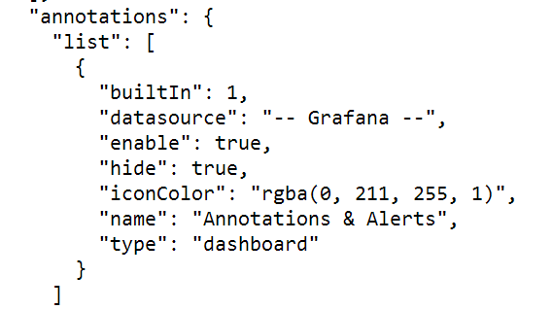
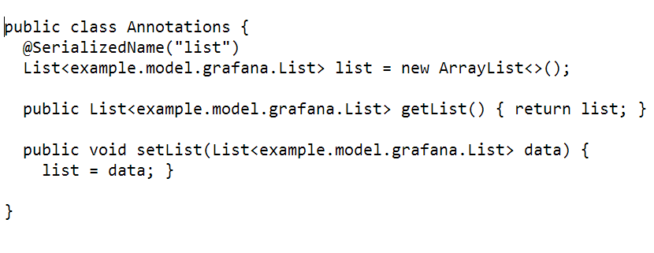
Deserialization Challenges

Slide 5
Clean Jsonnet Example
dashboard.new(
title = 'SQL heatmap',
tags = ['SQL'])
.addRows([
row.new(title = r.row_title)
.addPanels(
[
heatmap.new(
title = metric.name,
)
.addTarget(
grafana.sql.target(
query = |||
... RAW SQL ...
|||
))

Slide 6
Alternative JSON Template Languages
Generic:
const template = parse("{{foo:bar}}");
YAML based:
- name: overview
dashboard:
title: overview dashboard
time_options: [1h]
refresh_intervals: [5m]
templates:
- template-name:
metric-prefix: '{metric-prefix}'
time:
from: now-12h
to: now
rows:
- row-name

Slide 7
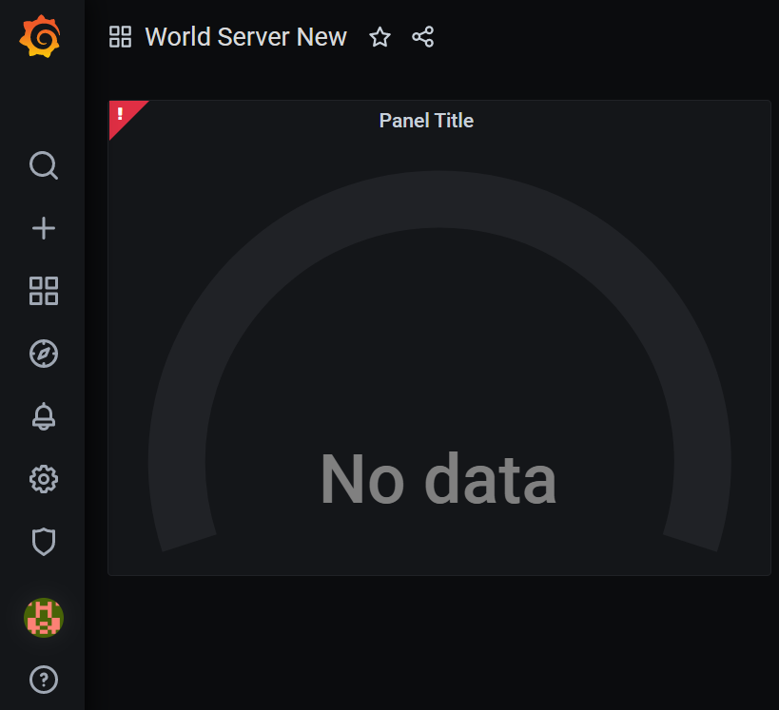
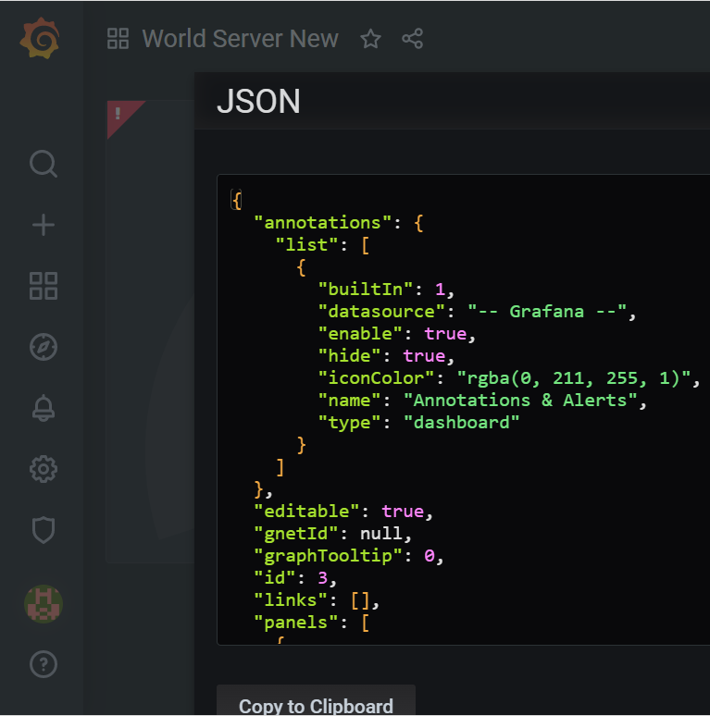
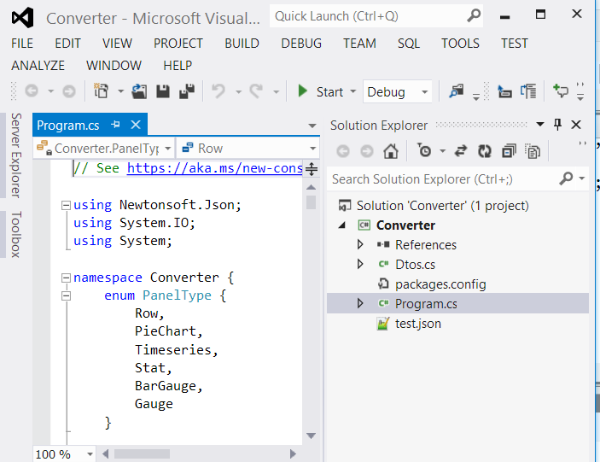
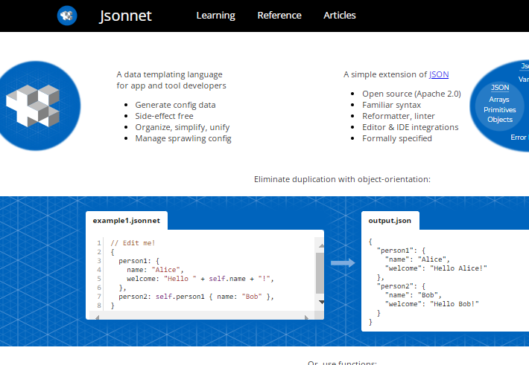
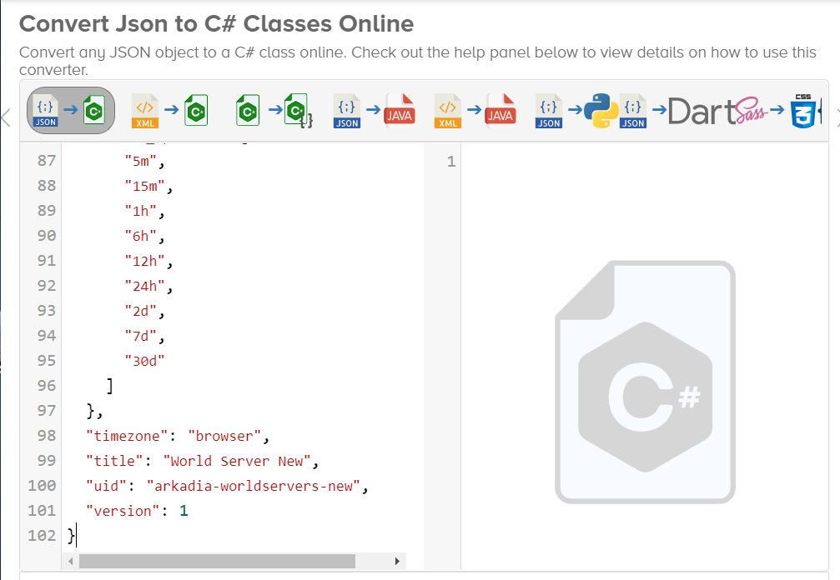
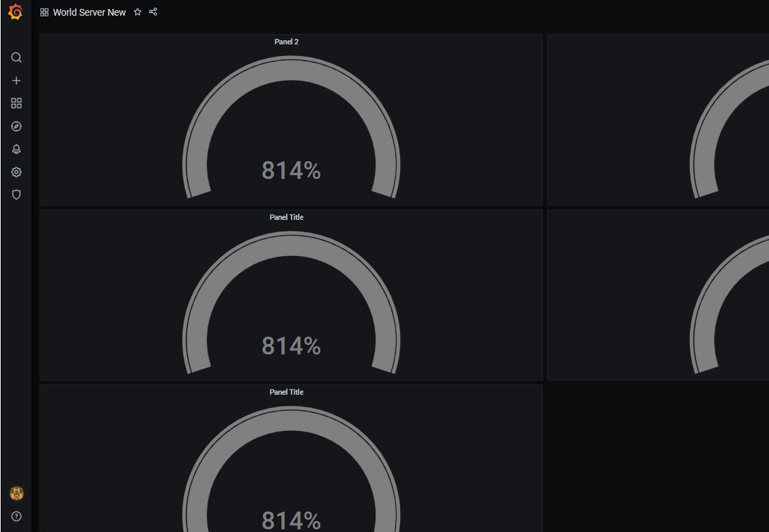
Grafana Dashboard Jsonnet Workflow with a Custom Tool
1
2
3
4
dashboard crafted manually
dashboard export
read JSON,write jsonnet file
convert jsonnet to JSON
Import dashboard into Grafana
3a) https://json2csharp.com
3a
5

Slide 8
Auto-generated Jsonnet Sample
grafana.dashboard.new(
'World Server New',
tags=[],
refresh='5s',
time_from='now-1h',
time_to='now',
timepicker=grafana.timepicker.new(
refresh_intervals=['30s', '1m', '5m', '15m', '30m', '1h', '2h', '1d', '2d', '7d'],
),
).addPanel(
gridPos={h: 9, w: 12, x: 0, y: 0},
panel=grafana.gaugePanel.new(title='Panel 2',pluginVersion='7.3.4',
thresholdsMode='absolute', datasource=prometheus)
.addTarget(
prometheus.target(
expr ='',
hide='False',
)
)
)

Slide 9
Perl Catalyst Template Language
# message assignment
if page.message_ids and page.message_ids.size() > 0;
foreach message_id in page.message_ids;
page.messages.push(page.message_texts.${message_id});
end;
end;
# building link assignment
linkvars = [ { login = id.login }
{ session = session_id }
{ obj_cust = sel.obj_cust }
]
arg = []; foreach pair in linkvars; arg.push(pair.keys.0 _ '=' _ pair.values.0); end;
[% # Add a link to delete a book %]
<a href="[% c.uri_for(c.controller.action_for('delete'), [book.id])%]">Delete</a> </td>

