Slide 1
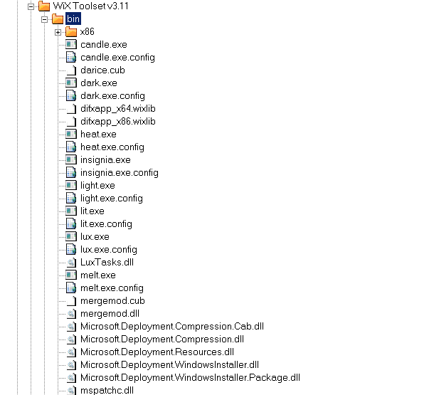
Wix Toolchain

Slide 2
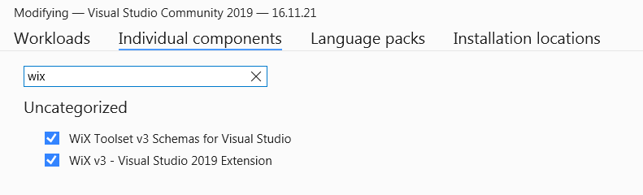
Wix Visual Studio Plugin

Slide 3
Wix Template Notation Diversity

Slide 4
Wix Cryptic Logging
warning LGHT1076: ICE69: Mismatched component reference.
Entry 'reg8DA1CC64DDF0C7F7D771318E27AE4747' of the Registry table belongs to component 'cmpEventSource'.
However, the formatted string in column 'Value' references file 'fileMessagesDLL' which belongs to component 'cmpMessagesDLL'. Components are in the same feature. [Setup.wixproj]
msiexec.exe /l*v a.log /i bin\Debug\Setup.msi
MSI (s) (18:2C) [06:24:49:068]: Note: 1: 2203 2: Setup.msi 3: -2147287038
0x80030002 (STG_E_FILENOTFOUND) - could not be found.

