Slide 1
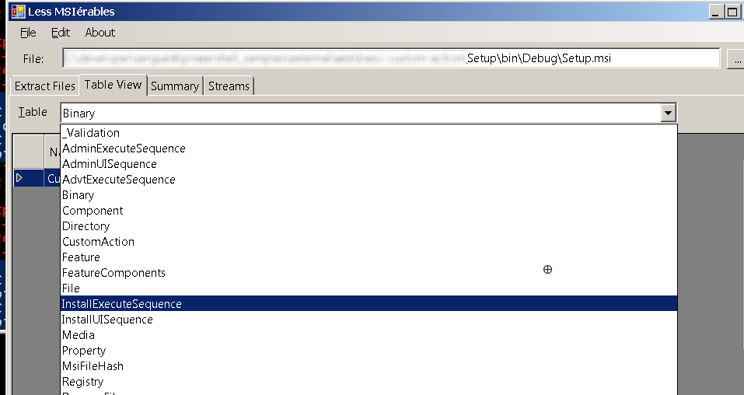
MSI Database

Slide 2
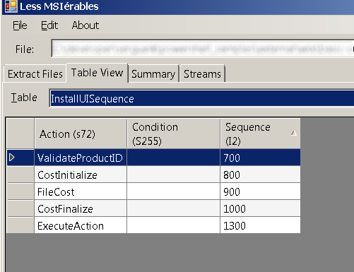
MSI Tables

Slide 3
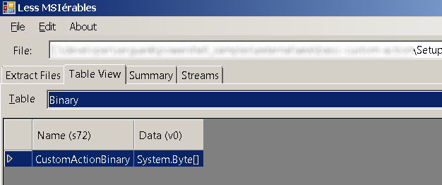
MSI Custom Action

Slide 4
MSI Custom Code
<?xml version="1.0"?>
<product>
<Binary Id="dll" SourceFile="$(var.TargetDir)CA.dll"/>
<Id="GetDateTime" BinaryKey="dll" DllEntry="GetDateTime" Execute="immediate" Return="check"/>
<Id="Display" Directory="SystemFolder"
ExeCommand="echo START_TIME = &quot;[START_TIME]&quot;" Execute="deferred" Impersonate="no"/>
<InstallExecuteSequence>
<Custom Action="GetDateTime" Before="Display"/>
<Custom Action="Display" Before="InstallFinalize">NOT Installed</Custom>
</InstallExecuteSequence>
</product>
using Microsoft.Deployment.WindowsInstaller;
using System;
[CustomAction]
public static ActionResult GetDateTime(Session session) {
session["START_TIME"] = String.Format("{0:HH:mm}", DateTime.Now.Add(new TimeSpan(0, 0, 2, 0)));
return ActionResult.Success;
}

