Slide 1
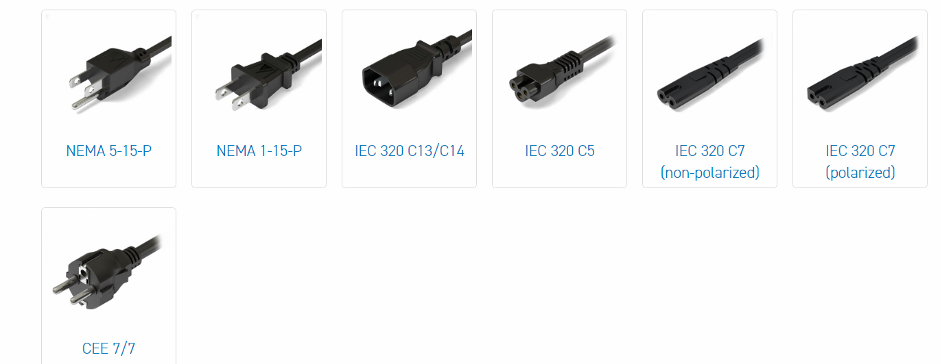
Logback EventLog
<appender name="CONSOLE"
class="ch.qos.logback.core.ConsoleAppender">
<encoder
class="ch.qos.logback.classic.encoder.PatternLayoutEncoder">
<pattern>%d{HH:mm:ss.SSS} [%thread] %-5level %logger{36} - %msg%n
</pattern>
</encoder>
</appender>
<root level="DEBUG">
<appender-ref ref="CONSOLE" />
</root>

Slide 2

JNA and Pinvoke Wrapper Functions

Slide 3
JNA and Pinvoke Wrapper Functions
BOOL ReportEventA(
[in] HANDLE hEventLog, [in] WORD wType, [in] WORD wCategory,
[in] DWORD dwEventID, [in] PSID lpUserSid, [in] WORD wNumStrings,
[in] DWORD dwDataSize, [in] LPCSTR *lpStrings, [in] LPVOID lpRawData)
https://learn.microsoft.com/en-us/windows/win32/api/winbase/nf-winbase-reporteventa
static extern int ReportEvent(
IntPtr hHandle, ushort wType, ushort wCategory,
uint dwEventID, IntPtr uSid, ushort wStrings,
uint dwDataSize, string[] lpStrings, byte bData)
https://www.pinvoke.net/search.aspx?search=ReportEvent
boolean com.sun.jna.platform.win32.Advapi32.ReportEvent(
HANDLE hHandle, int wType, int wCategory,
int dwEventID, PSID lpUserSid, int wNumStrings,
int dwDataSize, String[] lpStrings, Pointer lpRawData)
https://github.com/java-native-access/jna/blob/master/contrib/platform/src/com/sun/jna/platform/win32/Advapi32.java#L1650

