Slide 1

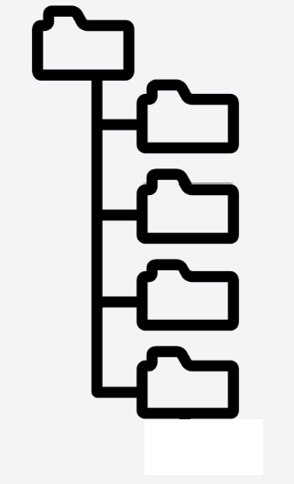




Config Server Operation
HTTP
Status
208 Already Reported
304 Not Modified
404 Not Found

Slide 2
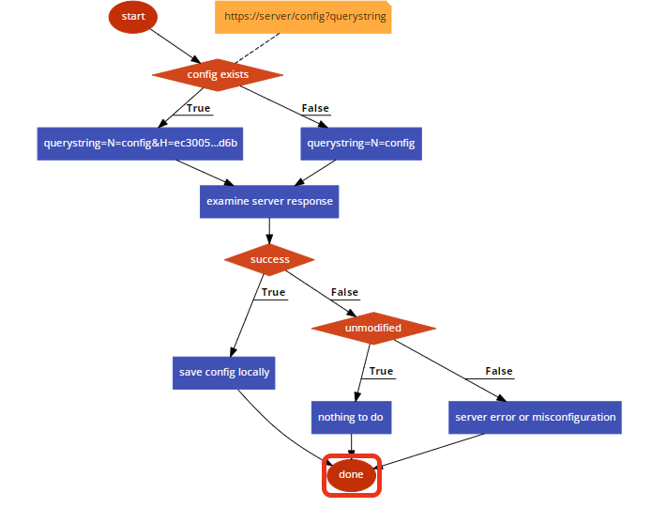
Client Logic Flow

Slide 3

Accessing HTTP Status Code
use LWP::Simple;
$status = mirror($url, $outputfile)
use HTTP::Tiny;
$response = HTTP::Tiny->new()
->mirror($url, $outputfile,
\%options)
$status = $response->{status}
try{
$response = invoke-webrequest -uri $url
-outfile $outfile -passthru
} catch [Exception](
$status =
$_.Exception.Response.StatusCode.value__
}
System.Management.Automation.Errorrecord
System.Net.WebExceptionSystem.Net.WebExceptionStatusSystem.Net.WebResponseSystem.Net.WebheaderCollectionSystem.Net.HttpStatusCode

Slide 4
HTTP Status 40x 50x and 304

Slide 5
Code
Server
Perl (with and w/o use CGI)
Java Spring
.Net (stub)
Client
Perl
Powershell (Invoke-RestMethod)
Powershell (Invoke-WebRequest)
Scheduled Task creator script (existing)
Installer script (existing)
Configurable Metric inventory script

