Slide 1
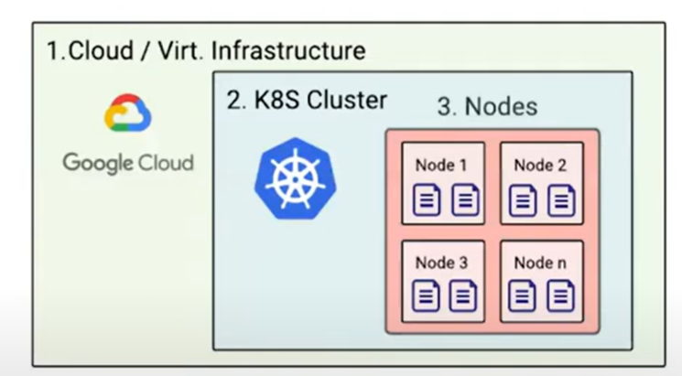
Assess the Security of Kubernetes with InSpec Keynote
https://www.chef.io/chefconf-keynotes/assess-the-security-of-kubernetes-with-inspec

Slide 2
Layers of Assess Kubernetes Cluster from InSpec
CLOUD API level: inspec-gcp, inspec-aws, inspec-azure
+ additonal gems if Kitchen is used
K8 API Layer train-kubernetes + inspec.k8s + ??
+ additonal gems if Kitchen is used
Container: Inspec (inspec-bin) (ssh is built-in)
Local: Inspec (inspec-bin)

Slide 3
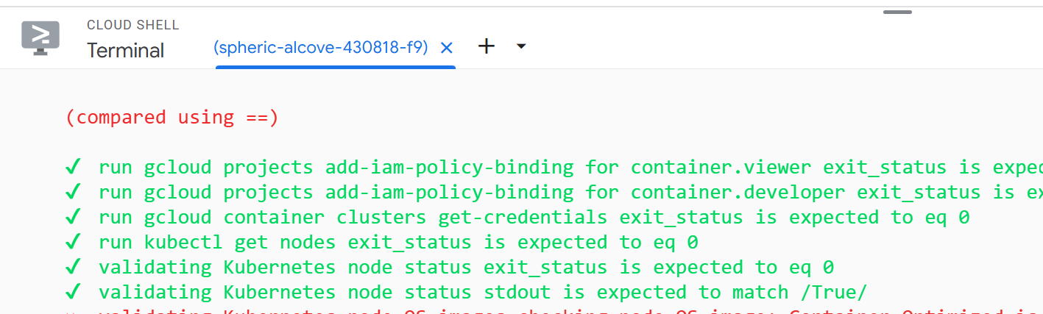
Local Train in Cloud Shell counts as 4
4. Cloud Shell

Slide 4
One console Command Control
describe 'validating Kubernetes node status' do
subject do
command('kubectl get nodes -o jsonpath="{.items[*].status.nodeInfo}"')
end
it 'should have Container-Optimized OS image' do
# Load the stdout (JSON string) and parse it
parsed_json = JSON.parse(subject.stdout)
os_image = parsed_json.dig(0, 'osImage')
expect(os_image).to eq('Container-Optimized OS from Google')
end
end
end

Slide 5
Equivalent Inspec-gcp Control
title "Ensure COS is used for GKE node images”
clusters.each do |cluster|
google_container_node_pools(
project: project,
location: cluster[:location],
cluster_name: cluster[:cluster_name]
).node_pool_names.each do |nodepool_name|
describe "Node Pool: #{nodepool_name}" do
subject { google_container_node_pool(
project: project,
location: cluster[:location],
cluster_name: cluster[:cluster_name],
nodepool_name: nodepool_name) }
its('config.image_type') { should match(/COS/) }
end
end
end

